Slide 1
HPC Labs – #1 Assignment
High-Performance Computing
Authors
MATTEO PINTAUDI
LORENZO VENTURELLI
ALI JAOUADI

Slide 2
Brief description of the application
Covariance application
Covariance is a measure of the extent to which corresponding elements from two sets of ordered data move in the same direction
What is Covariance Matrix?
Covariance matrix is a square matrix that displays the variance exhibited by elements of datasets and the covariance between a pair of datasets. Variance is a measure of dispersion and can be defined as the spread of data from the mean of the given dataset. Covariance is calculated between two variables and is used to measure how the two variables vary together.

Slide 3
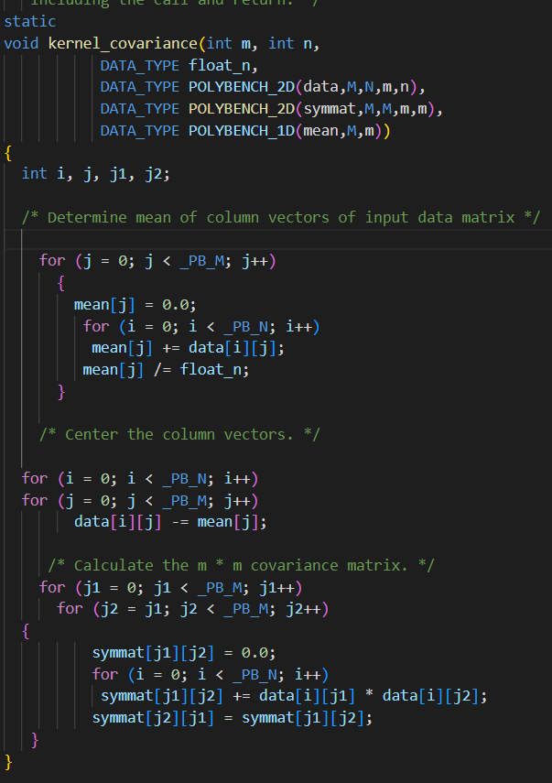
The target function in the application
Kernel_covariance it’s the most important function in the application so we have imposed two examples of parallelization in it

Slide 4
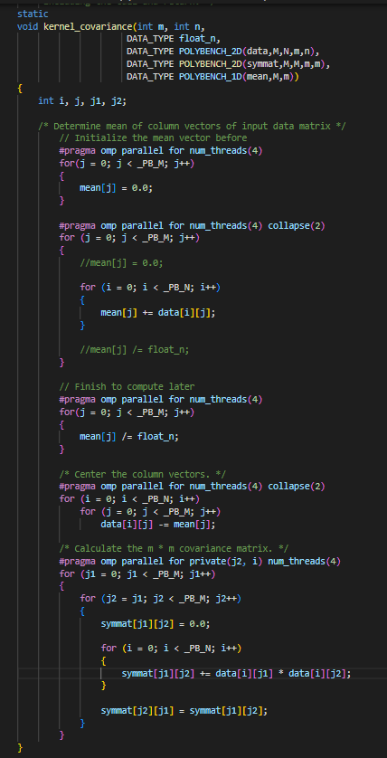
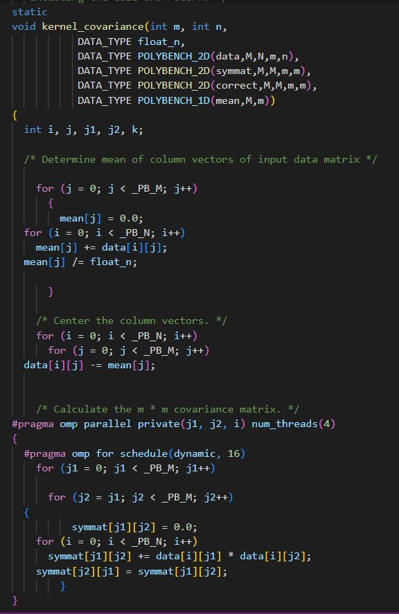
Two exemples of parallelization
Parallelizaion-2
Parallelization-1

Slide 5
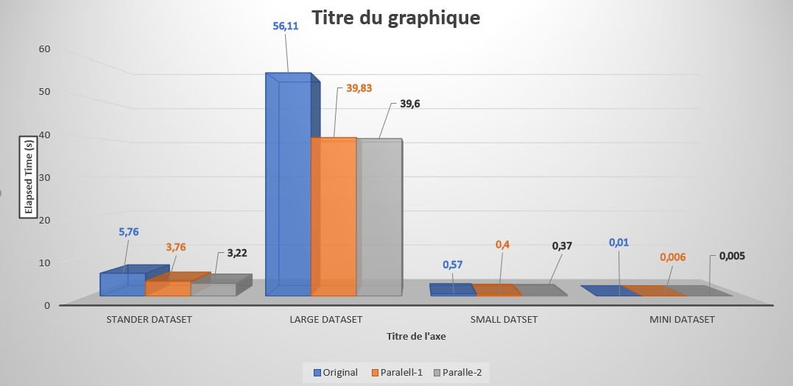
Measures
Comparison of excution time between originale code, parallelization-1 and parallelization-2 with 4 differents size of dataset

