Slide 1
HD-Vis: A visual analysis of global Human Development
Lorenzo Bianchi
Jessica Brandi
Gianluca Circelli
Visual Analytics – Project Presentation
Sapienza University of Rome

Slide 2
Table of contents
Introduction
Related Works
Dataset
Visualizations
Insight
Live Demo

Slide 3
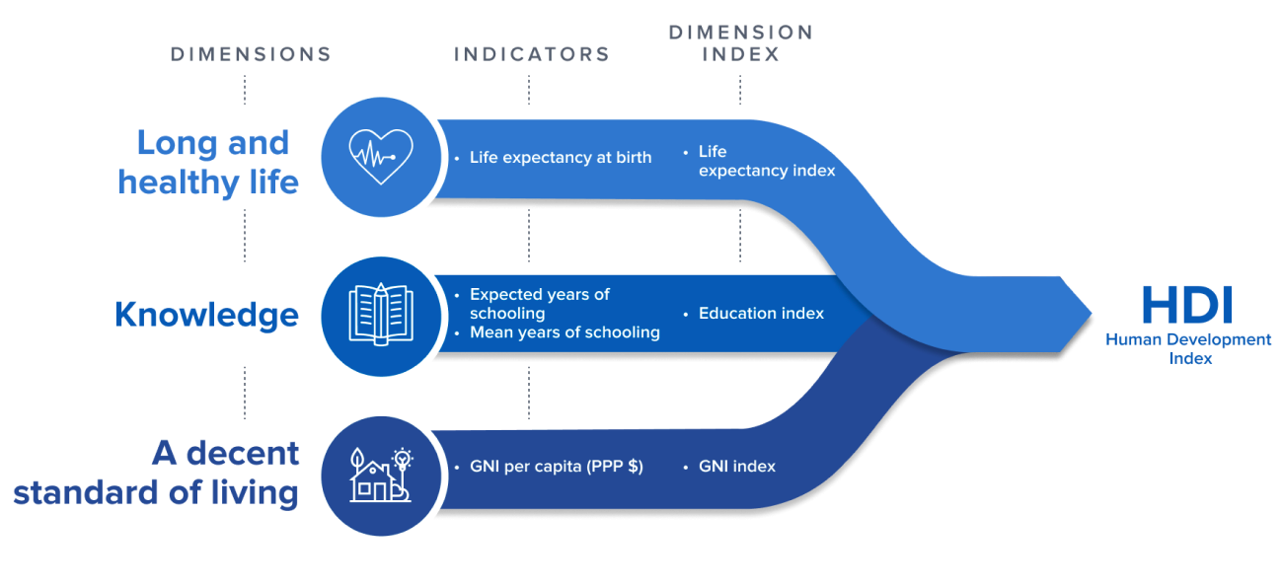
Introduction
HDI overview
The Human Devlopment Index (HDI) was developed by the United Nations Development Programme (UNDP) as an alternative to traditional measures of economic growth, such as GDP, that fail to take into account the welfare of a country's citizens.

Slide 4
Related Works
Scientific papers related to the HDI
[1] "Human Development Indices and Indicators: 2021 Statistical Update": This paper provides a recent general overview of the human development trends and statistics across the world.
[2] “The inequality-adjusted human development index: A constructive proposal”: proposes the Inequality-Adjusted Human Development Index (IHDI) as a more comprehensive measure of human development. The HDI fails to consider the distribution of these achievements within a country by not considering the inequality conditions.
[3] “The Uses and Misuses of the Gender‐related Development Index and Gender Empowerment Measure: A Review of the Literature”: The GDI is a valuable tool for identifying areas where gender disparities persist, and for tracking progress over time towards a more equitable and inclusive society.

Slide 5
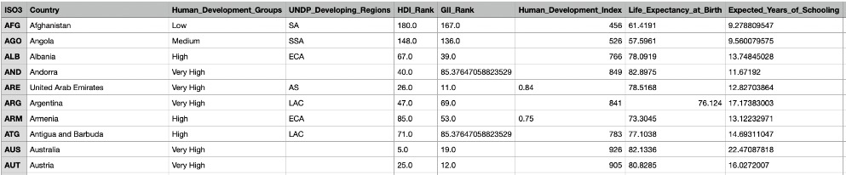
Dataset
Dataset description
The dataset contains general demographic country’s information and data related to the three macro-categories represented by the following composite indexes and their main indicators:
“Human Development Index (HDI)” → “Life Expectancy at Birth”, “Expected Years of Schooling”, ...
“Inequality-adjusted HDI (IHDI)” → “Inequality in life expectancy”, “Inequality in eduation”, ...
“Gender Development Index (GDI)” → “HDI male”, “HDI female”

Slide 6
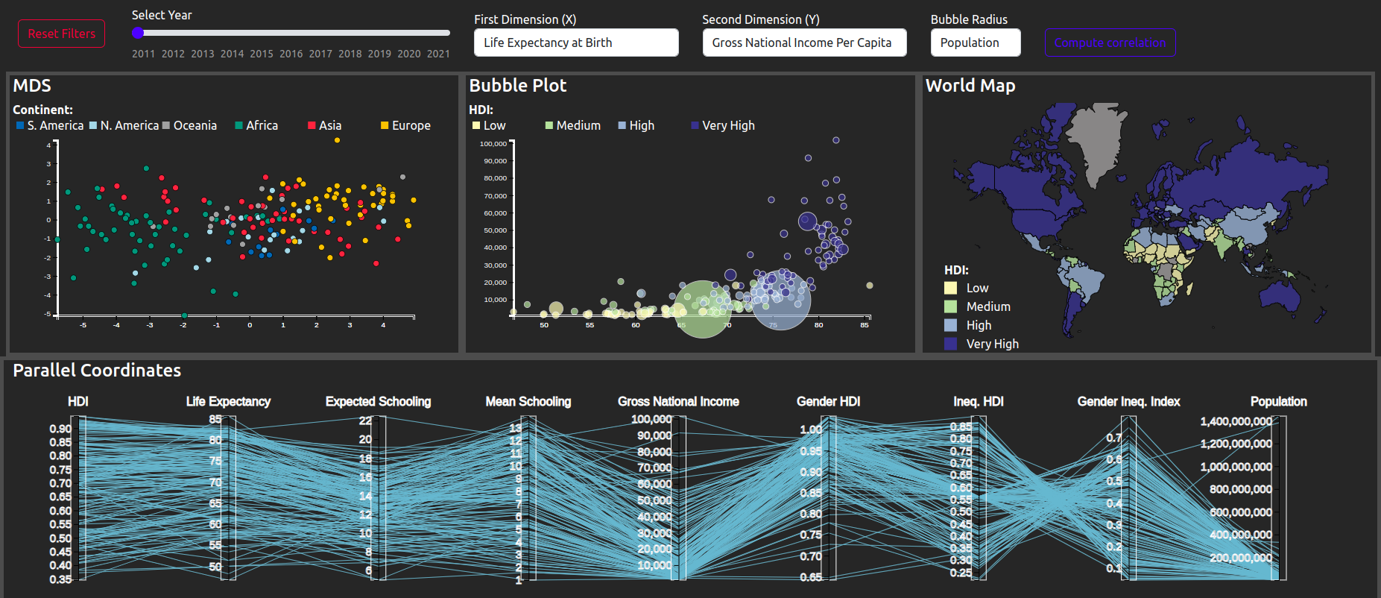
Visualizations
Complete Dashboard

Slide 7
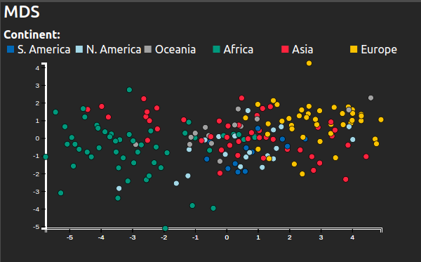
Visualizations
MDS Scatter Plot
Used for dimensionality reduction.
Represents and visualizes dissimilarity among data points.
Useful to find cluster in the data or possible outliers.
Supports brush and mouseon to interact with the country’s data.
Analysis of dissimilarity between countries in different continents, based on the human development indices.

Slide 8
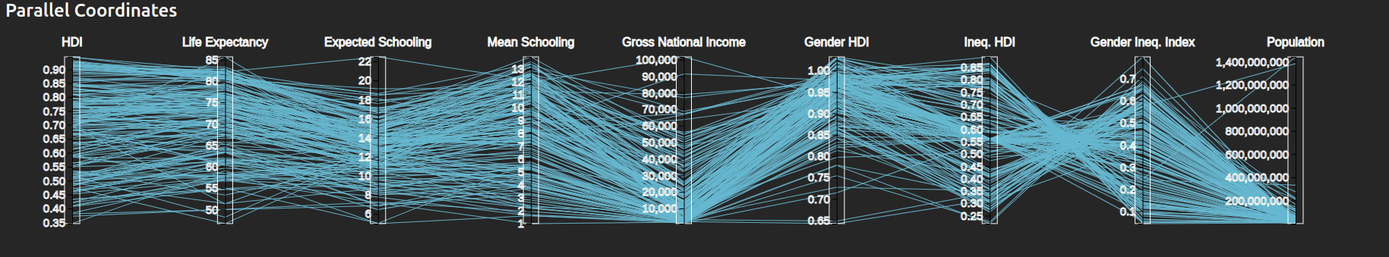
Visualizations
Parallel Coordinates
Each axis represents an index contained in our dataset.
The lines correspond to the countries intersecting each axis at its corresponding value of that index.
Supports brushing on the axis to filter only certain lines (countries).
Useful for identifying patterns, clusters, or outliers within the data.
can help to highlight any correlations or relationships.

Slide 9
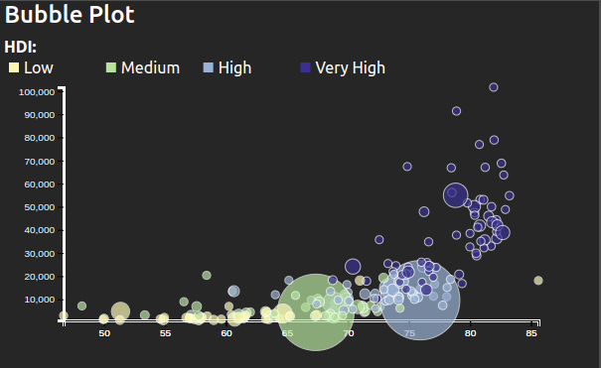
Visualizations
Bubble Plot
User can choose the attribute on each axis and the radius of the bubble.
Each bubble represents a single country.
Default size of the bubble: country population.
Colors represent the category of human development groups they belong.
Supports brush and mouseon.

Slide 10
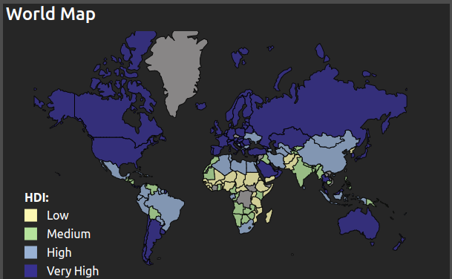
Visualizations
World Map
The world map allows to visualize data through a color scale.
Each color represents the category of human development groups to which each country belongs.
It allows to see how human development is distributed across various countries around the world.
It helps to identify geographic trends or patterns in the data.
Supports mouseon.

Slide 11
Analytics
Correlations
The user can do a real time computation on the correlations between the various indices or indicators present in the dataset.
Compute the Pearson correlation coefficient between mean year of schooling and inequality in education.
The correlation coefficient is a measure of the linear relationship between two variables.
The result is in the range [-1,1]: -1 indicates a perfect negative correlation, 0 indicates no correlation, and 1 indicates a perfect positive correlation.
The user can compute the correlation coefficient also on the filtered data.
Minimum and maximum correlation coefficents from all possible pairs of attributes.

Slide 12
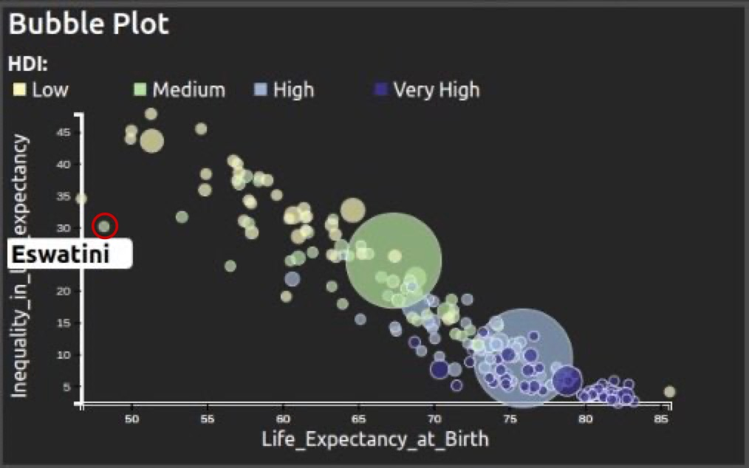
Insights
Correlations in bubble plot: Estwaini insight
Correlation coefficients provide insights on relationships between indexes in the data.
High inequality in life expectancy mostly seen in African countries with low HDI, except for Eswatini and Lesotho from 2011-2014.
Life expectancy in Estwain increased by almost 10 years from 2011 to 2021, but inequality conditions did not improve on average.

Slide 13
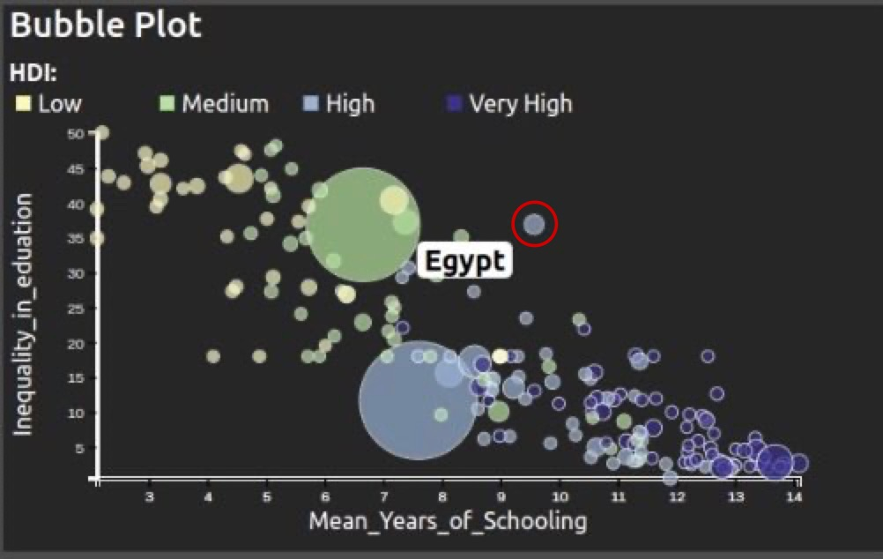
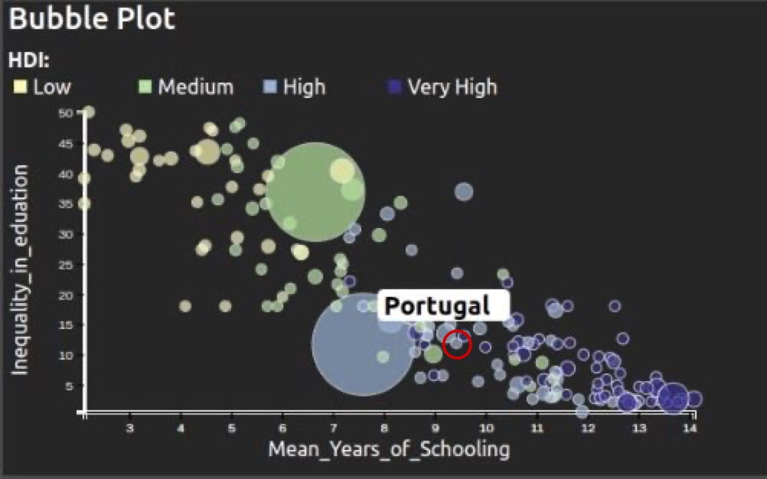
Insights
Correlations in bubble plot: Egypt vs Portugal
Inequality in Education is negatively correlated with Mean Years of Schooling.
As inequality in education increases, average years of schooling decrease.
Egypt is more affected by inequality in education compared to other countries with similar Mean Years of Schooling (e.g. Portugal).

Slide 14
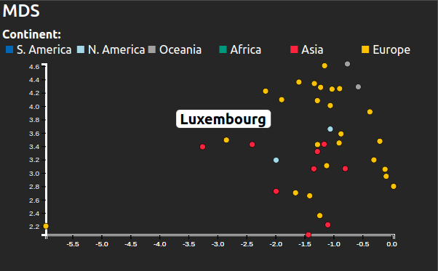
Insights
MDS Continent Clusters: The case of Luxembourg
MDS plot shows how countries from different continents cluster together.
High HDI European countries cluster together, with Luxembourg being most similar to Singapore and Hong Kong.
Low HDI countries are mostly in Africa, except for Yemen, Afghanistan, and Pakistan, which are similar to Senegal and Gambia.

Slide 15
Live Demo

Slide 16
Thank you for the attention!

