Slide 1

Software Engineering 2:
Politecnico di Milano
Lorenzo Binosi

Slide 2
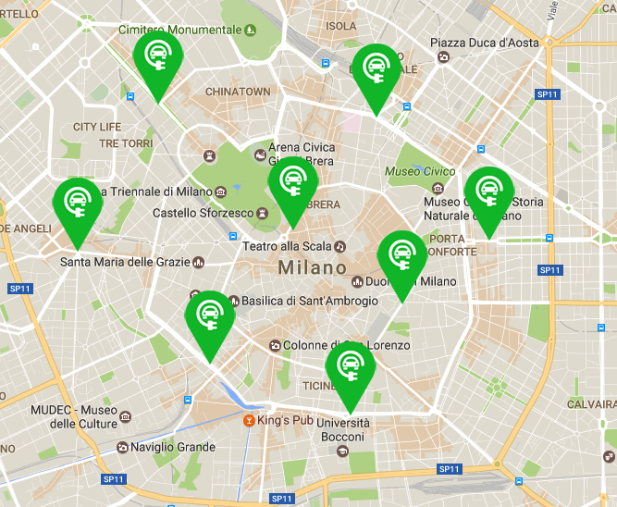
What is PowerEnJoy?

Slide 3
Goals
[G1] Allow a driver to rent a car.
  [G1.1] Allow a driver to search and reserve a car.
  [G1.2] Allow a driver to use a reserved car.
  [G1.3] Allow a driver to park a car in a safe area.
[G2] Allow a guest to sign up to the system.
[G3] Motivate a driver into car pooling.
[G4] Motivate a driver to a better behavior while renting a car.

Slide 4
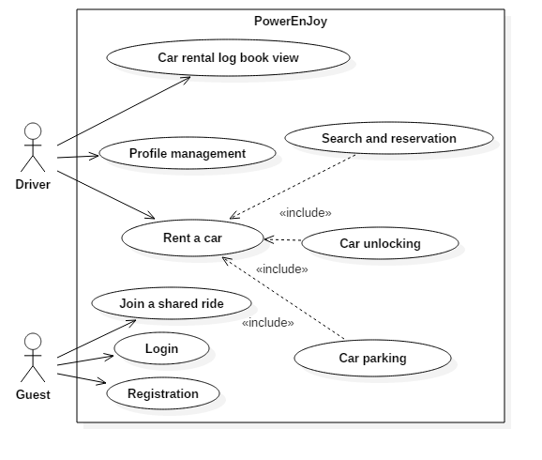
Use case diagram

Slide 5
User interfaces
Mobile application
Web application

Slide 6
Assumptions
All drivers have access to a stable internet connection.
Once a driver unlocks a car, he will use it for his trip.
Before leaving the car, the driver close it correctly.
The system is operating in an area composed by a city or agglomerated
cities, of the same country, closed each other.
All the areas where the system is operating are covered by a reliable
3G/4G connection.

Slide 7
Architectural Design

Slide 8
Architecture overview
Client tier:
  Mobile Application
  Web browser
  Car Applications
Web tier:
  Web server
Business tier:
  Application server
Data tier:
  Database

Slide 9
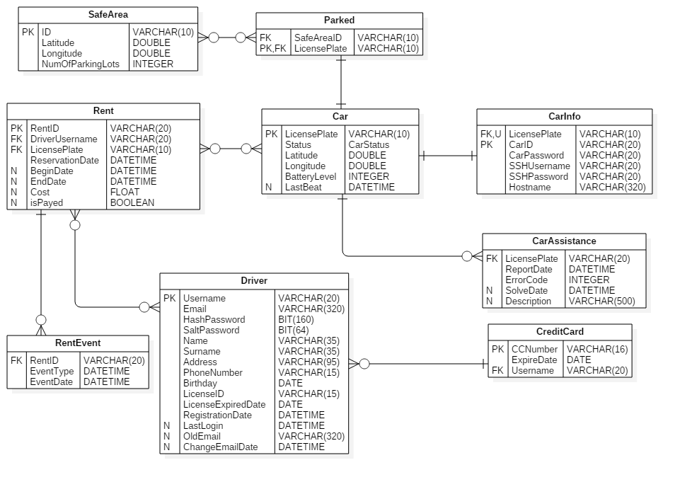
High level components
Database:
  Allows to store and retrieve all the persistent data
  Runs MySQL Community Edition 5.7
  Adheres to ACID properties with InnoDB

Slide 10
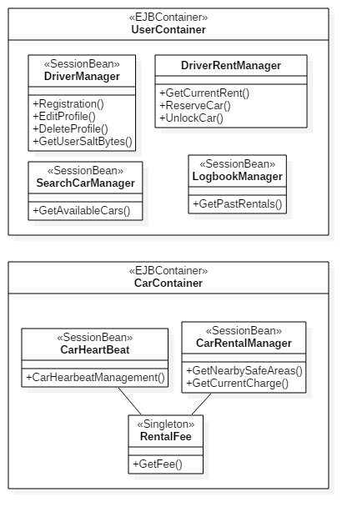
High level components
Application server:
  Contains the business logic of the system
  Runs on Glassfish
  Communicates with the database through JPA
  Implemented by custom EJB
  Provides RESTful API

Slide 11
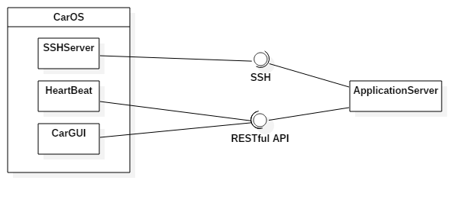
High level components
Car applications:
  Send information to the application server in order to be tracked
  Provide an SSH interface in order to be locked/unlocked remotly
  Provide a GUI to the driver with utility functionalities

Slide 12
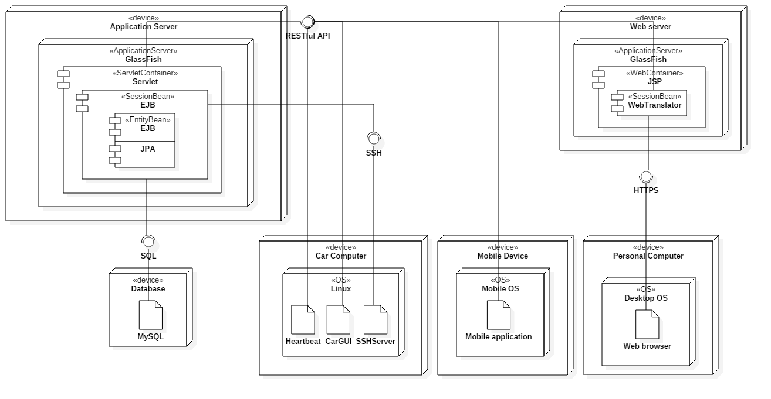
Deployment view

Slide 13
About REST
REpresentational State Transfer
Architectural style and approach to stateless communications
Architectural properties:
  Performance
  Scalability
  Simplicity
  Modifiability
  Reliablity

Slide 14
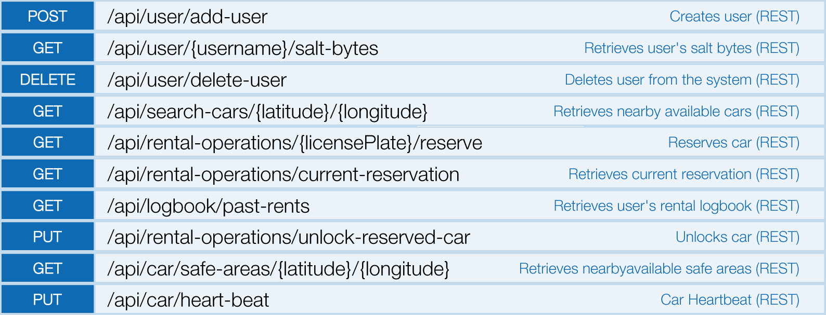
RESTful API

Slide 15
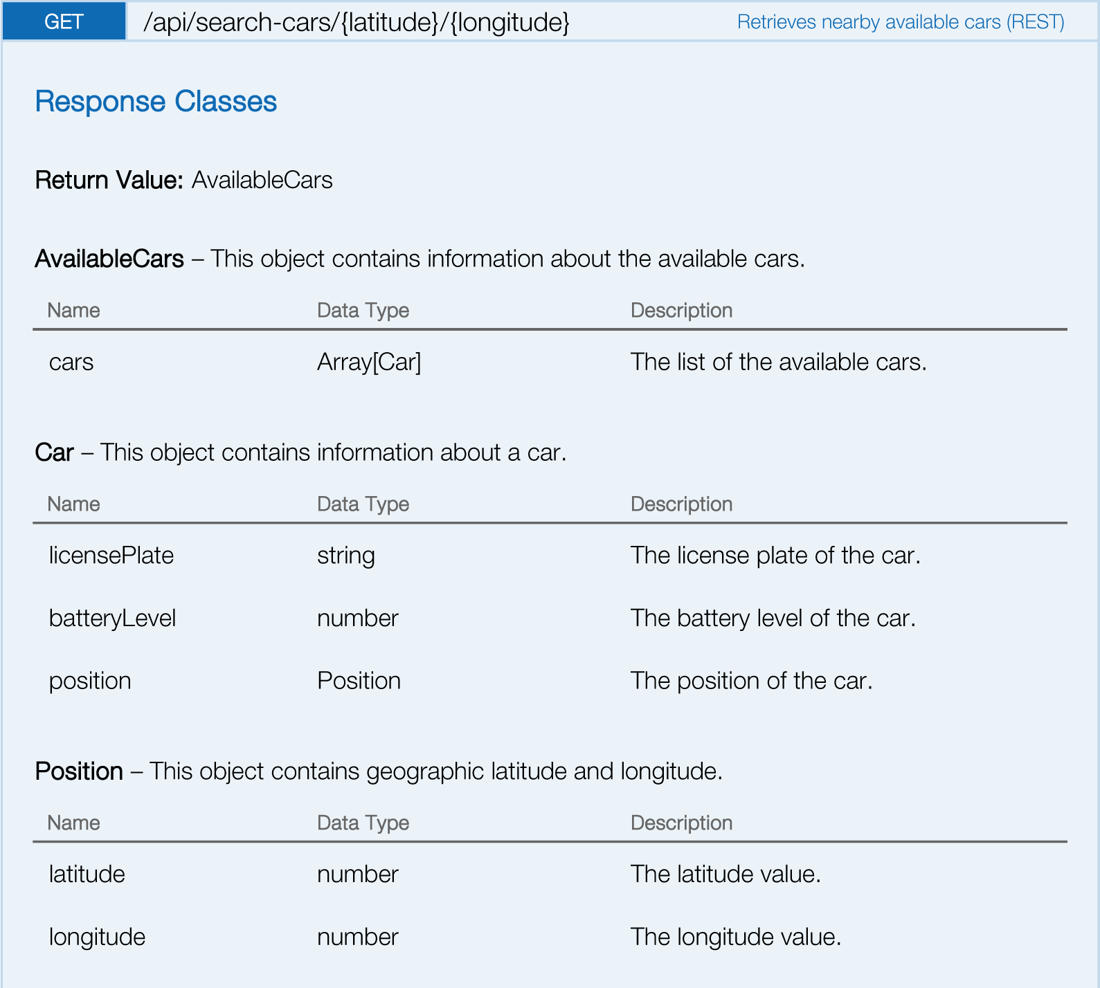
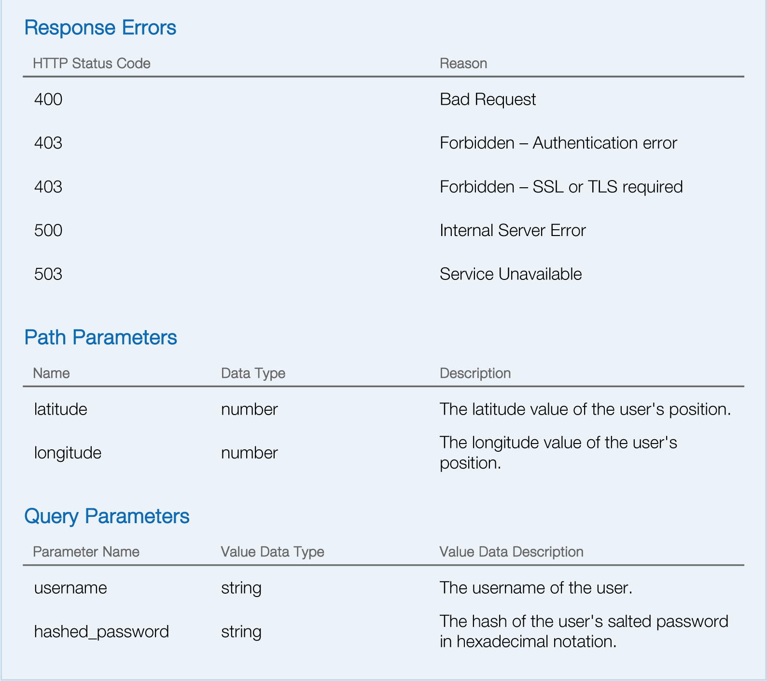
RESTful API request example

Slide 16
Integration testing

Slide 17


Entry criteria
RASD and DD must be delivered and tested
Once completed, components and subsystems can be integrated following the strategy adopted

Slide 18
Subsystems strategy and sequence
Critical-module-first approach

Slide 19
Components strategy and sequence
Bottom-up approach

Slide 20
Components strategy and sequence

Slide 21
Size, cost and effort estimation

Slide 22
Project team
Members: Lorenzo, Bob and Alice
Programmers with average skills
Members have never worked in other teams
First project for the team

Slide 23
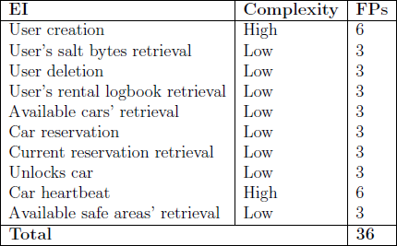
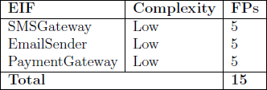
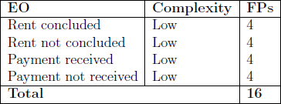
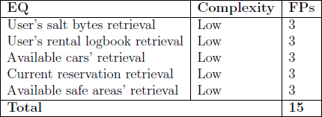
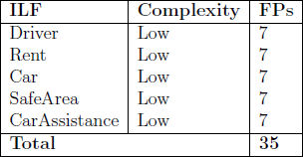
Function points

Slide 24
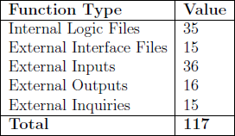
Function points
Total amount of unadjusted function points = 117
Java multiplicator = 53
SLOC = 117 x 53 = 6201 source line of code

Slide 25
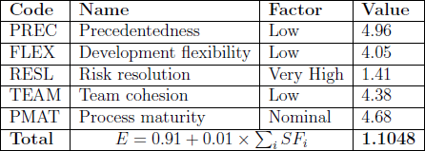
Scale factors

Slide 26
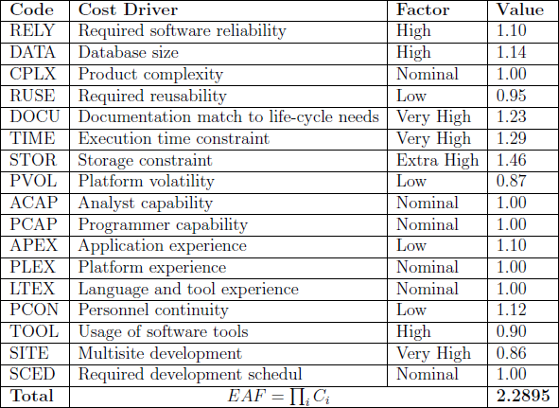
Cost drivers

Slide 27
Effort estimation
Effort = A x EAF x KSLOCE
Effort = 50.5 person-months, with
  A = 2.94 (According to COCOMO II)
  EAF = 2.2895 (Cost drivers)
  E = 1.1048 (Scale factors)
  KSLOC = 6.201

Slide 28
Duration
Duration = 3.67 x Effort^{F}
Duration = 12.82 months, with
  Effort = 50.5 person-months
  F = 0.28 + 0.2 x (E - B)
  E = 1.1048 (Scale factors)
  B = 0.91

Slide 29
People required
People =⎾Effort / Duration⏋
People = 4, with
  Effort = 50.5 person-months
  Duration = 12.82 months
Duration = Effort / People
Duration = 16.83 months, with
  Effort = 50.5 person-months
  People = 3 (since our team is composed by 3 people)

Slide 30
Thank You!

