Slide 1

A Project Presentation
AI-powered, accessible learning for children with special educational needs
Presented by Lorenzo Brent Reed Varca

Slide 2
THE PROBLEM
Every child learns differently.
Most learning apps don't.
Generic materials
Caregiver time
Left behind
One-size-fits-all resources rarely fit a child's disability, interests, or pace.
Parents spend hours searching for and adapting content for each child.
Children with ASD, ADHD, dyslexia, Down syndrome, and speech delay need it most.
IKeriKin · I Care for Your Kin
2

Slide 3
THE SOLUTION
IKeriKin turns one child profile
into a full personalized lesson.
YOU TELL US
IKERIKIN GENERATES
Age & disability
Interests & challenges
Goal & language
A story, flashcards, a quiz, memory & matching games, a daily activity, and parent tips — all built around that one child.
IKeriKin · I Care for Your Kin
3

Slide 4
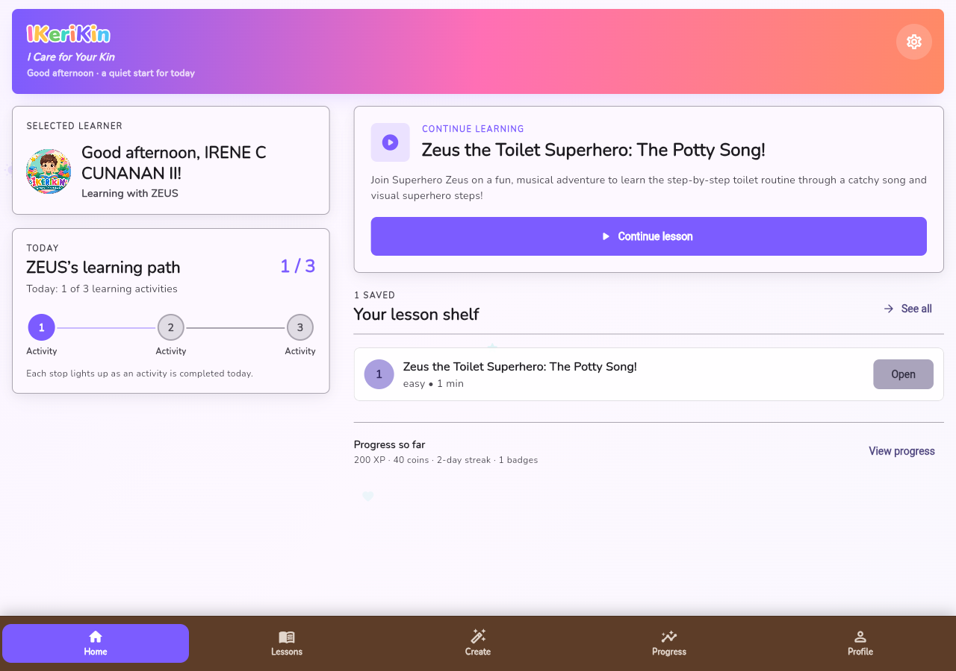
MEET THE APP
A calm starting point
Today's goal, a one-tap ‘Continue Learning’ card, and quick access to new lessons, the library, and progress — everything a parent needs from one screen.
IKeriKin · I Care for Your Kin
4

Slide 5
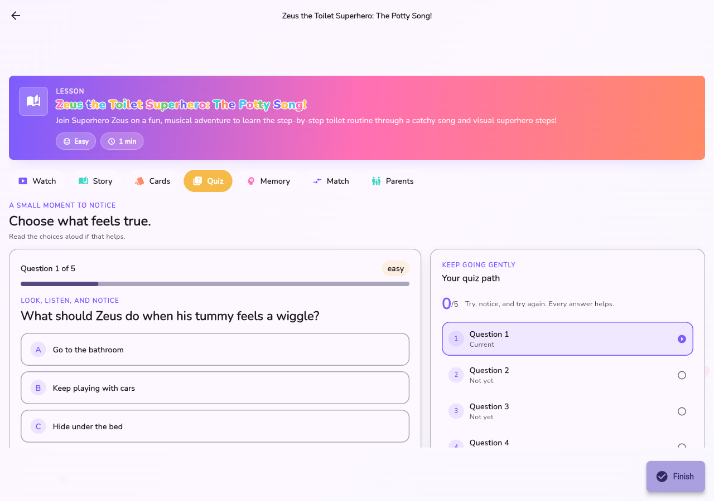
INSIDE A LESSON
Seven ways to practice one goal
Every lesson generates Watch, Story, Cards, Quiz, Memory, Match, and Parents tabs — shown here is Quiz, with one gentle question at a time and a visible path to the end.
IKeriKin · I Care for Your Kin
5

Slide 6
CORE FEATURES
Built for engagement and accessibility
AI-personalized lessons
Stories, cards & quizzes
Goals & rewards
English & Filipino, from one child profile
Plus memory and matching games
XP, coins, streaks, and badges
Accessibility built in
Progress dashboard
Parent guidance
Dyslexia font, high contrast, text-to-speech
Weekly, monthly, and all-time views for parents
Daily practice ideas and caregiver tips
IKeriKin · I Care for Your Kin
6

Slide 7
UNDER THE HOOD
One codebase, six platforms,
a real AI backend
Flutter + Dart
Android, iOS, Web, Windows, macOS, Linux — one codebase
Riverpod + GoRouter
App state and declarative navigation
Supabase
Auth, database, storage, and realtime sync
Edge Functions + AI
Gemini for lesson content, Runway for animated video
IKeriKin · I Care for Your Kin
7

Slide 8
WHERE THINGS STAND
Working today, and where it's headed
DONE
NEXT
Full Supabase backend — auth, data, storage, edge functions
AI lesson generation with 7 interactive learning modes
Accessibility settings: dyslexia font, contrast, text-to-speech
Progress tracking: XP, streaks, badges, weekly/monthly views
Expand to more schools & SPED centers
Broaden language support beyond English & Filipino
Deepen caregiver insights and recommendations
Thank you — questions welcome.

