Slide 1

Transformer-based Satellite Image and Segmentation Generation for Ground-to-Aerial Image Matching
Computer Vision A.A. 2024-2025
Project presentation by:
Filippo Tatafiore 1934988
Lorenzo Ciappetta 2011296

Slide 2
Table of Contents
Presentation outline
Objective
State of the art
Proposed method
Dataset
Setup and training
Evaluation
Conclusion
References
Transformer-based Satellite Image and Segmentation Generation for Ground-to-Aerial Image Matching

Slide 3
Objective
Area of interest of the project
Ground-to-Aerial image matching is the problem of associating a query ground-view with the corresponding satellite image, despite of the extreme view-point difference.
Objective:
Learn to synthesize aerial images through a transformer model for image generation
Learn to extract the characteristics and features of the images.
Correlate the features from the different images, and evaluate it with a score.
Discriminate non-matching views from matching ones
Transformer-based Satellite Image and Segmentation Generation for Ground-to-Aerial Image Matching

Slide 4
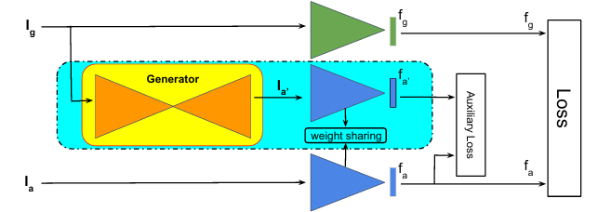
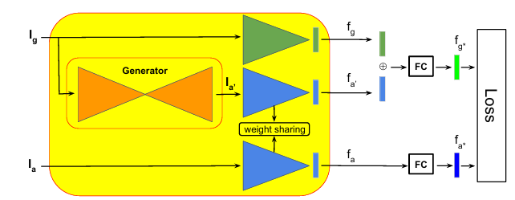
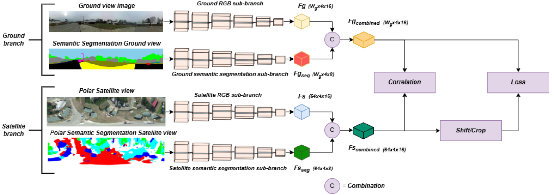
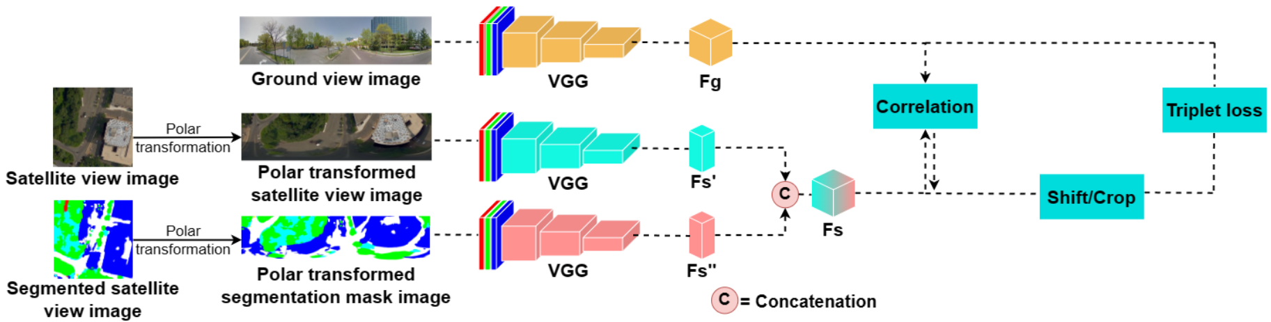
State of the art
Current research approaches to this challenge
Popular Approaches based on:
Feature extraction through VGG models and correlation between separate branches
Triplet loss
figure 1: JointFeatureLearningNet architecture from [1]
figure 2: FeatureFusionNett architecture from [1]
figure 3: SAN-QUAD Architecture from [2]
figure 4: SAN Architecture from [3]
Transformer-based Satellite Image and Segmentation Generation for Ground-to-Aerial Image Matching

Slide 5
Proposed method
Project pipeline
Image Generation, Feature Extraction and Fusion:
Fine-tune Image Generation model to produce expected aerial views and segmentation maps from ground images
Use generated images along with the others to aid in feature extraction
Fuse salient features to elaborate the compatiblity between query ground view and aerial candidate image
Image Discrimination
Train the model for matching to true aerial image representation from wrong ones via triplet loss
Transformer-based Satellite Image and Segmentation Generation for Ground-to-Aerial Image Matching

Slide 6
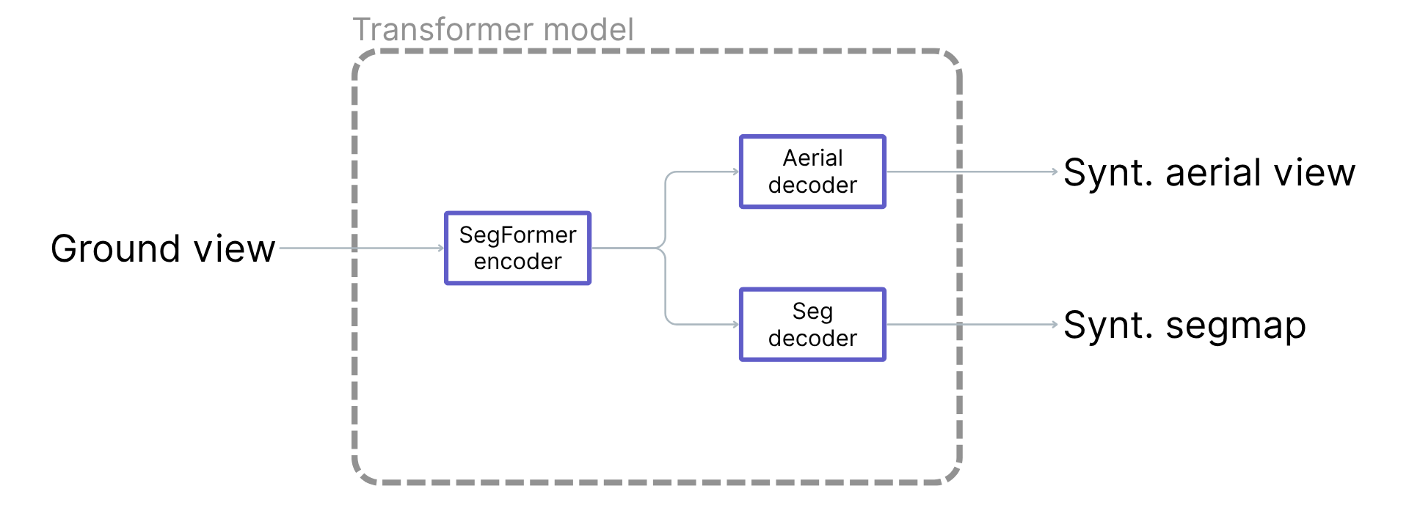
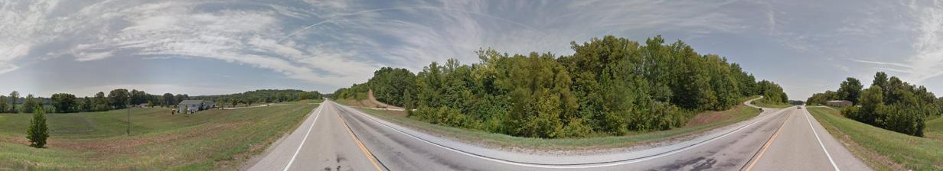

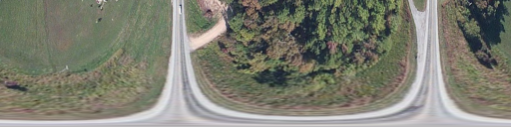


Proposed method
Models
Image Generation: Vision Transformer model
Transformer-based Satellite Image and Segmentation Generation for Ground-to-Aerial Image Matching

Slide 7
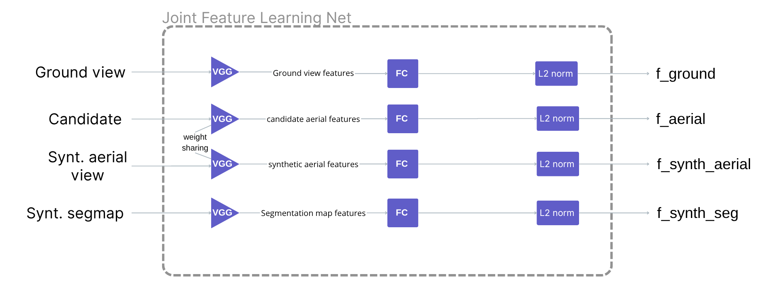
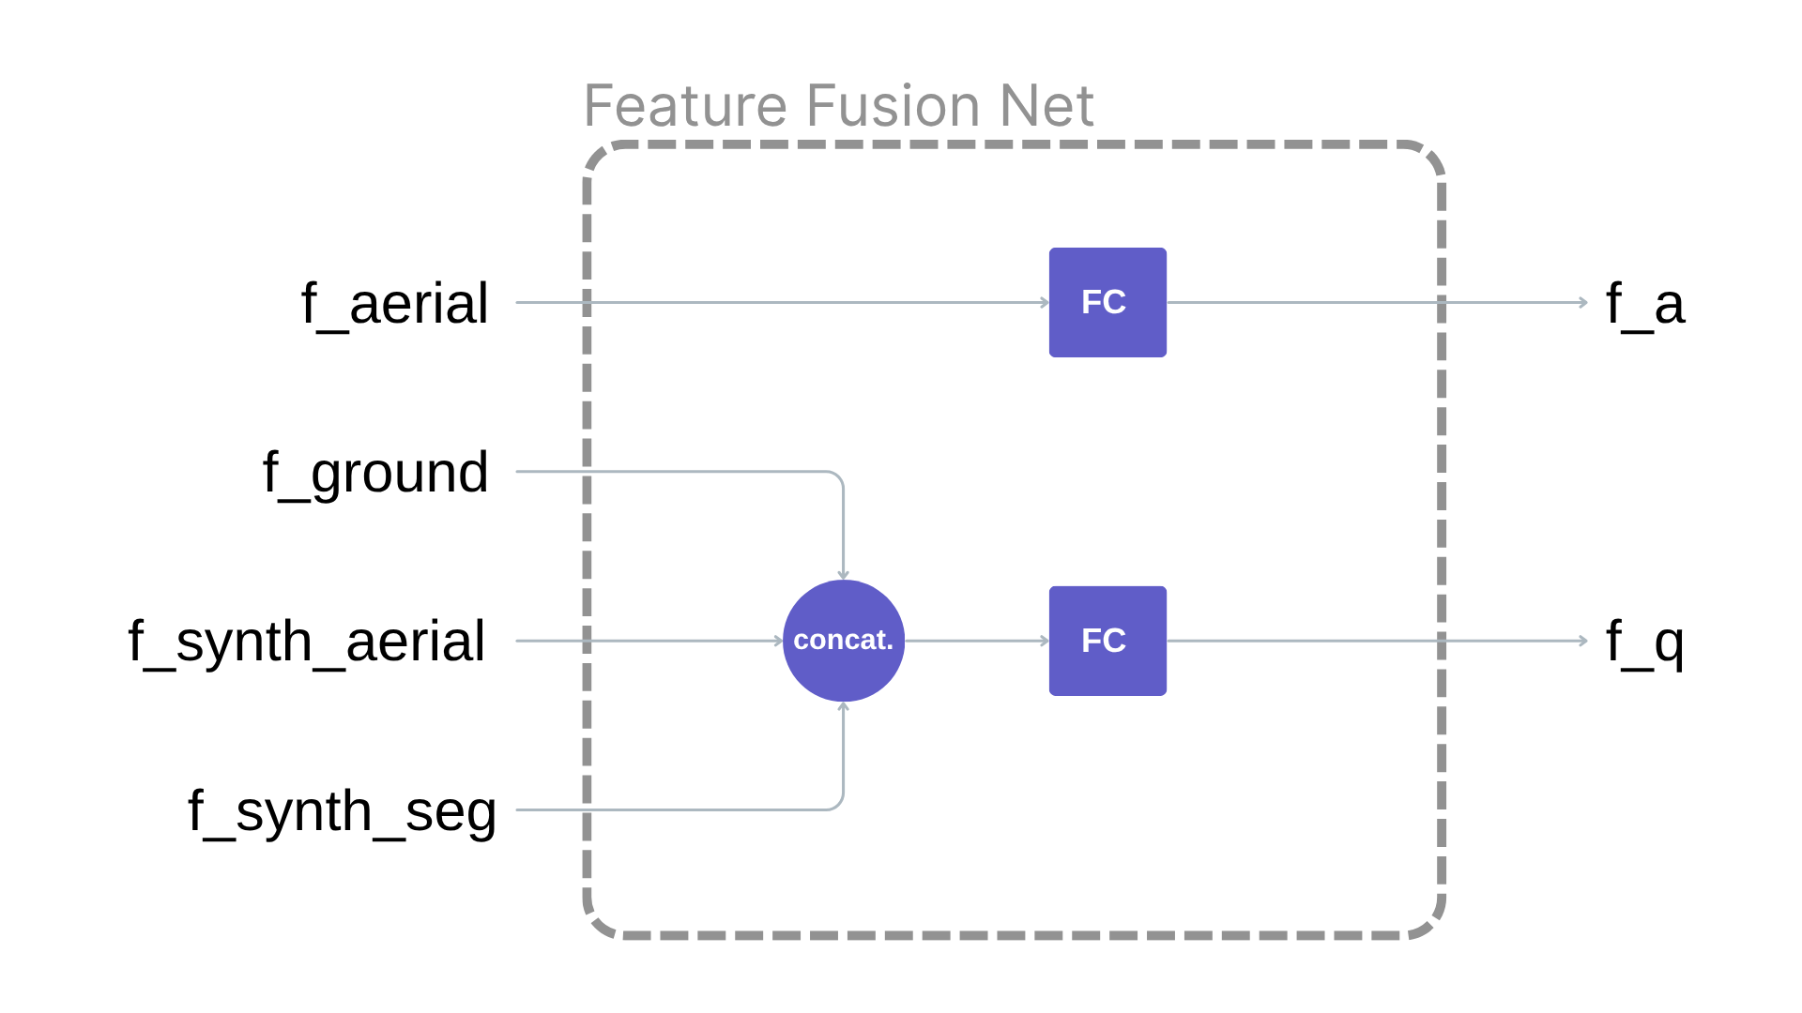
Proposed method
Models
Feature Extraction and Fusion: Joint Feature Learning Net and Feature Fusion Net
Transformer-based Satellite Image and Segmentation Generation for Ground-to-Aerial Image Matching

Slide 8
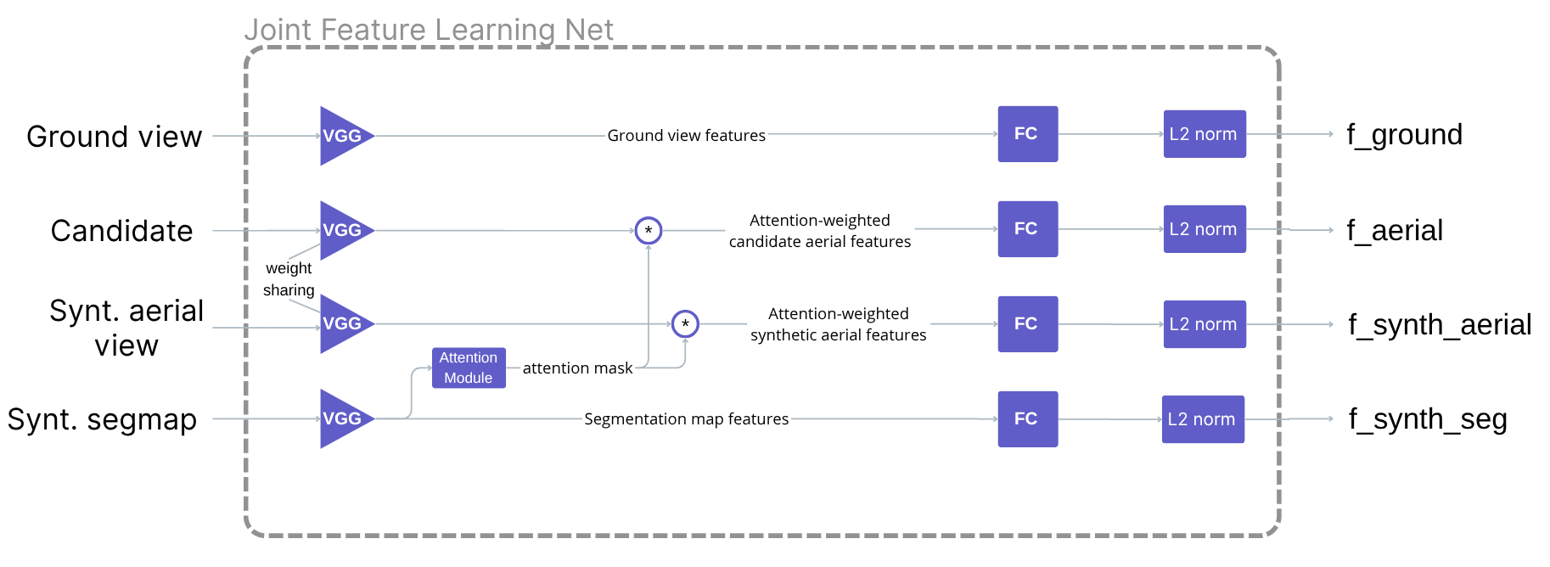
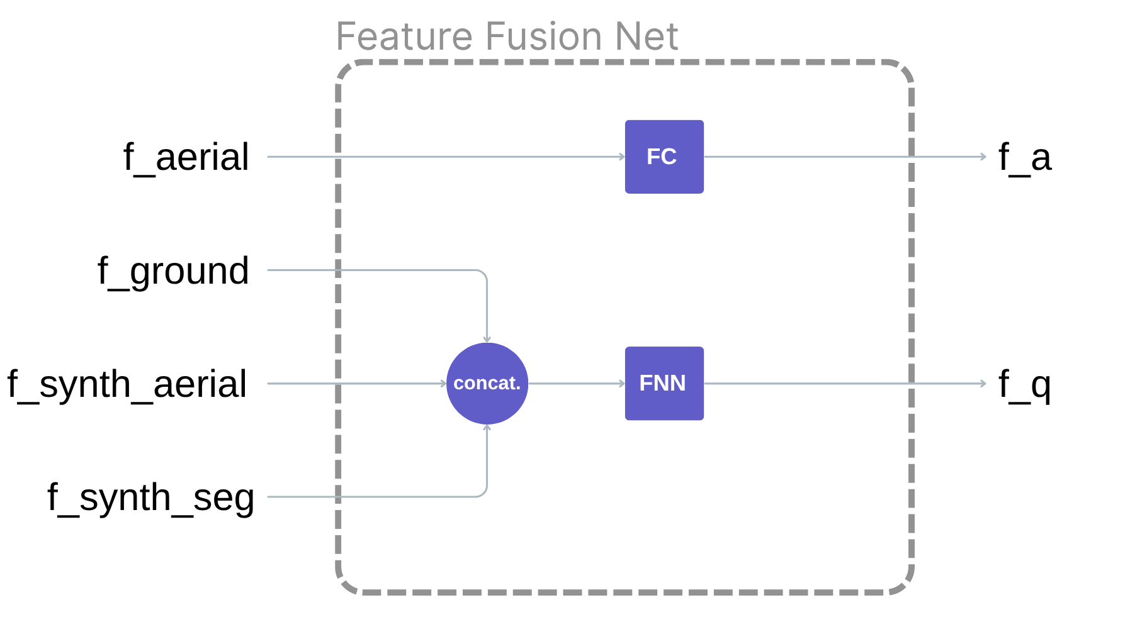
Proposed method
Another approach
Feature Extraction and Fusion: Joint Feature Learning Net and Feature Fusion Net
Transformer-based Satellite Image and Segmentation Generation for Ground-to-Aerial Image Matching

Slide 9
Dataset
CVUSA
polar-transformed ground view images
aerial satellite images
aerial satellite segmentation maps
polar-transformed aerial satellite images
polar-transformed aerial satellite segmentation maps
Preprocessing
Resize (adapt to pretrained models)
Data augmentation
Normalization
Transformer-based Satellite Image and Segmentation Generation for Ground-to-Aerial Image Matching

Slide 10
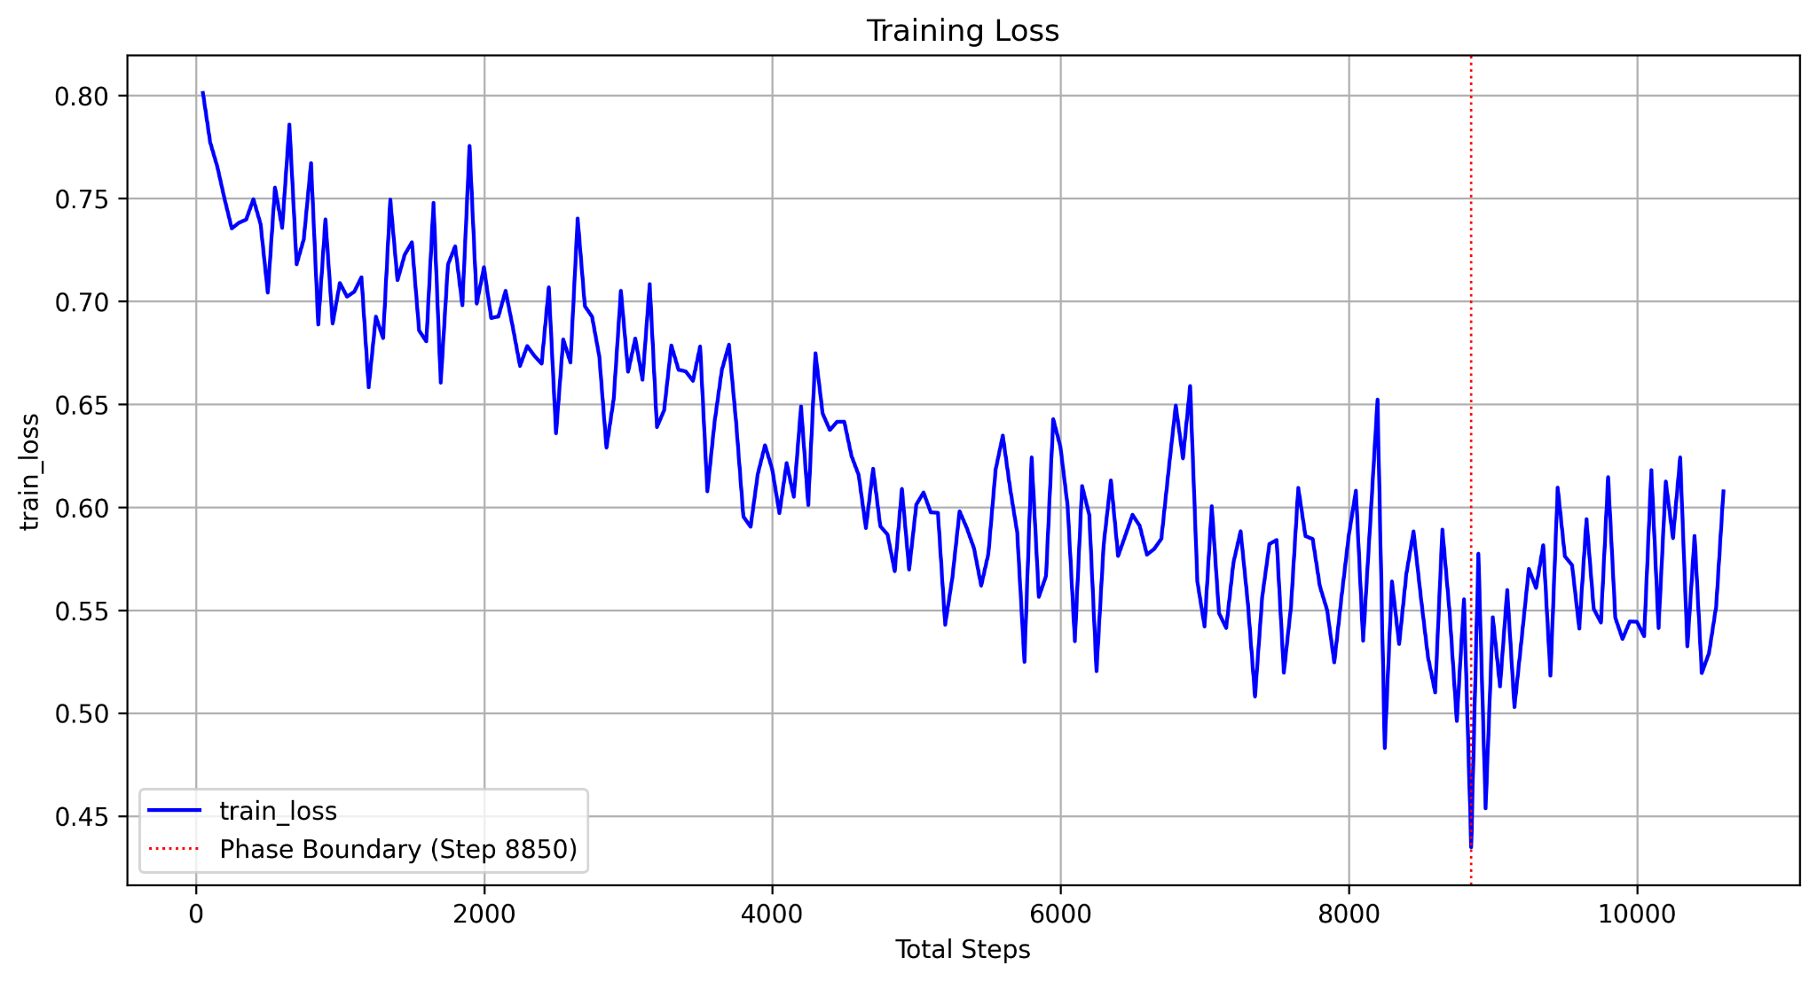
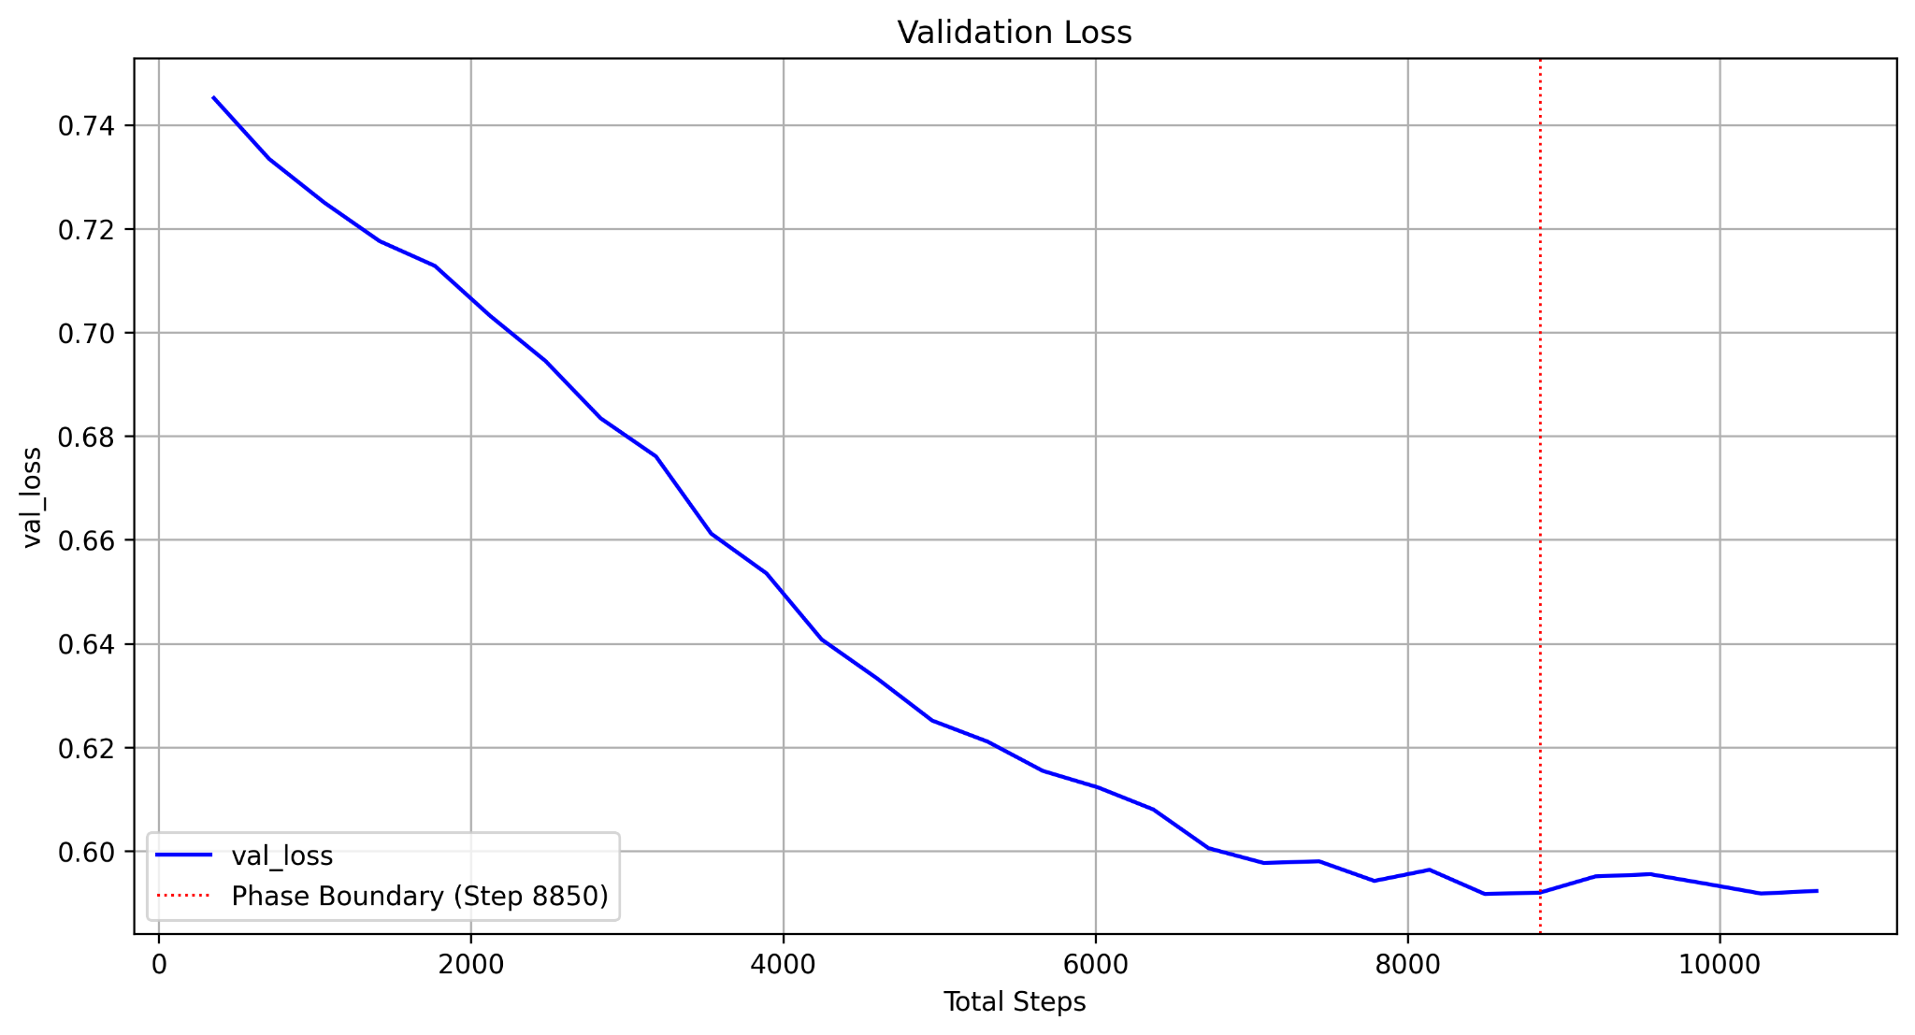
Setup and Training
Configuration of the elements of the project
Generative model
encoder: version of nvidia/segformer-b0-finetuned-ade-512-512, fine-tuned on satellite semantic dataset [4]
training strategy: 2 phases
Transformer-based Satellite Image and Segmentation Generation for Ground-to-Aerial Image Matching

Slide 11
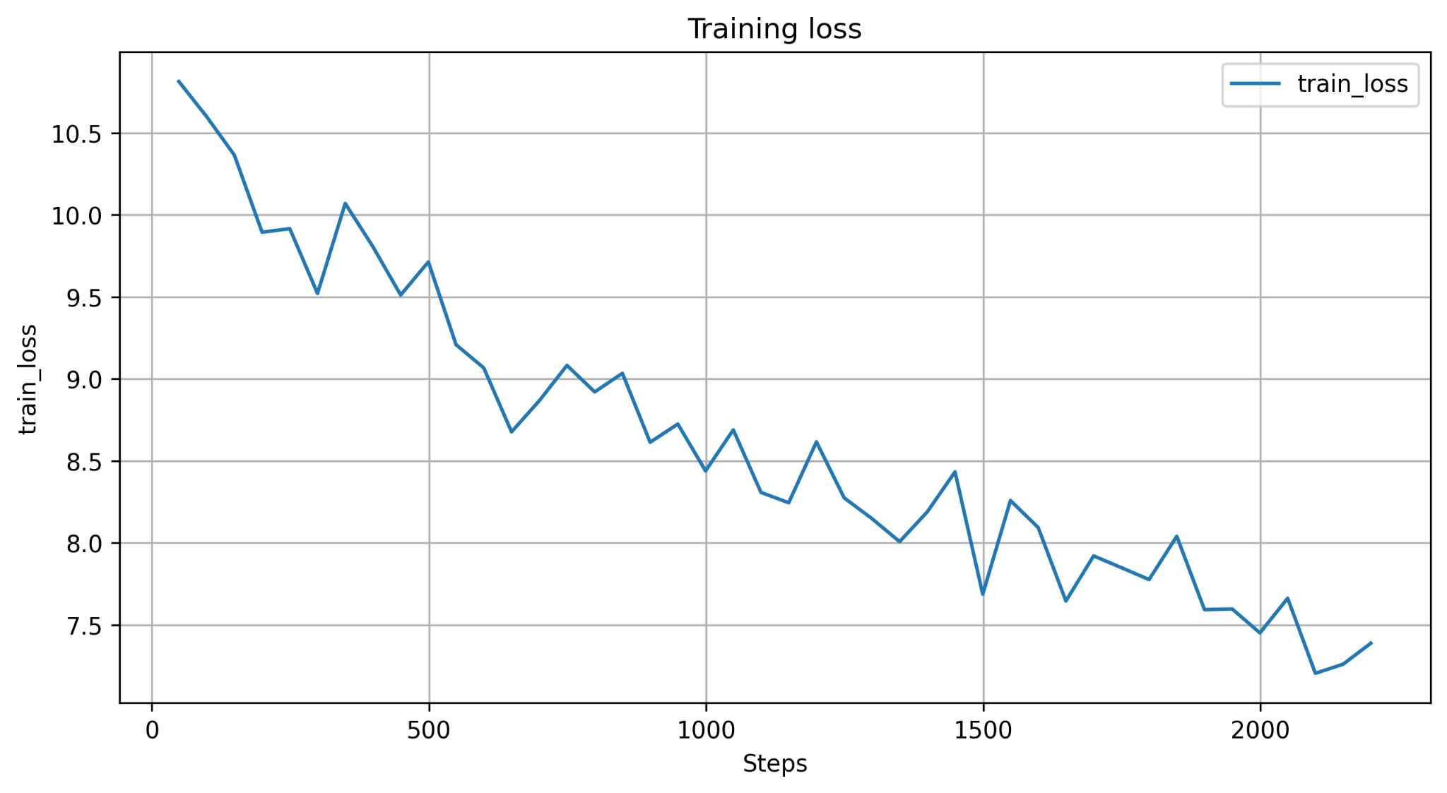
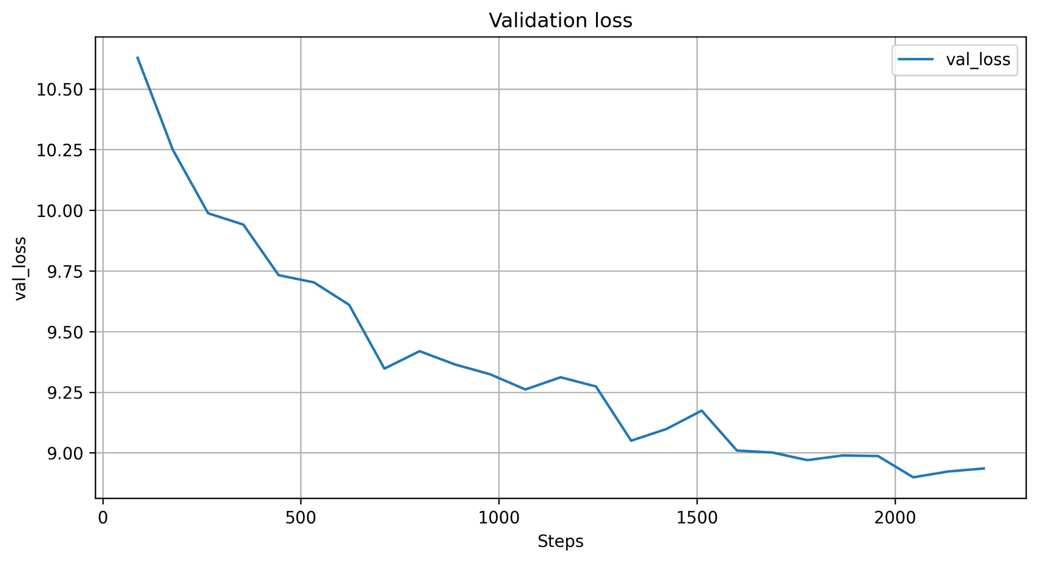
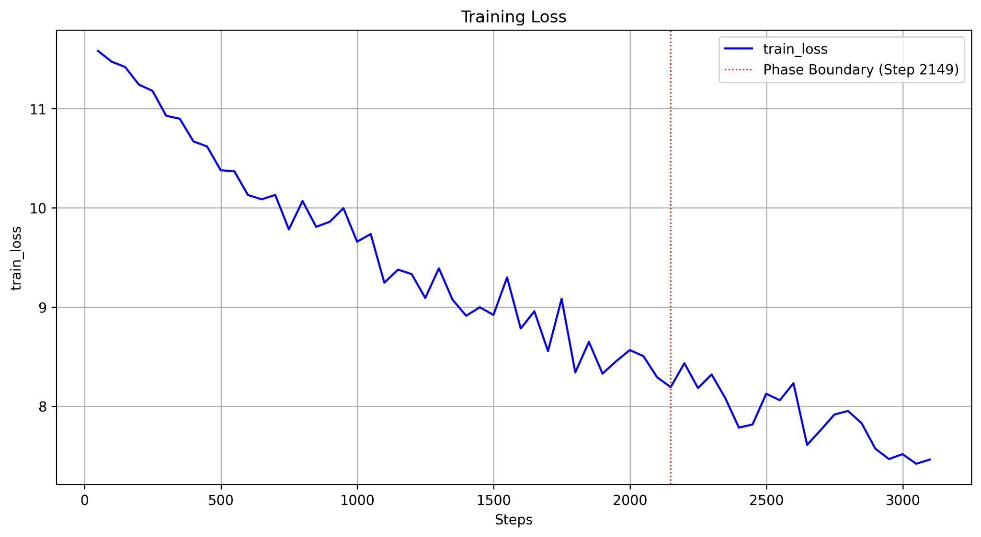
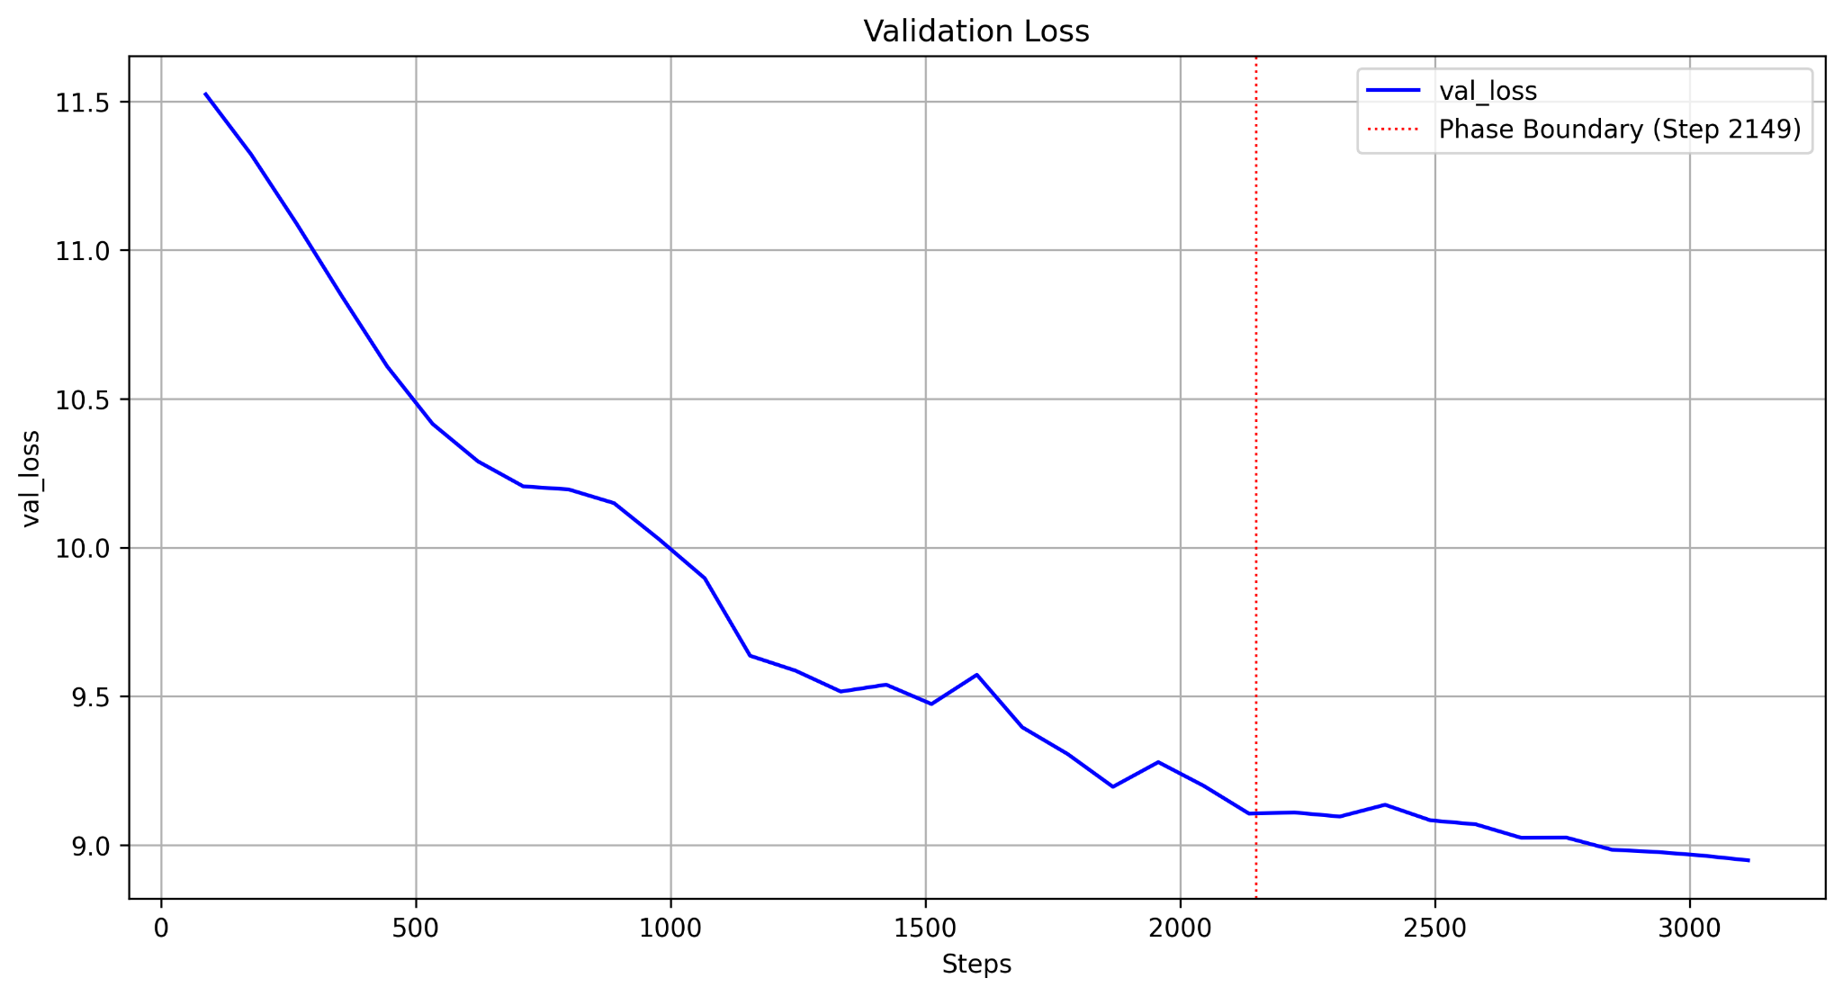
Setup and Training
Configuration of the elements of the project
Joint Feature Learning Net
Logs for first approach:
Logs for second approach (with attention module):
Transformer-based Satellite Image and Segmentation Generation for Ground-to-Aerial Image Matching

Slide 12
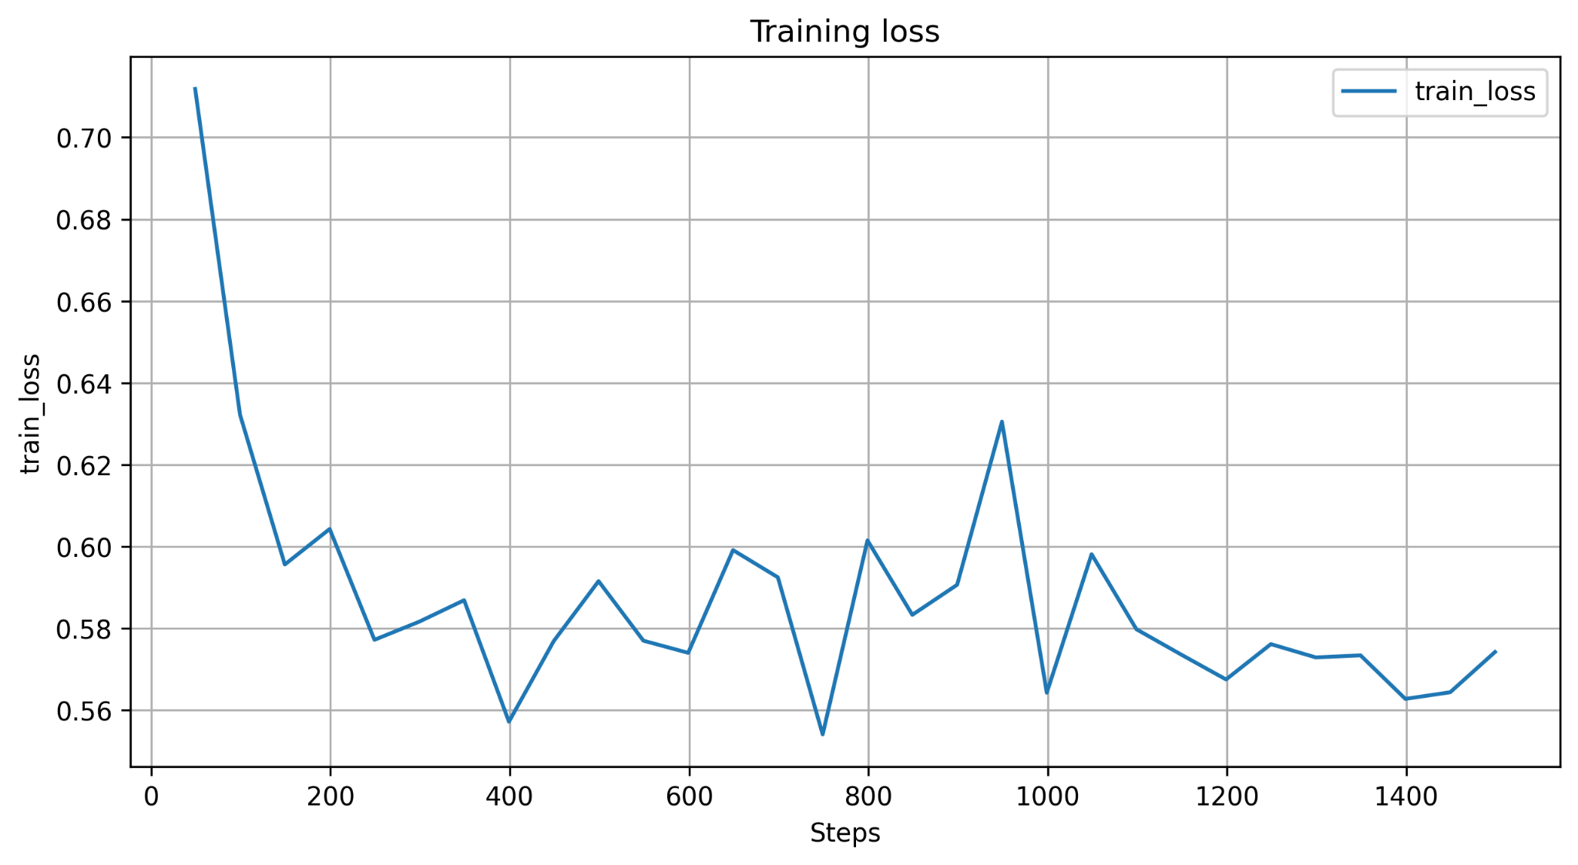
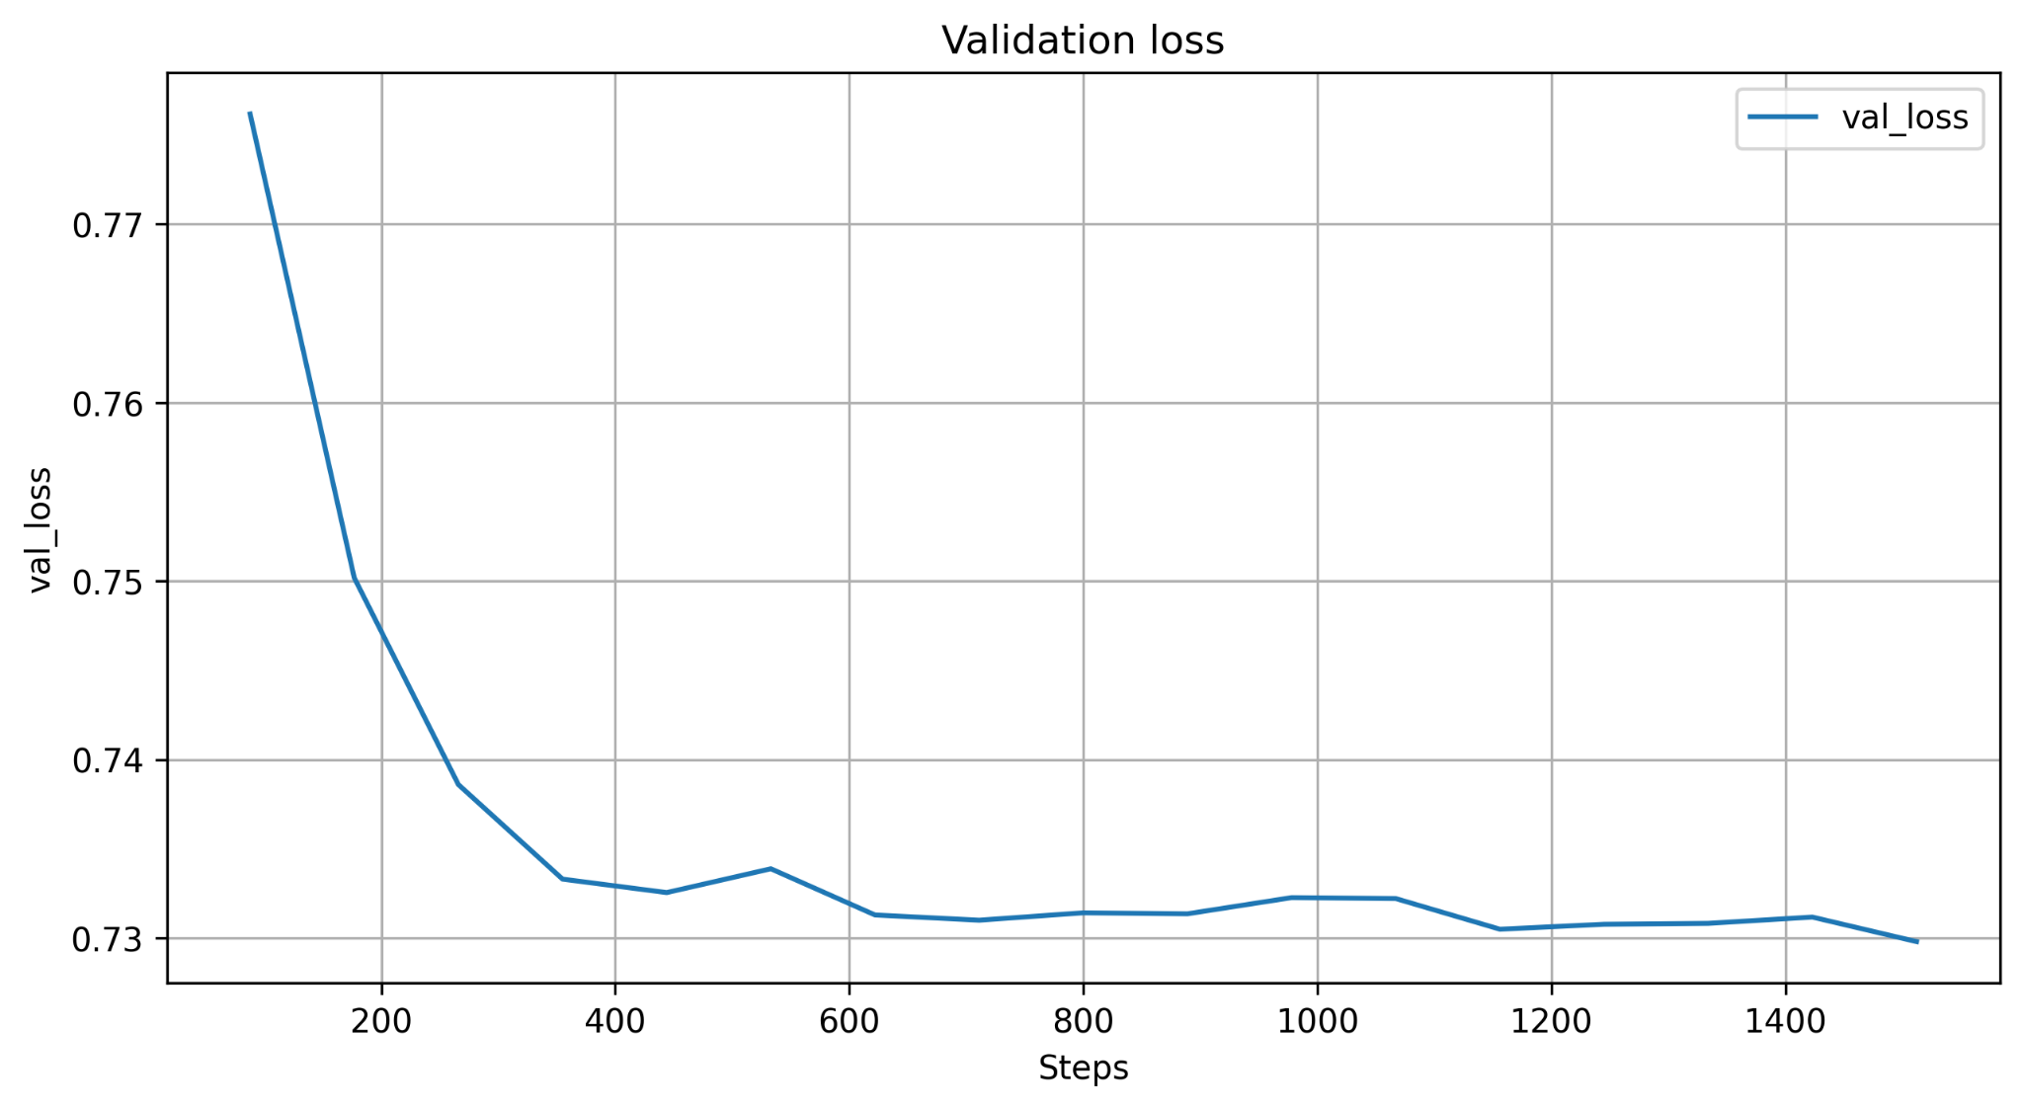
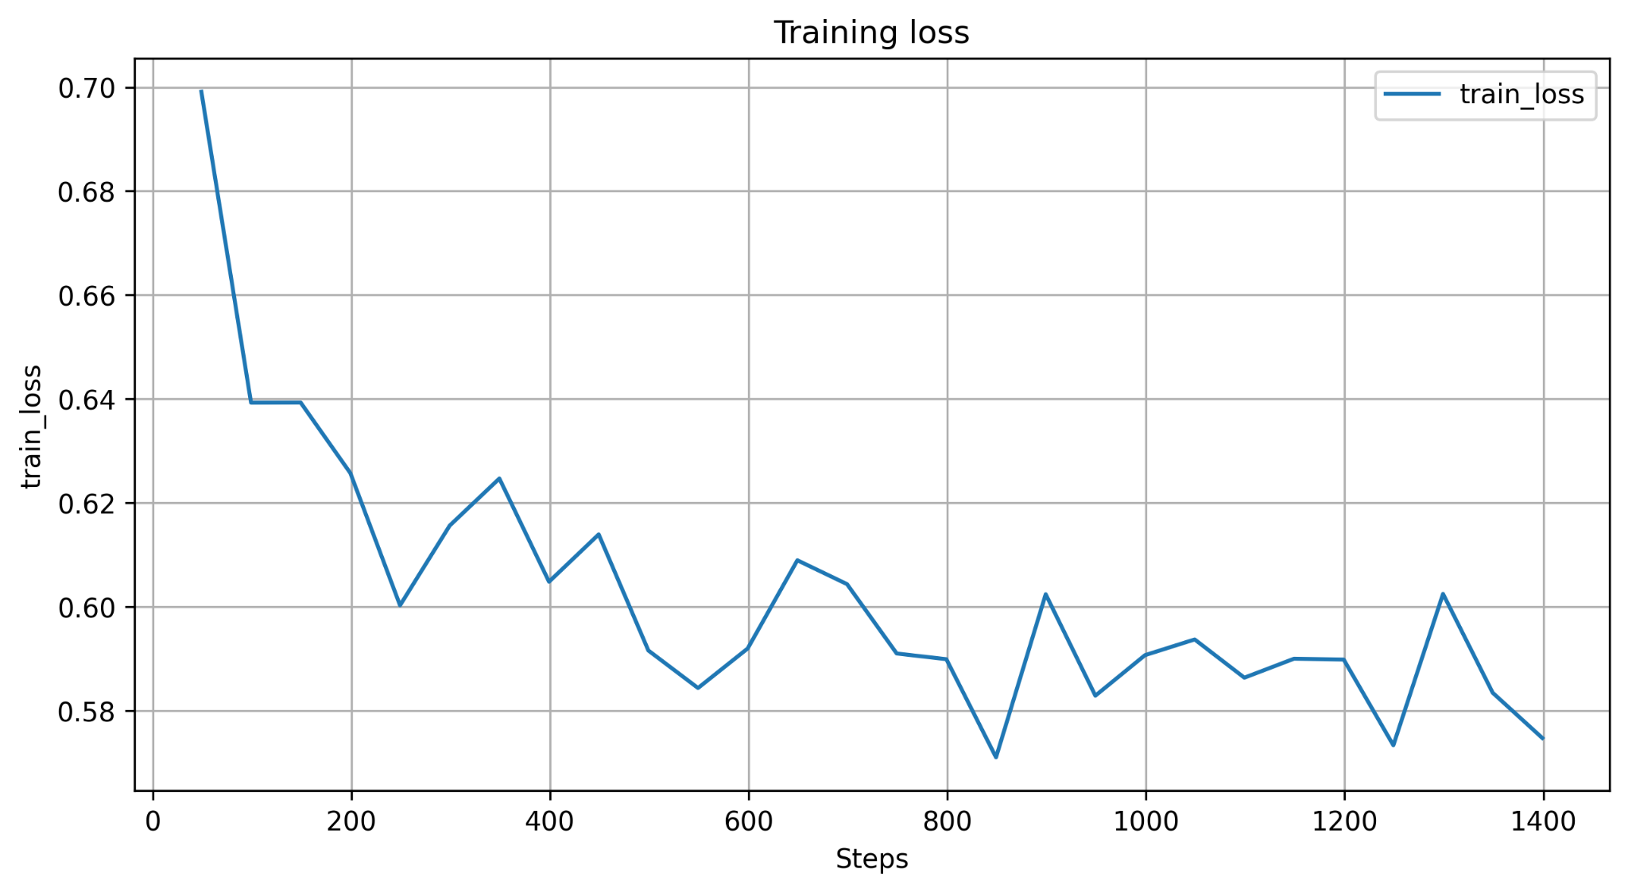
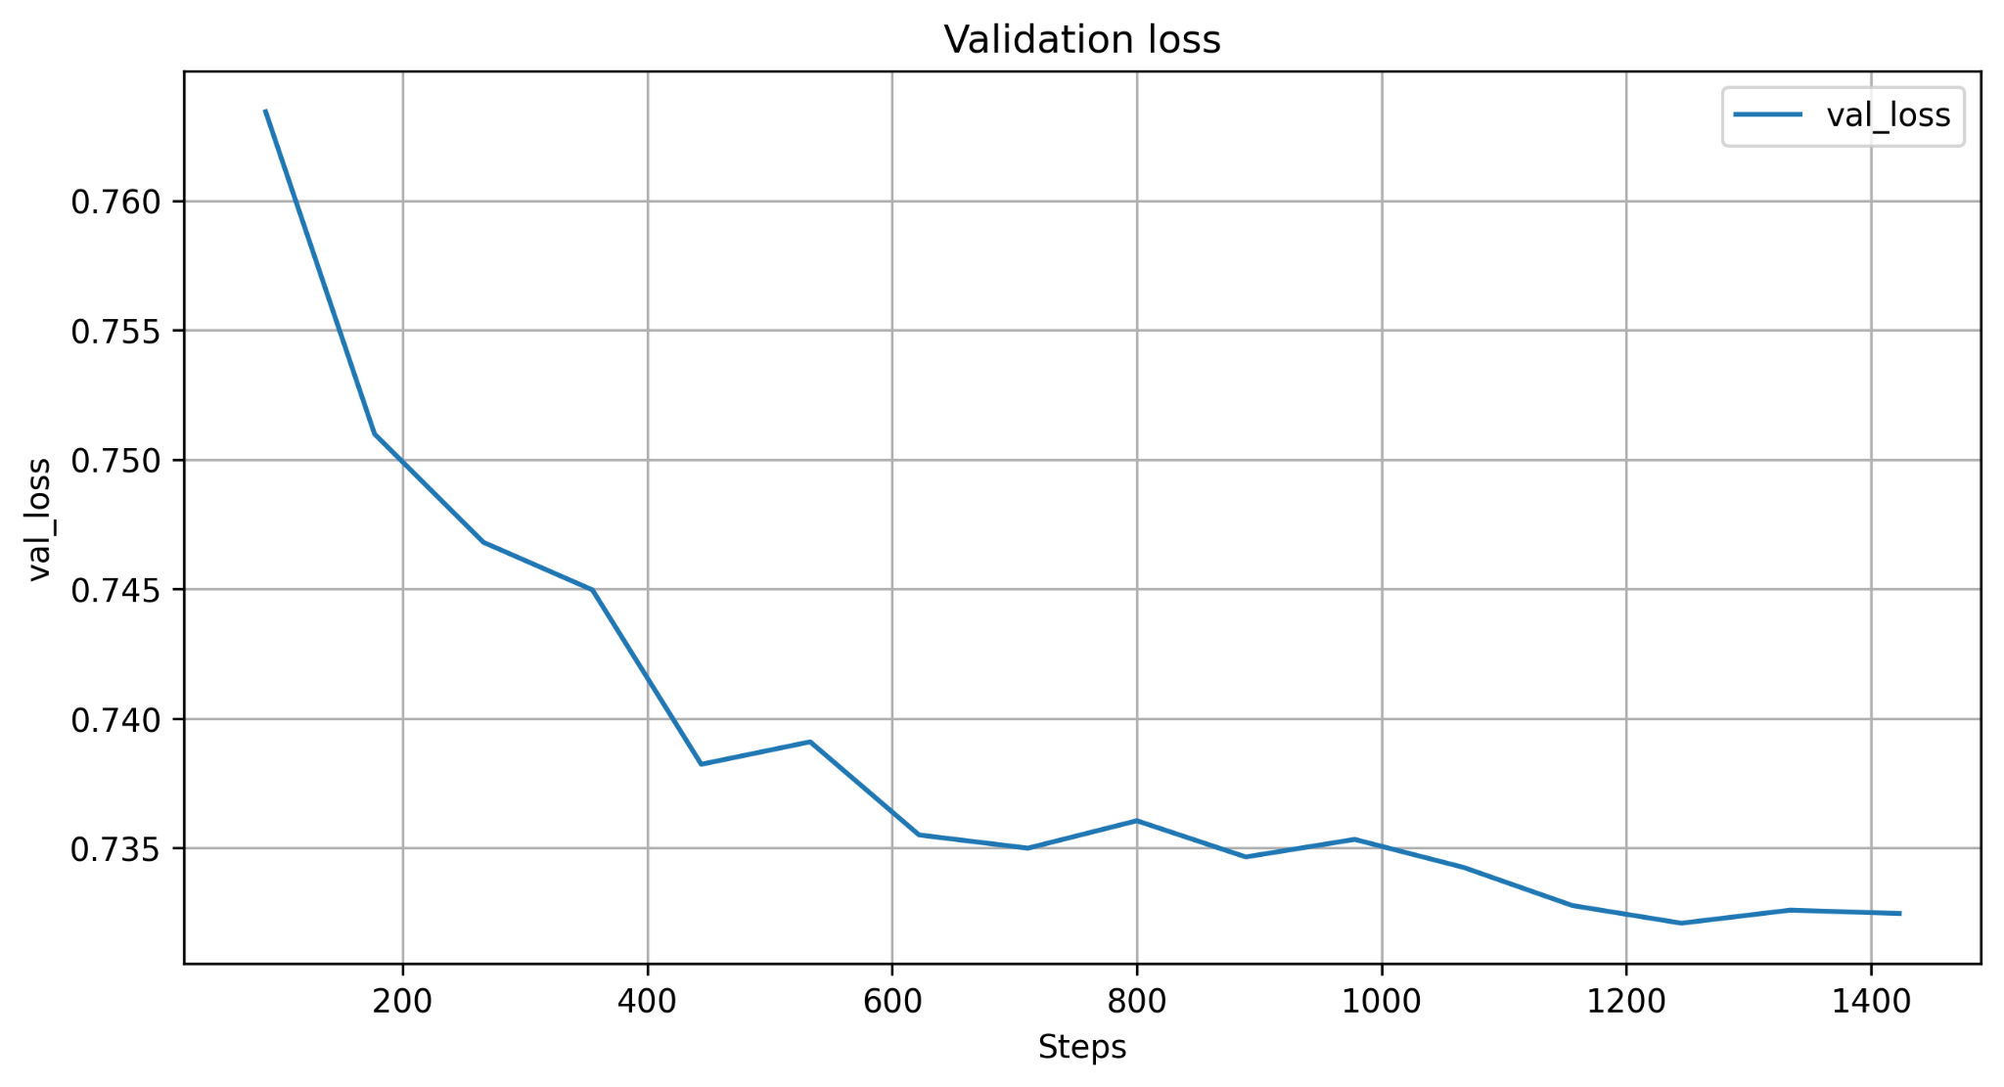
Setup and Training
Configuration of the elements of the project
Feature Fusion Net
Logs for first approach:
Logs for second approach (shallow NN instead of FC):
Transformer-based Satellite Image and Segmentation Generation for Ground-to-Aerial Image Matching

Slide 13

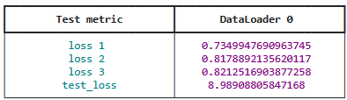

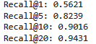
Evaluation
Generative model
Aerial Loss: weighted sum of Perceptual Loss and L1 loss
Segmentation loss: Weighted Focal Loss + Dice Loss
PSNR and IoU Monitoring
Joint Feature Learning Net model
Weighted sum of three triplet losses
Feature Fusion Net model
Triplet loss
Recall@k
Transformer-based Satellite Image and Segmentation Generation for Ground-to-Aerial Image Matching

Slide 14
Conclusion
Final considerations
Generative model:
different encoders: nvidia/mit-b1, sawthiha/segformer-b0-finetuned-deprem-satellite
different losses:
Aerial loss: L1 loss, Perceptual Loss
Segmentation loss: Weighted Cross Entropy, Weighted Focal Loss, Dice loss
Joint Feature Learning model:
different architectures: with or without attention
Feature Fusion model:
different approaches for extracting the query embedding
Transformer-based Satellite Image and Segmentation Generation for Ground-to-Aerial Image Matching

Slide 15
Conclusion
Future work
Generative model:
larger encoder, pre-trained on satellite data (Prithvi, Swin Transformer, …)
deeper decoders
Joint Feature Learning and Feature Fusion:
use also ground view segmentation maps
calculate negative not only within the current batch
Other possibilities:
Larger dataset
Different training strategies
Transformer-based Satellite Image and Segmentation Generation for Ground-to-Aerial Image Matching

Slide 16
References
[1] Regmi, K., & Shah, M. (2019). Bridging the Domain Gap for Ground-to-Aerial Image Matching. arXiv.
[2] Mule, E., Pannacci, M., Goudarzi, A., Pro, F., Papa, L., Maiano, L., and Amerini, I. (2025). Enhancing Ground-to-Aerial Image Matching for Visual Misinformation Detection Using Semantic Segmentation. In Proceedings of the Winter Conference on Applications of Computer Vision (WACV) Workshops (pp. 795-803).
[3] F. Pro, N. Dionelis, L. Maiano, B. L. Saux and I. Amerini, ”A Semantic Segmentation-Guided Approach for Ground-to-Aerial Image Matching,” IGARSS 2024 - Athens, Greece, 2024, pp. 2630-2635.
[4] https://huggingface.co/sawthiha/segformer-b0-finetuned-deprem-satellite
Transformer-based Satellite Image and Segmentation Generation for Ground-to-Aerial Image Matching

Slide 17
Thanks for your attention

