Slide 1


NAO PLANNING CHALLENGE 2025
LORENZO COLLIVA
GIADA DE MICCO
BallaConNAO

Slide 2


DANCE COREOGRAPHY
Reggaeton Song: Muevelou - Natanael cano

Slide 3

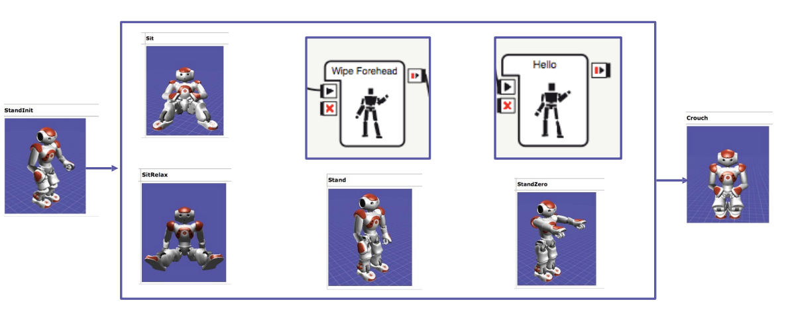
COMPETITION RULES
Total time of choreography 2 minutes
Initial state (StandInit)
Goal (Crouch)
6 mandatory positions
At least 5 intermediate positions selected by the algorithm

Slide 4

IMPLEMENTATION
Coded in Python
Search Algorithm: A*, through AIMA Library
Heuristic function combines three aspects: Entropy, Remaining Time, Musical Energy
Check if the preconditions are satisfied
Avoid repeating moves
Repo: https://github.com/LorenzoCollivaUnibo/BallaConNao

Slide 5
THANKS FOR THE ATTENTION
Now BALLA CON NAO!

Slide 6
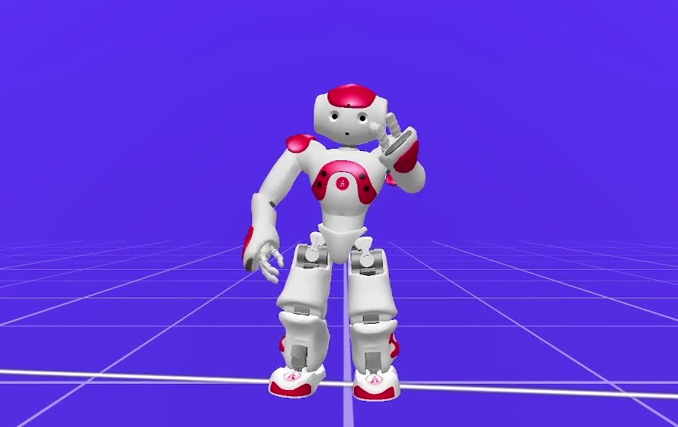
Choreography Video

