Slide 1
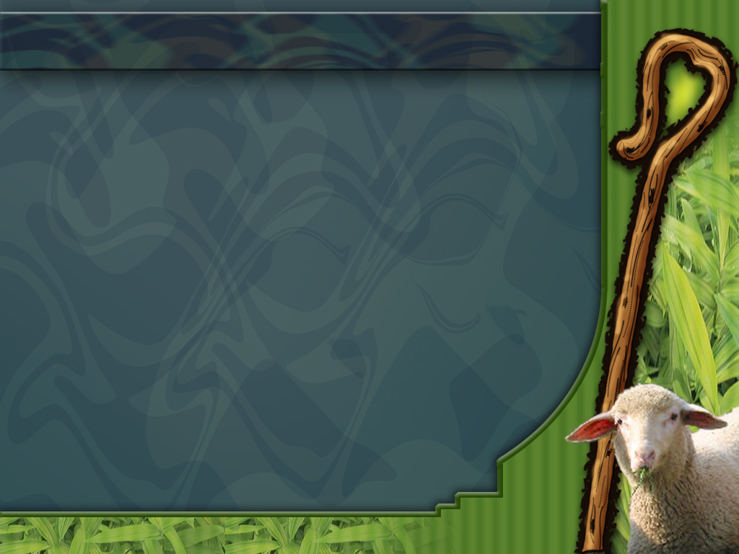

Music and Acoustic Engineering
Advanced Coding Tools and Methodologies
Prof. Bruschi Francesco
Prof. Rana Vincenzo
SHEEP-PHONY
A project by
Curcio Lorenzo
Bernasconi Marco
Albarracín Sánchez Juan Camilo

Slide 2

SHEEPS MOVEMENT
Sheeps are represented by point-like agents able to perceive and respond to their local environment.
The state of each sheep is represented by its speed at a certain time.
Stationary sheeps don’t change their position, while
walking and running ones do.
$$q_{i}^{t} ∈\{0,1,2\}$$
Stationary or walking sheep
Running sheep
Slide 1/totale

Slide 3



SHEEPS MOVEMENT
The evolution of the position of each sheep is described by the following equations.
Heading vector
$$r_{i}^{t+∆t}=r_{i}^{t}+v∆t s_{i}^{t+∆t}$$
Random noise
$$θ_{i}^{t+∆t}=Arg\sum_{j ε M}{s_{j}^{t}}+φ_{i}^{t}$$
Unit vector from sheep i to sheep j
$$θ_{i}^{t+∆t}=Arg\sum_{j ε M}{[δ_{2,q_{j}^{t}} s_{j}^{t}}+ β\min\left(1, \frac{r_{ij}^{t}−r_{e}}{r_{e}}\right)e_{ij}^{t}]$$
Cohesion
Metric neighbours
Equilibrium distance
Slide 2/totale

Slide 4



SHEEPS MOVEMENT
A sheep decides whether to change its state according to the following probabilities.
$p_{0→1}\left(i,t\right)=\frac{1+α n_{1}^{t}\left(i\right)}{τ_{0→1}}$
$p_{1→0}\left(i,t\right)=\frac{1+α n_{0}^{t}\left(i\right)}{τ_{1→0}}$
$p_{0,1→2}\left(i,t\right)=\frac{1}{τ_{0,1→2}}$ ${\text{[}\frac{l_{i}^{t}}{d_{R}}(1+α n_{2}^{t}\left(i\right))]}^{δ}$
$$p_{2→0}\left(i,t\right)=\frac{1}{τ_{2→0}}{\text{[}\frac{d_{S}}{l_{i}^{t}}(1+α n_{0}^{t}\left(i\right))]}^{δ}$$
$τ_{i→j}=spontaneous transition time from state i to state j$
$α$ and $δ$ = allelomimetic parameters
$n_{i}^{t}$ = number of metric neighbours that are in state i at time t
$l_{i}^{t}$ = average distance from sheep i to other sheeps at time t
$d_{S}$ and $d_{R}$ = characteristic lengths
Slide 2/totale

Slide 5
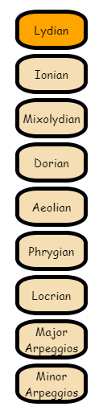


SHEEPS MUSIC
The way the sheeps change their state is used to create music.
function play(n)
function playDrums()
Slide 2/totale

Slide 6


SHEEPS MELODY
The following code is executed once every n frames, depending on how fast the BPM is set.
The four notes are equally spaced inside each measure.
BPM
//Notes
setTimeout(function(){play(ms)},0)
if(mr+ms+mw>=30){
setTimeout(function(){play(mr)},(2.5)/(10*fps)*1000*framesPermeasure)
}
setTimeout(function(){play(ms)},(5)/(10*fps)*1000*framesPermeasure)
if(ms>=10){
setTimeout(function(){play(ms+mw+mr)},(7.5)/(10*fps)*1000*framesPermeasure)
}
$mr, mw, ms=$number of sheeps that respectively started running, walking or stopped
Slide 2/totale

Slide 7
SHEEPS DRUMS
Drums are played using a similar logic, some conditions
are related to the number of sheeps that stopped in the
particular frame
if (mr>=10)
crash.play()
else if (mr>=5)
ride.play()
else if (n_pecore_stay<5)
kick.play()
if (n_pecore_stay<25){
if (ms<3)
setTimeout(function(){rewind(closed_hat)},(2.5)/(10*fps)*1000*framesPermeasure)
else if (ms<15)
setTimeout(function(){rewind(closed_hat)},(5)/(10*fps)*1000*framesPermeasure)
if (ms==0)
setTimeout(function(){rewind(closed_hat)},(7.5)/(10*fps)*1000*framesPermeasure)
}
if (ms<25){
if (ms>=15)
setTimeout(function(){rewind(snare)},(2.5)/(10*fps)*1000*framesPermeasure)
else if (ms>=10)
setTimeout(function(){rewind(snare)},(5)/(10*fps)*1000*framesPermeasure)
if (ms>=2)
setTimeout(function(){rewind(snare)},(7.5)/(10*fps)*1000*framesPermeasure)
}
if (ms<25){
if (mw>=20)
setTimeout(function(){rewind(open_hat)},(2.5)/(10*fps)*1000*framesPermeasure)
else if (mw>=10)
setTimeout(function(){rewind(open_hat)},(5)/(10*fps)*1000*framesPermeasure)
if (mw>=5)
setTimeout(function(){rewind(open_hat)},(7.5)/(10*fps)*1000*framesPermeasure)
}
if (n_pecore_stay>=30){
if (mw<3)
setTimeout(function(){rewind(tom)},(2.5)/(10*fps)*1000*framesPermeasure)
else if (mw<5)
setTimeout(function(){rewind(tom)},(5)/(10*fps)*1000*framesPermeasure)
if (mw==0)
setTimeout(function(){rewind(tom)},(7.5)/(10*fps)*1000*framesPermeasure)
}
Slide 2/totale

Slide 8
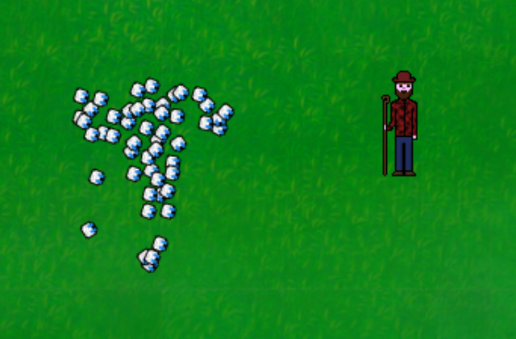
SHEEPS MIX
Spatial audio mix depending on the relative position of the listener (sheeperd) regarding the herd center of mass
Slide 2/totale

Slide 9
Slide 2/totale

Slide 10
Slide 2/totale

Slide 11
Slide 2/totale

Slide 12
Slide 2/totale

