Slide 1
Segmenting clients
Daniel Sima
Veronica Lucchetti
Edoardo Leonardi
Fintech Project 2021,
Politecnico di Milano

Slide 2
Goal
Data
Clustering analysis
Data-driven persona
Customized financial services
The goal is to segment the customers of a bank using Unsupervised Machine Learning techniques, this is a segmentation carried out from the perspective of the financial services sector.
The objective is to define data-driven personas, which are human prototypes with similar traits that will be used to customize the financial services.

Slide 3
Idea
Hierarchical Structure
As humans, we are all different, but with common traits and features. This could also be translated for individual financial characteristics.
From this fact we assume a nested structure in our clients, this means that each subgroup/persona could be part of a larger group, for example the high net worth individuals are a subgroup of the wealthy client group.
From this hypothesis we have implemented a hierarchical clustering algorithm.

Slide 4
Agglomerative Hierarchical clustering
Due to the lack of a priori knowledge on the possible number of personas, Hierarchical clustering has the advantage that does not require a particular pre-specified number of groups.
From the original dataset we removed the features "gender" and "family size", because in the different algorithms tested these two variables did not help us discriminating between groups.
To measure dissimilarities between clients x and y we tested two custom distance metrics:
$dist\left(x,y\right)=w∗{dist}_{Hamming}\left(x,y\right)+$ $\left(1−w\right)∗{dist}_{Euclidean}(x,y)$
$dist\left(x,y\right)=w∗{dist}_{Hamming}\left(x,y\right)+$ $\left(1−w\right)∗{dist}_{Manhattan}(x,y)$

Slide 5
Choosing the linkage
According to the cophenetic correlation coefficient and the inspection of the obtained groups through several attempts, the best results seems to be produced by the use of the mixed distance Hamming + Euclidean to measure dissimilarities and the complete linkage to measure the dissimilarity between two groups of observations.
Linkage | Norm (for numerical features) | Cophenetic correlation coefficent
Single | Manhattan | 0,5125
Average | Manhattan | 0,7100
Complete | Manhattan | 0,6111
Weigthed | Manhattan | 0,6783
Single | Euclidean | 0,6844
Average | Euclidean | 0,8136
Complete | Euclidean | 0,7359
Weigthed | Euclidean | 0,7751

Slide 6
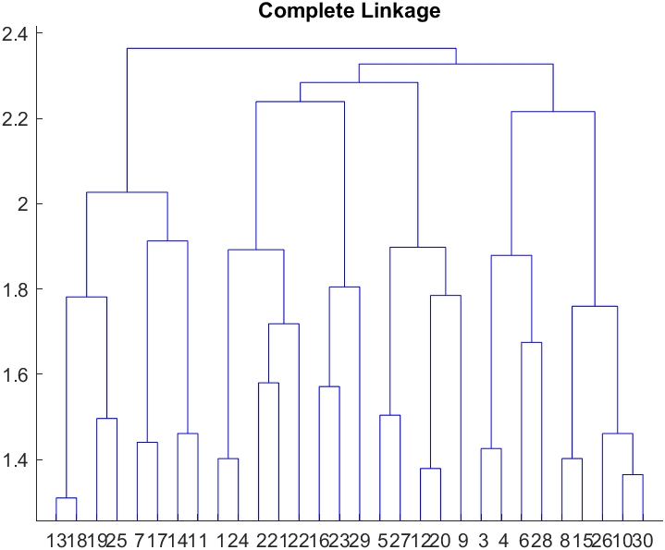
Choosing the number of clusters
A quick look at the heights of the fusion between the groups in the dendrogram obtained from hierarchically clustering the data with complete linkage suggest that a reasonable number for the clusters is 6.

Slide 7
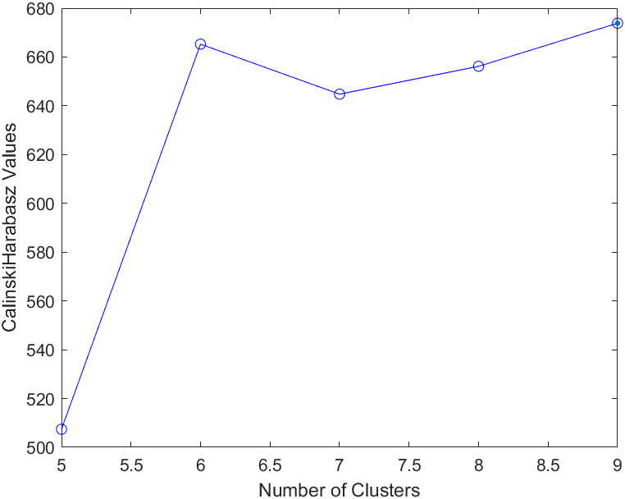
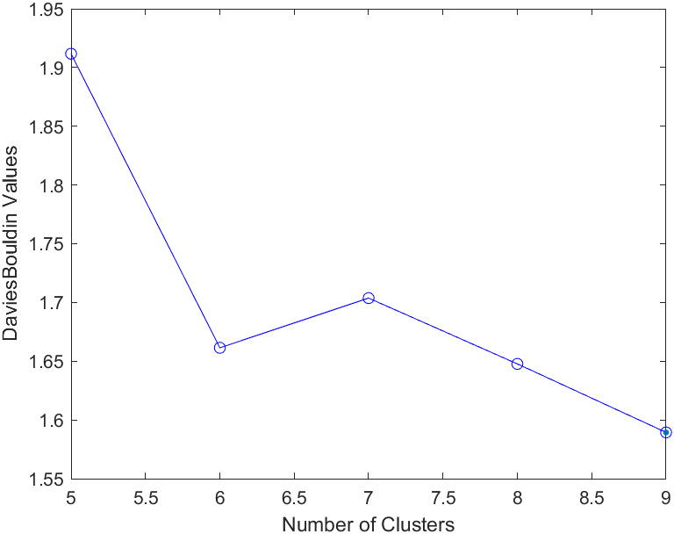
Choosing the number of clusters
Internal clustering validation measures, such as the Calinski-Harabasz index and the Davies-Bouldin index, also suggest that 6 is a sensible number of clusters.

Slide 8
from clusters to personas
To describe the clusters:
For categorical variables, we used the frequency tables to identify the most occuring class in each cluster.
For numerical variables, we have associated a group to each numeric range and used the mean to identify the group for the single cluster.
Range | Group
0-0,25 | Low
0,25-0,4 | Below average
0,4-0,6 | Average
0,6-0,75 | Above average
0,75-1 | High

Slide 9
Numerical Feature | Cluster 1 (19,48%)
Income | Average
Wealth | Average
Debt | Below Average
Financial Education | Average
ESG propensity | Average
Digital propensity | Average
Bank Friendliness | Above average
Lifestyle index | Below average
Luxury spending | Below average
Saving propensity | Average
PEOPLE FROM SMALL CITIES IN THE NORTH
In the first cluster we can find workers from small cities in the north of Italy.
Their general lifestyle is below the average and they are interested both in capital accumulation and lump sum kind of investments.
Service model:
- physical
- call center

Slide 10
Numerical Feature | Cluster 2 (31%)
Income | Above average
Wealth | Above average
Debt | Average
Financial Education | Average
ESG propensity | Above average
Digital propensity | Average
Bank friendliness | Above average
Lifestyle index | Average
Luxury spending | Average
Saving propensity | Average
EMPLOYEES FROM THE NORTH
In this second cluster we find a huge category of employees from the north of Italy, most of them located in medium size cities, but there are also some of them who live in big cities.
They are interested mainly in capital accumulation type of investment and, as we can see in the table, they present an overall good income and financial wealth with respect to the average client.
Service model:
- digital
- Physical and call center

Slide 11
Numerical Feature | Cluster 3 (2,94%)
Income | Above average
Wealth | Above average
Debt | Average
Financial Education | Average
ESG propensity | Average
Digital propensity | Average
Bank Friendliness | Above average
Lifestyle index | Average
Luxury spending | Average
Saving propensity | Average
WEALTHY PEOPLE FROM THE SOUTH
OR THE ISLANDS
This third cluster is the smallest we have, it cointains all people from big or medium size cities located in the south of the country or in the islands.
They are all interested in a capital accumulation type of investment and they present a good level of financial wealth.
Service model:
- digital
- Physical and call center

Slide 12
Numerical Feature | Cluster 4 (8,70%)
Income | Average
Wealth | Above average
Debt | Below average
Financial Education | Average
ESG propensity | Average
Digital propensity | Average
Bank Friendliness | Above average
Lifestyle index | Average
Luxury spending | Average
Saving propensity | Average
EMPLOYEES FROM THE CENTER
The fourth cluster contains employees, but also a discrete percentage of retired, all from small cities in the center of Italy.
Most of them is interested in a capital accumulation kind of investment and some of them is not interested in investing at all.
Service model:
- physical and call center

Slide 13
WEALTHY PEOPLE FROM BIG CITIES IN THE NORTH
Numerical Feature | Cluster 5 (13,74%)
Income | Above average
Wealth | Above average
Debt | Below average
Financial Education | Average
ESG propensity | Above average
Digital propensity | Above average
Bank Friendliness | Above average
Lifestyle index | Average
Luxury spending | Average
Saving propensity | Average
In the fifth cluster we can find people who are generally richer than the average client, they are all from the north of Italy and they live in big cities.
Moreover they are all only interested in a lump sum kind of investments.
We can also notice that they have a higher digital propensity and eco-sustainable interest than the average.
Service model:
Digital
Physical

Slide 14
The last cluster contains a group of people who is not interested in any type of investment.
They are mainly located in the north of Italy, but we can see that they have a lower lifestyle, luxury spendings and debt with respect to the average client.
Numerical Feature | Cluster 6 (24,06%)
Income | Average
Wealth | Average
Debt | Below average
Financial Education | Average
ESG propensity | Average
Digital propensity | Average
Bank Friendliness | Above average
Lifestyle index | Below average
Luxury spending | Below average
Saving propensity | Average
NOT INVESTORS
Service model:
- physical
- physical and call center

Slide 15
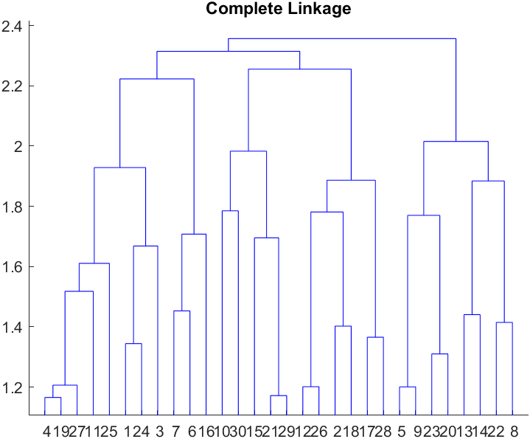

issues
The main problem we encountered concerns the scalability of the hierarchical clustering algorithm: in fact, after the identification of a linkage criteria using a subsample, the changing of the number of observations to cluster in the dataset changed considerably the optimal number of clusters and their composition.
This high variability of the results based on the dataset size seems to suggest that the hierarchical clustering algorithm does not work well with large datasets.
n= 1950
n= 5000
15

Slide 16
issues
conclusions
Other possible issues/doubts concern the arbitrary decisions we made:
both in the choice of distance metric and in the choice of linkage criteria we used the cophenetic coefficient. According to this coefficient the distance metric and the linkage we used are not the best choice, but after some results analysis we found out that they perform better than the ones suggested by the coefficient. Therefore our choice was in some sense arbitrary.
subsequently we analyzed the best number of clusters using the dendrogram and some internal clustering validation measures, and in the end we inspected the clusters to obtain the best partition in terms of business interpretability, but we did not find out strong discrimination between the groups, as one could have expected at the beginning, indeed the identification of the personas was difficult.
In conclusion there isn't any strong theoretical basis for such decisions, but we based them on several guesses and attempts and this makes the results of dubious significance.
16

