Slide 1



MASTER’S DEGREE IN MATHEMATICAL ENGINEERING
IMPLEMENTATION OF AN AGENT-BASED RECOMMENDATION SYSTEM USING TIME-VARIANT MARKOV CHAINS:
Investor Personas Forecasting
with a Business Case Application
AUTHOR: Lorenzo Grossi
ADVISOR: Prof. Daniele Marazzina
CO-ADVISOR: Prof. Raffaele Zenti
October 10, 2024

Slide 2

CONTENT
01
CONTEXT AND MOTIVATIONS
02
THE PROCESS
03
DATA AND RECOMMENDATION SYSTEM
04
MODEL ALGORITHM
05
MODEL OUTCOME
06
MODEL RESULTS
07
BUSINESS PROPOSAL
08
DISCUSSIONS
09
CONCLUSION
0

Slide 3
CONTEXT AND MOTIVATIONS:
The revolution in investors world
Demographic changes
A population older than ever that requires tailored products
1

Slide 4
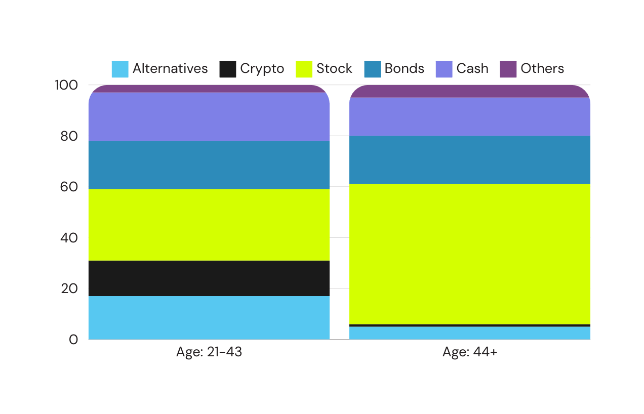
CONTEXT AND MOTIVATIONS:
The revolution in investors world
Demographic changes
A population older than ever that requires tailored products
Investment preferences evolution
Significant differences in the financial products preferred by younger versus older generations
Different investments strategies between different generations (percentages)
Credits: BofA, 2024
1

Slide 5


CONTEXT AND MOTIVATIONS:
The revolution in investors world
Demographic changes
Need to forecast: the necessity to predict client behavior and adapt strategies in advance, for which an Agent-Based Model
is ideal, as it can distinguish personas and their needs, and anticipate how preferences and quantities will evolve over time
A population older than ever that requires tailored products
Investment preferences evolution
Significant differences in the financial products preferred by younger versus older generations
1

Slide 6

THE PROCESS
Estimation of Markov Chains throught Monte Carlo simulations (incorporating probabilities for a client to change cluster)
Recommendation system for current clients
(clustering and product suggestions)
Simulation of client evolution over future years
Extrapolation of distributional results from the chains and derivation of data-driven solutions
STARTING POINT
GOAL
2

Slide 7
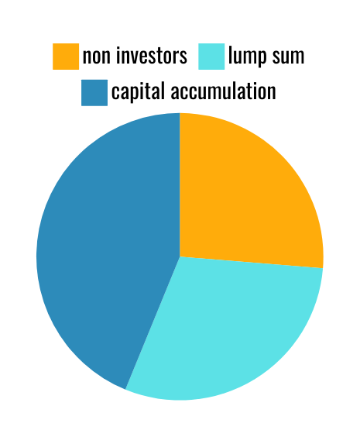
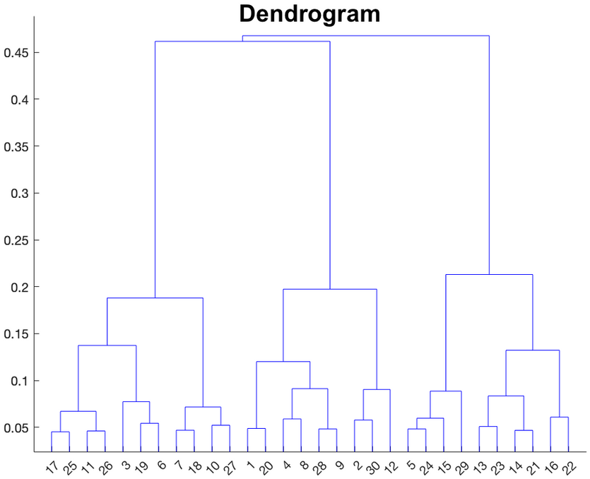
DATA AND RECOMMENDATION SYSTEM
“Data-driven customer segmentation: A needs-based cluster analysis for optimizing financial product recommendations”
V. Lucchetti, 2024
DATASET PRESENTATION
CLUSTER ANALYSIS
5000 clients from an Italian Bank
Numerical Variables (Income, Wealth, ESG...)
Categorical Variables (Job, City Size, Investor Type...)
Definition of a distance metric combining numerical and categorical features (with a significant weight given to investor type dissimilarity)
Hierarchical structure
Identification of 6 clusters as the optimal solution
STRATEGY N°3
STRATEGY N°3
3

Slide 8
DATA AND RECOMMENDATION SYSTEM
“Data-driven customer segmentation: A needs-based cluster analysis for optimizing financial product recommendations”
V. Lucchetti, 2024
PERSONAS IDENTIFICATION AND PRODUCTS SUGGESTED
02
A Persona is a prototype that groups clients with similar needs and, in our case, is represented by a cluster.
The prototypes obtained with the product suggested are strongly connected to the investor type, and will be identified with it:
Old, capital accumulation | Income Conservative Unit-Linked
2. Young, capital accumulation | Balanced High Dividend Mutual Fund
3. Old, lump sum | Defensive Flexible Allocation Unit-Linked
4. Young, lump sum | Balanced Flexible Allocation Unit-Linked
5. Old, non-investors | -
6. Young, non-investors | -
STRATEGY N°3
3

Slide 9
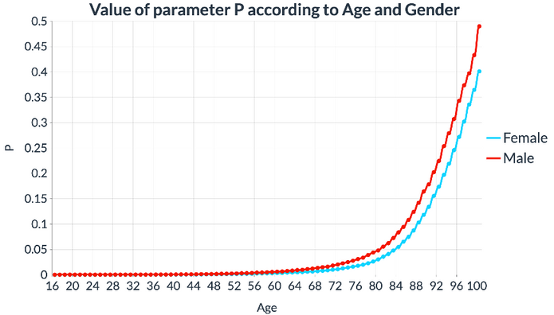
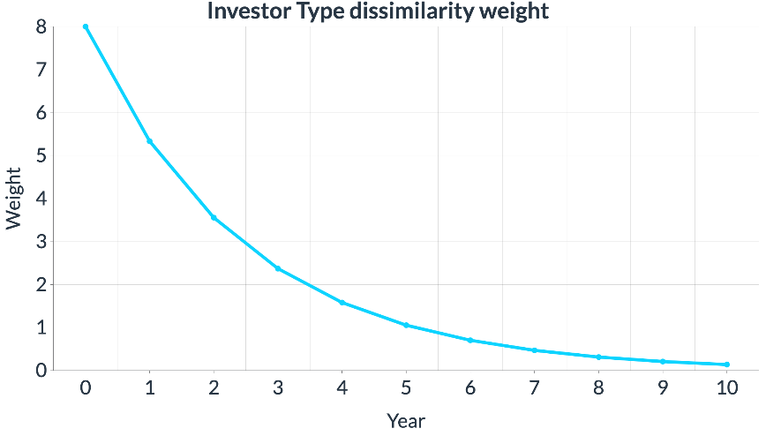
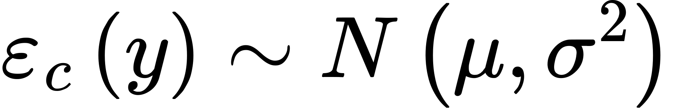
MODEL ALGORITHM
1. Death simulation
10 years; each year y, for each client c alive:
3. New Cluster computation
The client's death or survival is simulated using a Bernoulli random variable, where the parameter p depends on age and gender.
The client is assigned to the cluster with the nearest center. In computing the distance, the weight assigned to investor type dissimilarity depends on the year being considered (as shown below).
2. Features evolution
The client’s features evolve based on the selected version; numerical features are perturbed by adding Gaussian noise, while categorical features remain constant.
Remy Marsh
Ceo Of Ingoude Company
4. Addition to the clientbase
200 clients are added to the current clientbase from a storage
4

Slide 10


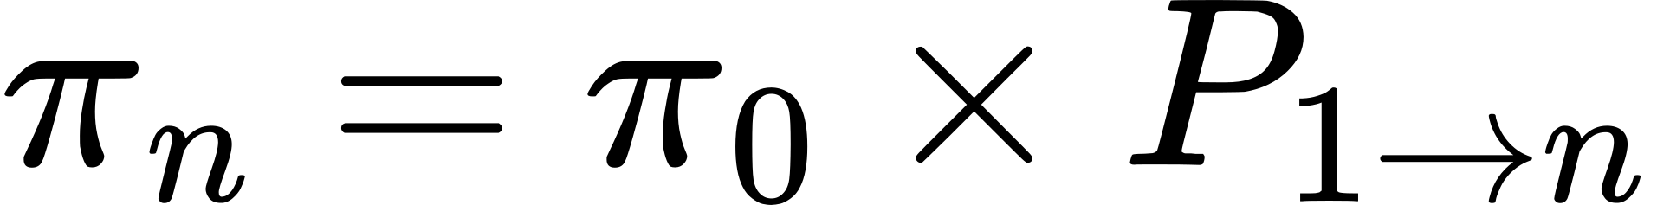



MODEL OUTCOME
Time-Variant Markov Chains: an overview
What we have obtained from the Monte Carlo simulations is a discrete time-variant Markov Chain.
A time-variant Markov Chain is represented by a transition matrix , where the transition probabilities of moving from state i to state j between year y-1 and year y depend on y.
Specifically, an n-year transition matrix can be obtained from the single-year transition matrices as follows:
The distribution of clients across clusters at year n can then be estimated (given the initial distribution
at year 0) through:
5

Slide 11

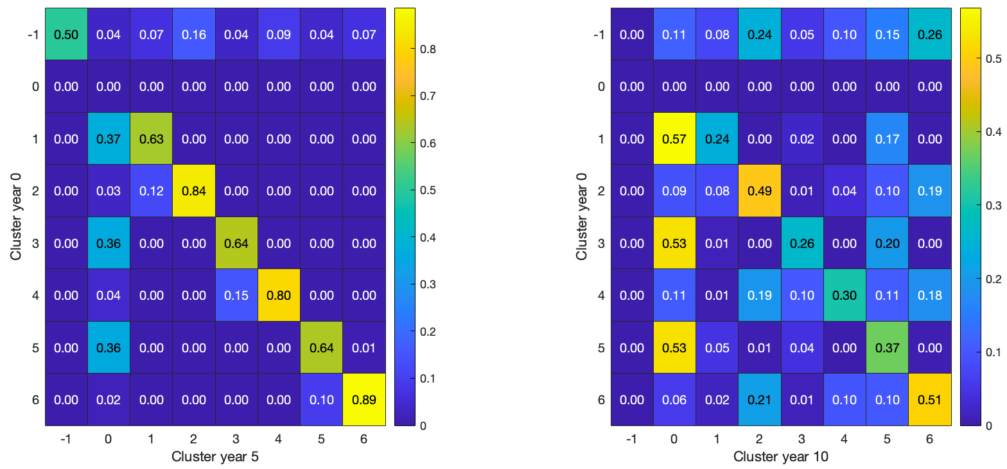

MODEL OUTCOME
Transition matrices obtained from the Monte Carlo simulation (first version)
5

Slide 12
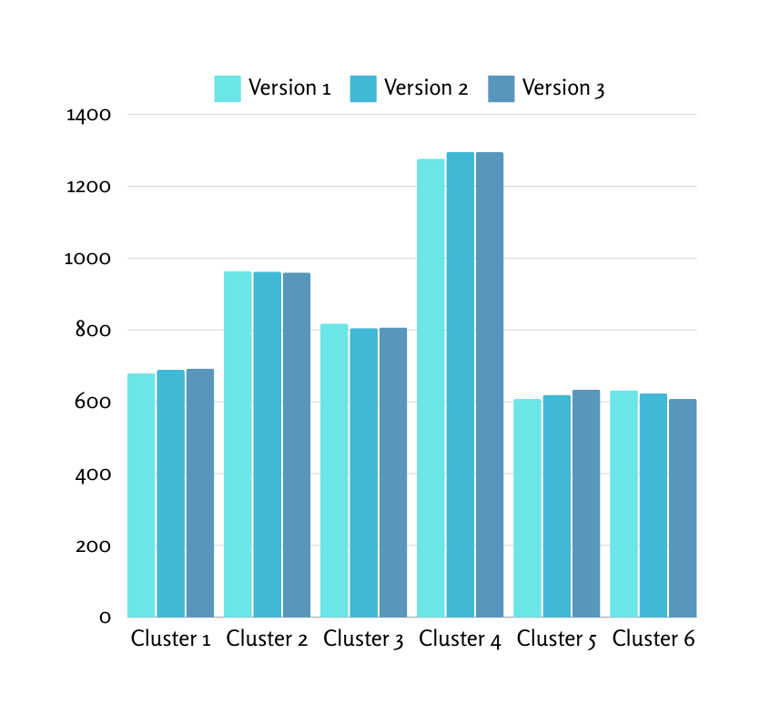
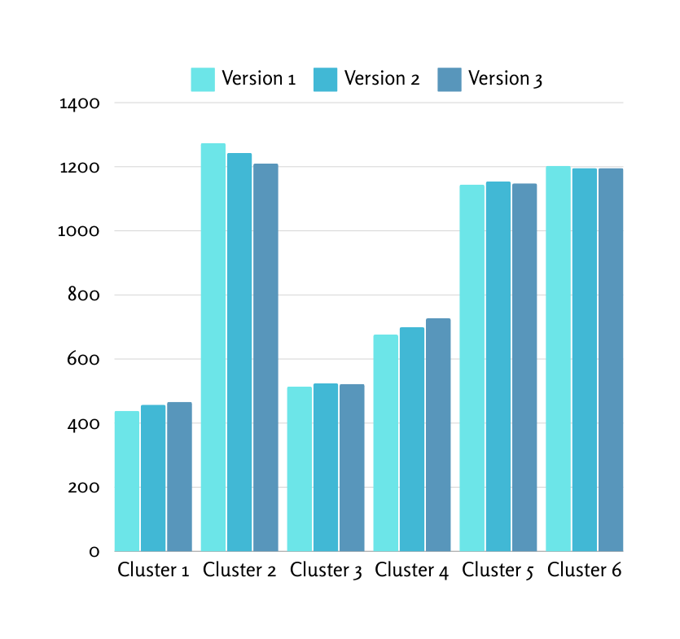
MODEL OUTCOME
Client distribution after 5 years and after 10 years according to the three different versions
5

Slide 13
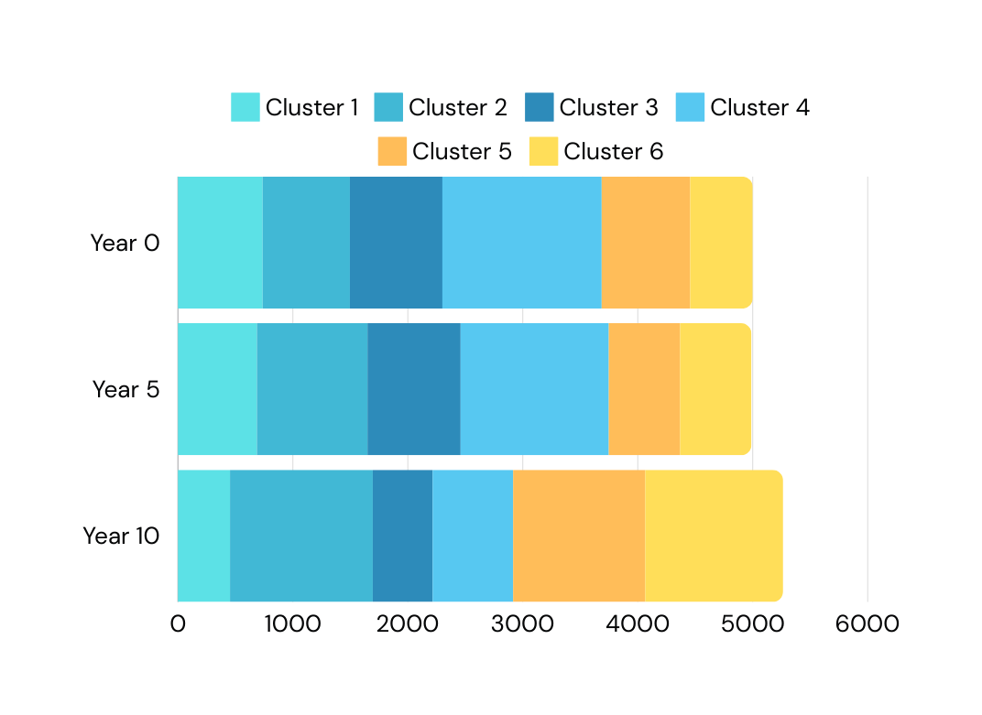
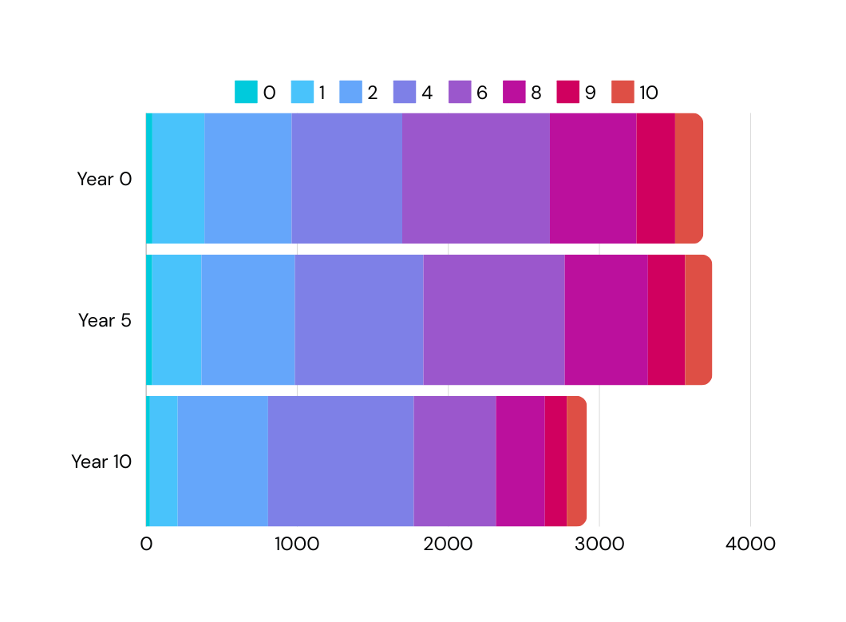
MODEL RESULTS
Estimate of clients distribution in financial clusters over years
Projected product sales based on the original recommendation system
Product ID
Number of clients
Number of products
There is a projected decrease in investors and an increase in non-investors
6

Slide 14
Investors Clusters (1 to 4)
The suggested financial products are the same as those in the original recommendation system, leading to a decrease in the predicted total units sold.
BUSINESS PROPOSAL
7

Slide 15
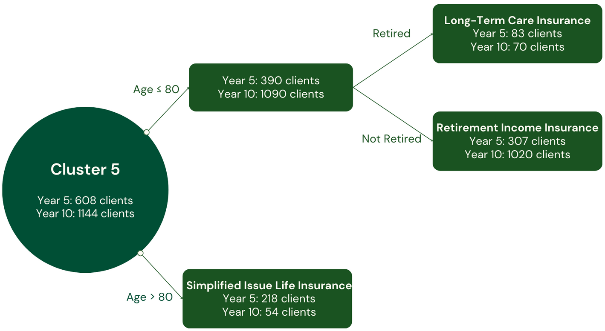
Investors Clusters (1 to 4)
Non investors Clusters (5 and 6)
The suggested financial products are the same as those in the original recommendation system, leading to a decrease in the predicted total units sold.
The idea is to find insurance products, particularly tailored to a subcluster identified through a decision tree-like division of each cluster. For example, the suggestions for cluster 5 are reported below:
BUSINESS PROPOSAL
7

Slide 16
Investors Clusters (1 to 4)
Non investors Clusters (5 and 6)
The suggested financial products are the same as those in the original recommendation system, leading to a decrease in the predicted total units sold.
The idea is to find insurance products, particularly tailored to a subcluster identified through a decision tree-like division of each cluster. For example, the suggestions for cluster 5 are reported below:
FINAL ESTIMATE
Assuming 40% of non investor clients purchase the insurance products suggested for their subcluster, the final estimate of total units sold across all clusters leads to an increase of 15.1% in units at year 5 compared to year 0, and 4.6% at year 10.
BUSINESS PROPOSAL
7

Slide 17

DISCUSSIONS
Primary takeaway: Agent-based models offer significant potential and flexibility, which has only been minimally explored so far:
These models can be utilized to solve real-world problems and contribute to the development of operational strategies across various fields (e.g., from patient health issues to client profiling and student classifications).
There is a need for a reliable dataset, a clear definition and profiling of personas, and a deeper understanding of how to model future evolutions effectively.
The flexibility in modeling these evolutions is vast: gathering more information on trends and past events can prove invaluable in building realistic future scenarios.
Continuous-time Markov Chains have proven to be a crucial tool for modeling different dynamics occurring over time in various periods.
8

Slide 18
CONCLUSION
Starting from the revolutionary challenges presented in the Introduction, we have developed a method to address the construction of plausible future scenarios for client behavior.
This includes presenting outcomes (e.g., the increase in non-investors and the decrease in investors) and offering a concrete approach to managing these changes.
We have created a flexible system that, in synergy with expert insights and intuition, can serve as a critical tool for industries to navigate shifts and plan for the future.
We strongly believe that our model can provide valuable insights and practical recommendations within the complex and expansive field of agent-based modeling, where forecasting represents a captivating and significant challenge.
9

Slide 19
BACKUP SLIDES

Slide 20
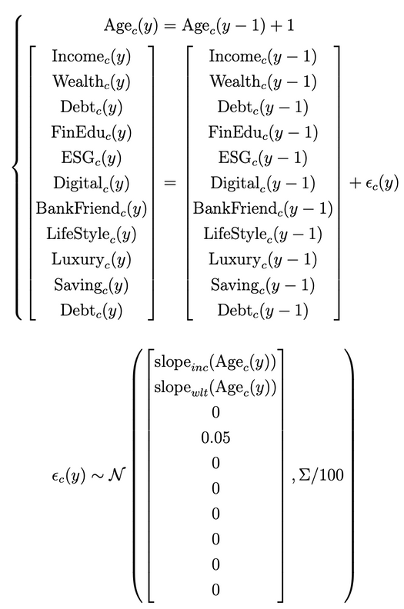

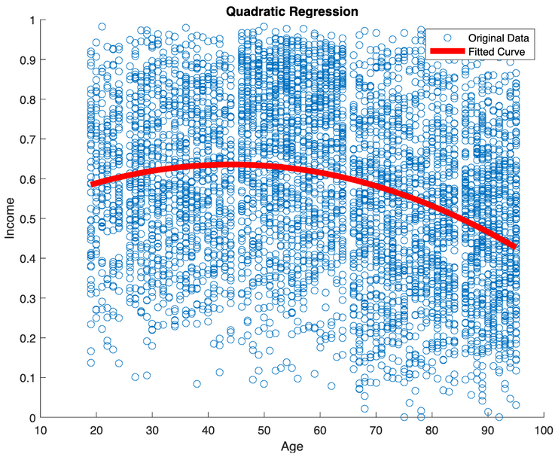
FEATURES EVOLUTION
Version 3:
numerical features variations
Version 1: deterministic
Version 2: income variation
Fully deterministic model, without any randomness:
Categorical variables remain unchanged;
Numerical variables remain unchanged;
Age is incremented by 1 each year.
In formulas:
All variables are the same as in the previous version, with the only difference being that income is perturbed by Gaussian noise, with a mean given by the slope of the quadratic regression curve at the client's age. In formulas:
In this model, all numerical variables are perturbed by Gaussian noise as follows:
Remy Marsh
Ceo Of Ingoude Company

Slide 21
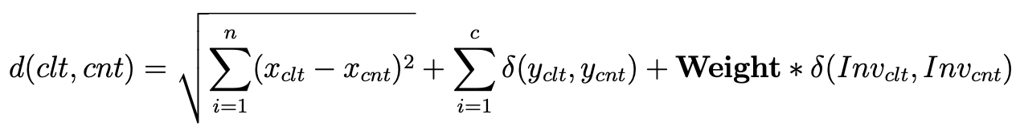
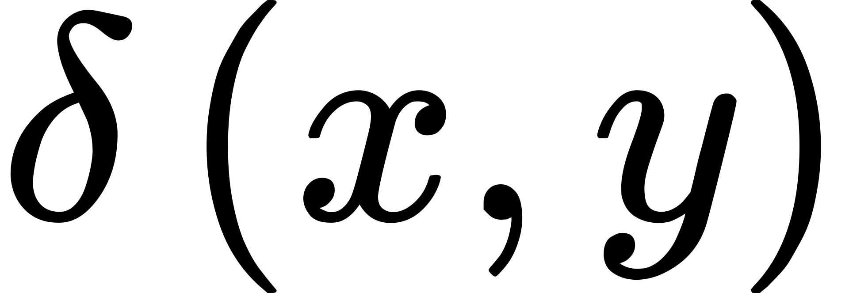


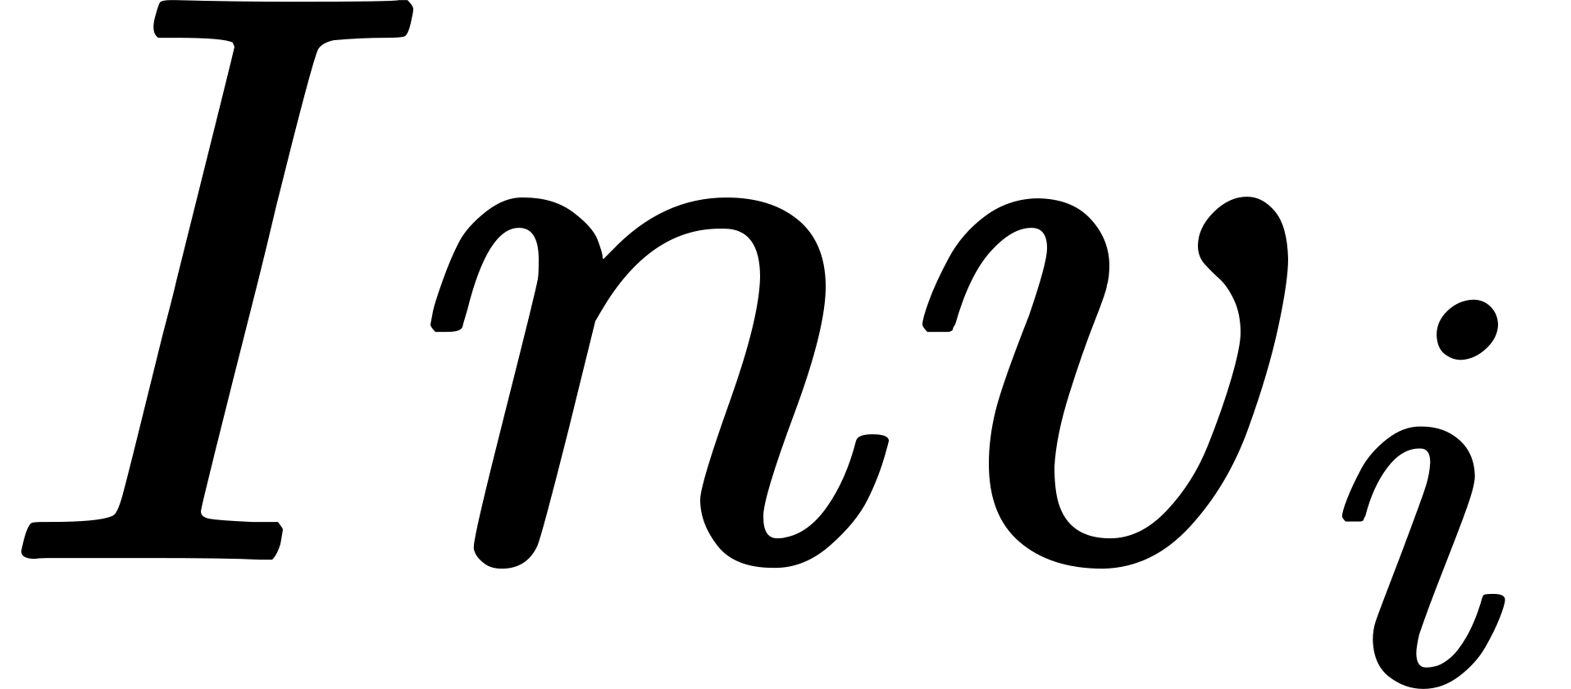
VANISHING INVESTOR COEFFICIENT
The concept consistently applied across all three models is the so-called "Vanishing Investor Coefficient," which refers to the diminishing importance over time of the Investor Type at year 0.
To understand this concept, we need to recall how the distance of a client from a cluster center is computed. Each client’s clt distance from a cluster center cnt is computed using a Mixed Distance, which is:
Where is the Kronecker delta function, is one of the n numerical features of the client/center i, is one of the c categorical features, is the Investor Type (Lump Sum, Capital, or non-investor), and Weight is the Investor Coefficient.
To model the diminishing importance, less weight is given to the dissimilarity of the Investor Type, as shown in the figure below. The rationale is that the Investor Type at year 0 gradually loses relevance over time, and reducing its impact each year reflects this idea: initially, its influence is significant, but by the end, it becomes almost negligible.

Slide 22
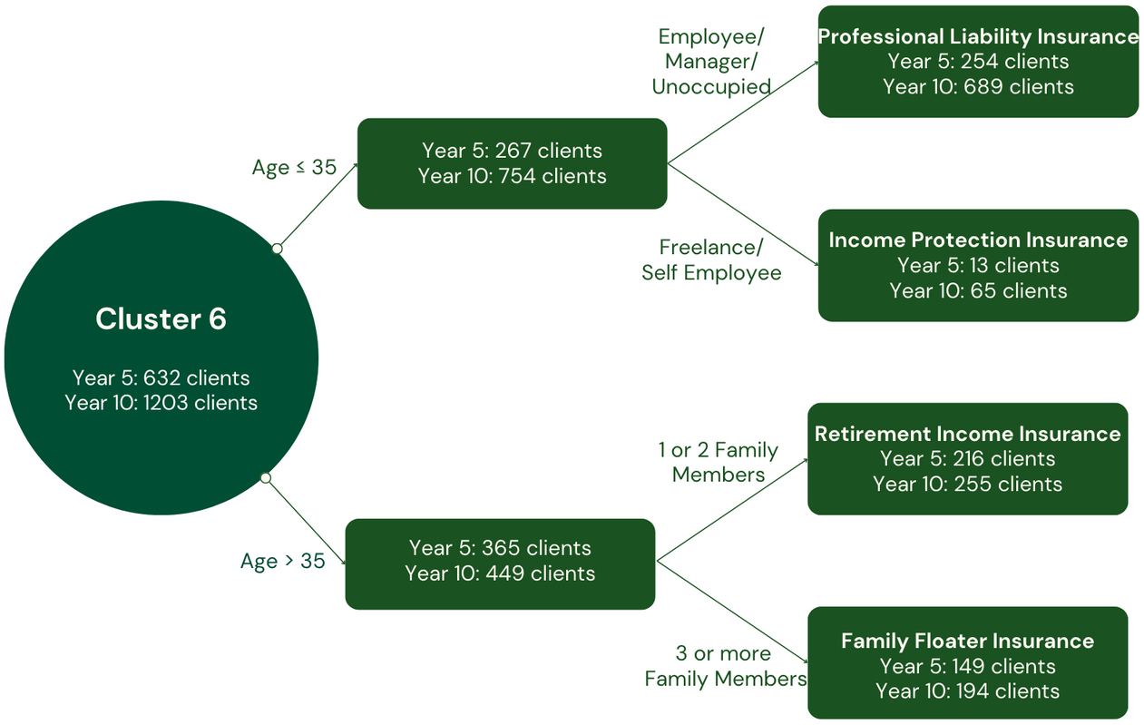
Investors Clusters (1 to 4)
Non investors Clusters (5 and 6)
The suggested financial products are the same as those in the original recommendation system, leading to a decrease in the predicted total units sold.
The idea is to find insurance products, particularly tailored to a subcluster identified through a decision tree-like division of each cluster. For example, the suggestions for cluster 6 are reported below:
FINAL ESTIMATE
Assuming 40% of non investor clients purchase the insurance products suggested for their subcluster, the final estimate of total units sold across all clusters leads to an increase of 15.1% in units at year 5 compared to year 0, and 4.6% at year 10.
BUSINESS PROPOSAL
7

