Slide 1
HomeBites
Home-cooking Made Easy

Slide 2
Problem
With the increasing amount of fast food being made more available with the introduction of food delivery services such as Deliveroo and UberEats, home-cooking is slowly dying down. Because of this increase of big chain marketing the local community end up investing most if not all their money to big companies.

Slide 3
Solution
HomeBites is a quick and simple way for anyone to order home-cooked food from one of our many cooks that have registered to the website. All the cooks are locals that want to help contribute to the community by either providing a healthy alternative or a delicious meal for the user or their family.

Slide 4
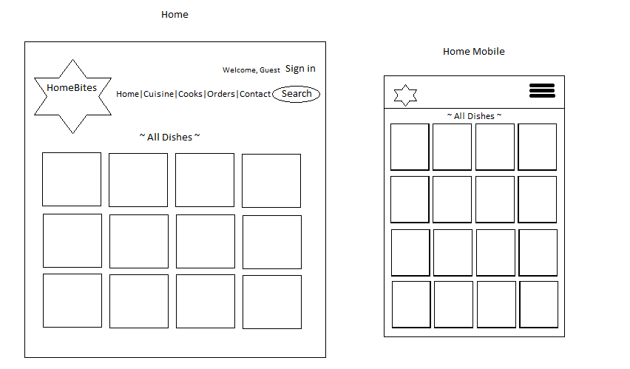
Wireframe

Slide 5
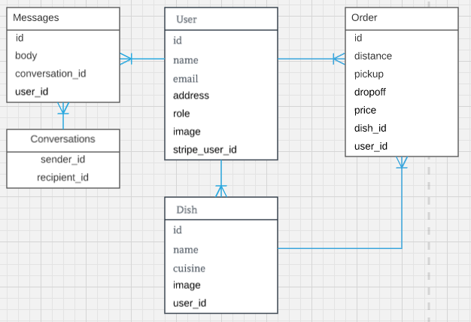
ERD

Slide 6
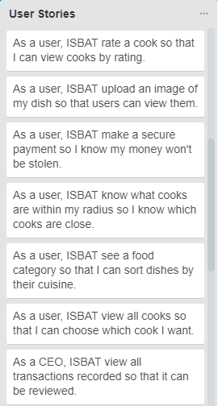
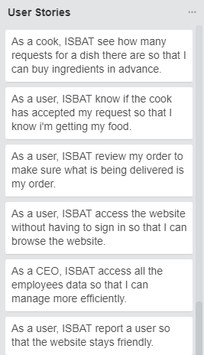
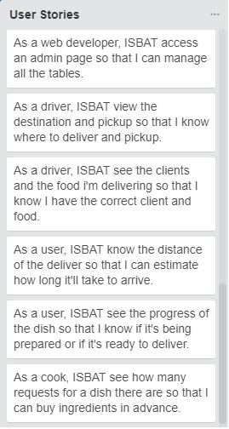
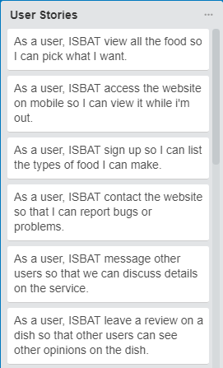
User Stories

Slide 7
Thank You Any questions?

