Slide 1
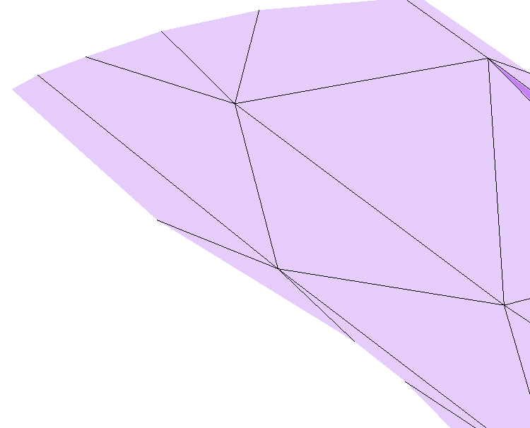

z
3. Projected starting point
1. Starting point
MDT
y
$$σ_{3}$$
4. modSPdiff
2. Point b
x

