Slide 1

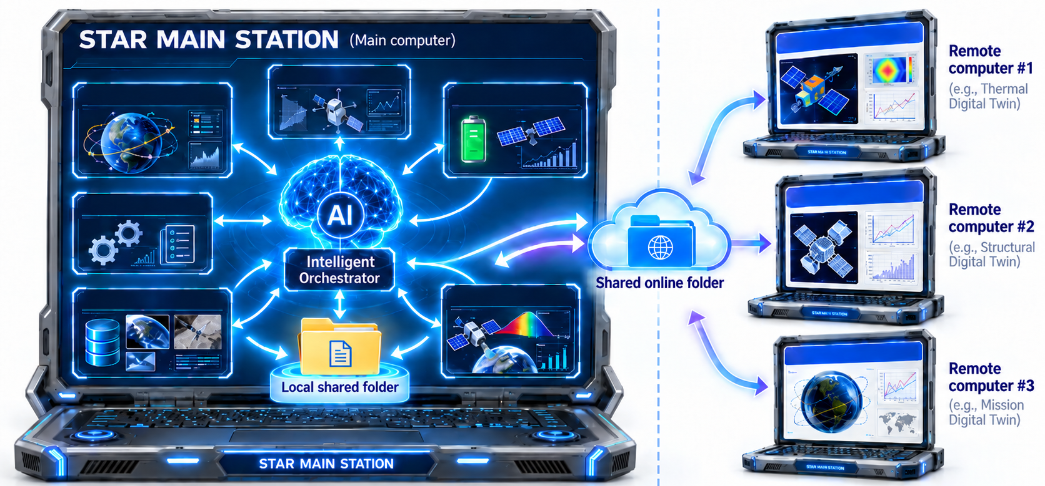
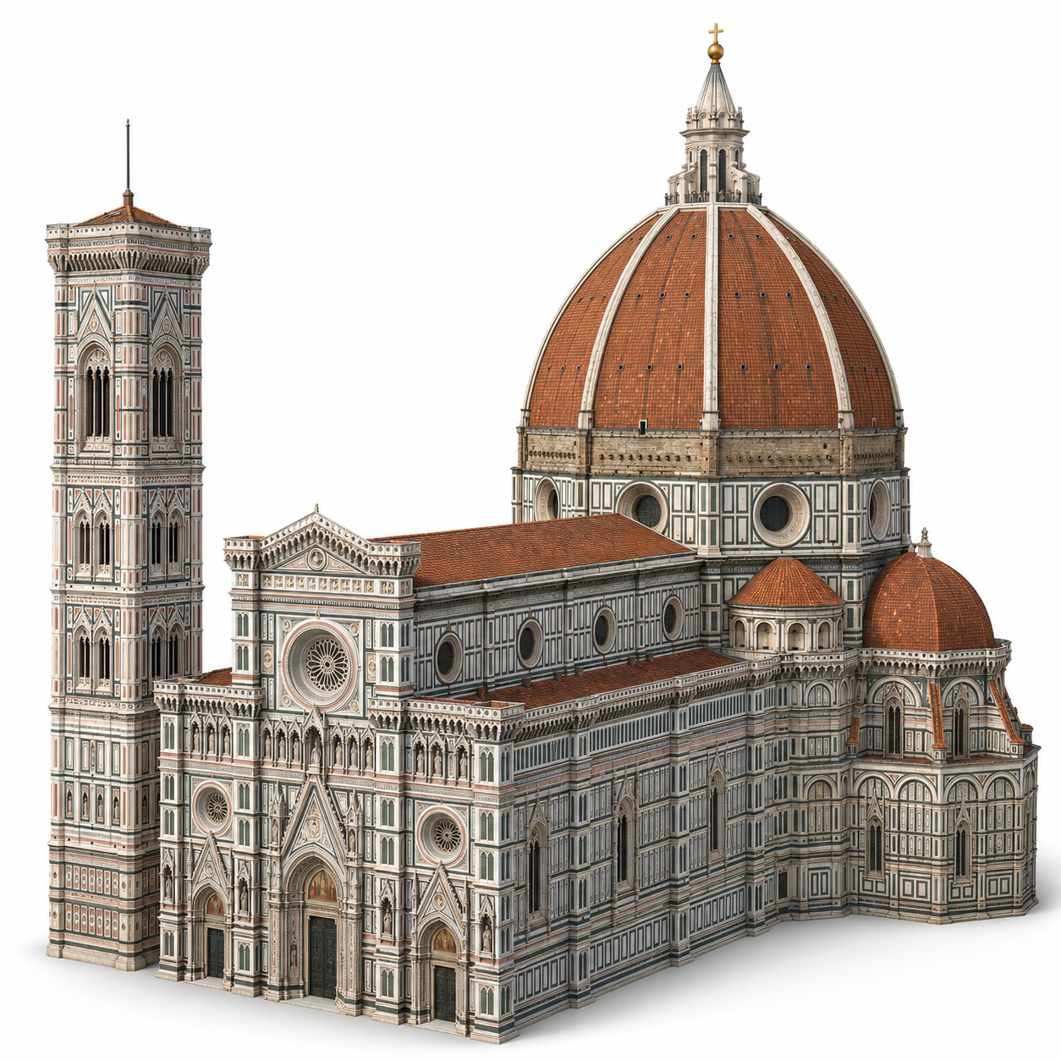
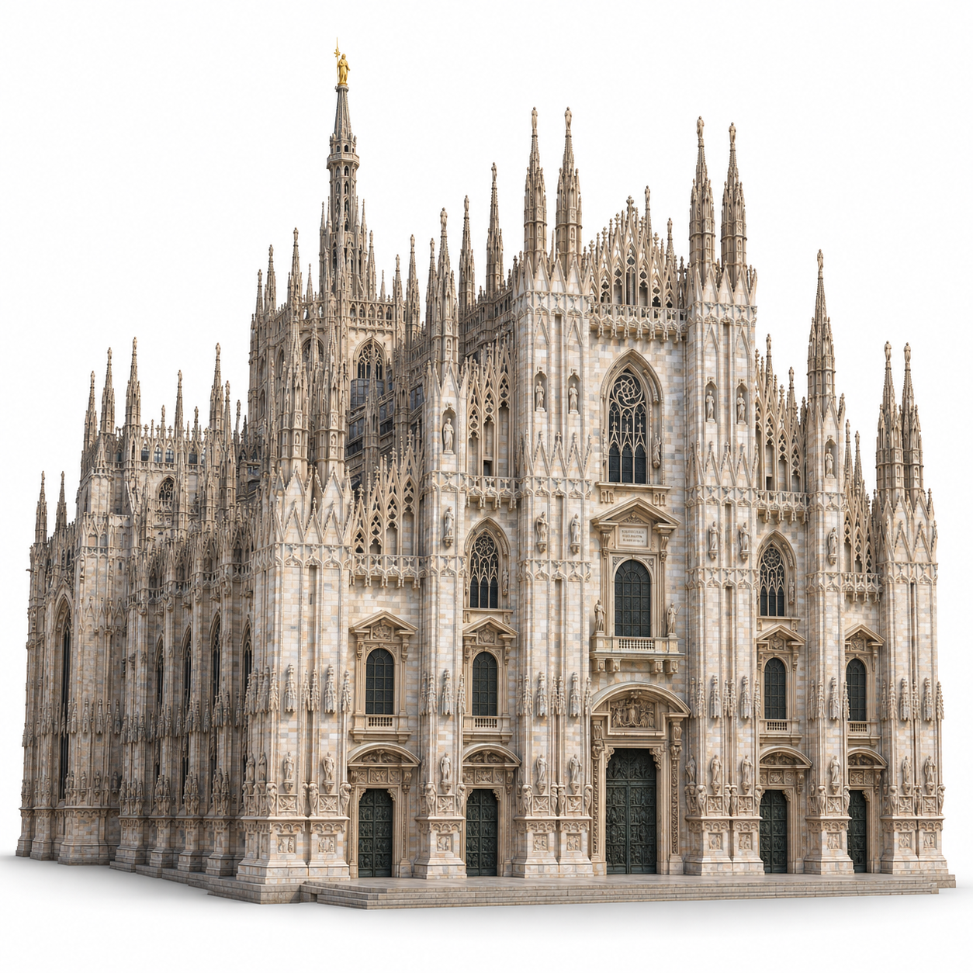
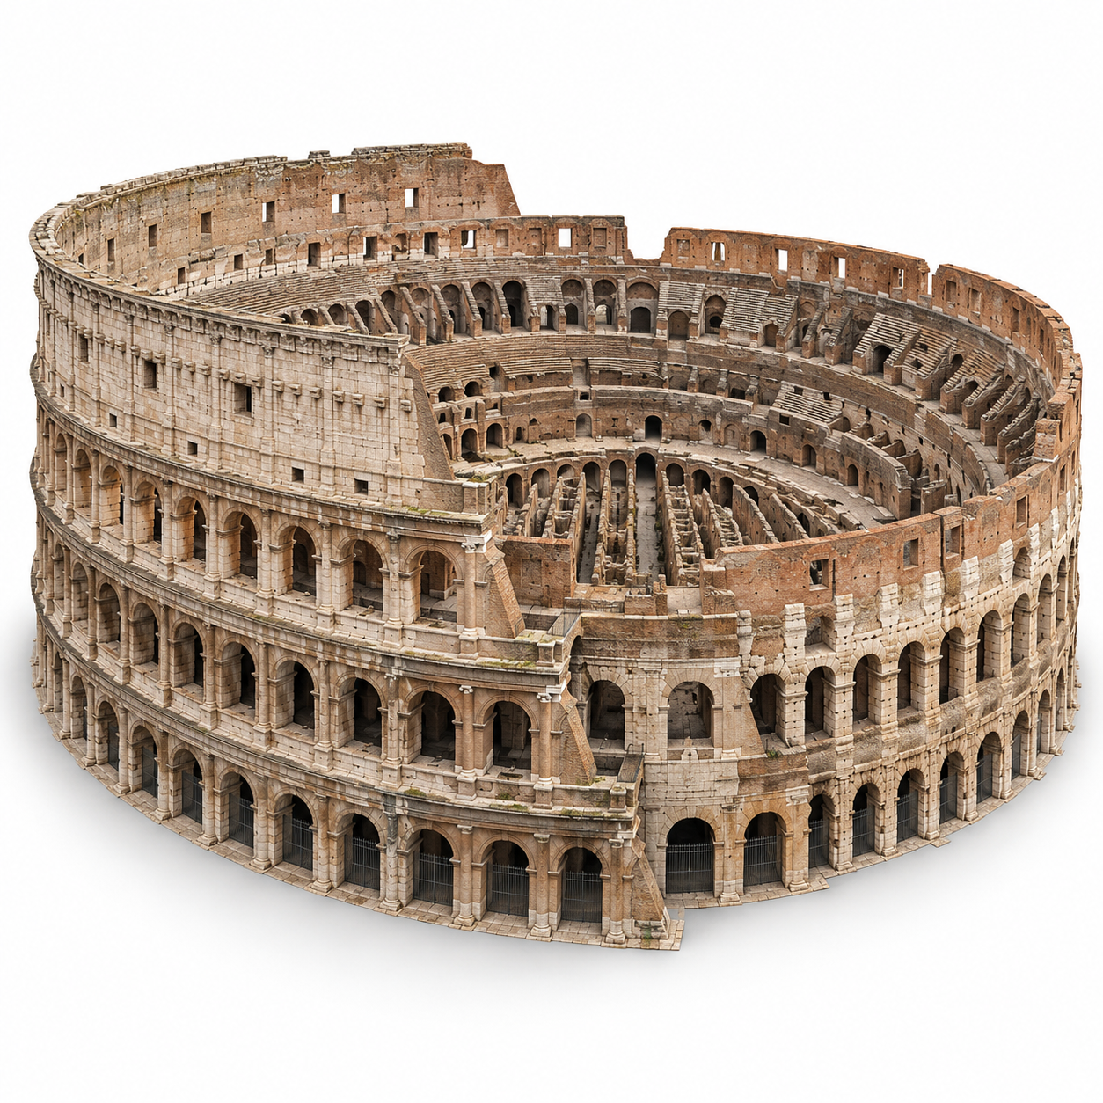
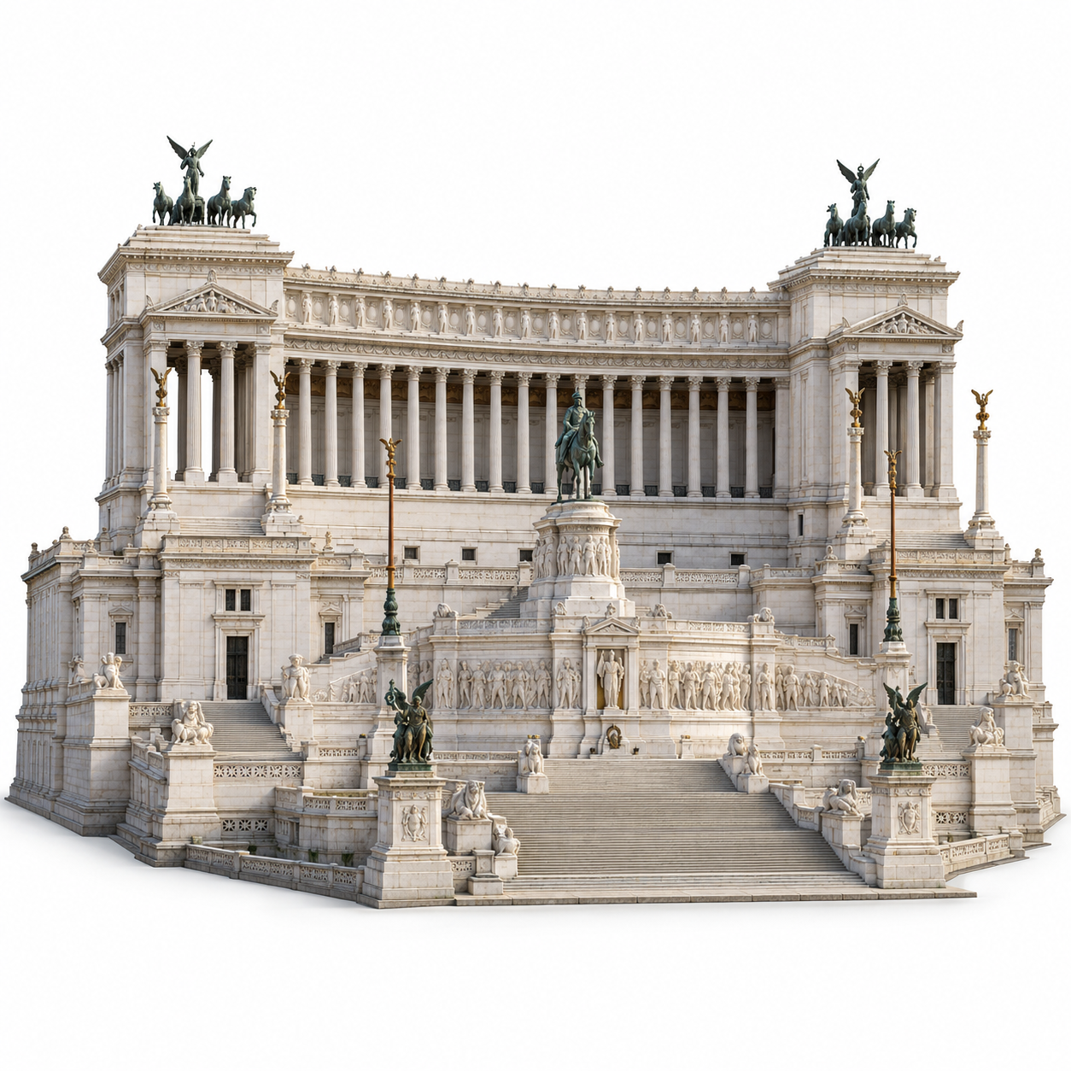
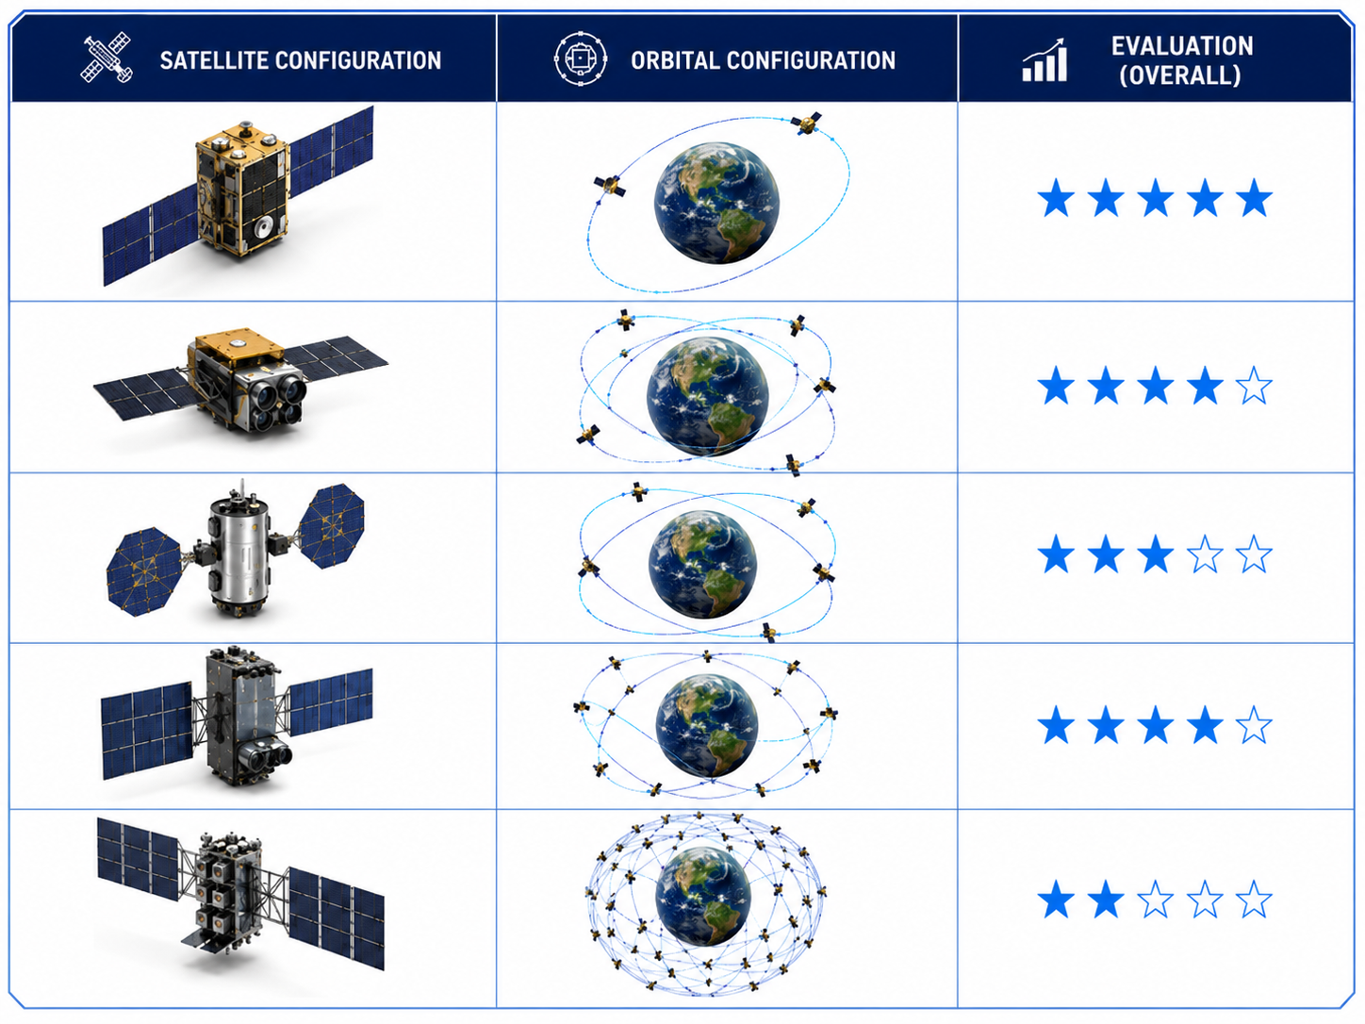

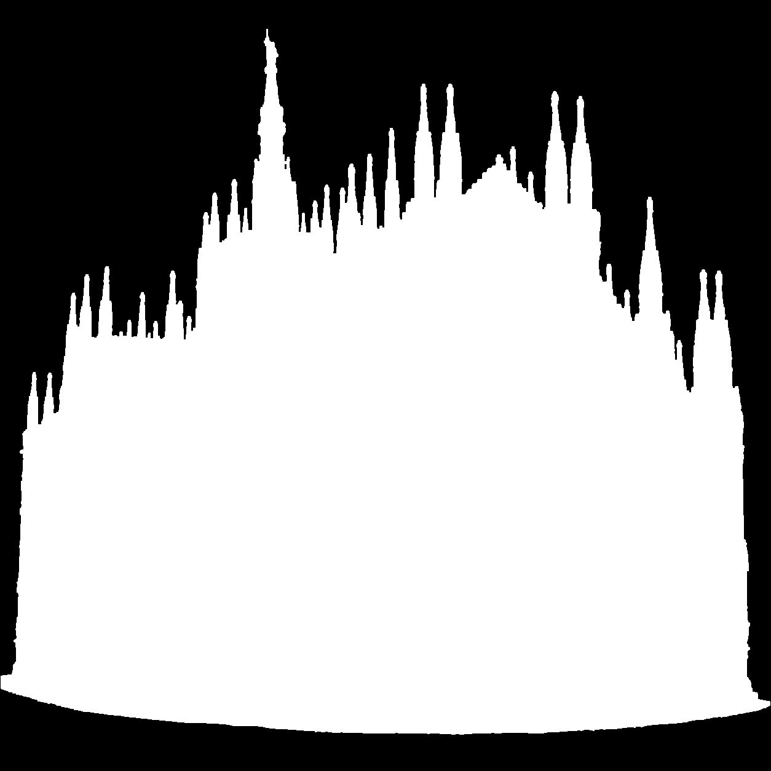




Earth Observation services for the preservation and risk assessment of major Italian cultural heritage sites and monuments.
Compliance with the Italian Space law (Space segment designed to minimize its luminous impact on the night sky, Space-debris conjunction monitoring and warning capability).
KPIs evaluation example
Selected configurations example
CAD
MASK
% IN THE IMAGE | 15% | 10% | 2% | 5%
VISIBLE
MONUMENTS SEEN |  | 3/4

Slide 2
