Slide 1


Mhlathuze Industrial Suppliers and Services cc
Vendor Order Management System
Developed by Normalisers42

Slide 2

Normalisers42
Founded in 2019
Situated in
6 team members
No | Student Number | Name and Surname | Role | Email
1 | 217037162 | Lorenzo Munisami | Project Manager Lead Developer | munisamilorenzo@gmail.com
2 | 217079609 | Sharad Singh | Business Analyst Developer
3 | 217027128 | Shankar Dayal | Lead Analyst Developer
4 | 217011174 | Praveer Ramphul | Communications Manager Human Resource Manager
5 | 217028569 | Yashin Soobramoney | Analyst Developer
6 | 217057571 | Warren Pillay | Developer Database Designer

Slide 3
M.I.S.S Background
Founded in 2004
Situated in Richards Bay
Mhlathuze Industrial Suppliers and Services cc (M.I.S.S) is a growing vendor company in the Central Business District of Richards Bay.
M.I.S.S supply corporate companies, such as Mondi and Foskor, with goods and services that are needed
E.g.) valves and actuators used to maintain factory plants, to water coolers that are used in their staff areas
They also advise buyers on the products that would best suit the application

Slide 4
How do they currently operate/What needs to be fixed?
M.I.S.S currently runs on a manual system in which everything is written, or printed, and filed.
Their current system is rather inefficient and time consuming when it comes to reviewing previously stored information.
Employees have to manually calculate quotation
This takes up valuable time that should have been used to grow their business in an effective manner

Slide 5
Business Process
The customer will request a quote for a product.
MISS will then search for a supplier that can supply the product, taking into consideration the price of the product, the location of the supplier, as well as the time that it will take to acquire the product from the said supplier.
The chosen supplier sends a quote (supplier quote) to MISS.
MISS will then use the supplier quote and create a final customer quote. To create the customer quote, the supplier price is used, a markup (core source of income) and VAT is added to it, and, dependent on the customer, a discount is included.
The quote (customer quote) is sent to the customer.
If the customer accepts the quote, an order is placed with the supplier.
The products will then be received from the supplier.
An invoice is created and is sent, along with the product, to the customer.
The development of the VOMS system will speed up processes as well as making it more reliable than a manual filing system. It will be easier to keep track of customer, supplier and product information while also being more secure than a manual filing system.

Slide 6
What did we Fix/Improve on our FES?
Improved Error checking drastically
Login now uses Customer Email and has a unique email validation (not id)
Improved Data Validation
Improved Help System

Slide 7
What did we Fix/Improve on our FES?
Added Default passwords for initial Web Login
Changed UI
Supplier Quotes are now able to be used in the Customer Quote Making Process

Slide 8
Crystal Reports
Total Cost Per Supplier
Total Sales Per Suburb
Employee Sales per product
Average acceptance time of quotes
Sales per products for a select month

Slide 9
Crystal Reports
Total Sales per Product
Amount of products sold per month (Last 12 months)
Amount of Products sold per employee per month (last 12 months)
Quotations per month
Total of Customer Orders

Slide 10
Web Design
Contains different Access to restricted and public pages
Website contains Reporting features available to manager
Also Used xHtml markup and CSS styling
Made Using VS 2010 with .net Framework

Slide 11
Web Design
Company Information + Contact Details
Fluid navigation
The website also contains a quote request Email Page
The Website functionality will include supplier manager, customer manager etc

Slide 12
Web Design
Access levels: manager employee customer public page
Manager will see reports and employee manager pages
Information about current events at the company
Social media pages

Slide 13
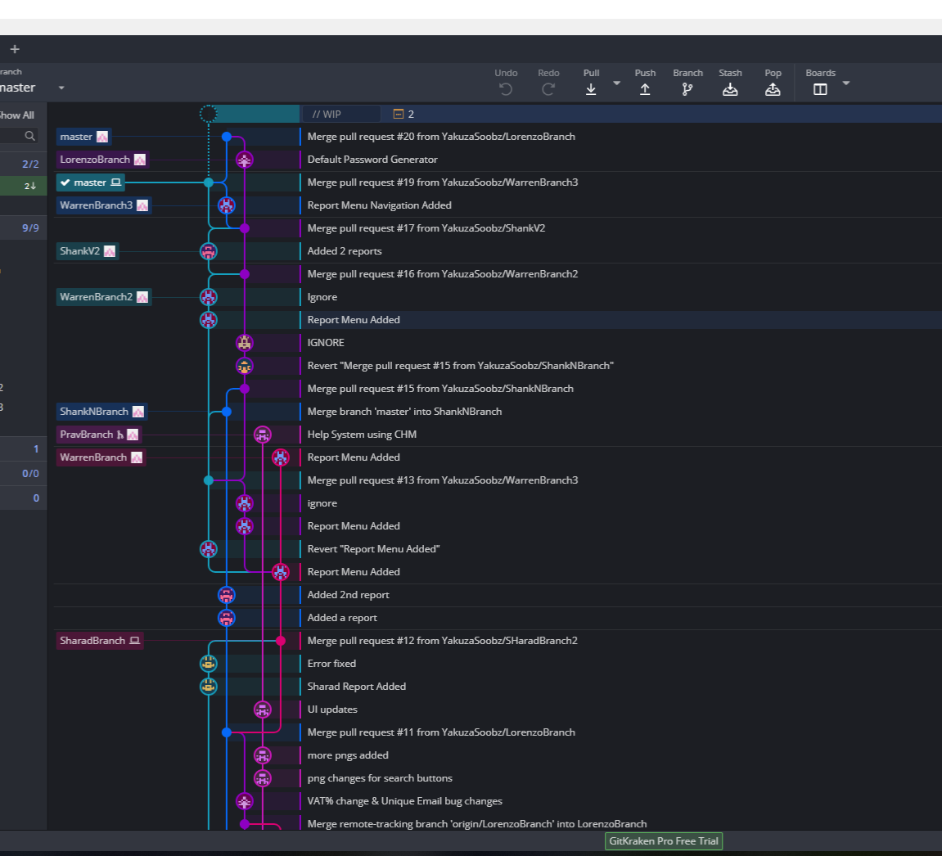
How did we achieve our goals
For source control we used Github with Gitkraken as our interface
This allowed us to achieve our goals whilst using the AGILE development
It allowed us to work in groups of two simultaneously on different aspects of the project
This was tied together using a VOIP to communicate at all times and allow for smooth work flow

