Slide 1

Long Term Planning Johannesburg Airport

Slide 2

Long Term Planning Johannesburg Airport
Flavio Aicardi Giovanni Lorenzo Napoleoni

Slide 3
1.
Introduzione

Slide 4
Data Analysis
Negli ultimi anni si è assistito ad una esplosione dei dati
Importanza di analizzare questi grandi dataset
Necessità di applicativi basati sul Data Analysis
Prendere decisioni in base all’analisi dati

Slide 5

Data Analysis Esempi
Analisi Social media
Fraud detection
Gestione Aeroporti

Slide 6
2.
Project Work

Slide 7
Long term plannig JNB
Lo scopo del project work è di fornire supporto nei processi decisionali dell’ allocamento futuro delle risorse dell’aeroporto.
Le decisioni devono essere prese in base alle previsioni di crescita/decrescita delle risorse dell’areoporto.
Aiutare nel processo decisionale mediante l’analisi dei data raccolti nei database dell’ente che gestisce l’aeroporto.

Slide 8
Gestione Aeroporti Previsioni
Flussi
Aeroportuali
Flussi
Passeggeri
Gestione Piazzole
Rifornimento

Slide 9
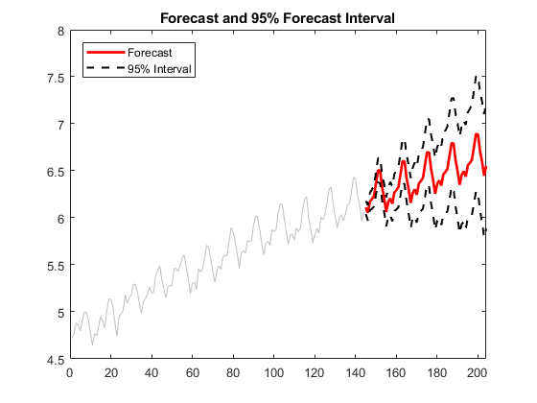
Obiettivo
Place your screenshot here

Slide 10
Fasi del project work
Interpretazione
DB
Estrazione
Serie Storiche
Analisi serie
storiche
Confronto
risultati
Analisi
DB
Cluster
Analysis
Definizioni
Nuove
Serie Storiche
Analisi serie
storiche

Slide 11
3.
Interpretazione DB

Slide 12
Interpretazione DB Data Mining
All’interno nel DB sono presenti le seguenti informazioni:
Informazioni dei voli arrivati e partiti
Informazioni sulle Rotte
Informazioni sui tipi di velivoli impiegati
Informazioni sulle compagnie aeree
???

Slide 13
Interpretazione DB Difficoltà
Nessuna documentazione presente
Più di (mettere numero) di tabelle
Difficoltà nel trovare le relazioni tra le tabelle
Capire quali dati devono essere esclusi

Slide 14
Interpretazione DB Difficoltà
45
45
Numero tabelle
Pesi in GB del db
185,244
Numero totale record
185,244
Numero totale voli

Slide 15
Inserire img
Relazioni DB

Slide 16
3.
Estrazione Serie Storiche

Slide 17
Estrazione Serie Storiche Data Cleaning
Per estrarre le serie storiche dal DB sono state utilizzate le categorie presenti sul sito ufficiale dell’aeroporto di JBN.
Le categorie dei voli sono state suddivise in:
Regionali
Domestici
Internazionali
Unscheduled

Slide 18
Estrazione Serie Storiche Data Cleaning
Dai dati sono stati eleminati tutti i record che presentavano dati sporchi o inconsistenti:
Rotte sconosciute
Categorie di voli non presenti
Voli militari ??
???

Slide 19
Estrazione Serie Storiche Correlazioni Sito Ufficiale
Tipo Voli | DB | Sito Ufficiale | Diff
Regionali | 10 | 20 | 7
Domestici | 30 | 15 | 10
Unscheduled | 5 | 24 | 16
Internazionali

Slide 20
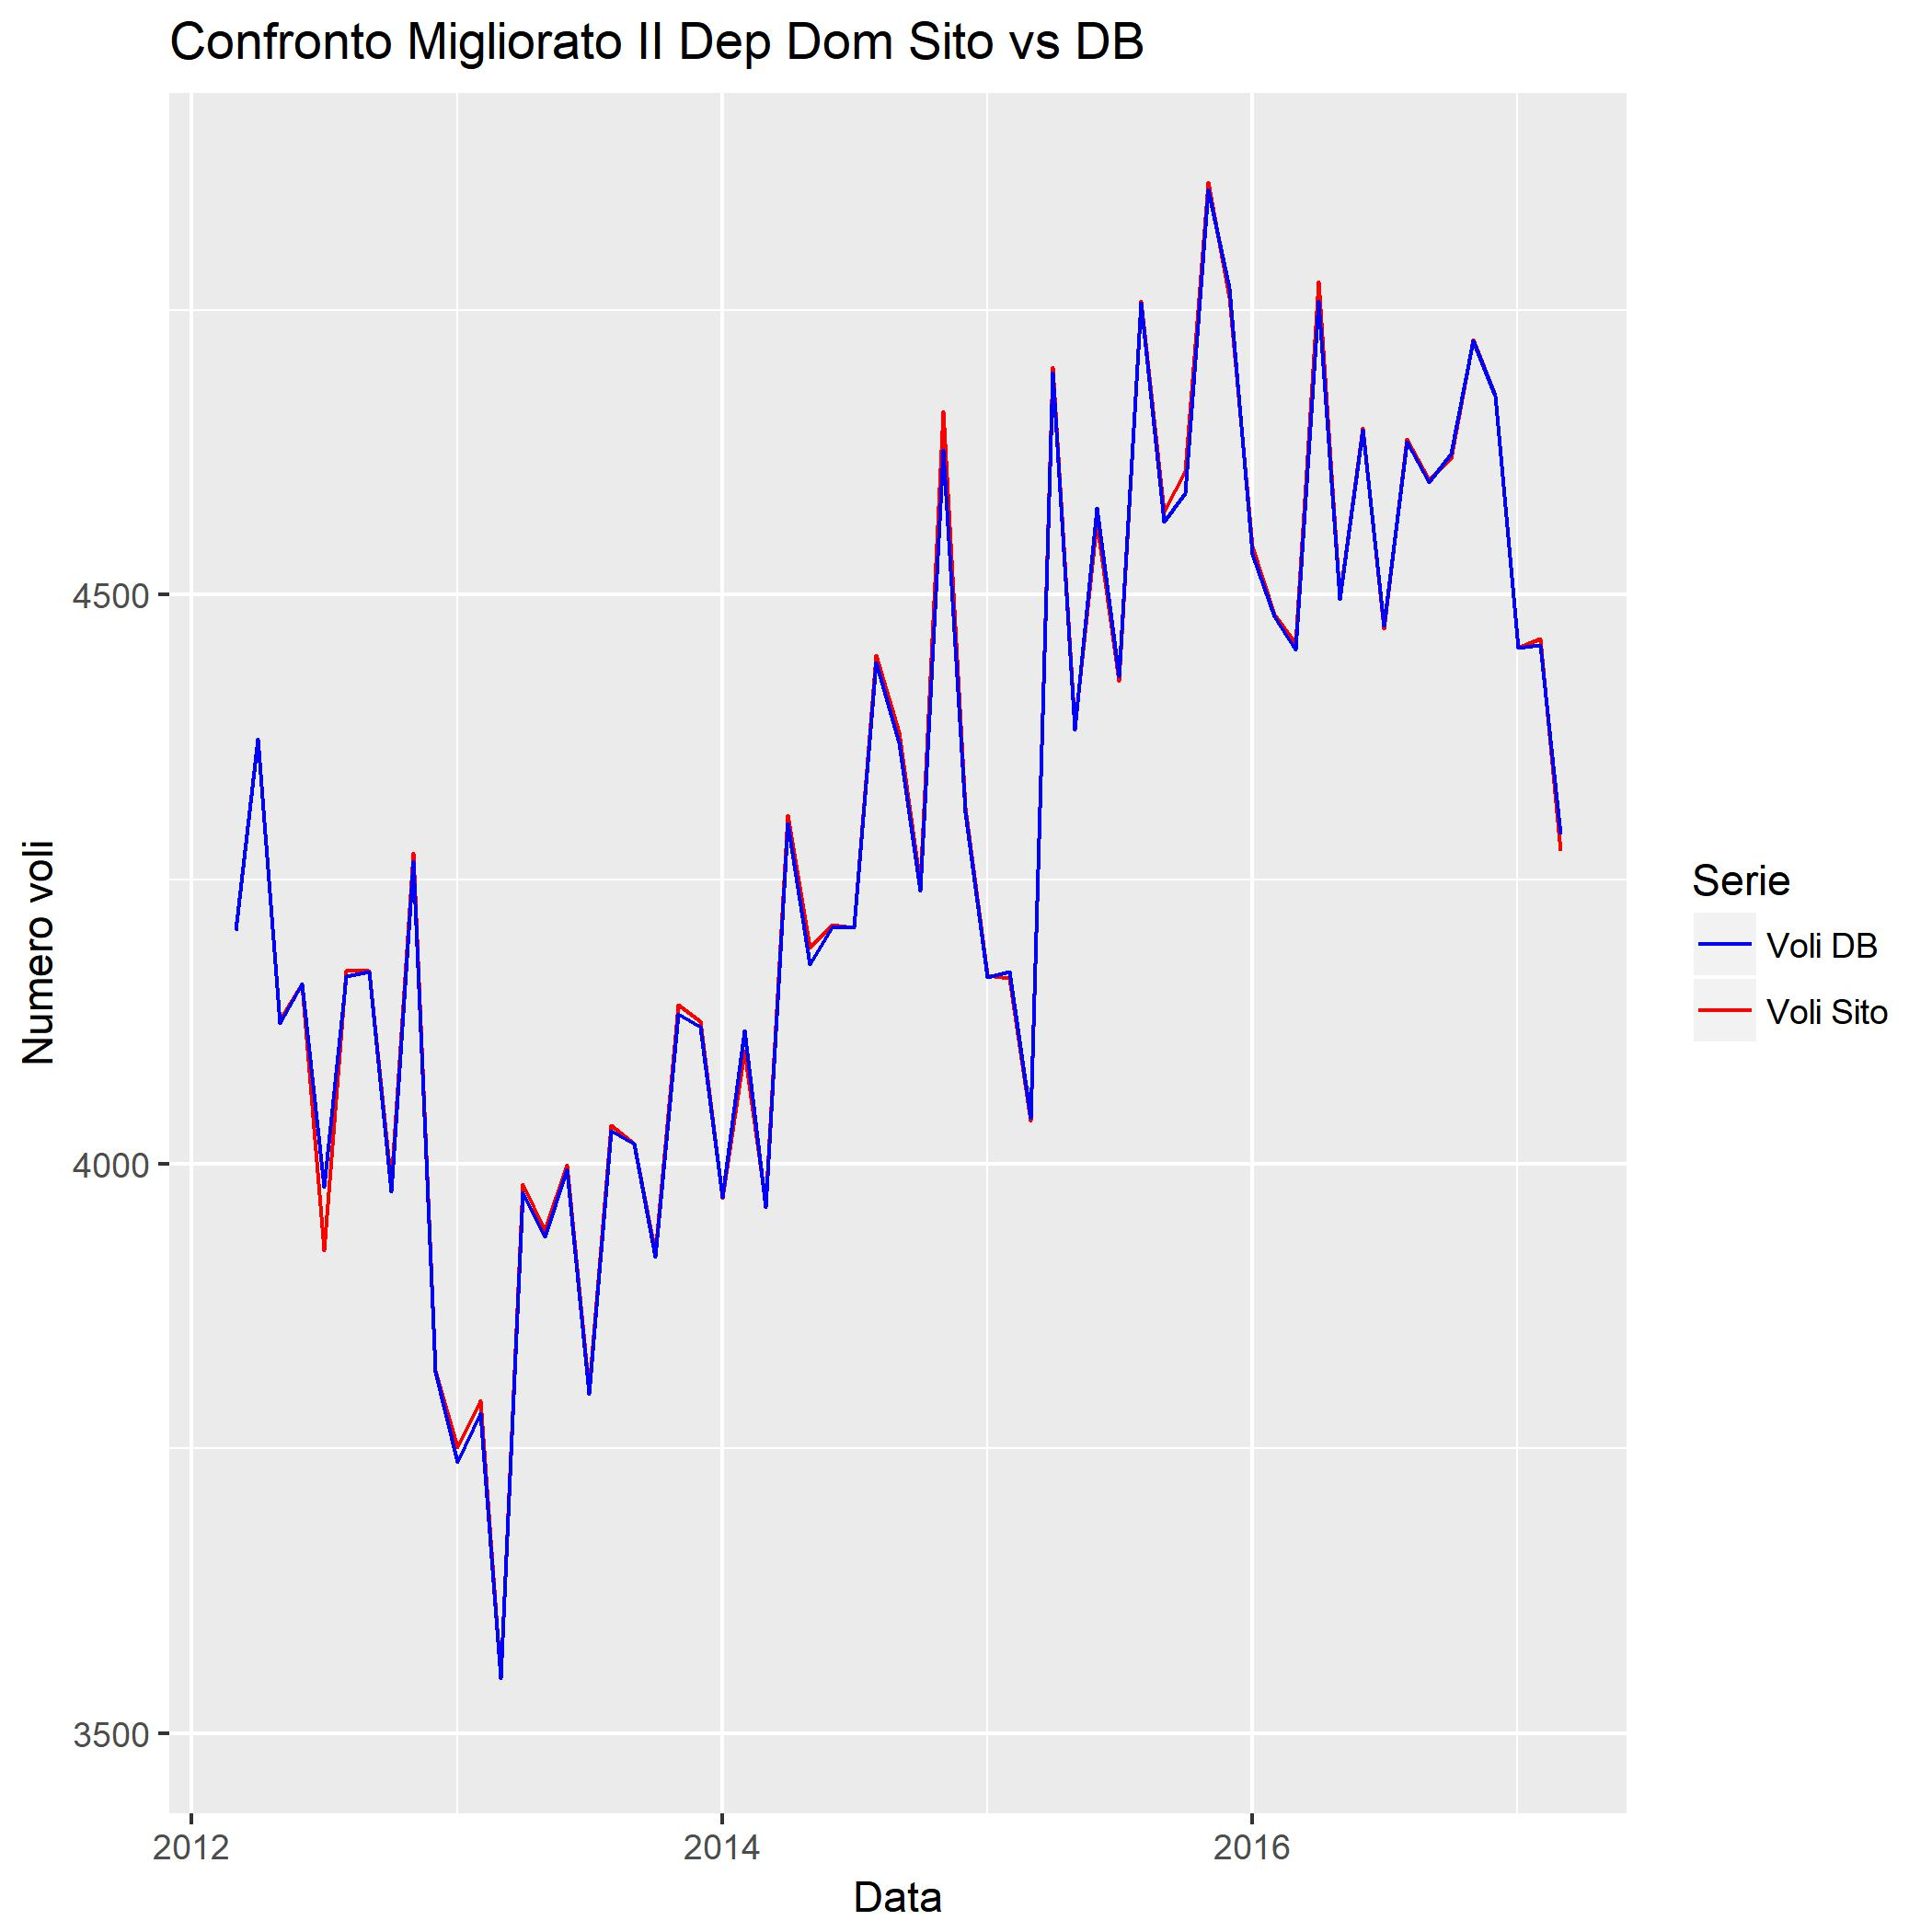

Slide 21
4.
Analisi Serie Storiche

Slide 22
Instructions for use
EDIT IN GOOGLE SLIDES
Click on the button under the presentation preview that says "Use as Google Slides Theme".
You will get a copy of this document on your Google Drive and will be able to edit, add or delete slides.
You have to be signed in to your Google account.
EDIT IN POWERPOINT®
Click on the button under the presentation preview that says "Download as PowerPoint template". You will get a .pptx file that you can edit in PowerPoint.
Remember to download and install the fonts used in this presentation (you’ll find the links to the font files needed in the Presentation design slide)
More info on how to use this template at www.slidescarnival.com/help-use-presentation-template
This template is free to use under Creative Commons Attribution license. You can keep the Credits slide or mention SlidesCarnival and other resources used in a slide footer.

Slide 23

Hello!
I am Jayden Smith
I am here because I love to give presentations. You can find me at @username

Slide 24
Quotations are commonly printed as a means of inspiration and to invoke philosophical thoughts from the reader.

Slide 25
This is a
slide title
Here you have a list of items
And some text
But remember not to overload your slides with content
Your audience will listen to you or read the content, but won’t do both.

Slide 26
BIG CONCEPT
Bring the attention of your audience over a key concept using icons or illustrations

Slide 27
You can also split your content
White
Is the color of milk and fresh snow, the color produced by the combination of all the colors of the visible spectrum.
Black
Is the color of coal, ebony, and of outer space. It is the darkest color, the result of the absence of or complete absorption of light.

Slide 28
In two or three columns
Yellow
Is the color of gold, butter and ripe lemons. In the spectrum of visible light, yellow is found between green and orange.
Blue
Is the colour of the clear sky and the deep sea. It is located between violet and green on the optical spectrum.
Red
Is the color of blood, and because of this it has historically been associated with sacrifice, danger and courage.

Slide 29
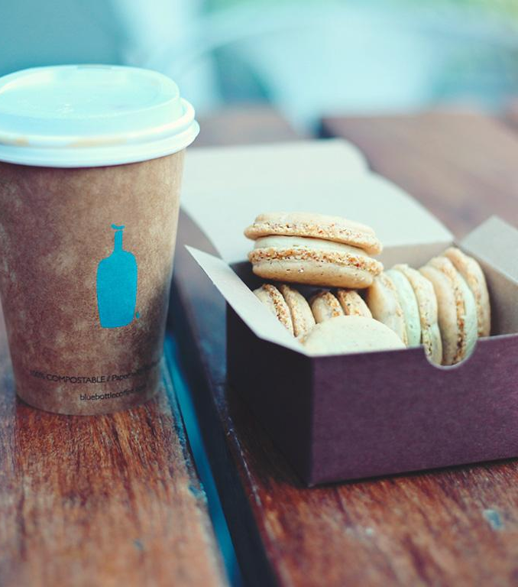
A picture is worth a thousand words
A complex idea can be conveyed with just a single still image, namely making it possible to absorb large amounts of data quickly.

Slide 30
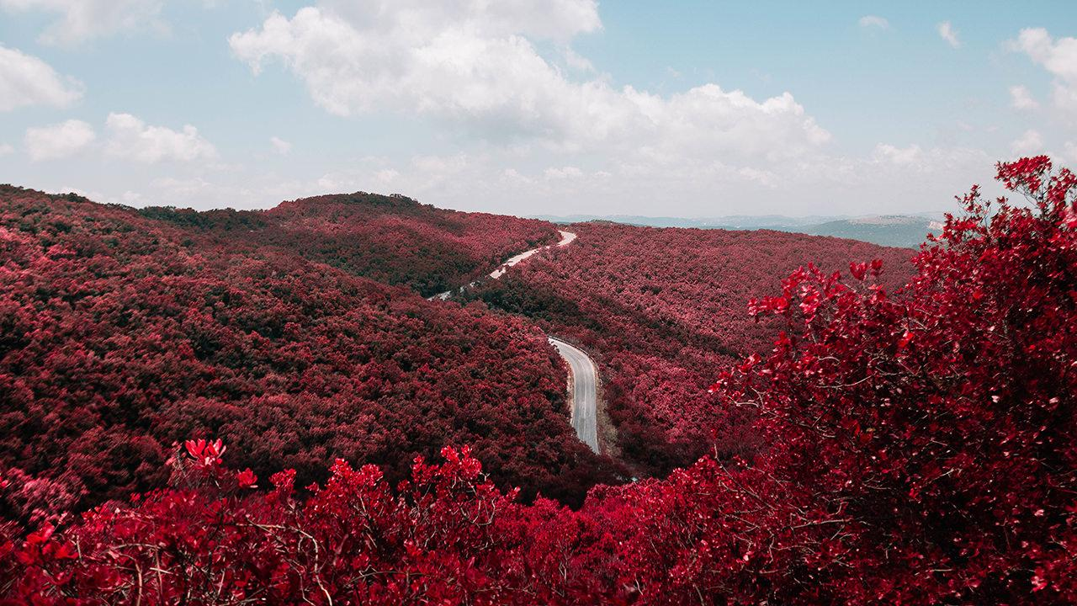
Want big impact?
Use big image.

Slide 31
Want big impact?
Use big image.

Slide 32
Use charts to explain your ideas
White
Gray
Black

Slide 33
Or use diagrams to explain complex ideas
Example text.
Example text.
Example text.
Example text.
Example text.
Example text.
Business
Rise
Risk
Leader
Economy
Idea
Profit
Example text.
Example text.
Example text.
Finance
Diagram featured by poweredtemplate.com
Example text.
Example text.
Example text.

Slide 34
And tables to compare data
 | A | B | C
Yellow | 10 | 20 | 7
Blue | 30 | 15 | 10
Orange | 5 | 24 | 16

Slide 35
Maps
our office

Slide 36
89,526,124
Whoa! That’s a big number, aren’t you proud?

Slide 37
89,526,124$
185,244 users
100%
That’s a lot of money
And a lot of users
Total success!

Slide 38
Our process
is easy
first
second
last

Slide 39
Let’s review
some concepts
Yellow
Is the color of gold, butter and ripe lemons. In the spectrum of visible light, yellow is found between green and orange.
Blue
Is the colour of the clear sky and the deep sea. It is located between violet and green on the optical spectrum.
Red
Is the color of blood, and because of this it has historically been associated with sacrifice, danger and courage.
Blue
Is the colour of the clear sky and the deep sea. It is located between violet and green on the optical spectrum.
Yellow
Is the color of gold, butter and ripe lemons. In the spectrum of visible light, yellow is found between green and orange.
Red
Is the color of blood, and because of this it has historically been associated with sacrifice, danger and courage.

Slide 40
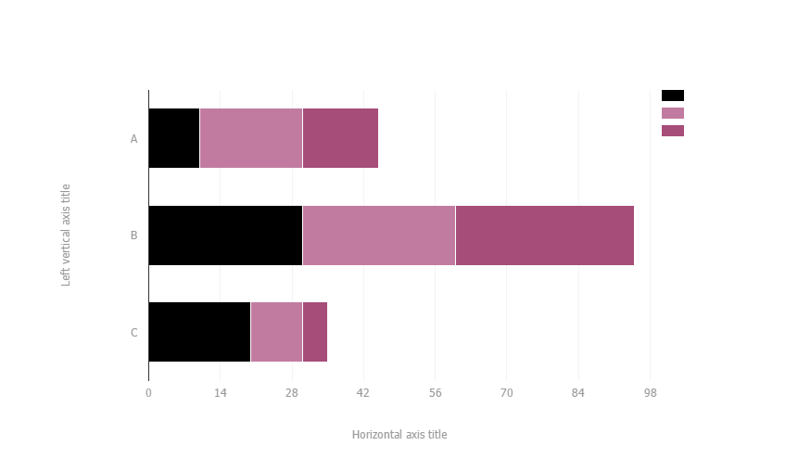
You can copy&paste graphs from Google Sheets

Slide 41
Android
project
Place your screenshot here
Show and explain your web, app or software projects using these gadget templates.

Slide 42
iPhone
project
Place your screenshot here
Show and explain your web, app or software projects using these gadget templates.

Slide 43
Tablet
project
Place your screenshot here
Show and explain your web, app or software projects using these gadget templates.

Slide 44
Desktop
project
Place your screenshot here
Show and explain your web, app or software projects using these gadget templates.

Slide 45
Thanks!!
Any questions?
You can find me at @username & user@mail.me

Slide 46
Credits
Special thanks to all the people who made and released these awesome resources for free:
Presentation template by SlidesCarnival
Photographs by Unsplash

Slide 47

Presentation
design
This presentation uses the following typographies and colors:
Titles: Titillium web
Body copy: Titillium web
You can download the fonts on this page:
https://www.google.com/fonts#UsePlace:use/Collection:Titillium+Web:400,400italic,700,700italic
Click on the “arrow button” that appears on the top right
Black #000000
Magenta #ff004e
You don’t need to keep this slide in your presentation. It’s only here to serve you as a design guide if you need to create new slides or download the fonts to edit the presentation in PowerPoint®

Slide 48
SlidesCarnival icons are editable shapes.
This means that you can:
Resize them without losing quality.
Change line color, width and style.
Isn’t that nice? :)
Examples:

Slide 49
😉
Now you can use any emoji as an icon!
And of course it resizes without losing quality and you can change the color.
How? Follow Google instructions https://twitter.com/googledocs/status/730087240156643328
✋👆👉👍👤👦👧👨👩👪💃🏃💑❤😂😉😋😒😭👶😸🐟🍒🍔💣📌📖🔨🎃🎈🎨🏈🏰🌏🔌🔑 and many more...

