Slide 1

WHAT’S THE MOOD
Internet Of Things Algorithms and Services
A point of the situation on the project
Michele Nicoletti 1886646 - Lorenzo Pecorari 1885161

Slide 2
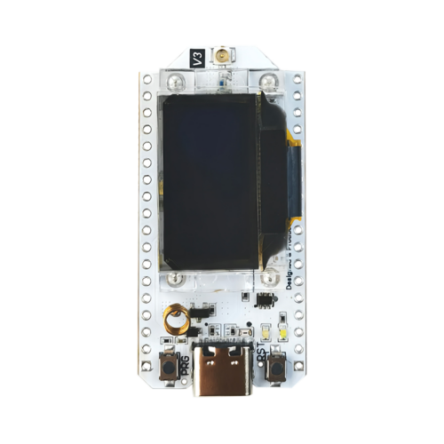

APPLICATION CONTEXT
Detecting people and air quality
Communication between nodes and to broker
Evaluating data and acting on environment
CLEAR REQUIREMENTS
Getting data and setting thresholds
Acting on environment
Communication
Sleep mode: which one is the best?

Slide 3
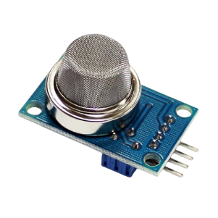

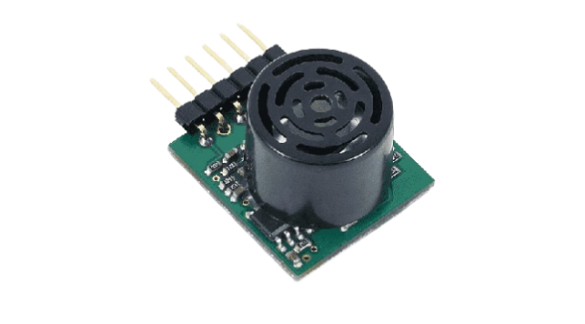

SENSORS ACTUATORS
MQ-2 - air sensor
Microphone
Fan
Servomotor

Slide 4

ALGORITHMS AND TECHNOLOGIES
Sampling: digital and analogic input detection
Data transmission to a MQTT broker
Communication through ESP-NOW protocol
Sleep modes for energy saving

Slide 5

EXPERIMENTS
Actuators effect on environment
Air quality on different conditions
Noises with and without people inside room
Communication
Energy modes

Slide 6
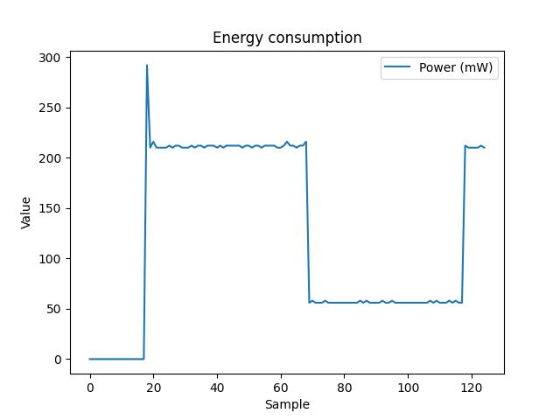
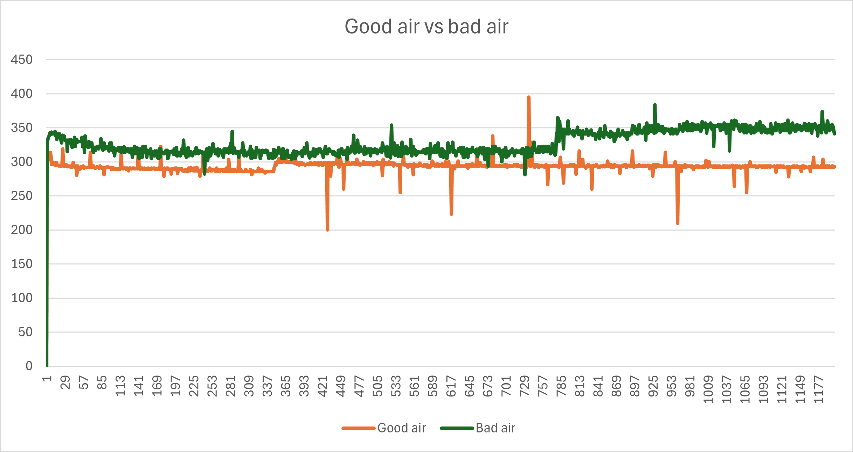
MEASUREMENTS
vTaskDelay() vs light sleep
Measurement done during lectures

Slide 7

PROBLEMS AND SOLUTIONS
Development problems:
Microphone, analog or digital
ESP-NOW wake up
Measurment problem:
Good places for sampling
Acting problem:
Setting up the actuators

Slide 8
Thanks for your attention

