Slide 1

WHAT’S THE MOOD
Final presentation
Internet of Things Algorithms and Services A.Y. 2023/2024
Michele Nicoletti- Lorenzo Pecorari

Slide 2



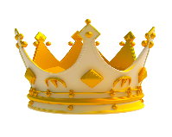
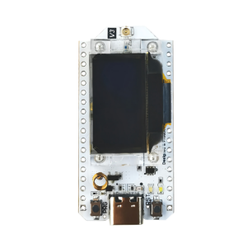
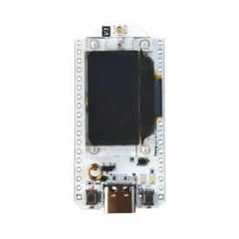

APPLICATION ARCHITECTURE
…
MCUs collect data and communicate through ESP-NOW
Helper interacts with environment
Central publishes results into a dedicated topic of the HiveMQ broker
Data available to everyone that securely subscribe to the topic
…

Slide 3
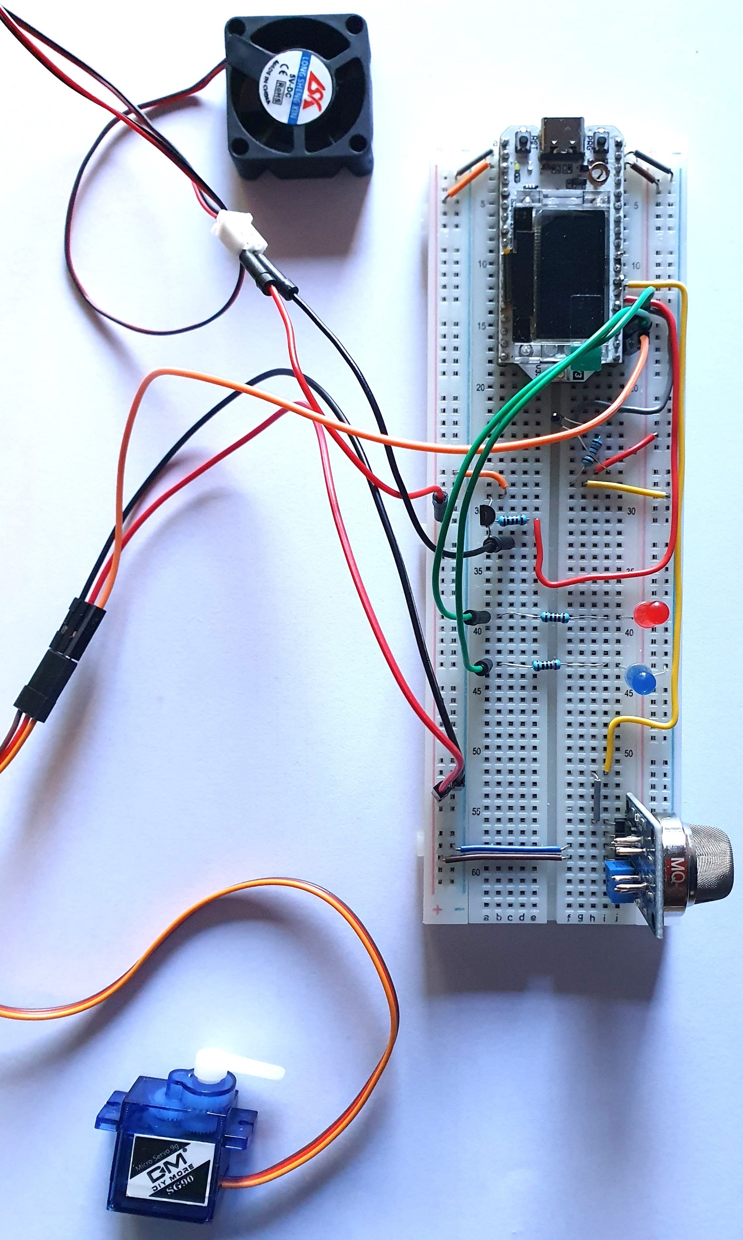
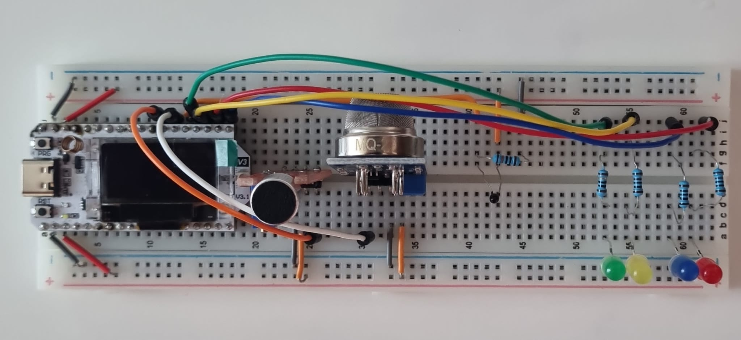
FINAL HARDWARE
Central: place where can detect people like the desk of teacher
Helper: place where can interact with windows and conditioner

Slide 4
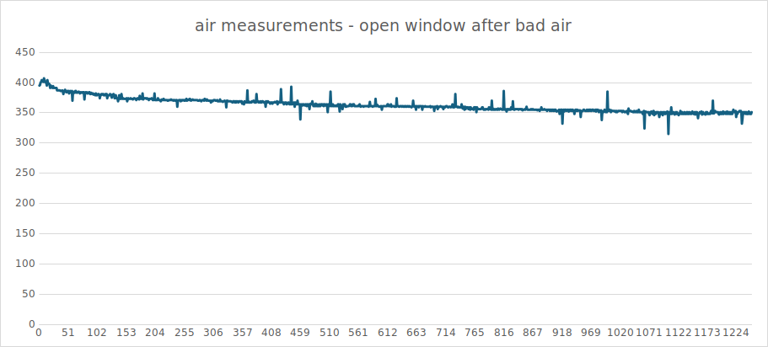
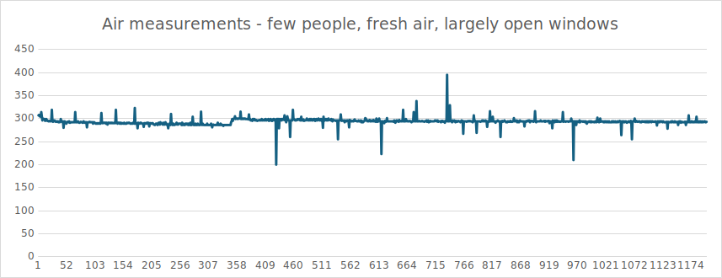
EXPERIMENTS – AIR MODULE
Allow to find air threshold
Bad value detected: 400 mV
Good value detected: 300 mV
Threshold: 350 mV

Slide 5
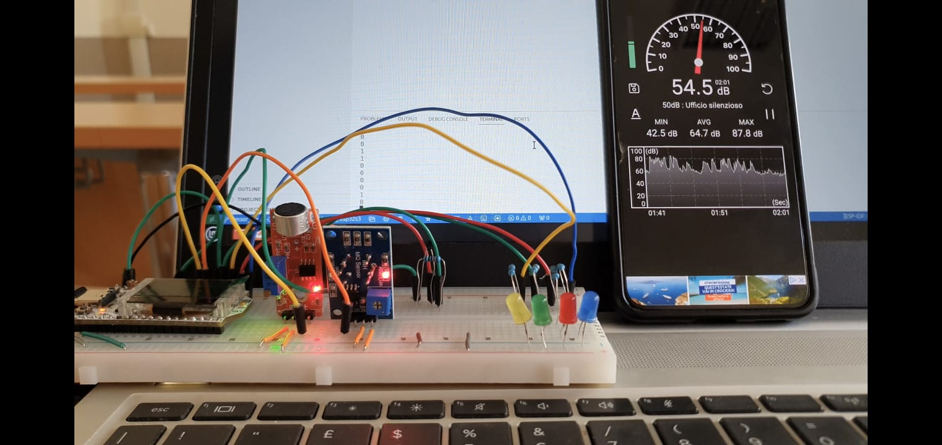
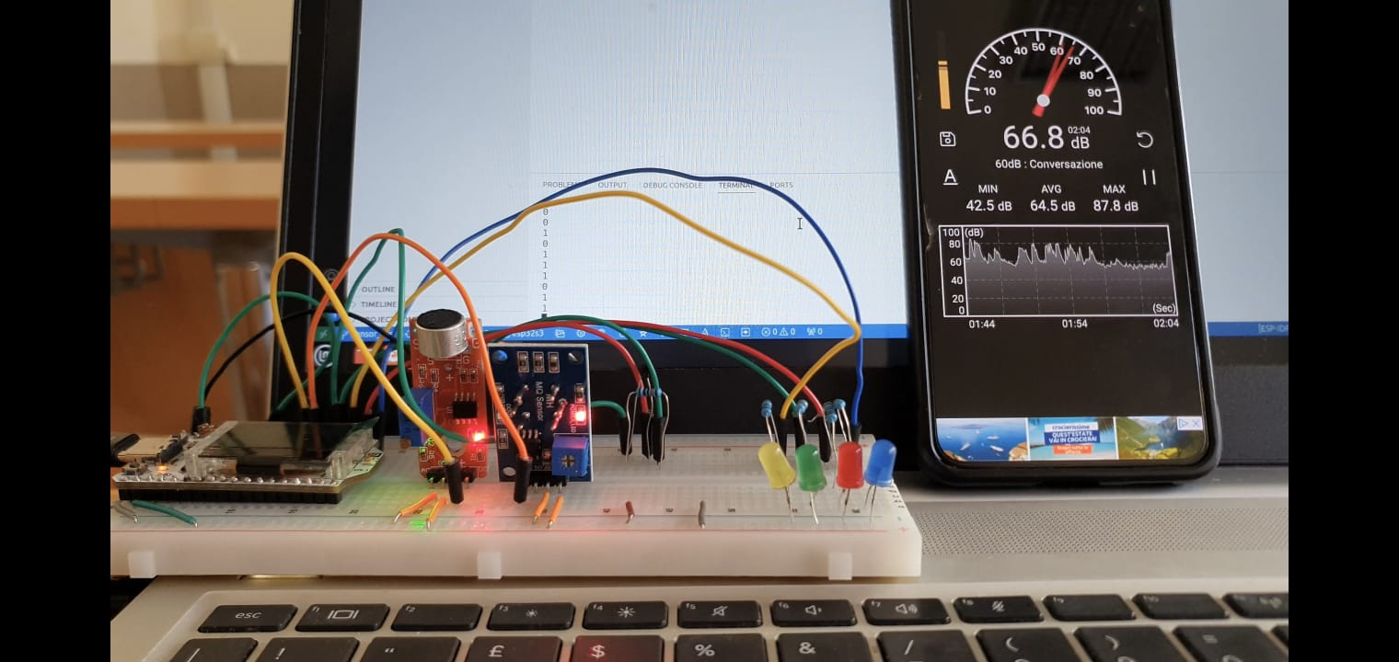
EXPERIMENTS – MICROPHONE
Allow to find microphone threshold
Low value detected: 55 dB
High value detected: 65 dB
Threshold: 60 dB

Slide 6
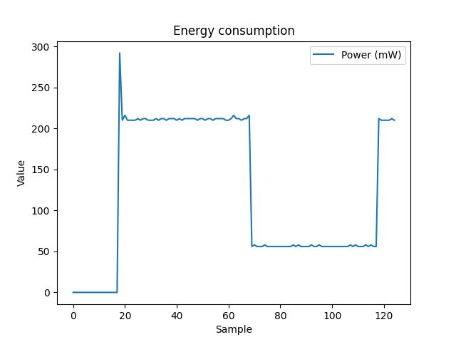
EXPERIMENTS – LIGHT SLEEP
Energy saving technique: light sleep mode
vTaskDelay vs light sleep
Appreciatable reduction of energy consumption (avg 4 times better)
Adoption for better duty cycling

Slide 7
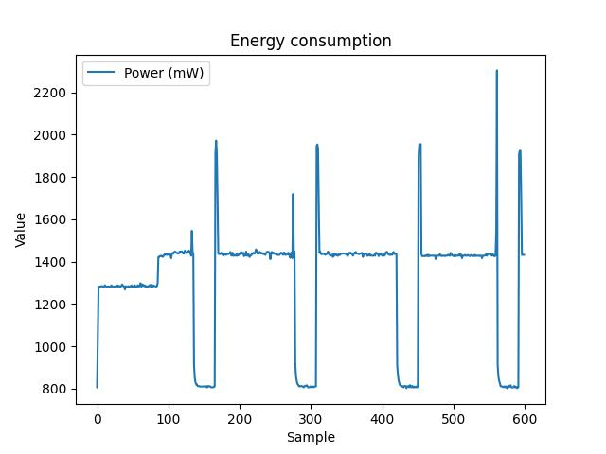
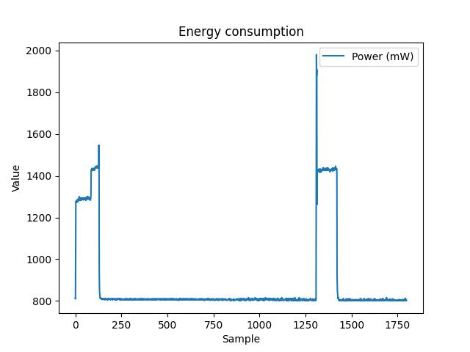
EXPERIMENTS – CENTRAL DUTY CYCLES
Multilevel of energy consumption
Normal value: 1400 mW
Highest point: mqtt transmission and wake up
Sleep mode: 40% energy safe

Slide 8
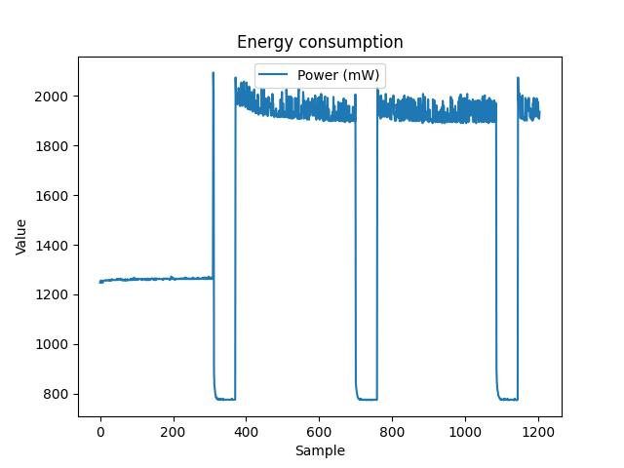
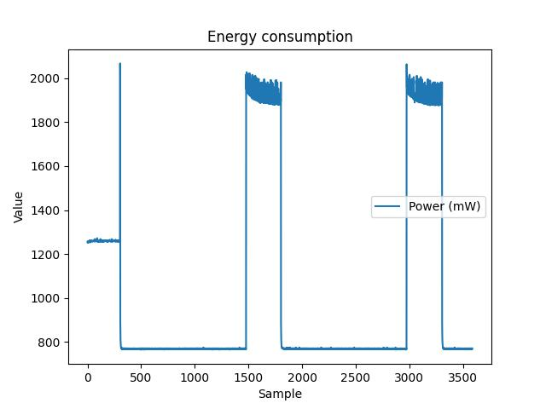
EXPERIMENTS – HELPER DUTY CYCLES
Sleep period comparison: 30s vs 600s
Awake period: 180s
Sleep mode: 800mW
Awake mode: 1900mW
High frequency: 1743mW
Lower frequency: 1053mW
Saving: 40% avg
avg

Slide 9
Thanks for your attention

