Slide 1
WHAT’S THE MOOD? (CHE ARIA TIRA?)
An IoT project by
Michele Nicoletti and Lorenzo Pecorari

Slide 2

PROBLEM AND A POSSIBLE SOLUTION
Maintenance of good quality air into classrooms for better focus of students and teachers
IoT project as a proposed solution for reaching that aim
Need for data sampling and interacting with environment

Slide 3
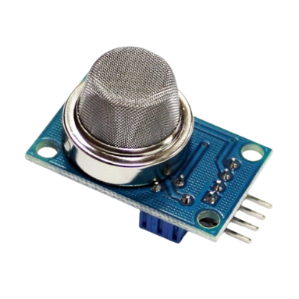
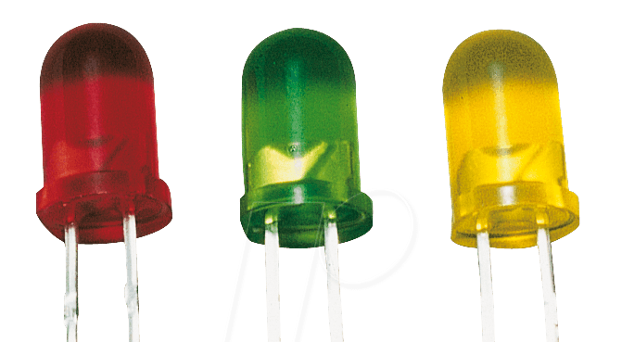
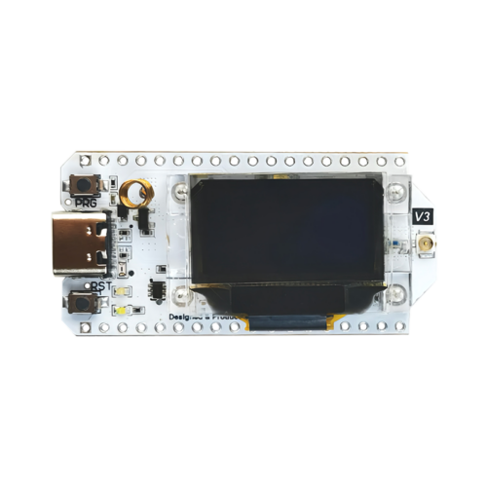
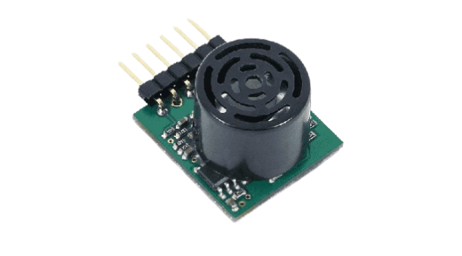
CENTRAL DEVICE
What it does?
Management of «helper» devices
Sampling of data
Data transmission to cloud
And its hardware?
Esp32 based
AC supplied
Microphone
Air module
Leds

Slide 4
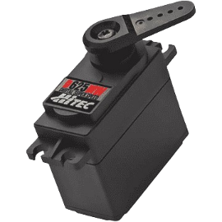



HELPER DEVICE(S)
What it does?
Coordinated by «central»
Sampling and transmission of data
Interactions with environment
And its hardware?
Esp32 based
Battery supplied
Air module
Servomotor
Fan

Slide 5

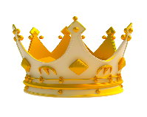
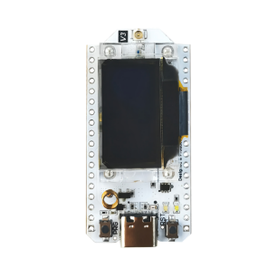
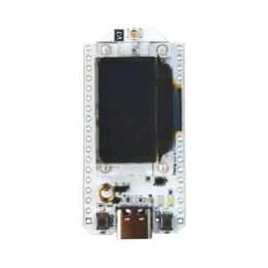
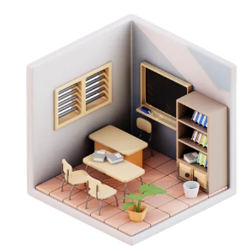
HOW DOES IT WORK?
Central device
Noises detection
Indicating helpers to start sampling
Data sampling
Reception, comparison and estimation of data
Telling interaction to do
Transmission of data to cloud
Helper device
Asking to central what to do
Data sampling
Data transmission to central
Executing interaction through actuator(s)
DFOPJGBDLFKBMNJODIFKIBN

Slide 6
EFFECTIVENESS
Better quality of air
Appreciation of temperature
Visible warnings (led)
Possible information from cloud

