Slide 1
CPU vs GPU Sequential vs Parallel
Lorenzo Pecorari - 1885161

Slide 2
New formulation: state aggregation
Independent Q-Learning with Partial Observability (other agents’ states aggregated)
s_{t}^{i} = [b_{t}^{i}, q_{t}^{i}, τ_{t}^{i}] $$→$$ s_{t}^{i} = [b_{t}^{i}, q_{t}^{i}, τ_{t}^{i}, mb_{t}^{i}, Mb_{t}^{i}, $$μ$$b_{t}^{i}, mq_{t}^{i}, Mq_{t}^{i}, $$μ$$q_{t}^{i}] (9 different variables)
where:
mb_{t}^{i} = argmin $${\{b_{t}^{j}\}}_{j≠i}$$ , min battery level of other agents
Mb_{t}^{i} = argmax $${\{b_{t}^{j}\}}_{j≠i}$$ , max battery level of other agents
mq_{t}^{i} = argmin $${\{q_{t}^{i}\}}_{j≠i}$$ , min backlog status of other agents
Mq_{t}^{i} = argmax $${\{q_{t}^{i}\}}_{j≠i}$$ , max backlog status of other agents
$$μ$$b_{t}^{i} = $$\frac{1}{n-1}\sum_{j≠i}^{n}{b_{t}^{j}}$$ , average battery level of other agents
$$μ$$q_{t}^{i} = $$\frac{1}{n-1}\sum_{j≠i}^{n}{q_{t}^{j}}$$ , average backlog status of other agents
Same action space as previous formulation: a_{t} = [a_{t}⁰, a_{t}¹], where a_{t}^{i} = [f_{t}^{i}, x_{t}^{i}, g_{t}^{i}, h_{t}^{i} ]

Slide 3
Setup
2, 3, 4 and 5 nodes, all of them as agents
Battery capacities: 25Wh, 37Wh, 50Wh, 67Wh, 100Wh
PV surfaces: 1.0 m², 0.85 m², 0.75 m², 0.65 m², 0.5 m² (efficiency = 20%)
Dataset from Solcast, year 2024 (172th and 355th days mostly used for tests)
Observation space: s_{t} = [s_{t}^{i}]_{i}∈_{[0, n]}, where s_{t}^{i} = [b_{t}^{i}, q_{t}^{i}, τ_{t}^{i}, mb_{t}^{i}, Mb_{t}^{i}, $$μ$$b_{t}^{i}, mq_{t}^{i}, Mq_{t}^{i}, $$μ$$q_{t}^{i}]
Action space: a_{t} = [a_{t}⁰, a_{t}¹], where a_{t}^{i} = [f_{t}^{i}, x_{t}^{i}, g_{t}^{i}, h_{t}^{i} ]
Each agent can see local state and aggregated statistics of others but not their actions
Same environment and same reward function for both implementations
DQN algorithm for performing learning

Slide 4
Extract of training code
for agent_id in range(0, self.num_agents):
self.models[agent_id]._current_progress_remaining = progress_remaining
if(np.random.random() < self.eps):
action = self.models[agent_id].action_space.sample()
else:
action, _ = self.models[agent_id].predict(obs[agent_id], deterministic=False)
actions_encoded[agent_id] = action
actions[agent_id] = self.decode(action)
For every agent, action is chosen using 𝛆-greedy strategy

Slide 5
Parallelization for action selection
Library: concurrent.futures
ThreadPoolExecutor with num_agents workers or ProcessPoolExecutor with cpu_cores workers
Differentiation between use of processes and threads
Limitations due to Global Interpreter Lock of Python
self.executor = ThreadPoolExecutor(max_workers= self._max_workers)
...
futures = [
self.executor.submit(self.get_action_single_thread, agent_id, observations[agent_id])
for agent_id in range(self.num_agents)
]
for future in futures:
agent_id, action_encoded = future.result()
actions_encoded[agent_id] = action_encoded
actions[agent_id] = self.decode(action_encoded)
...

Slide 6
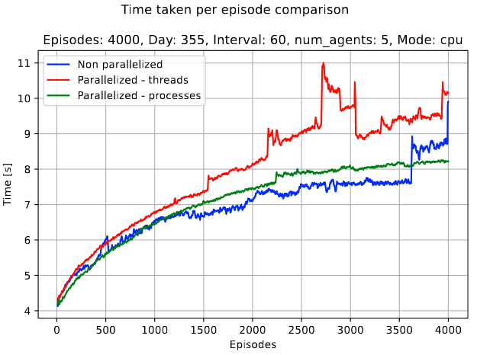
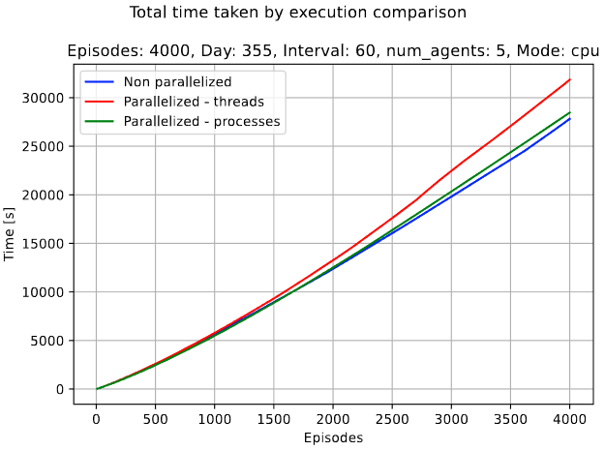
Time comparison

Slide 7
Adoption of GPU
Taking advantage of NVIDIA GPU in order to speedup calculations
Up to # gpu cores for batch size for each agent before saturation
Exploitation of Cuda for parallelizing operations of training
Note: it is needed a downgrade of some libraries due to Pascal architecture (sm_61) of MX330 and GTX1050

Slide 8
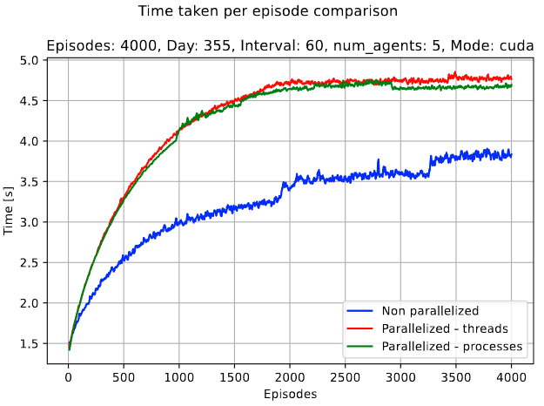
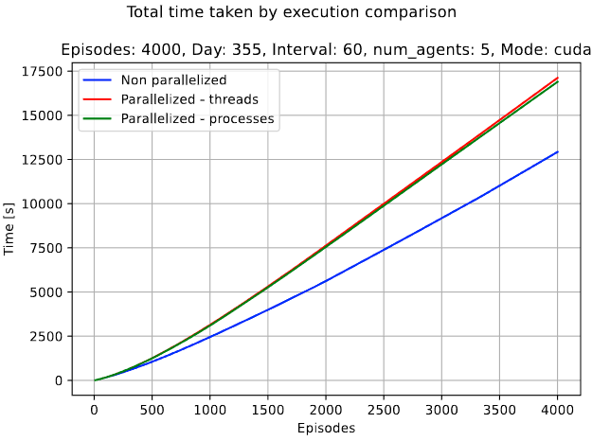
Time comparison

Slide 9
CPU vs GPU
Serialized action decision and GPU usage “outsmarts” other combinations

Slide 10
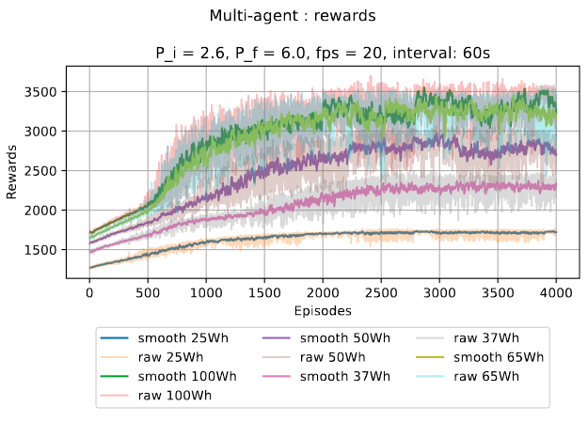
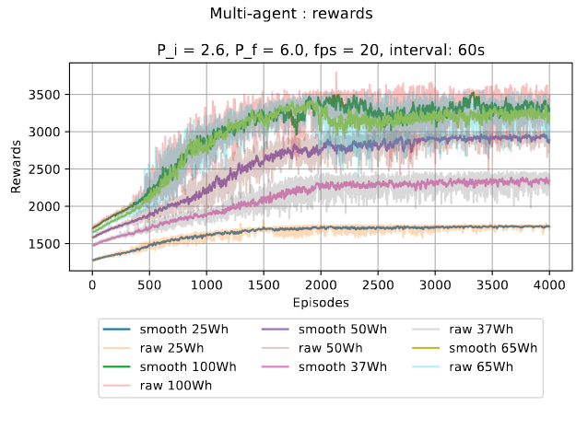
Other metrics comparison
Using GPU instead of CPU leads to no differences in terms of the usual metrics tracked during training (ex. rewards):
CPU
GPU

Slide 11
Information remotion from observation
Lorenzo Pecorari - 1885161

Slide 12
Main goal
Removing some information from observation in order to check behavior of agents with weaker knowledge about the system
From s_{t}^{i} = [b_{t}^{i}, q_{t}^{i}, τ_{t}^{i}, mb_{t}^{i}, Mb_{t}^{i}, $$μ$$b_{t}^{i}, mq_{t}^{i}, Mq_{t}^{i}, $$μ$$q_{t}^{i}]
To s_{t}^{i} = [b_{t}^{i}, q_{t}^{i}, τ_{t}^{i}, $$μ$$b_{t}^{i}, $$μ$$q_{t}^{i}]
Only mean battery level and mean storage level are available
During tests, this attempt will be called “Reduced states”
Tests done with DQN, day 355 and 5 agents

Slide 13
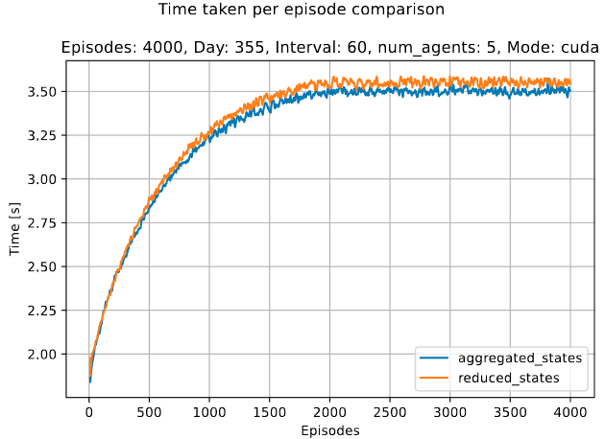
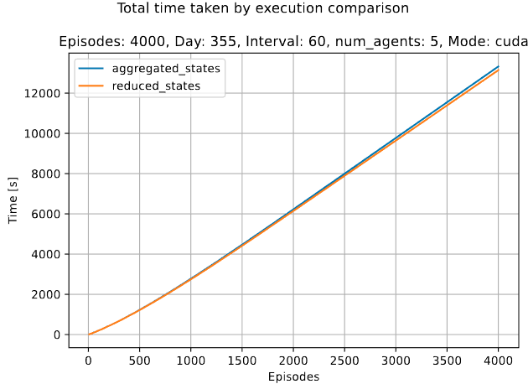
Time comparison
Slightly higher required time for formulation with less information

Slide 14
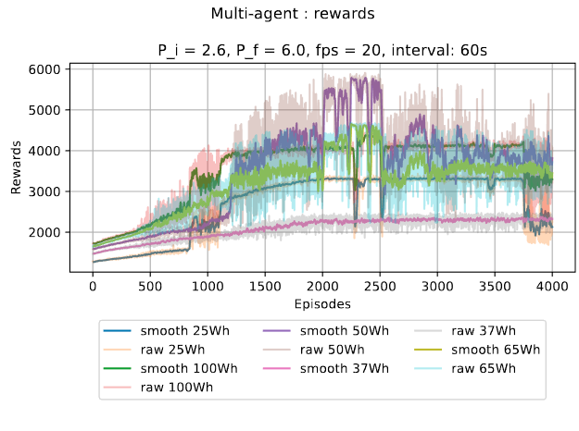
Rewards - detail
BEFORE
AFTER

Slide 15
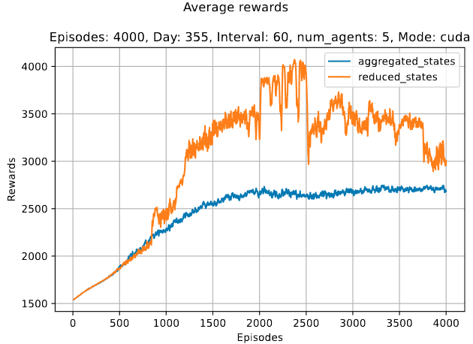
Rewards - average
Average of rewards of 5 agents for each episode
Less stable rewards for configuration with reduced information

Slide 16
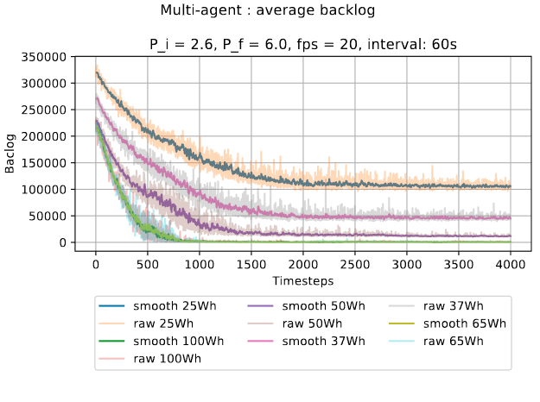
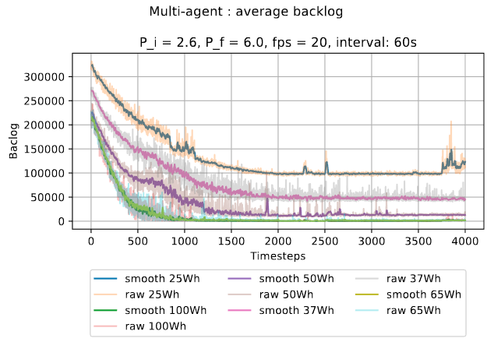
Backlogs
BEFORE
AFTER

Slide 17
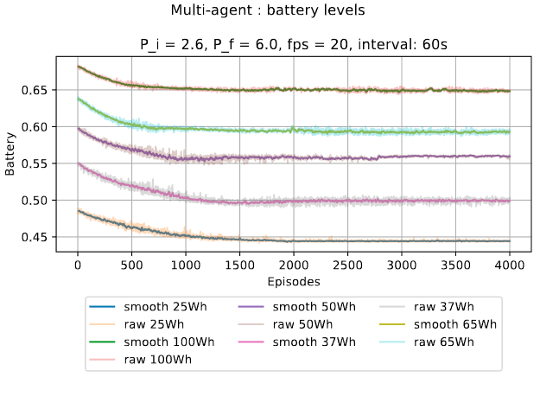
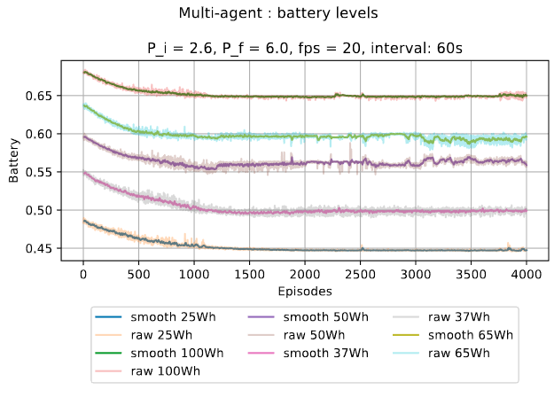
Batteries
BEFORE
AFTER

Slide 18
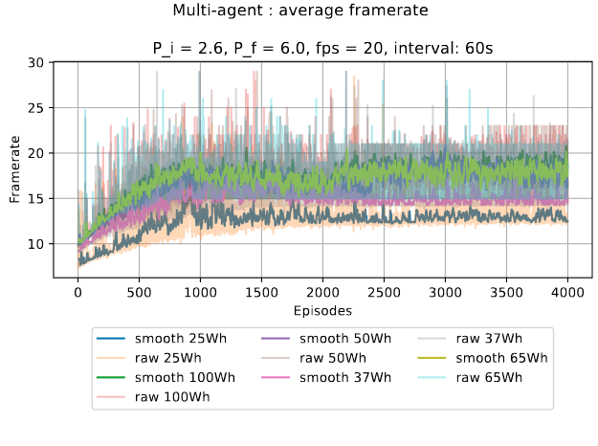
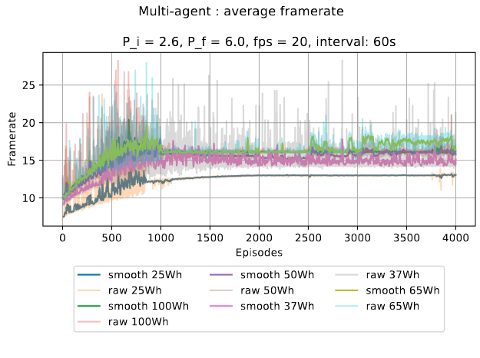
Framerates
BEFORE
AFTER

Slide 19
Extra: test with 10 agents
Attempt to reproduce the previous tests with double the number of agents
Run with 1000 episodes and ~50% of them used for exploration
Less episodes for each run due to long time required (~3 h)
Battery capacities: [25, 100, 50, 37, 65, 80, 40, 75, 55, 90] Wh
Panel surfaces: [1.00, 0.50, 0.75, 0.85, 0.65, 0.55, 0.90, 0.30, 0.80, 0.52] m²
Usual solar data from Solcast, 2024

Slide 20
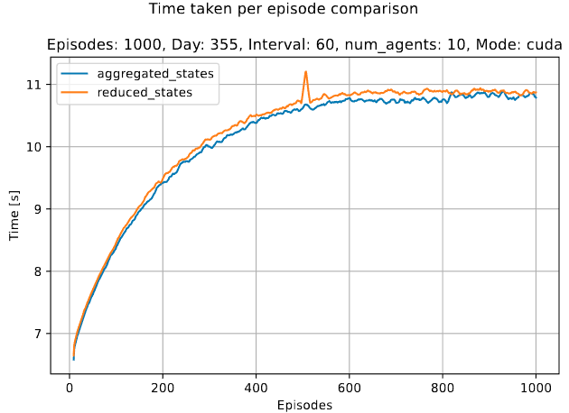
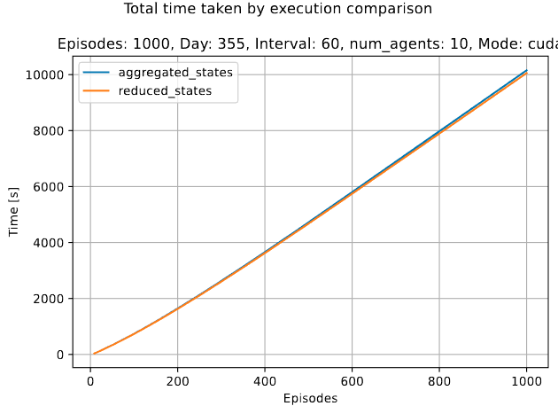
Time comparison
Very similar results wrt less agents in the system

Slide 21
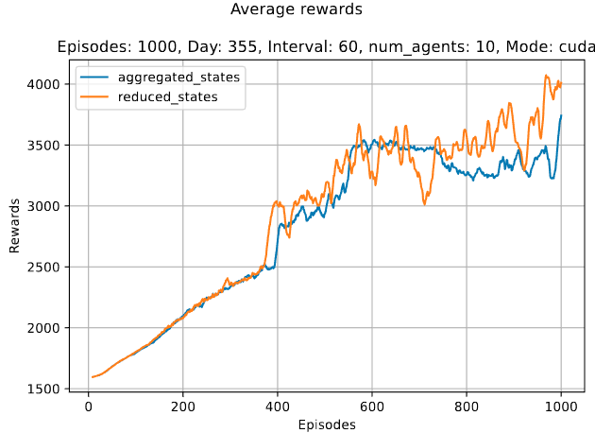
Rewards - average
Similar trend as previous tests with less nodes
Higher average rewards for initial formulation but reduced one always better

Slide 22
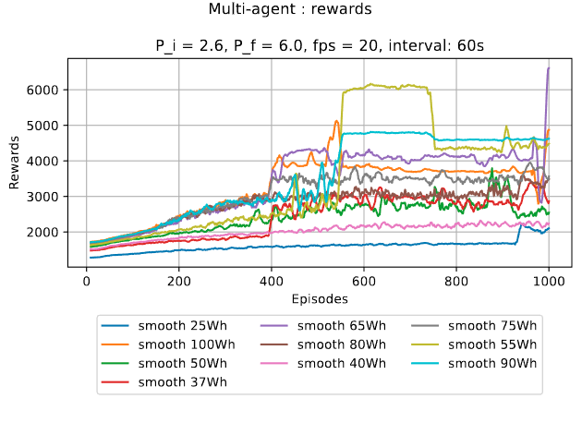
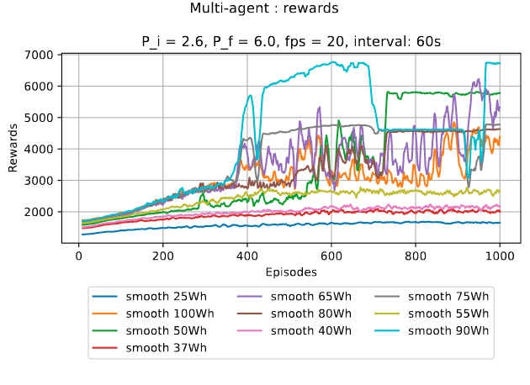
Rewards - detail
BEFORE
AFTER

Slide 23
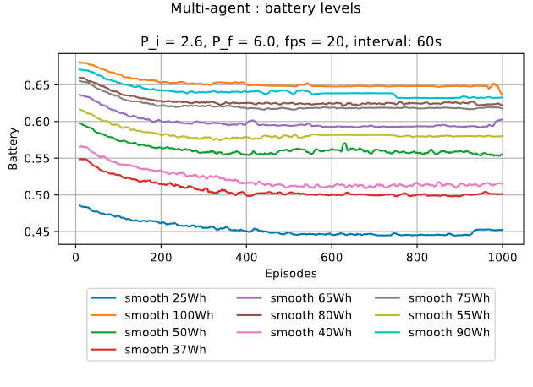
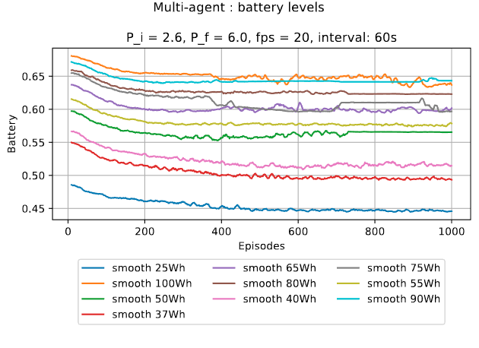
Batteries
BEFORE
AFTER

Slide 24
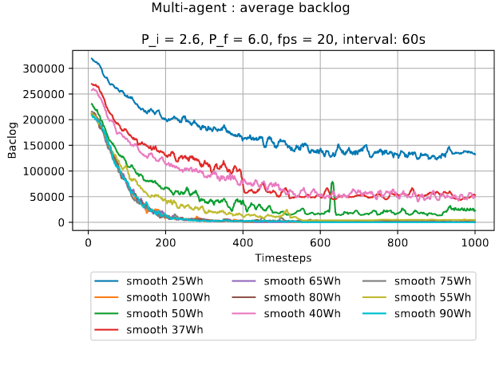
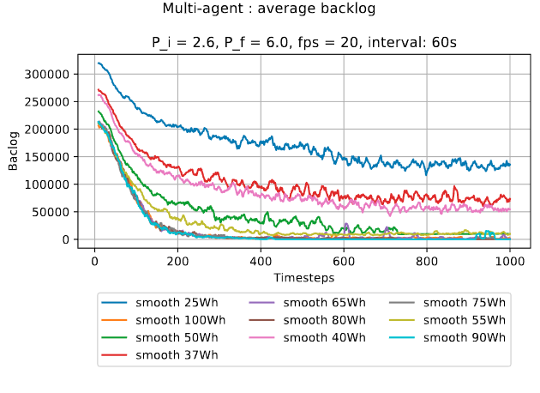
Backlogs
BEFORE
AFTER

Slide 25
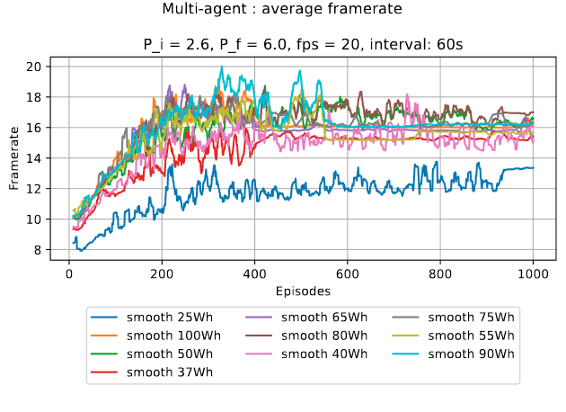
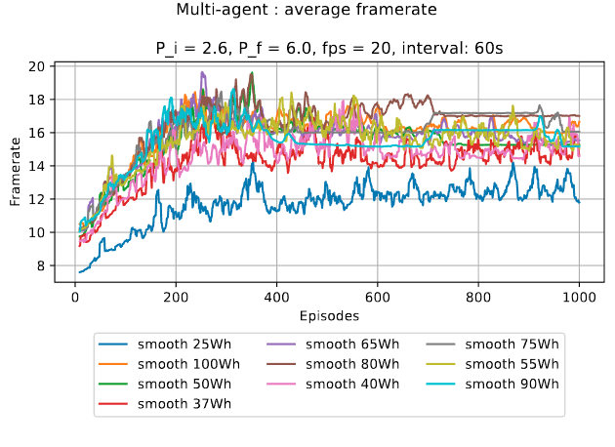
Framerates
BEFORE
AFTER

Slide 26
Explicit matching
Lorenzo Pecorari - 1885161

Slide 27
Formulation
Adding a binary variable in observation for informing agents if offloading matching happened at time t-1
From s_{t}^{i} = [b_{t}^{i}, q_{t}^{i}, τ_{t}^{i}, mb_{t}^{i}, Mb_{t}^{i}, $$μ$$b_{t}^{i}, mq_{t}^{i}, Mq_{t}^{i}, $$μ$$q_{t}^{i}]
To s_{t}^{i} = [b_{t}^{i}, q_{t}^{i}, τ_{t}^{i}, mb_{t}^{i}, Mb_{t}^{i}, $$μ$$b_{t}^{i}, mq_{t}^{i}, Mq_{t}^{i}, $$μ$$q_{t}^{i}, match_{t}^{i}]
Or to s_{t}^{i} = [b_{t}^{i}, q_{t}^{i}, τ_{t}^{i}, $$μ$$b_{t}^{i}, $$μ$$q_{t}^{i}, match_{t}^{i}] (“reduced states”)
Increasing of 1 dimension the observation, agents can know if offloading at t-1 was successful (match_{t}^{i} = 1) or not (match_{t}^{i} = 0)

Slide 28
More expressive state aggregation
Lorenzo Pecorari - 1885161

Slide 29
From average to more expressive metric
Minimum, maximum and average allow agent to know their state wrt the others
Reducing to only average (of others) may lead to loss of information about the range
Using z-score might help to define the “position” of each agent compared to others
However, it is unbounded and it may be needed a clipping

Slide 30
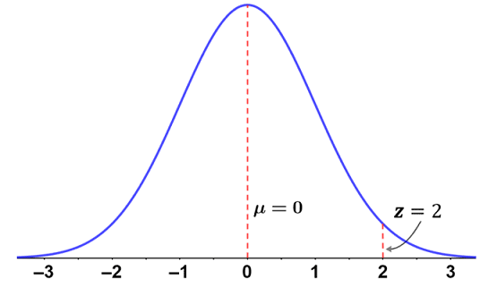
Z-Score
z : ℝ^{k} →ℝ
z(x) = $$\frac{x - μ}{σ}$$, where: $$μ=\frac{1}{N}\sum_{i = 1}^{N}{x_{i}}$$ σ=1Ni = 1Nxi-μ )2
“how many std deviation x is far from the mean” or “how far x is from the group”
Applying this to battery and backlog level for each agent, it allows to know which is the situation of the node without using three variables

Slide 31
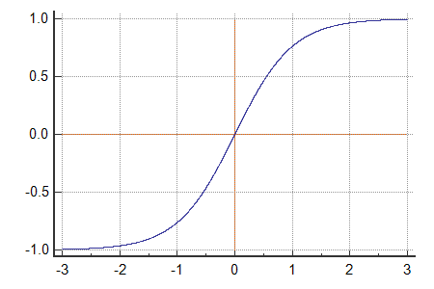
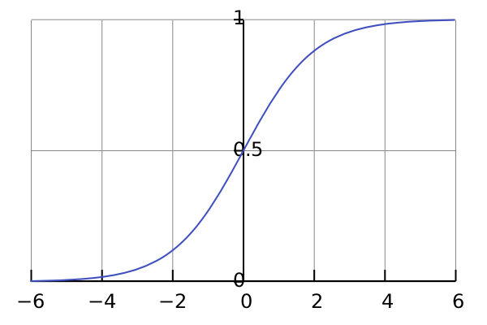
Limiting the z-score
Due to the range (-∞, +∞) of the output of z(x), it can be applied a limitation of its value to smaller intervals
Ex: hyperbolic tangent function and sigmoid can cope such problem
tanh: ℝ^{k} → [-1, +1]
$$tanh\left(x\right)= \frac{e^{2x} - 1}{e^{2x} + 1}$$
sigmoid: ℝ^{k} → [0, +1]
$$sigmoid\left(x\right)= \frac{1}{1 + e^{-x}}$$

Slide 32
Formulation with hyperbolic tangent
Using z-score for finding position of agent metrics wrt the group
Using tanh for delimit the z-score
From s_{t}^{i} = [b_{t}^{i}, q_{t}^{i}, τ_{t}^{i}, mb_{t}^{i}, Mb_{t}^{i}, $$μ$$b_{t}^{i}, mq_{t}^{i}, Mq_{t}^{i}, $$μ$$q_{t}^{i}]
To s_{t}^{i} = [b_{t}^{i}, q_{t}^{i}, τ_{t}^{i}, tz(b_{t}^{i}), tz(q_{t}^{i})]
where:
tz(x) = tanh(z(x)),
tanh(z(x)) = $$\frac{e^{2z(x)} - 1}{e^{2z(x)} + 1}$$
z(x) = $$\frac{1}{1 + e^{-x}}$$
from 9 dimensions to 5

Slide 33
Formulation with hyperbolic tangent
It can be preferred to use tanh instead of sigmoid since, when the node has same metrics values as the others, with sigmoid the variable becomes 0.5 but with tanh 0 (centrality)
It might be possible to extend this formulation with the binary variable which tells to the agent if the offloading successfully happened at t-1, so observation becomes:
s_{t}^{i} = [b_{t}^{i}, q_{t}^{i}, τ_{t}^{i}, tz(b_{t}^{i}), tz(q_{t}^{i}), match_{t}^{i}]

