Slide 1
Training one agent per time
Lorenzo Pecorari - 1885161

Slide 2
Key idea
Given N different agents, let N-1 of them act randomly and the remaining one learns a policy
Saving trained model and reusing for future training with different configurations
Loading trained model in all the agents’ NN for evaluating obtainable performances

Slide 3







Key idea: a sketchy representation
Training only one agent, N-1 have not to learn
Saving the model
Loading the model for future trainings

Slide 4
System setup
N = 10 agents
First run of 4000 episodes, subsequent runs of 2000 episodes
Battery capacities: [25, 100, 50, 37, 65, 80, 40, 75, 55, 90] Wh
Panel surfaces: [1.00, 0.50, 0.75, 0.85, 0.65, 0.55, 0.90, 0.30, 0.80, 0.52] m²
Observations: o_{t}^{i} = [b_{t}^{i}, q_{t}^{i}, τ_{t}^{i}, $$μ$$b_{t}^{i}, $$μ$$q_{t}^{i}]
Usual solar data from Solcast, 355th day of 2024
Irradiance data with noise of ±20% wrt dataset values

Slide 5
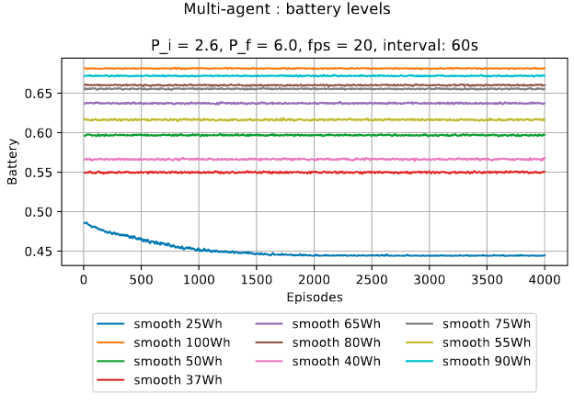
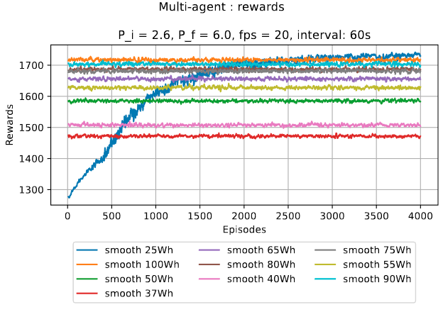
Initial test: intelligent 25Wh

Slide 6
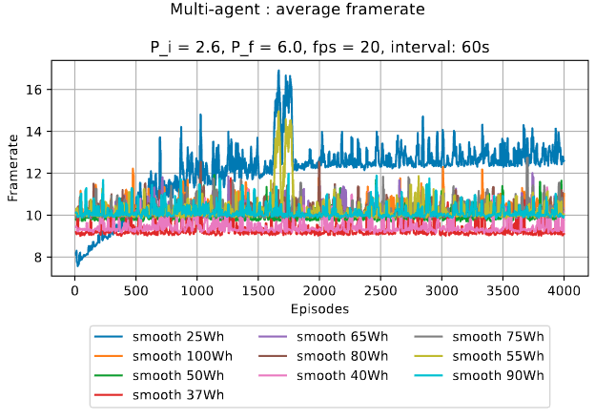
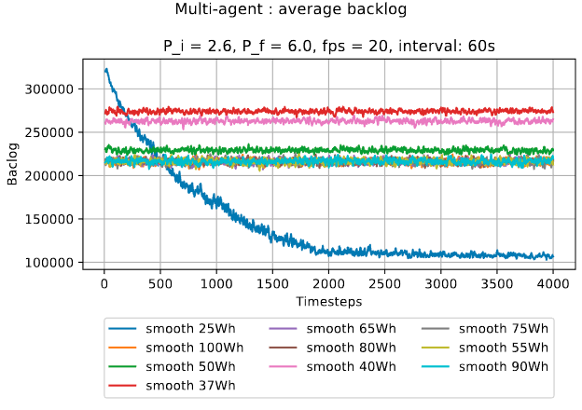
Initial test: intelligent 25Wh

Slide 7
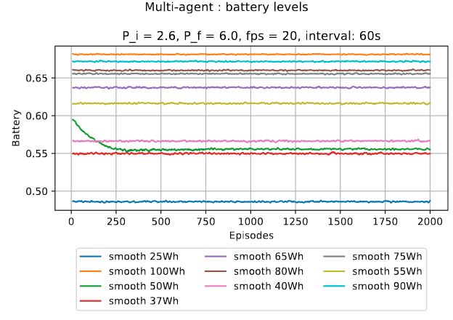
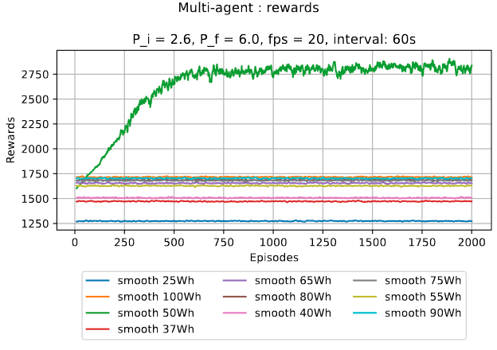
Second test: intelligent 50Wh
Imported trained model of node with 25Wh

Slide 8
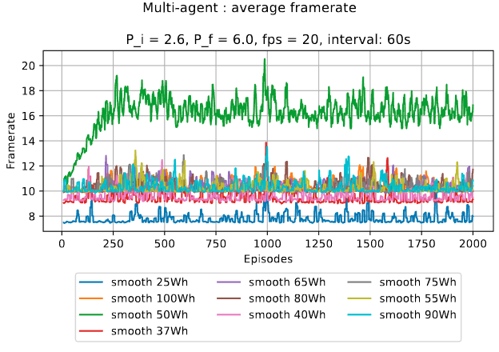
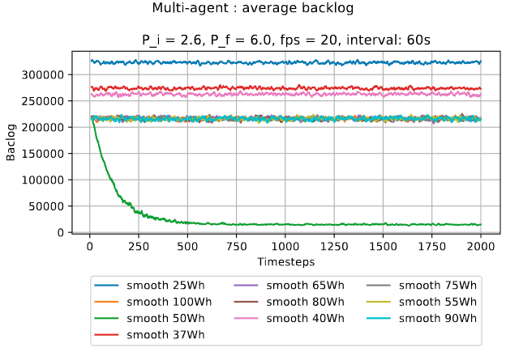
Second test: intelligent 50Wh
Imported trained model of node with 25Wh

Slide 9
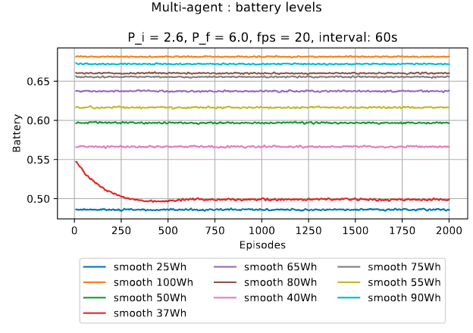
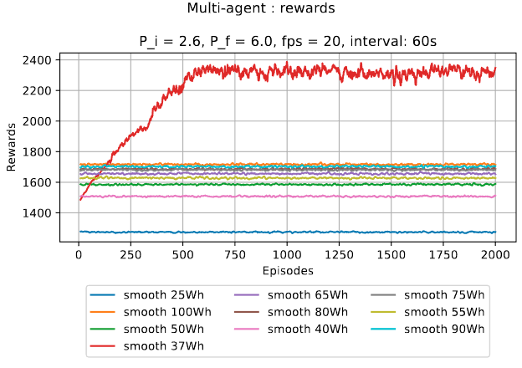
Third test: intelligent 37Wh
Imported trained model of node with 50Wh

Slide 10
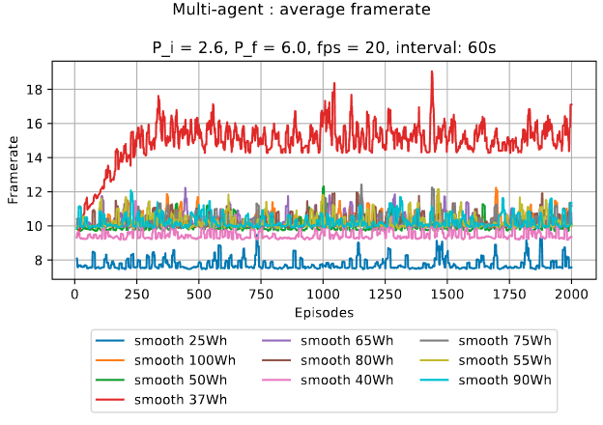
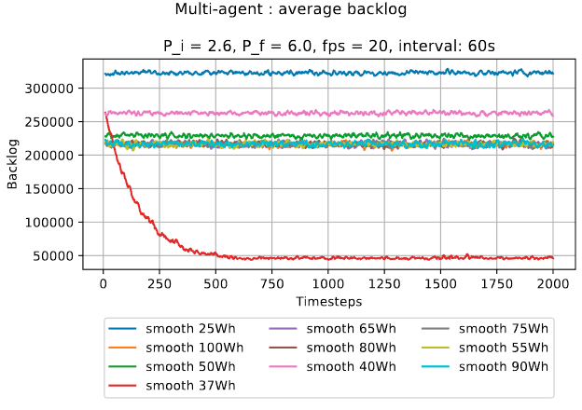
Third test: intelligent 37Wh
Imported trained model of node with 50Wh

Slide 11
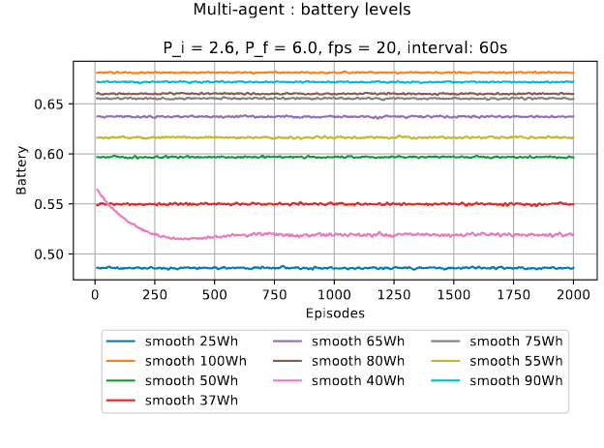
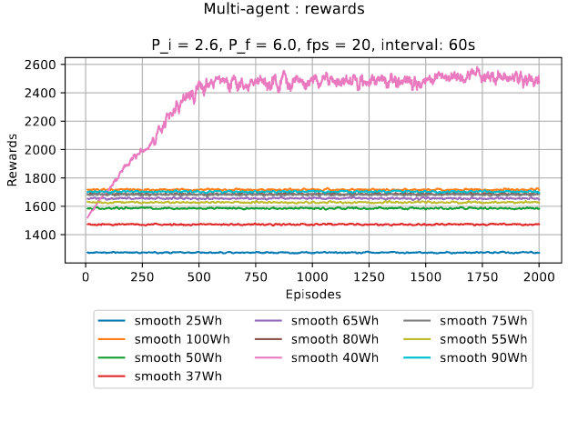
Fourth test: intelligent 40Wh
Imported trained model of node with 37Wh

Slide 12
Fourth test: intelligent 40Wh
Imported trained model of node with 50Wh

Slide 13
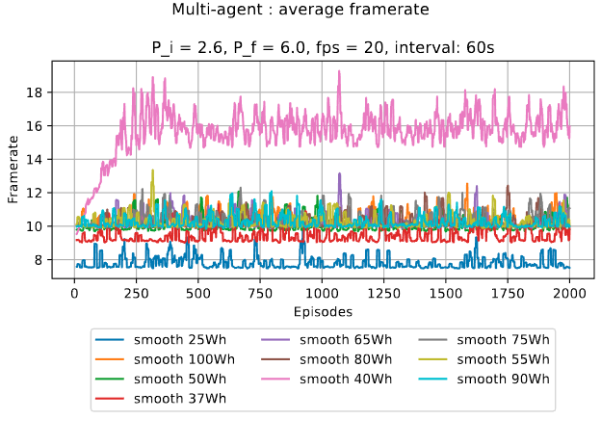
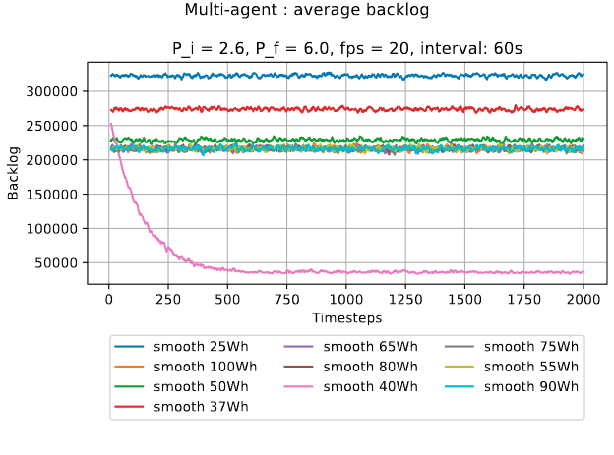
Fourth test: intelligent 40Wh
Imported trained model of node with 37Wh

Slide 14
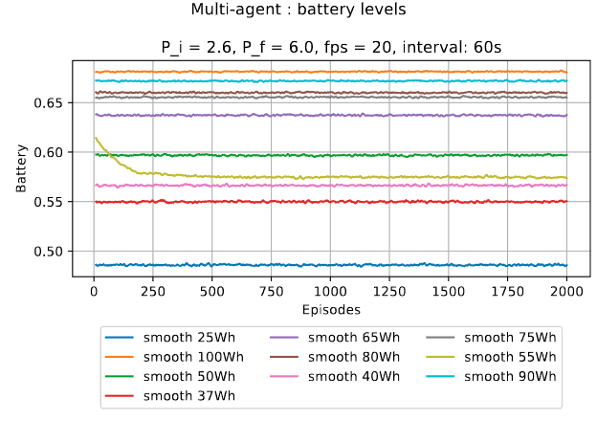
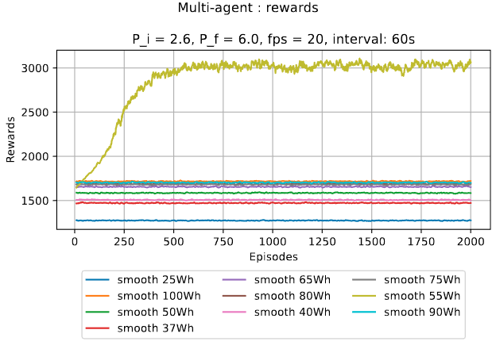
Fourth test: intelligent 55Wh
Imported trained model of node with 40Wh

Slide 15
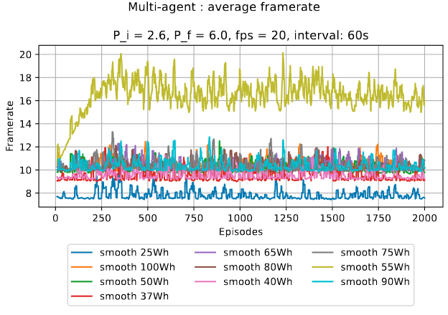
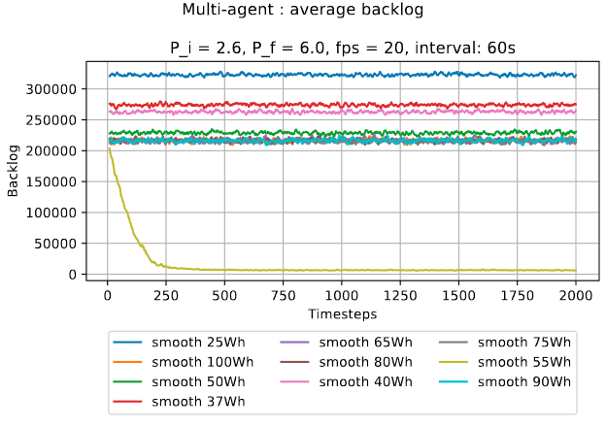
Fifth test: intelligent 55Wh
Imported trained model of node with 40Wh

Slide 16
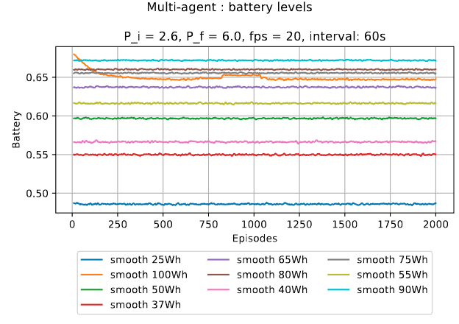
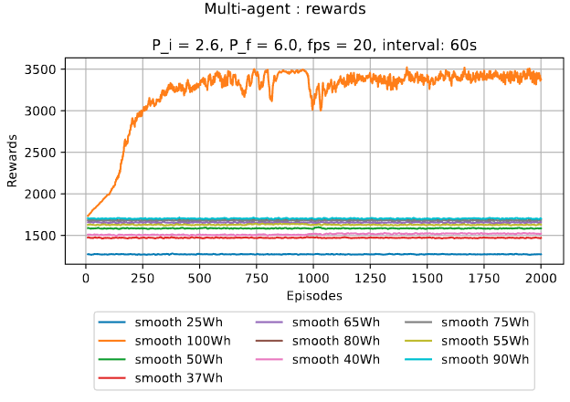
Sixth test: intelligent 100Wh
Imported trained model of node with 55Wh

Slide 17
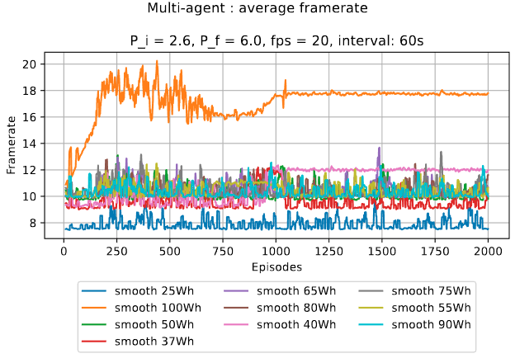
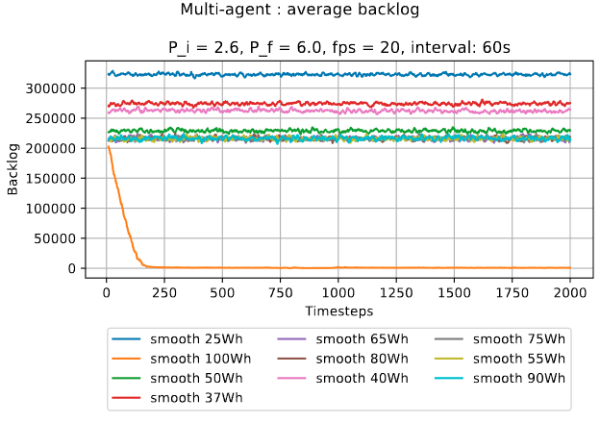
Sixth test: intelligent 100Wh
Imported trained model of node with 55Wh

Slide 18
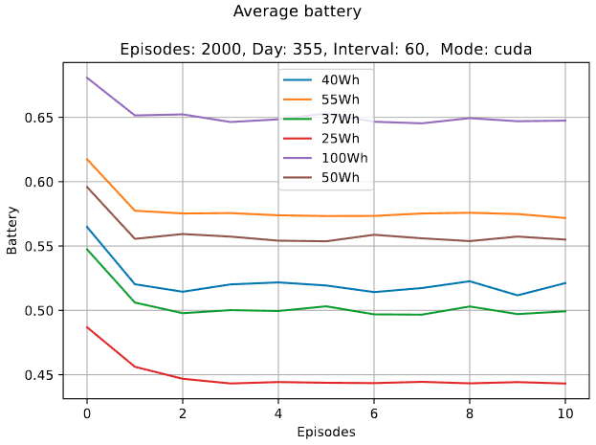
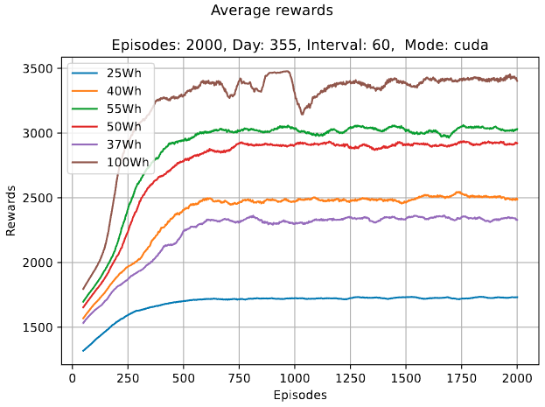
Comparison

Slide 19
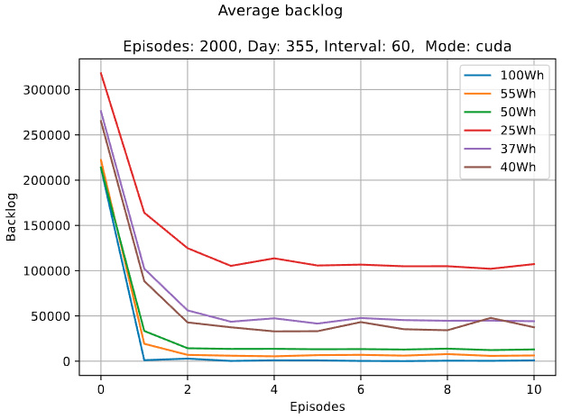
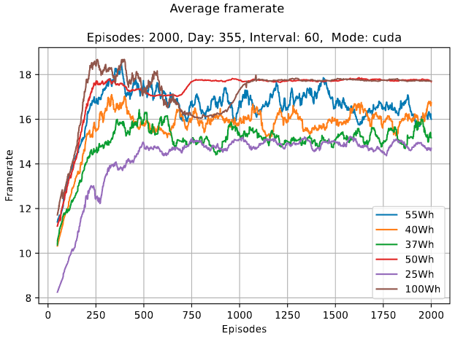
Comparison

