Slide 1
Local Info only
Lorenzo Pecorari - 1885161

Slide 2
Lighten the observation
From s_{t}^{i} = [b_{t}^{i}, q_{t}^{i}, τ_{t}^{i}, mb_{t}^{i}, Mb_{t}^{i}, $$μ$$b_{t}^{i}, mq_{t}^{i}, Mq_{t}^{i}, $$μ$$q_{t}^{i}]
To s_{t}^{i} = [b_{t}^{i}, q_{t}^{i}, τ_{t}^{i}]
Agents can rely only on information coming from their local state
Observation with same dimensionality of single agent formulation
Smaller observation space wrt initial formulation
Interesting to compare performances between “full” aggregated, partial and no global information

Slide 3
Comparisons
“Local only” → s_{t}^{i} = [b_{t}^{i}, q_{t}^{i}, τ_{t}^{i}]
Agent only knows its battery, backlog and time
“Reduced states” → s_{t}^{i} = [b_{t}^{i}, q_{t}^{i}, τ_{t}^{i}, $$μ$$b_{t}^{i}, $$μ$$q_{t}^{i}]
Agent knows also average battery and average backlog status of others
“Aggregated states” → s_{t}^{i} = [b_{t}^{i}, q_{t}^{i}, τ_{t}^{i}, mb_{t}^{i}, Mb_{t}^{i}, $$μ$$b_{t}^{i}, mq_{t}^{i}, Mq_{t}^{i}, $$μ$$q_{t}^{i}]
Agent knows also min and max of battery and backlog status of others

Slide 4
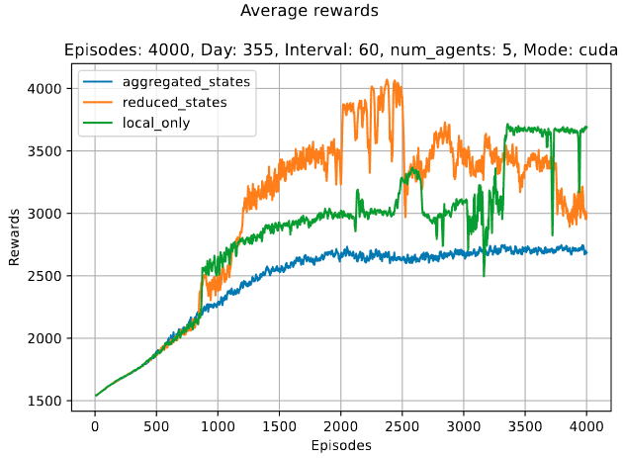
Rewards comparison
State aggregation leads to lower rewards with a more stable curve
Giving only local information to agents determines better rewards than aggregated info
Allowing agents to observe an average of others’ metrics seems to be the better trade-off between the configurations

Slide 5
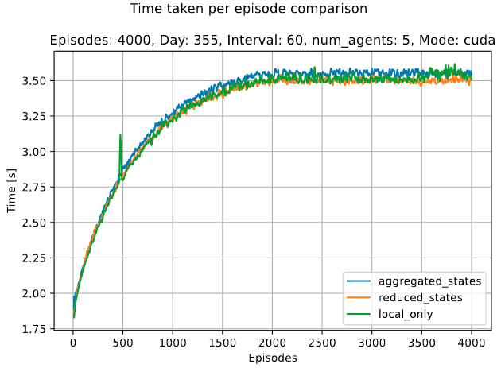
Time comparison
Temporal performances seems to be very similar across the different configurations
No relevant differences between “heavier” informations

Slide 6
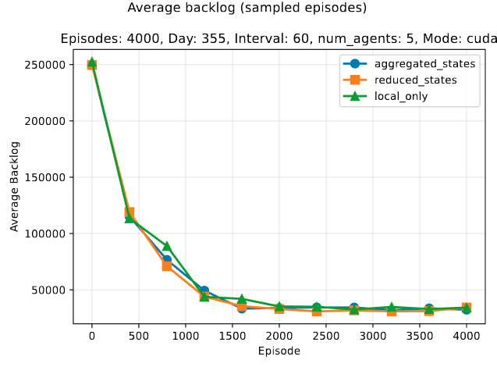
Backlog comparison
No significant differences between different configurations
“Reduced states” slightly better than others two

Slide 7
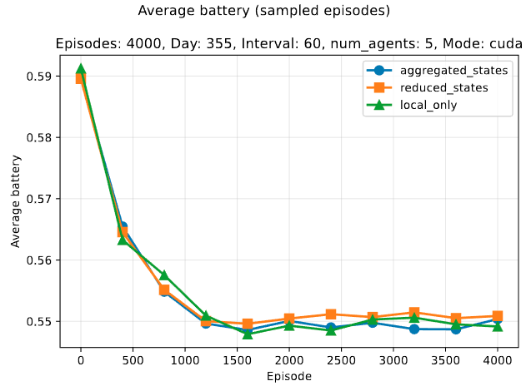
Battery comparison
Better battery management for “reduced states” configuration
“aggregated states” tends to consume more energy than others

Slide 8
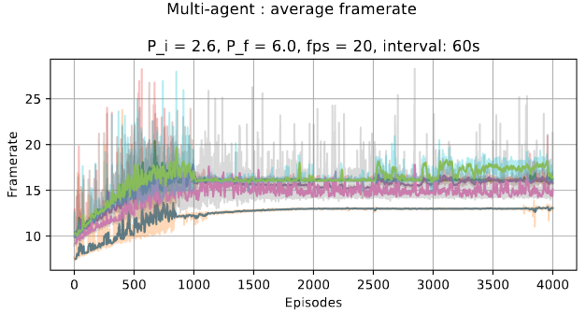
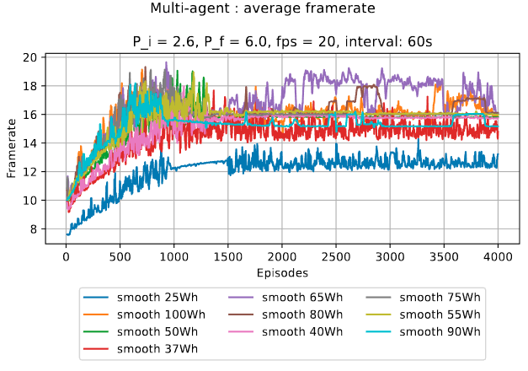
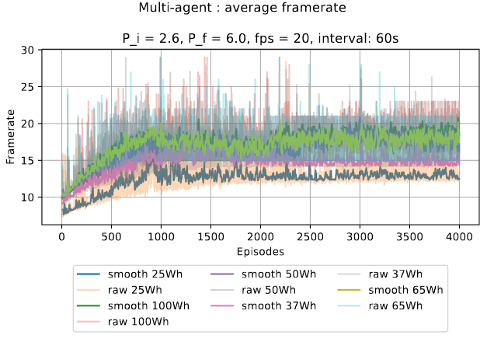
Framerate comparison
REDUCED STATES
“Reduced states” configuration shows faster convergence and more stable if compared with others
LOCAL INFO ONLY
AGGREGATED STATES

Slide 9
More expressive information
Z score and sigmoid

Slide 10
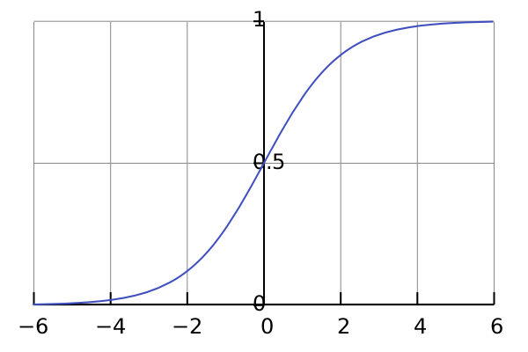
Limiting the z-score
Due to the range (-∞, +∞) of the output of z(x), it can be applied a limitation of its value to smaller intervals
Ex: sigmoid function and sigmoid can cope such problem
sigmoid: ℝ^{k} → [0, +1]
$$sigmoid\left(x\right)= σ(z(x)) = \frac{1}{1 + e^{-x}}$$
Agent in:
Similar conditions → ~0.5
Better conditions → >0.5
Worse conditions → <0.5

Slide 11
Formulation with sigmoid
Using z-score for finding position of agent metrics wrt the group
Using tanh for delimit the z-score
From s_{t}^{i} = [b_{t}^{i}, q_{t}^{i}, τ_{t}^{i}, mb_{t}^{i}, Mb_{t}^{i}, $$μ$$b_{t}^{i}, mq_{t}^{i}, Mq_{t}^{i}, $$μ$$q_{t}^{i}]
To s_{t}^{i} = [b_{t}^{i}, q_{t}^{i}, τ_{t}^{i}, σ(z(b_{t}^{i})), σ(z(q_{t}^{i}))]
where:
σ(z(x)) = $$\frac{1}{1 + e^{-x}}$$
from 9 dimensions to 5

Slide 12
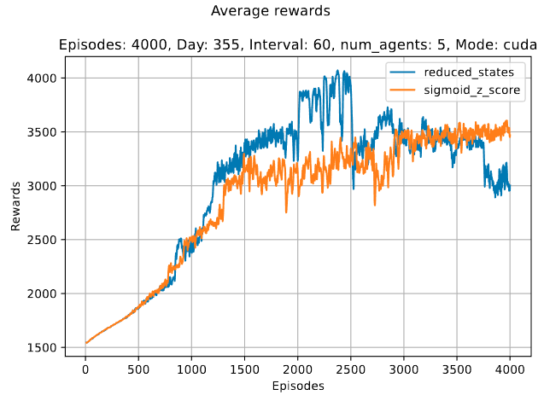
Rewards comparison
Adoption of sigmoid and z-score introduces more gradual growth of rewards with overtake in final phases of training

Slide 13
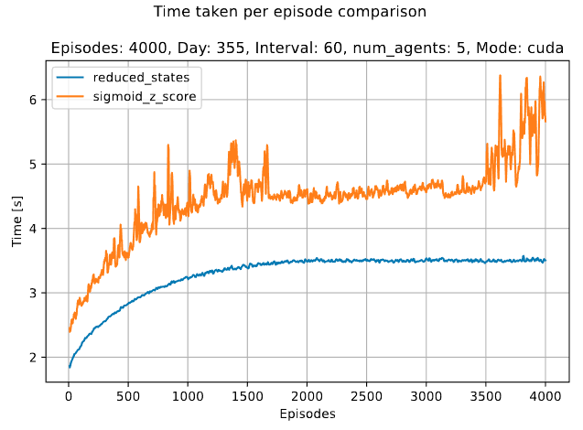
Time comparison
Higher time required by newer configuration
Note: reduced states uses library function “numpy.mean”, which is optimized while sigmoid configuration uses a hand-made version

Slide 14
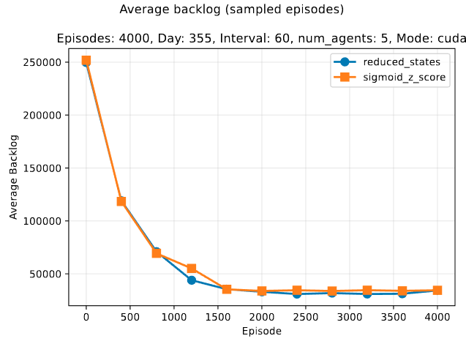
Backlog comparison
Slightly higher average backlog for configuration using sigmoid and z-score
Convergence to same result after epsilon reaches the min value

Slide 15
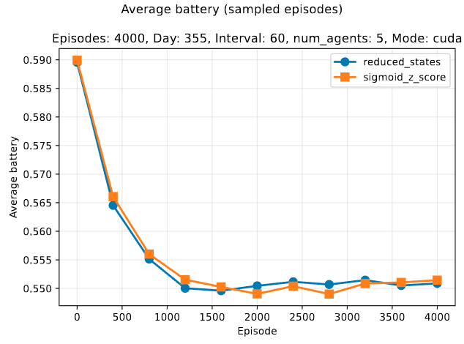
Battery comparison
Initial advantage of sigmoid configuration with interleaving along the training
Slightly advantage in final phases of episodes for newer configuration

Slide 16
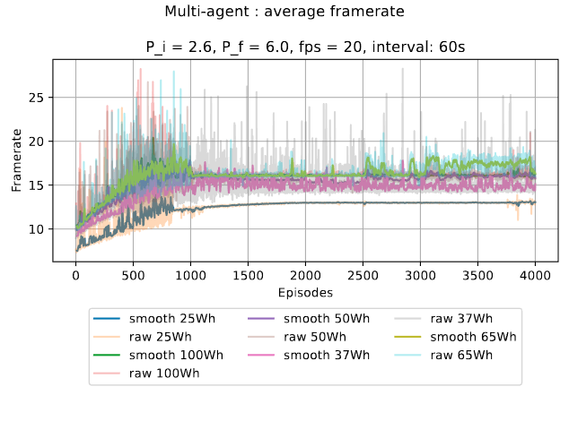
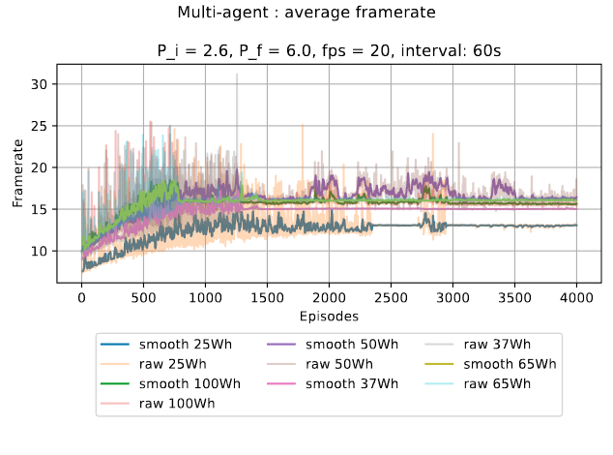
Framerate comparison
REDUCED STATES
SIGMOID Z SCORE
No relevant differences between the configuration
Slightl greater oscillation of second version

