Slide 1

Comparative Study on the Scalability of Multi-Agent Reinforcement Learning for Workload Offloading in Solar-Powered Edge Networks

Slide 2
Introduction
Solar-powered edge nodes with constant workload
Energy source coming from solar irradiance
Devices usually adopt static thresholds for balancing computational efficiency and energy availability
Variations on solar energy can compromise operability
Reinforcement Learning as approach to make nodes capable to automatically adapt to different situations

Slide 3





General problem
Constant arrival rate for incoming frames: λ = 15fps
Maximum computational rate: μ = 20fps
FIFO queue for storing frames, devices adapts μ for balancing energy and performances
Limited energy availability given by solar panel and battery
q_{i}(t)
λ
μ_{i}(t)

Slide 4
Energy constraints
Irradiance: electomagnetic radiation power incident on a surface, $$G(t)$$ in W/m²
Real data taken from Solcast, referred to year 2024
Solar panel with area $$A_{PV}$$ and efficiency $$η_{PV}$$
Energy, in J, from solar light:
$$E_{PV}(t)= \int{G(t)A_{PV}η_{PV} dt}$$
Battery with nominal capacity $$B$$ in Wh

Slide 5
Energy constraints
Raspberry Pi 4-like devices with idle power consumption of 2.6W and 6.0W at full load
If local computation only → 3.4W for frames elaboration
If local and communications → 3.4W in 80:20 ratio
Dynamics of battery energy:
$$E_{Battery}\left(t+1\right) = E_{Battery}\left(t\right)+E_{PV}\left(t\right)-(E_{Frames}\left(t\right)+E_{TXRX}\left(t\right)+E_{Idle})$$
Where $$E_{Frames}\left(t\right)$$ , $$E_{TXRX}\left(t\right)$$, $$E_{Idle}$$ are energy required in t for processing frames, communicating and idling respectively

Slide 6
Single-agent and multi-agent RL
Energy and transition dynamics encoded in isolated or cooperative environments
Single-agent RL:
Local state only in observations
Action space restricted to local framerate
Multi-agent RL:
with indipendent learners
different observations design
Action space extended with workload offloading

Slide 7
Learning algorithms
Tabular Q-learning:
Multidimensional arrays for representing state-actions tuples
Exponential complexity in MARL wrt number of agents (N)
Update rule following Bellman equation
Useful for understaning initial dynamics
Deep Q-Networks (DQN MLP):
Approximators for Q-function, indirect application
Linear growth wrt N
Higher scalability in MARL
Useful for complex scenarios

Slide 8
Setup
Simulation of network from 1 to 10 nodes
Implementation in Python using Gymnasium, PettingZoo and Stable-Baselines 3 as main libraries
Agents specifications:
Battery capacities: [25, 100, 50, 37, 65, 80, 40, 75, 55, 90] Wh
PV areas: [1.00, 0.50, 0.75, 0.85, 0.65, 0.55, 0.90, 0.30, 0.80, 0.52] m²
Irradiance data of December 21th 2024

Slide 9
Single-agent RL: formulation
Isolated agents without cooperation
Observations: o_{t}^{i} = [b_{t}^{i}, q_{t}^{i}, τ_{t}^{i}]
b_{t}^{i} as residual battery energy over capacity
q_{t}^{i} as backlog level on a scale 0-4
τ_{t}^{i} as timestep over total steps for episode
Actions: a_{t}^{i} ∊ [0, μ_{max, i}] framerate adopted in t
Table size: |O^{i}×A^{i}| = |O^{i}|×|A^{i}|
State discretization for accessing table

Slide 10
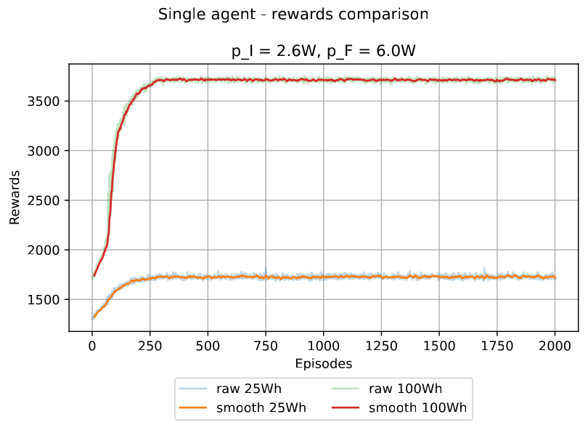
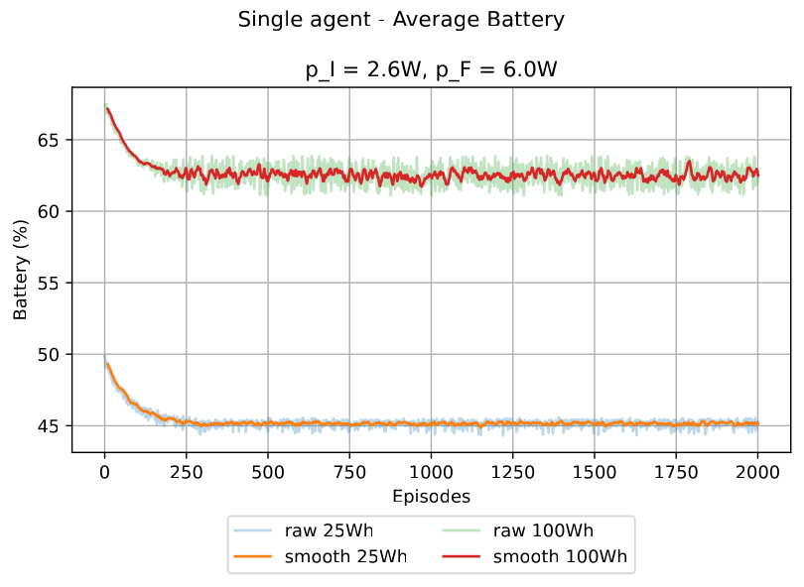
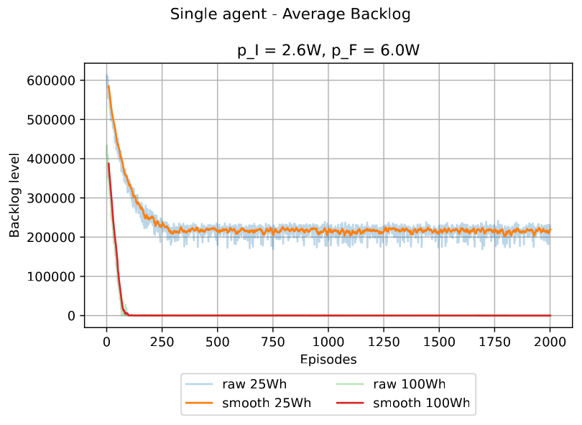
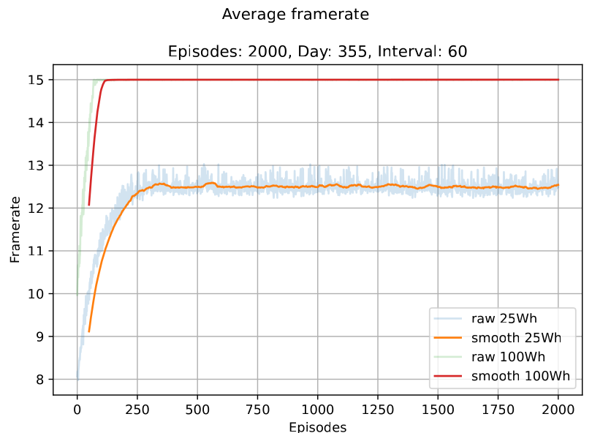
Single-agent RL:experiments

Slide 11
Multi-agent RL: formulations
Agents can use offloading for cooperation
Different number of agents in the system
Action space: a_{t}^{i} = [f_{t}^{i}, x_{t}^{i}, g_{t}^{i}, h_{t}^{i} ]
f_{t}^{i} as local framerate
x_{t}^{i} as offloading mode (no off., send, receive)
g_{t}^{i} as id offloading target
h_{t}^{i} as local framerate
Different formulation for observation space:
Full-state: all the local state of others
Aggregated-states: local state min/avg/max of batteries & backlog
Reduced-states: local state and avg of metrics
Local-only: local state

Slide 12
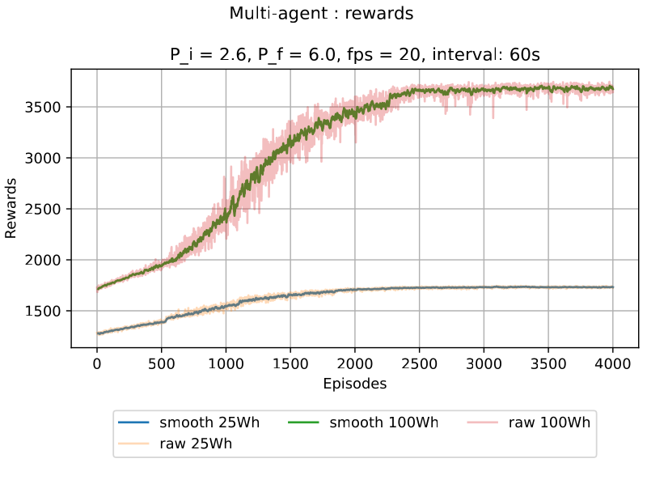
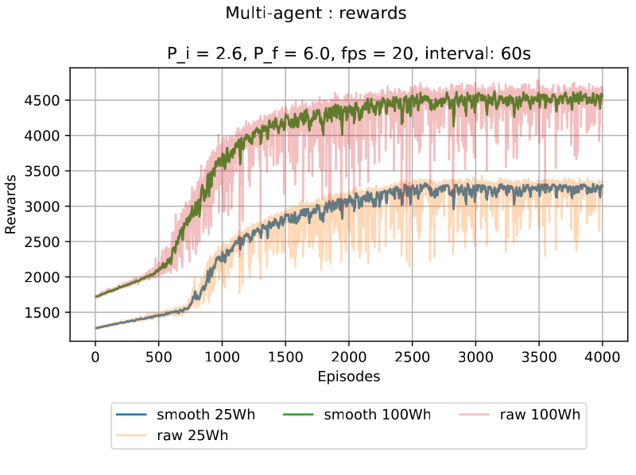
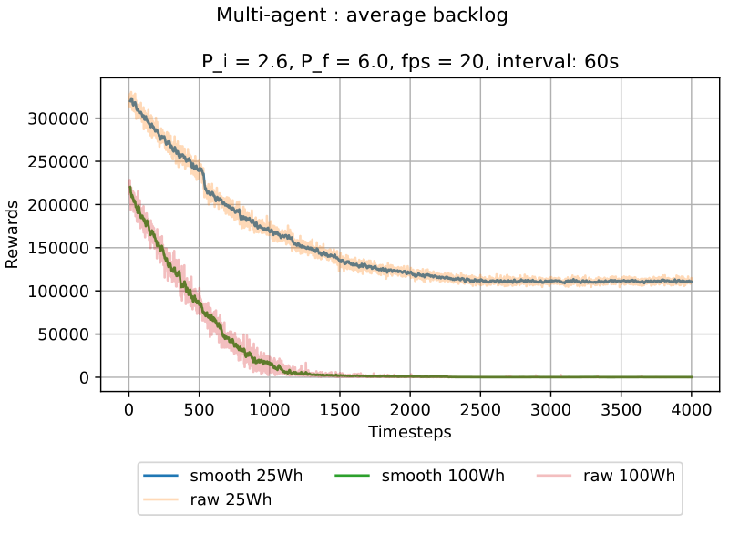
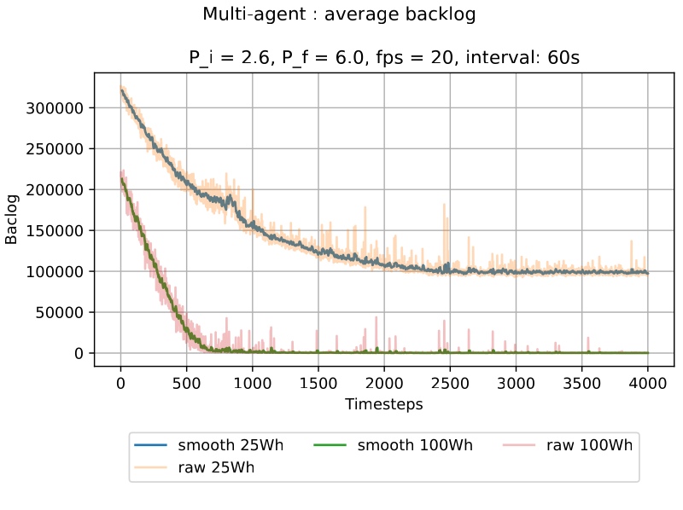
MARL: N=2, full-states
TABULAR
DQN

Slide 13
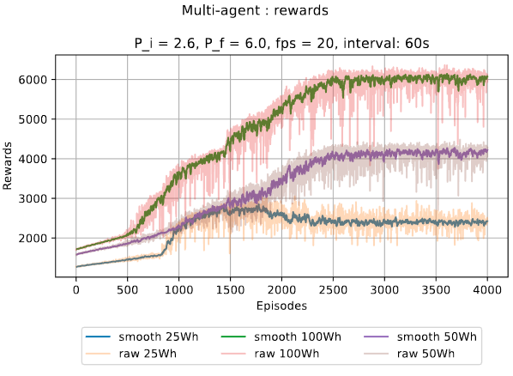
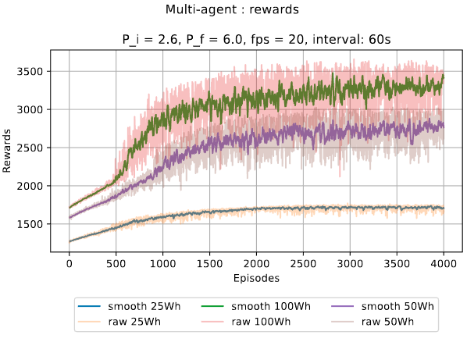
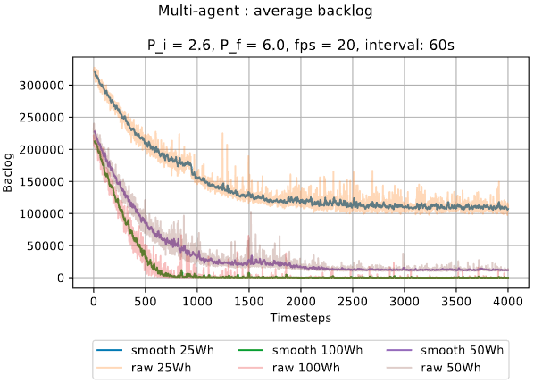
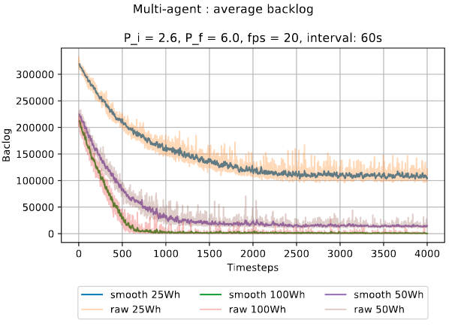
MARL: N=3 - DQN
FULL-STATES
AGGREGATED-STATES

Slide 14
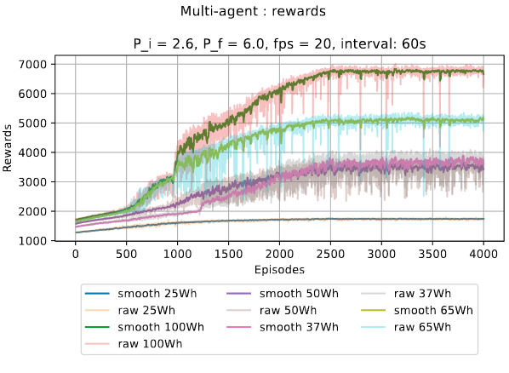

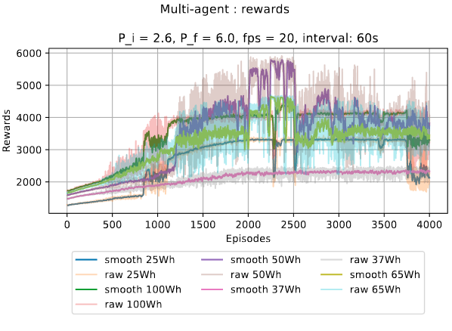
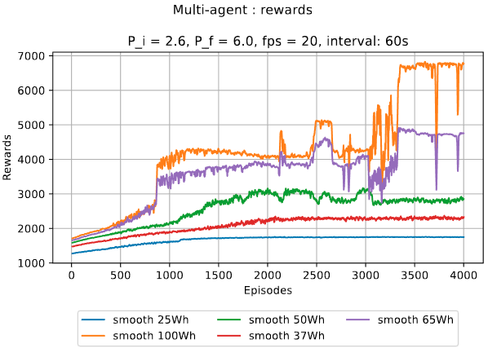
MARL: N=5 - DQN (rewards)
FULL-STATES
AGGR.-STATES
REDUCED-STATES
LOCAL-ONLY

Slide 15
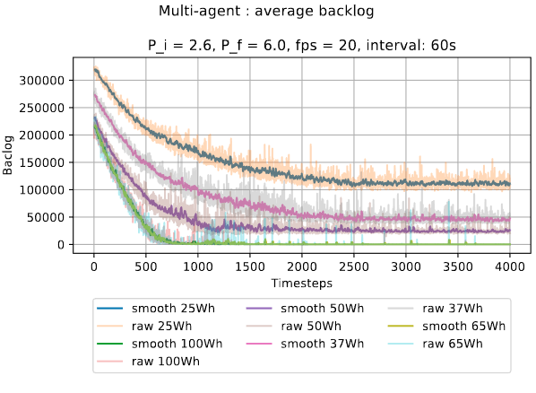
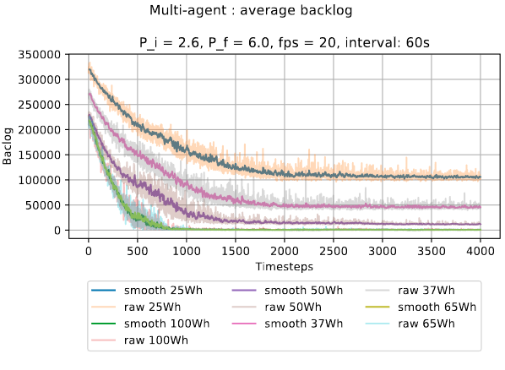
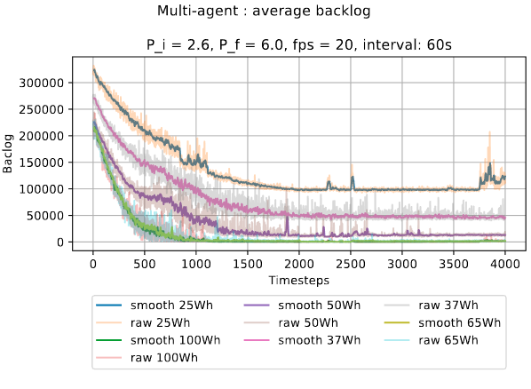
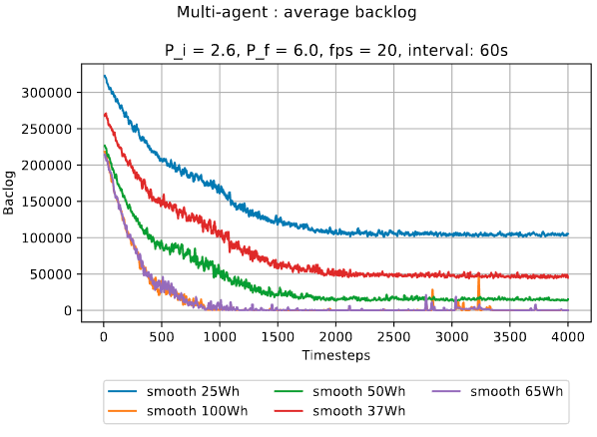
MARL: N=5 - DQN (backlog)
FULL-STATES
AGGR.-STATES
REDUCED-STATES
LOCAL-ONLY

Slide 16
MARL: N=10 - DQN
Experimental approach: training an agent per time with N-1 acting randomly
Saving model and retrain another agent starting with the pre-trained model
Repeat until model has not been trained by all the agents
Attempt to obtain a model capable to generalize with every node
Run with all agents having this model

Slide 17
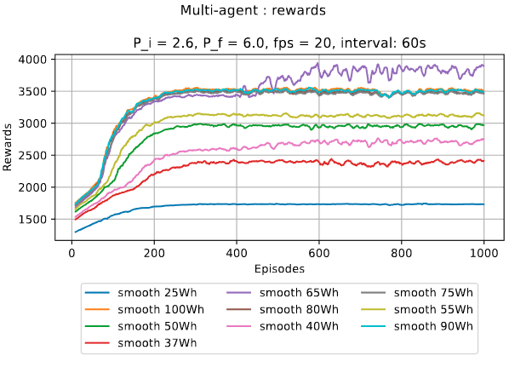
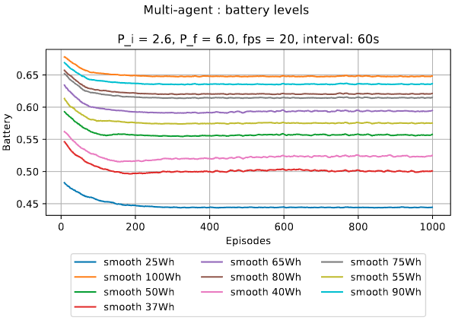
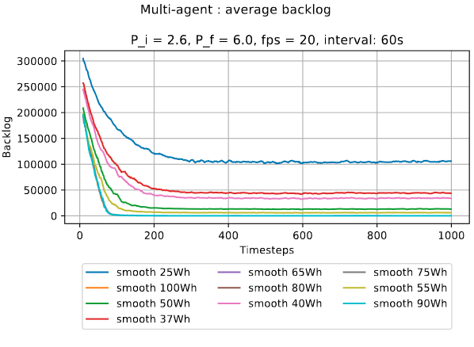
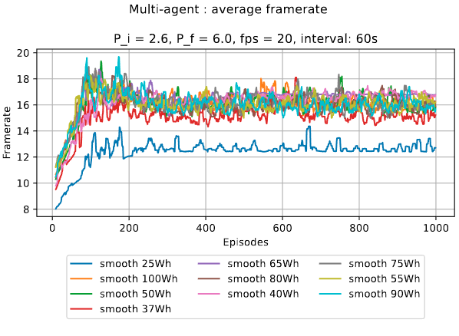
MARL: N=10 - DQN

Slide 18
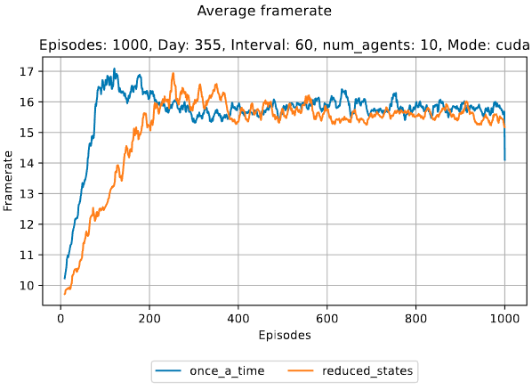
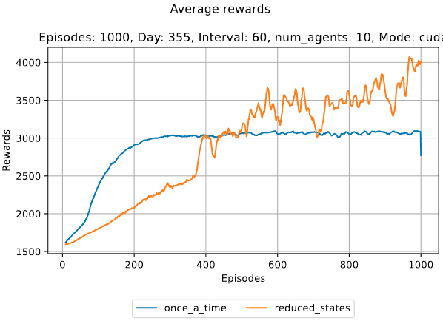
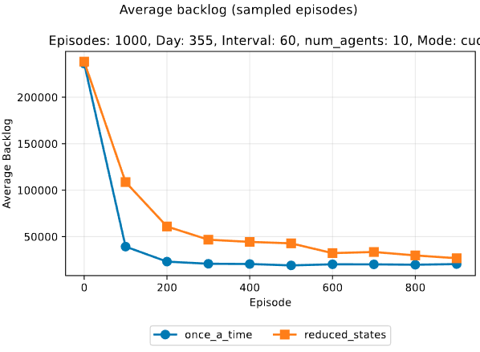
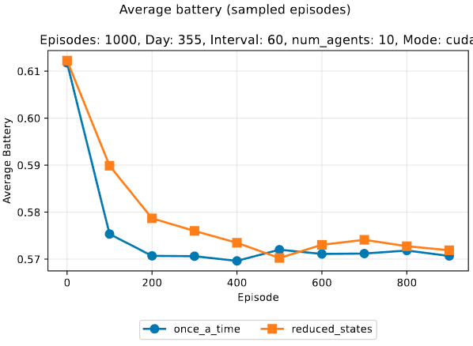
MARL: N=10 – pre-trained vs zero

