Slide 1

Comparative Study on the Scalability of Multi-Agent Reinforcement Learning for Workload Offloading in Solar-Powered Edge Networks
Advisor
Prof. Roberto Beraldi

Slide 2
Introduction
Solar-powered edge nodes with constant workload
Energy source coming from solar irradiance
Devices usually adopt static thresholds for balancing computational efficiency and energy availability
Variations on solar energy can compromise operability
Reinforcement Learning as approach to make nodes capable to automatically adapt to different situations

Slide 3





Problem
Constant arrival rate for incoming frames: λ = 15fps
Maximum computational rate: μ_{max} = 20fps
FIFO queue for storing frames, needed to adapt μ :
Real data taken from Solcast, referred to year 2024
Battery capacity B in Wh, solar panel with $$A_{PV}$$ in m² and $$η_{PV}$$
Energy, in J, from solar light:
$$E_{PV}(t)= \int{G(t)A_{PV}η_{PV} dt}$$
Solar irradiance $$G(t)$$ in W/m²
λ
q_{i}(t)
μ_{i}(t)

Slide 4
Energy constraints
Raspberry Pi 4-like devices with idle power consumption of 2.6W and 6.0W at full load
If local computation only → 3.4W for frames elaboration
If local and communications → 3.4W in 80:20 ratio
Dynamics of battery energy:
$$E_{Battery}\left(t+1\right) = E_{Battery}\left(t\right)+E_{PV}\left(t\right)-(E_{Frames}\left(t\right)+E_{TXRX}\left(t\right)+E_{Idle})$$
Where $$E_{Frames}\left(t\right)$$ , $$E_{TXRX}\left(t\right)$$, $$E_{Idle}$$ are energy required in t for processing frames, communicating and idling respectively

Slide 5
RL and setup
Paradigms for describing the problem:
Single-Agent RL based on MDP
Multi-Agent RL based on Stochastic games
both with independent learners
Learning algorithms:
Tabular Q-Learning using multidimensional arrays
Deep Q-Networks adopting MLP approximators
Simulation of network from 1 to 10 nodes
Python with Gymnasium, PettingZoo and Stable-Baselines 3
Agents specifications:
Battery capacities: [25, 100, 50, 37, 65, 80, 40, 75, 55, 90] Wh
PV areas: [1.00, 0.50, 0.75, 0.85, 0.65, 0.55, 0.90, 0.30, 0.80, 0.52] m²
Irradiance data of December 21th 2024

Slide 6
Single-agent RL: formulation
Isolated agents without cooperation
Observations: o_{t}^{i} = [b_{t}^{i}, q_{t}^{i}, τ_{t}^{i}]
b_{t}^{i} as residual battery energy over capacity
q_{t}^{i} as backlog level on a scale 0-4
τ_{t}^{i} as timestep over total steps for episode
Actions: a_{t}^{i} ∊ [0, μ_{max, i}] framerate adopted in t
Tabular Q-Learning with table size: |O^{i}×A^{i}| = |O^{i}|×|A^{i}|
State discretization for accessing table

Slide 7
Multi-agent RL: formulations
Agents can use offloading for cooperation
Different number of agents in the system
Action space: a_{t}^{i} = [f_{t}^{i}, x_{t}^{i}, g_{t}^{i}, h_{t}^{i} ]
f_{t}^{i} as local framerate
x_{t}^{i} as offloading mode (no off., send, receive)
g_{t}^{i} as id offloading target
h_{t}^{i} as offloading framerate
Different formulation for observation space:
Full-state: all the local state of others
Aggregated-states: local state min/avg/max of batteries & backlog
Reduced-states: local state and avg of metrics
Local-only: local state

Slide 8
Reward function
Combination of local and offloading actions:
$$R_{i}\left(t\right)$$ = $$R_{i , local}\left(t\right)$$ + $$R_{i , offloading}\left(t\right)$$
Each component takes in consideration various metrics as backlog, remaining battery, computable and comptued frames:
$$R_{i , *}\left(t\right)$$ = $$\frac{processed frames}{processable frames} + \frac{remaining battery}{battery capacity} + \frac{processed frames}{frmaes in backlog}$$
Where:
processable frames = max min (backlog, $$\frac{remaining battery - E_{idle}}{E_{F}}$$ , framerate‧$$∆t$$),0)
processed frames = min(framerate •Δt, processable)

Slide 9
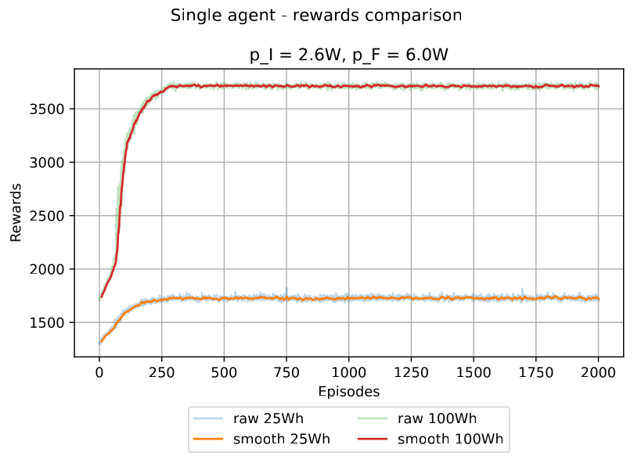
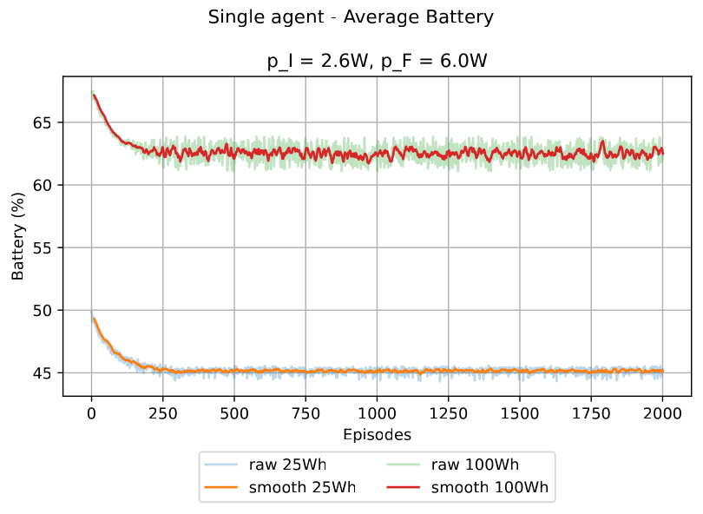
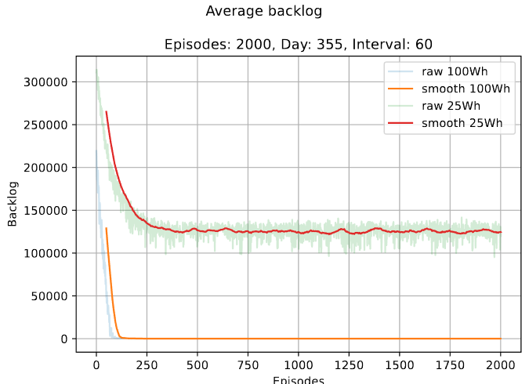
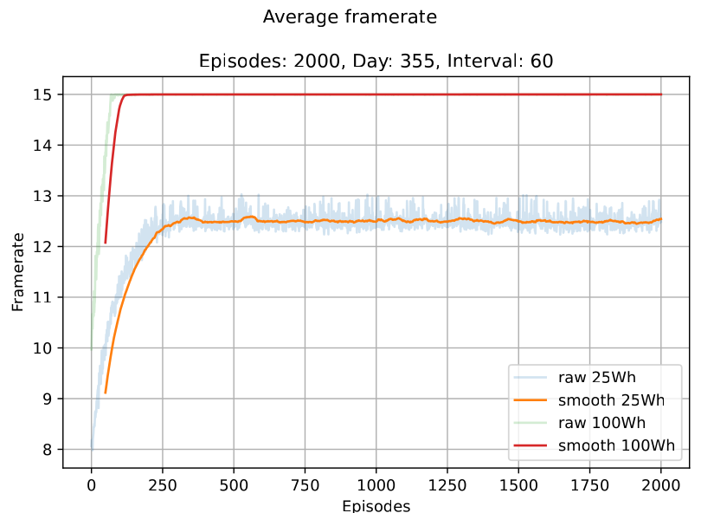
Single-agent RL: experiments

Slide 10
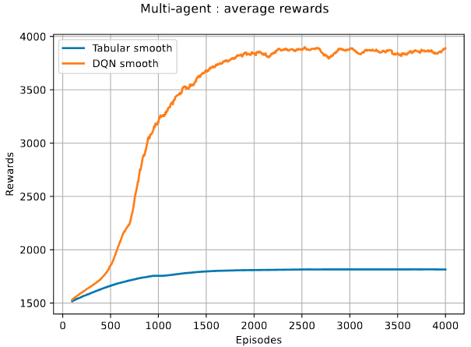
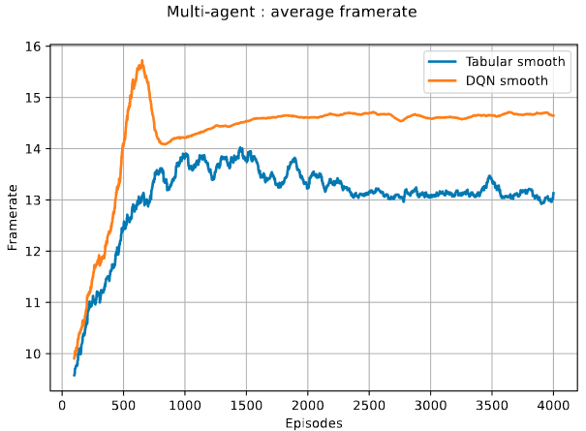
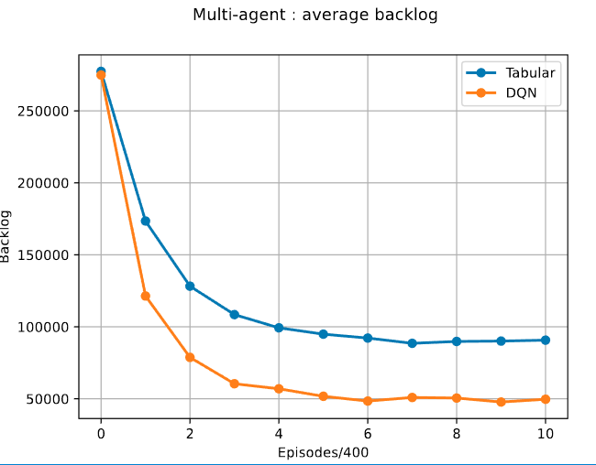
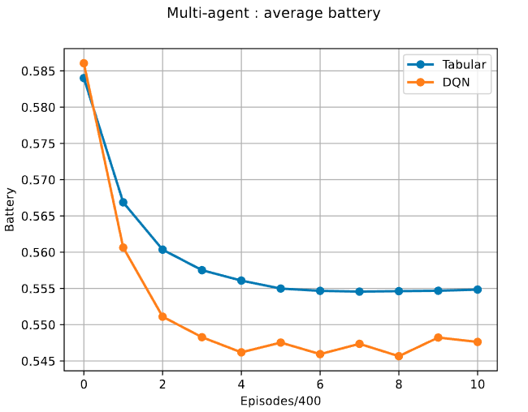
MARL: Tabular-DQN full-state, N=2

Slide 11
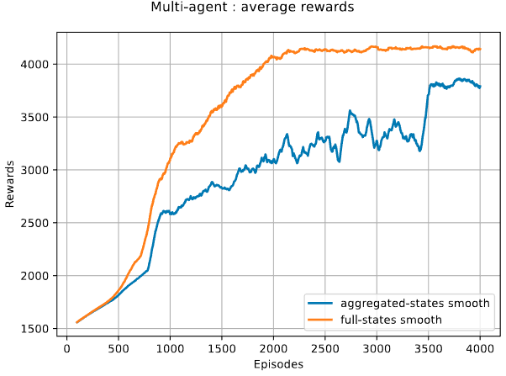
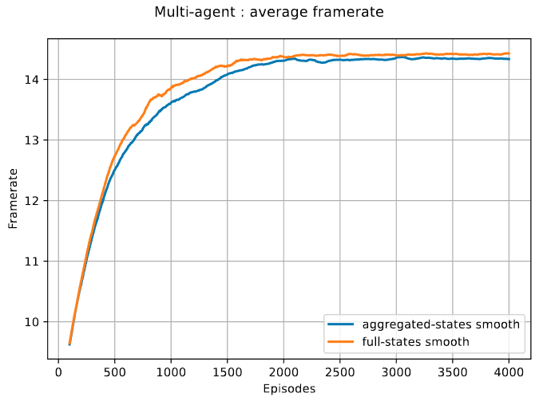
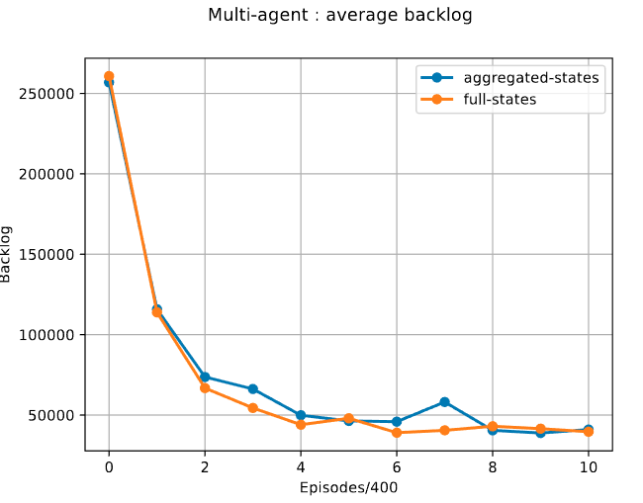
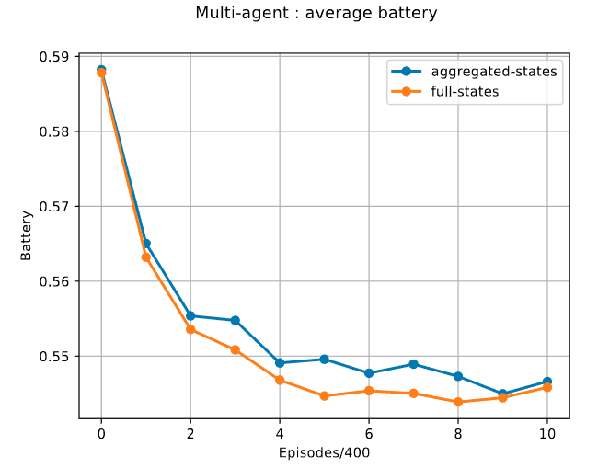
MARL: N=3 - DQN

Slide 12
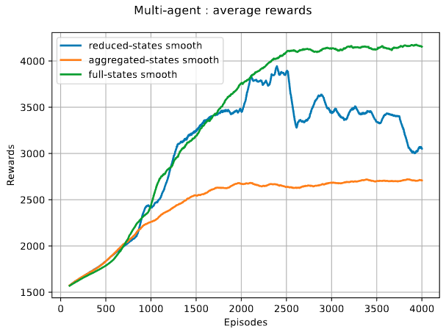
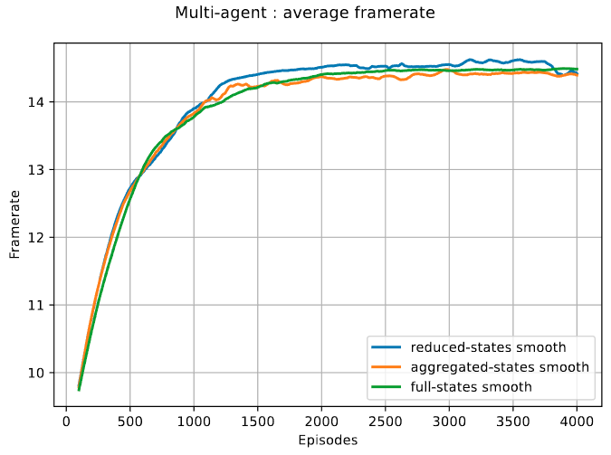
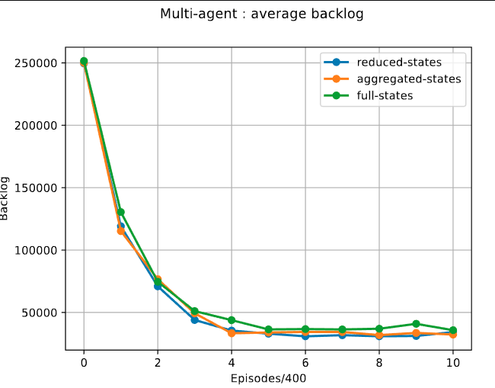
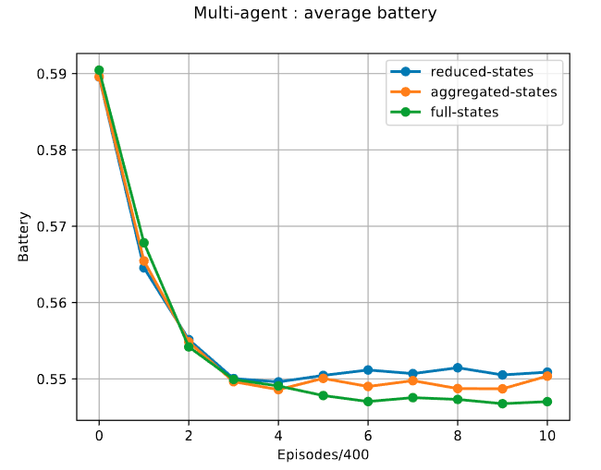
MARL: N=5 - DQN

Slide 13



MARL: N=10 - DQN
Experimental approach: training an agent per time with N-1 acting randomly
Saving model and retrain another agent starting with the pre-trained model
Repeat until model has not been trained by all the agents
Attempt to obtain a model capable to generalize with every node through fine-tuning

Slide 14
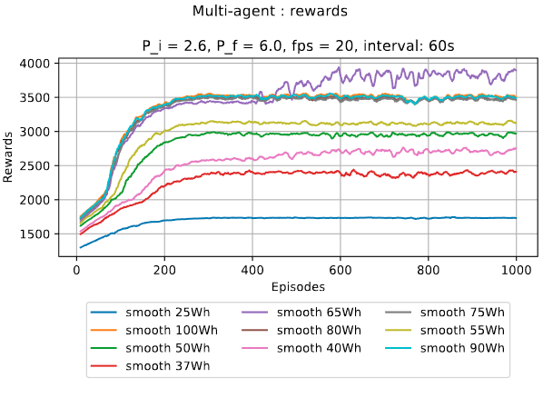
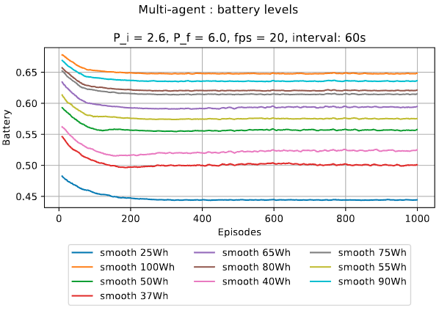
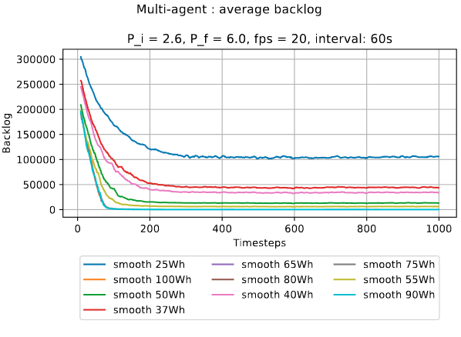
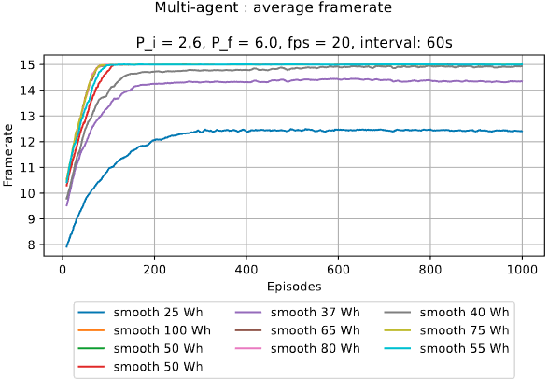
MARL: N=10 - DQN

Slide 15
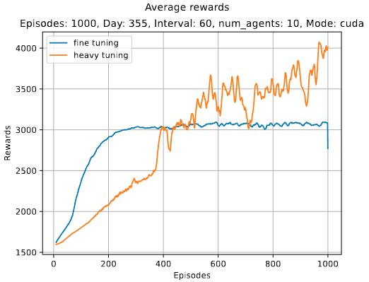
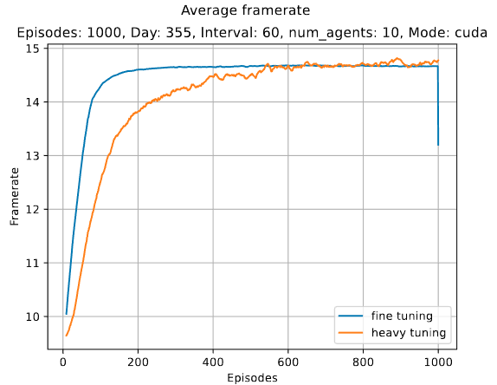
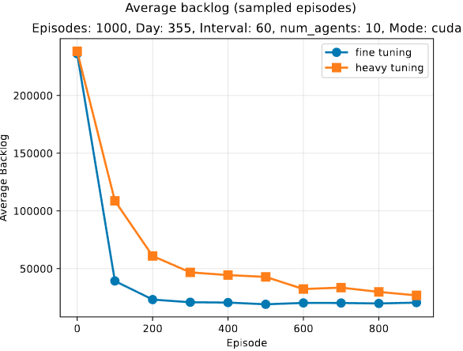
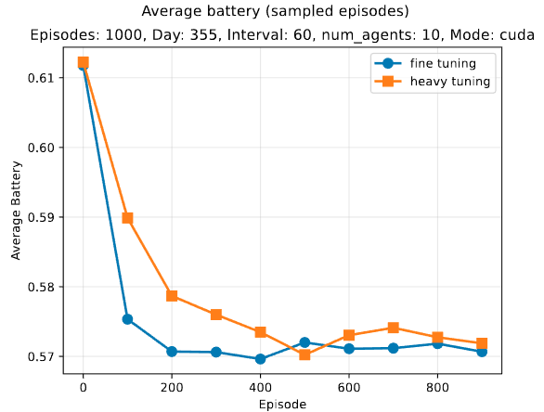
MARL: N=10 - fine vs “heavy” tuning

Slide 16
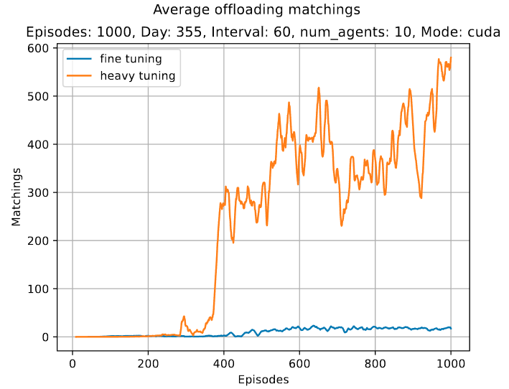
MARL: N=10 - fine vs “heavy” tuning
Fine tuning remarks higher stability than “heavy” tuning because it privileged local computation
Having N-1 agents acting randomly generates a model that knows that other agents may not cooperate
In average, fine tuning scenario leads to lower offloading matching across the system
Training from zero has higher reward due to the generation of policies that tend to cooperate more

