Slide 1
Overview
Architettura logica
enterRequest(CID)
order(CID, TEA)
smartbell
waiter
barman
answer(TIME)
orderReady(CID, TEA)
---------------------------------------------------------------------------------------------------------------------------------------------
waiterResponse(CID)
Ring(N)
readyToPay
readyToOrder
Dispatch
Request
client_simulator*
situation_observer
Reply
Event
*per scopo di simulazione

Slide 2
SPRINT1
Mappa della TeaRoom
0 1 2 3 4 5
6
0
r
1
1
1
1
1
X
X
1
1
1
1
1
1
1
1
1
1
1
1
1
2
3
X
X
1
1
1
1
X X
1
1
1
1
1
4
5
1
X
X
X X
X X
X X

Slide 3
SPRINT1
Architettura Logica
movetoCell(X,Y)
cmd(CMD)
step(TIME)
planner
basicRobot
atCell(X,Y)
stepDone
Dispatch
Request
Reply
Event

Slide 4
SPRINT1
Architettura Logica
obstacle
cmd
movetoCell(X,Y)
step
waiterwalker
basicrobot
atCell(X,Y)
walkBreak
stepDone
stepFail
Dispatch
Request
Reply
Event

Slide 5
SPRINT1
Progetto
project
it.unibo.iss.sprint_1
8050
obstacle
8020
movetoCell
cmd( M )
basicrobot
waiterwalker
step
atCell
walkBreak
stepDone
stepFail
robotSupport
ctxwaiter
virtualRobotSupportQak
mbotSupport
robotDataSourceArduino
project
it.unibo.qak20.basicrobot
TCP socket
Serial
ctxbasicrobot

Slide 6
SPRINT2
Architettura Logica
obstacle
cmd
enterRequest(CID)
movetoCell(X,Y)
step
smartbell
waiterlogic
waiterwalker
basicrobot
atCell(X,Y)
walkBreak
stepDone
stepFail
answer(TIME)
order(CID, TEA)
orderReady(CID, TEA)
barman

Slide 7
SPRINT2
Progetto
project
it.unibo.iss.sprint2
project
it.unibo.qak20.basicrobot
8050
clientsituationkb.pl
maxstaytimeobserver
obstacle
8020
movetoCell
cmd( M )
basicrobot
maxStayTime(CID,CSTATE)
waiterlogic
waiterwalker
step
atCell
walkBreak
stepDone
stepFail
tearoomkb.pl
robotSupport
ctxwaiter
virtualRobotSupportQak
mbotSupport
robotDataSourceArduino
TCP socket
Serial
ctxbasicrobot
smartbell
barman
ctxsmartbell
ctxbarman

Slide 8
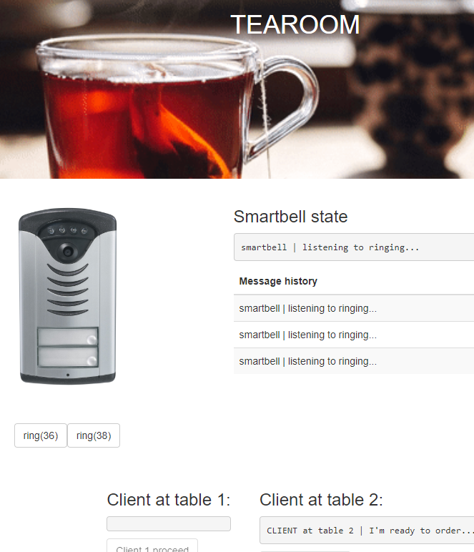

SPRINT3
Progetto
project
it.unibo.iss.clientWeb
project
it.unibo.iss.sprint3
project
it.unibo.qak20.basicrobot
ring(T)
8050
GuiController.java
clientsituationkb.pl
proceed
maxstaytimeobserver
obstacle
8020
webSocket
Interaction
cmd( M )
movetoCell
basicrobot
maxStayTime
waiterlogic
waiterwalker
step
atCell
walkBreak
stepDone
stepFail
tearoomkb.pl
robotSupport
tearoomSocket.html
virtualRobotSupportQak
mbotSupport
robotDataSourceArduino
simulator1
simulator2
smartbell
barman
TCP socket
Serial
ctxbasicrobot
ctxwaiter

Slide 9
SPRINT4
Progetto
project
it.unibo.iss.clientWeb
project
it.unibo.iss.sprint4
project
it.unibo.qak20.basicrobot
ring(TEMP)
GuiController.java
proceed
8050
Coap
Observer
clientsituationkb.pl
maxstaytimeobserver
obstacle
8020
webSocket
Interaction
cmd( M )
maxStayTime
movetoCell
basicrobot
waiterlogic
waiterwalker
step
atCell
walkBreak
stepDone
stepFail
tearoomkb.pl
robotSupport
tearoomSocket.html
virtualRobotSupportQak
mbotSupport
robotDataSourceArduino
simulator1
simulator2
smartbell
barman
TCP socket
Serial
ctxbasicrobot
ctxwaiter

