Slide 1
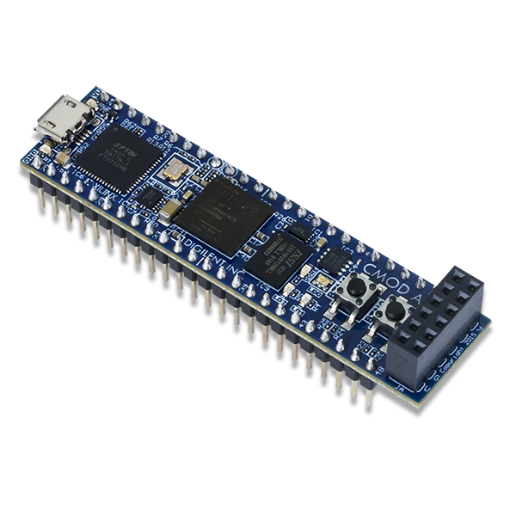


Lorenzo Pina 894396, Simone Rancati 900052
Informatica Industriale
l.pina4@campus.unimib.it, s.rancati8@campus.unimib.it
https://github.com/LorenzoPinaUnimib/InformaticaIndustriale
Microelectronics Group

Slide 2
Final Documentation Report for filter_ma DESIGN
Introduction (1 slide)
Scheme
Main I/O Signals and Parameters
Design of Multiadder, Accumulator e divide_by (max 6 slides)
Testbenches
Final Simulation Results for NFIFO=32, 64, 128 in VIVADO (max 10 slides)
Frequency Response
Time Domain Evolution of ysignal+ynoise
Time Domain Evolution of ynoise
Signal to Noise Ratio
Final Table Resume and Comments
Conclusions (any idea about improvements?)

Slide 3
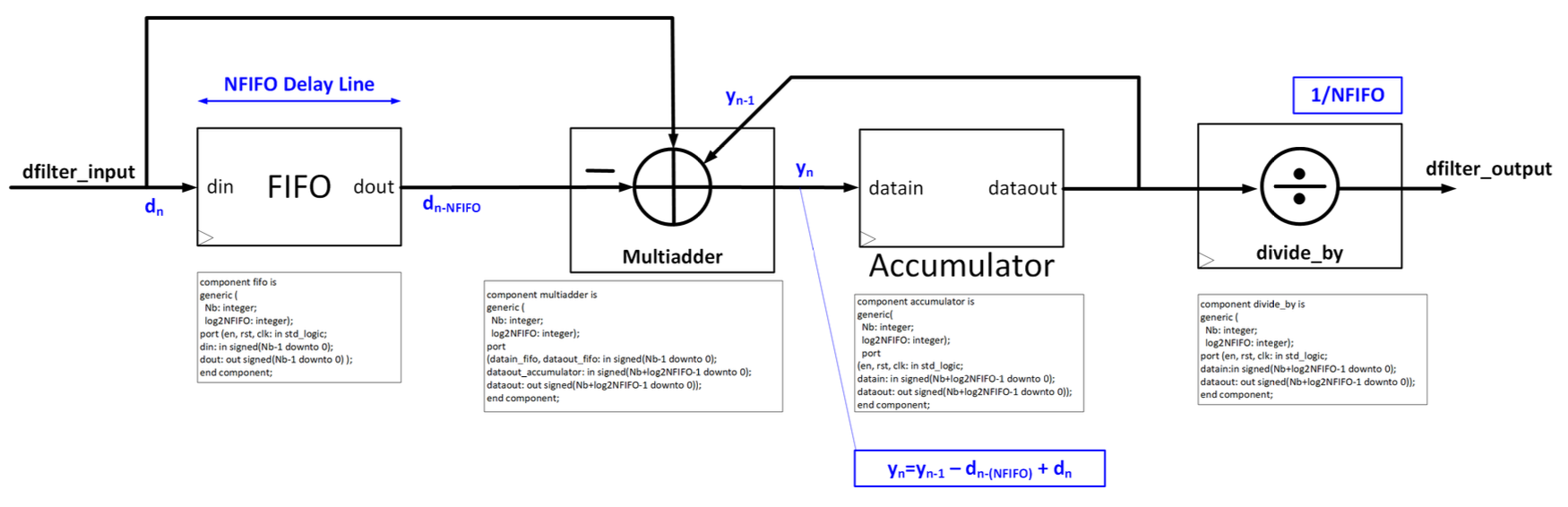
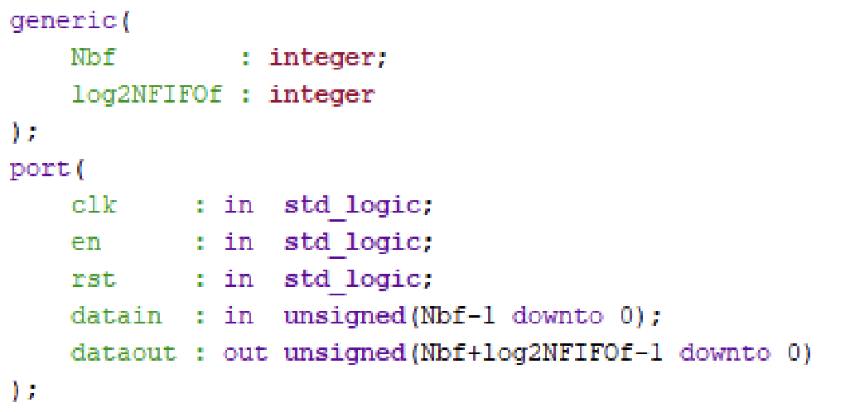
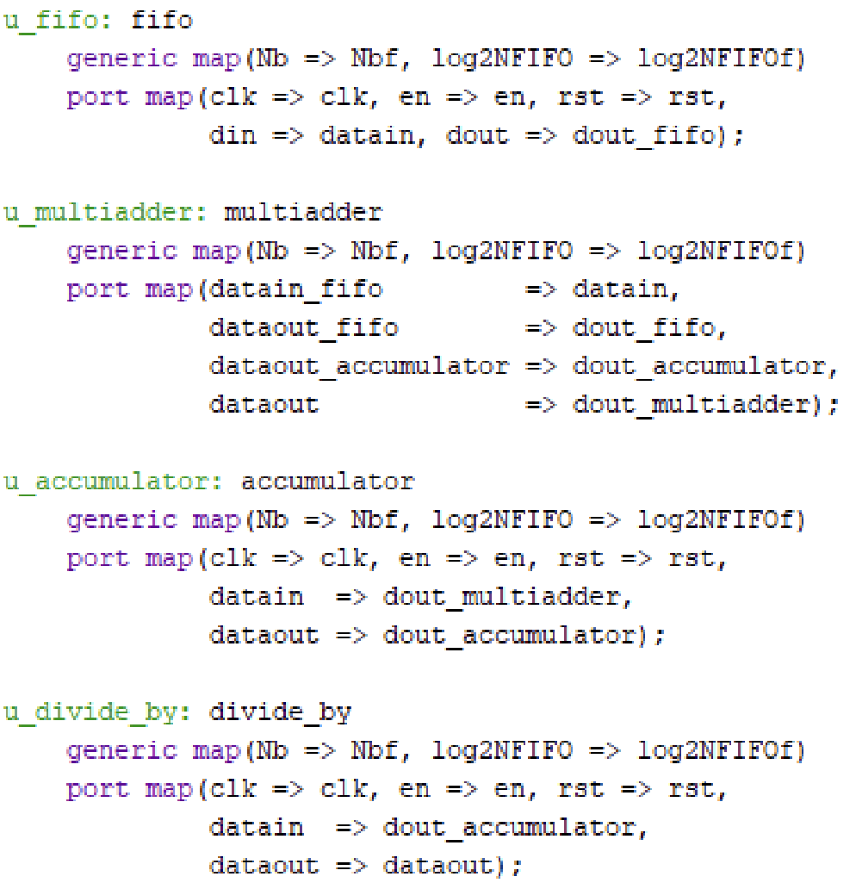
Introduction
Filter_MA uses datain and dataout as input
and output signals
Other signals are used internally to
communicate between components
The parameters used are Nbf and log2NFIFO
Nbf = bit resolution of the original signal
log2NFIFO = log2 of the number of elements in the FIFO

Slide 4
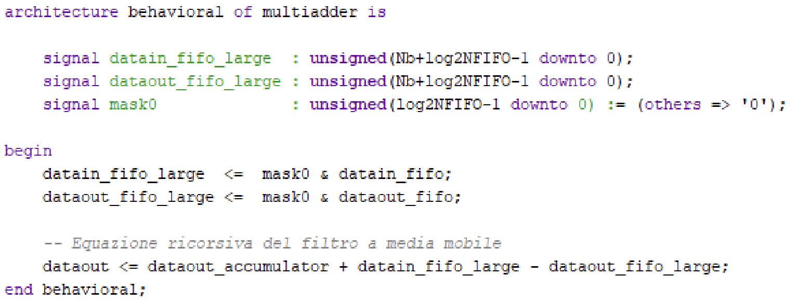
Design of Multiadder
We use mask0 to extend datain_fifo and dataout_fifo to Nb+log2NFIFO-1 bits
We calculate the sum of the last NFIFO elements by taking the last result (saved in the accumulator), removing the last element and adding the new one

Slide 5
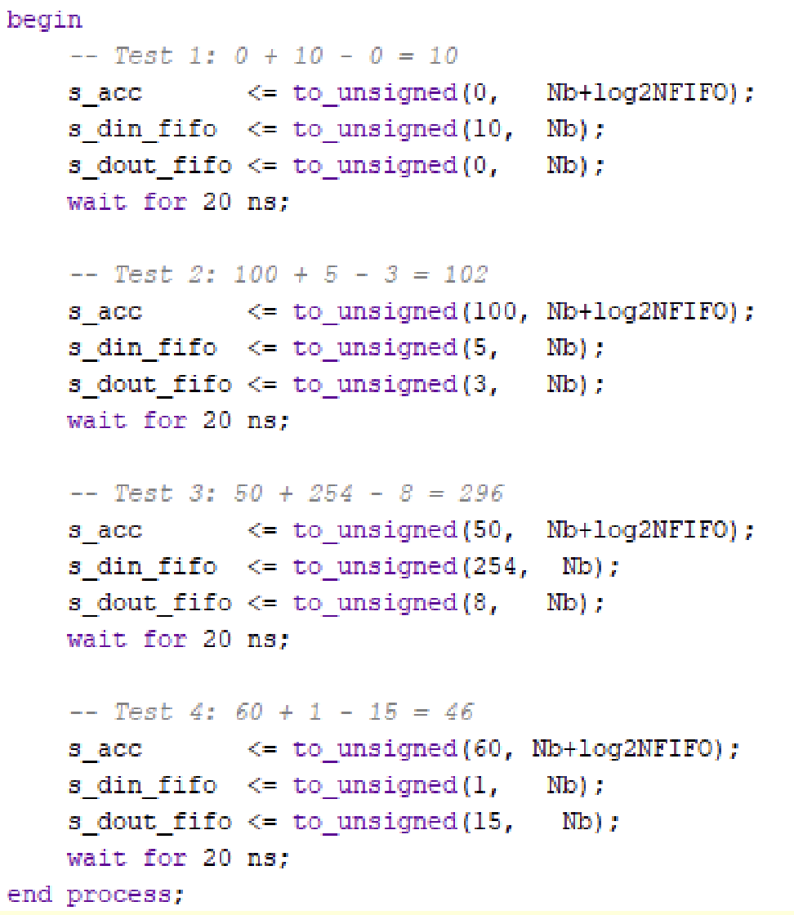
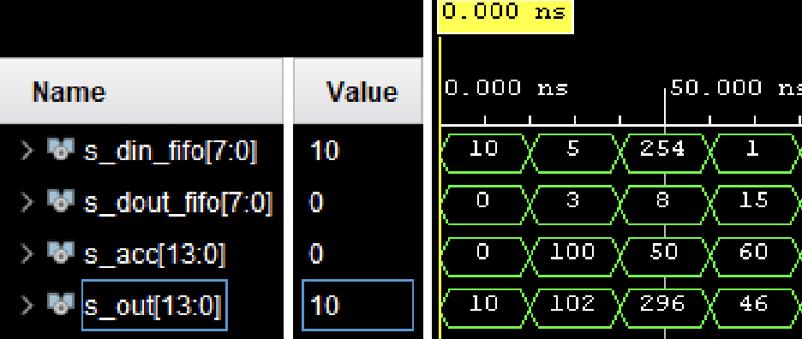
Design of Multiadder - Testbench
We test the Multiadder by doing some math operations

Slide 6
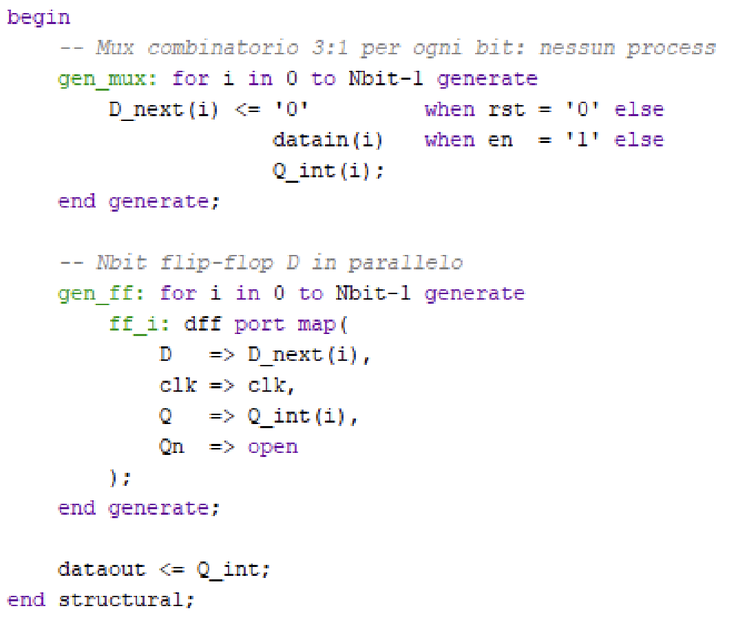
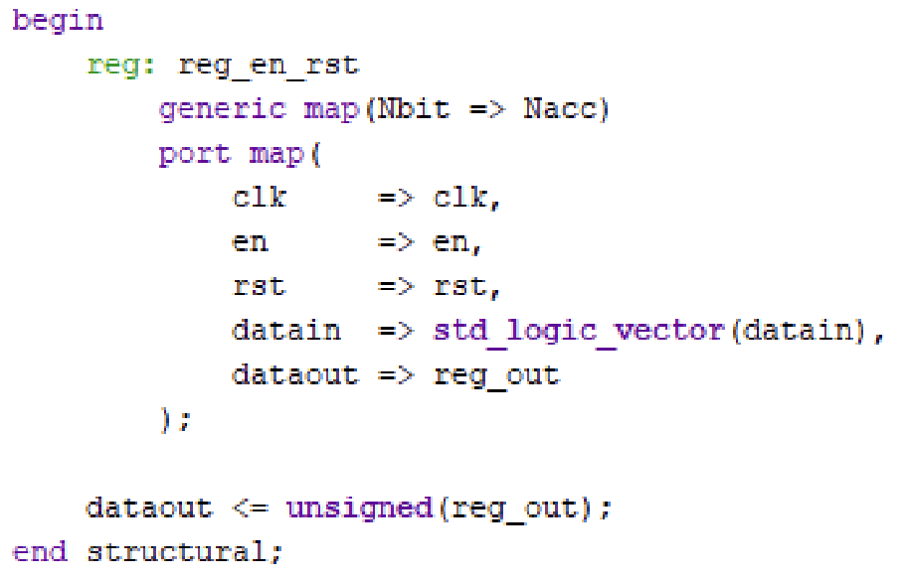
Design of Accumulator
We used a D-Flip-Flop to delay the result of the Multiadder by a clock tick
The Accumulator resets when the reset signal is 0

Slide 7
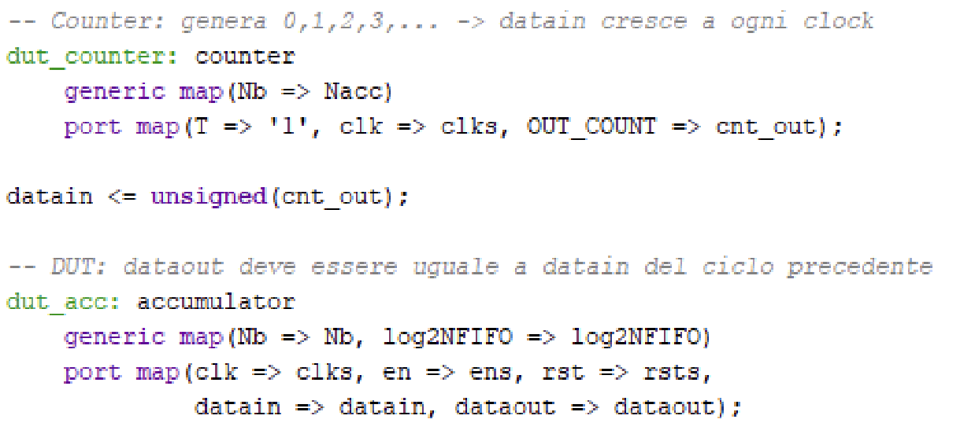
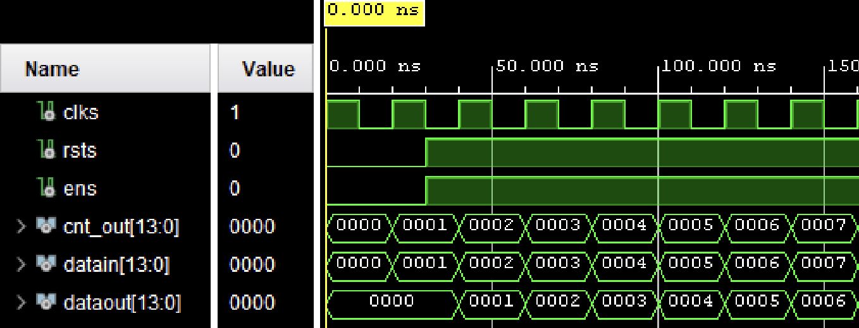
Design of Accumulator – Testbench
We test the Accumulator using a counter and seeing if the output is delayed by a clock cycle

Slide 8
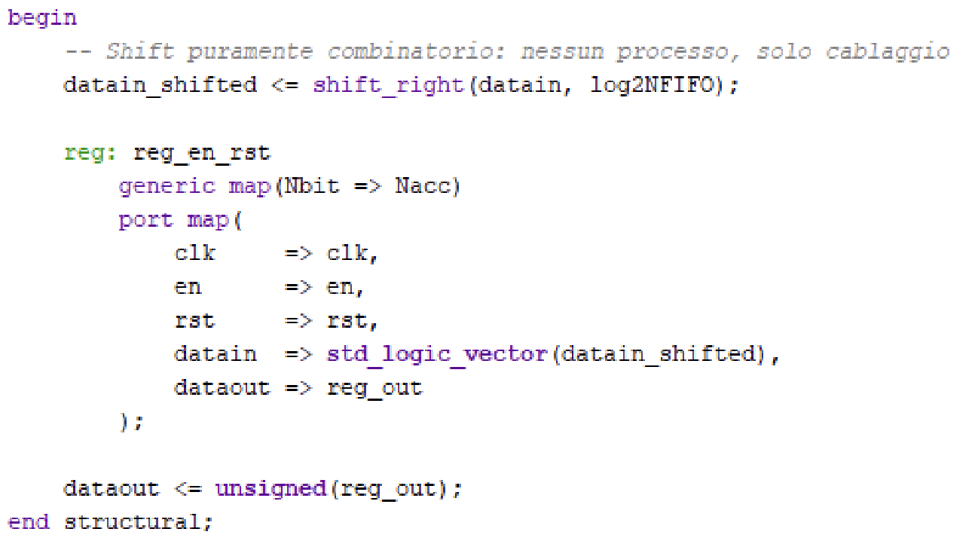
Design of Divide_by
We implement Divide_by using a right shift of log2NFIFO bits and delaying the output using a D-Flip-Flop

Slide 9
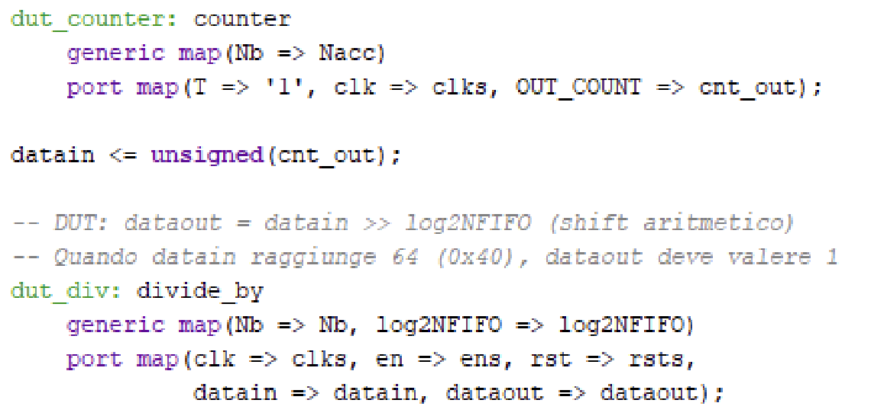
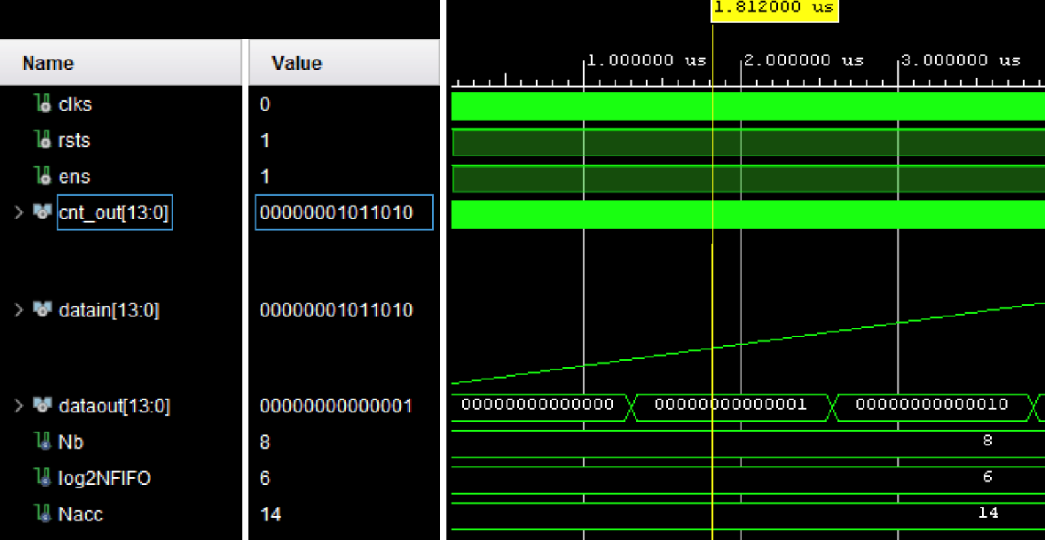
Design of Divide_by - Testbench
We use a counter to apply the Divide_by to every number

Slide 10
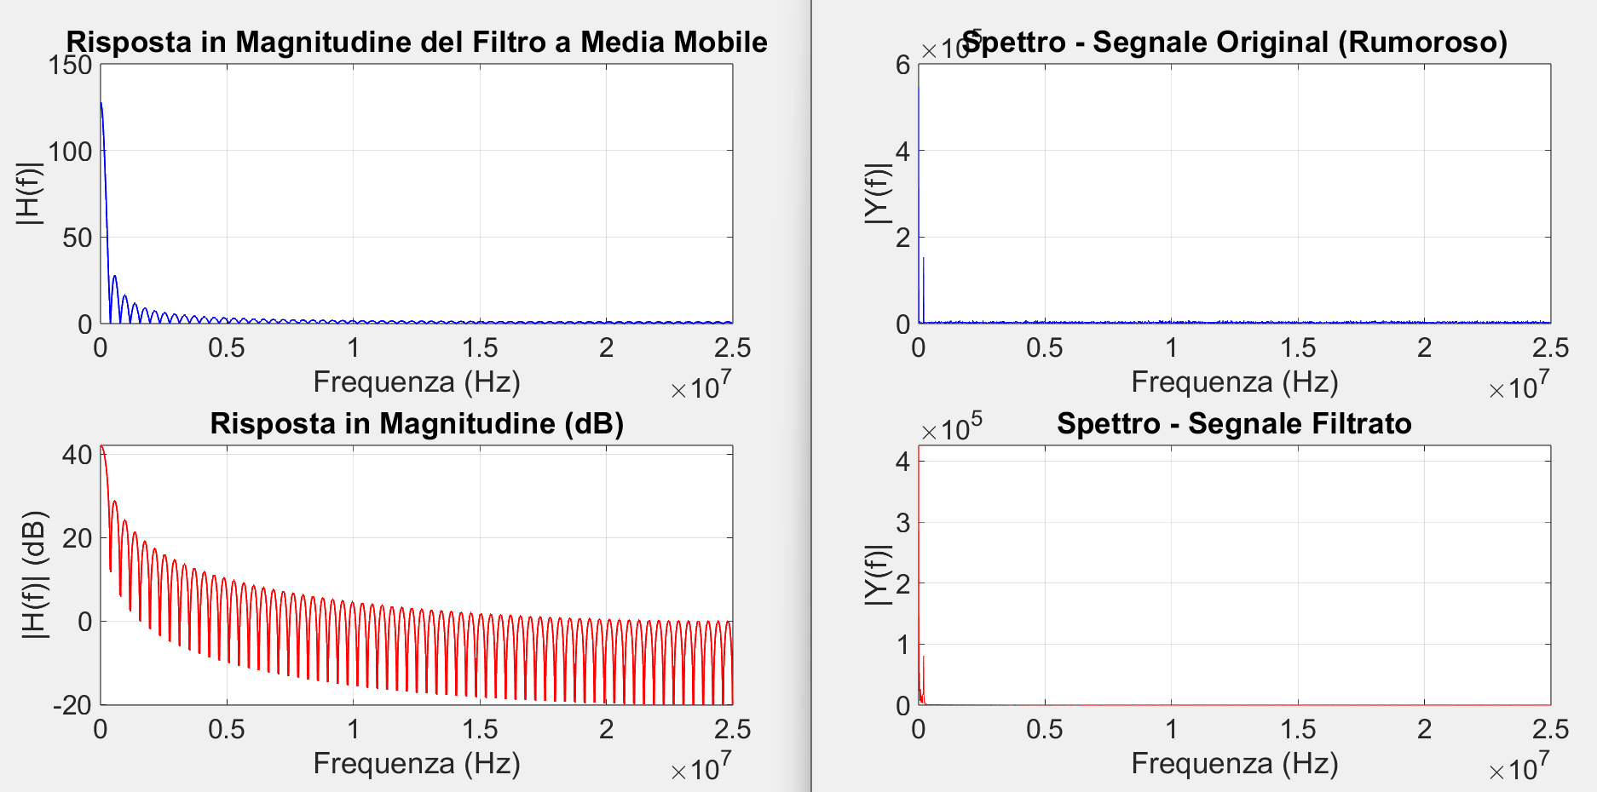
Frequency Response
The filter has removed the high frequency noise

Slide 11
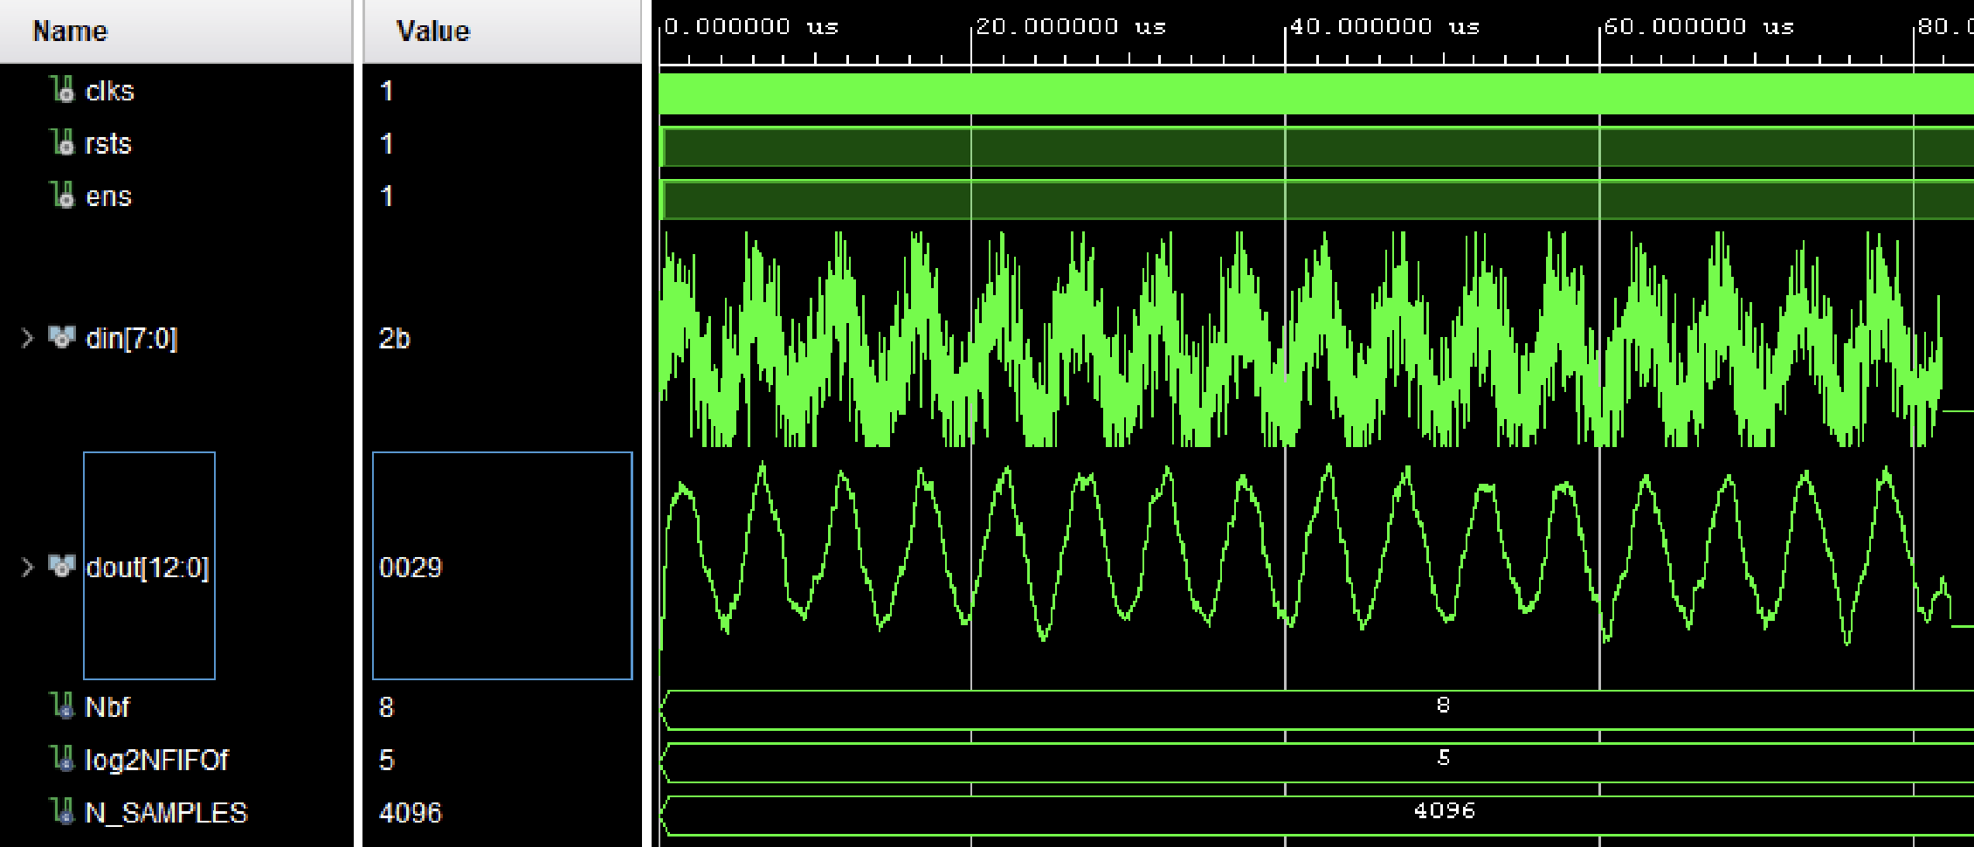
Simulation result – NFIFO = 32 (log2NFIFO = 5)
We can see that the result still shows the presence of some noise

Slide 12
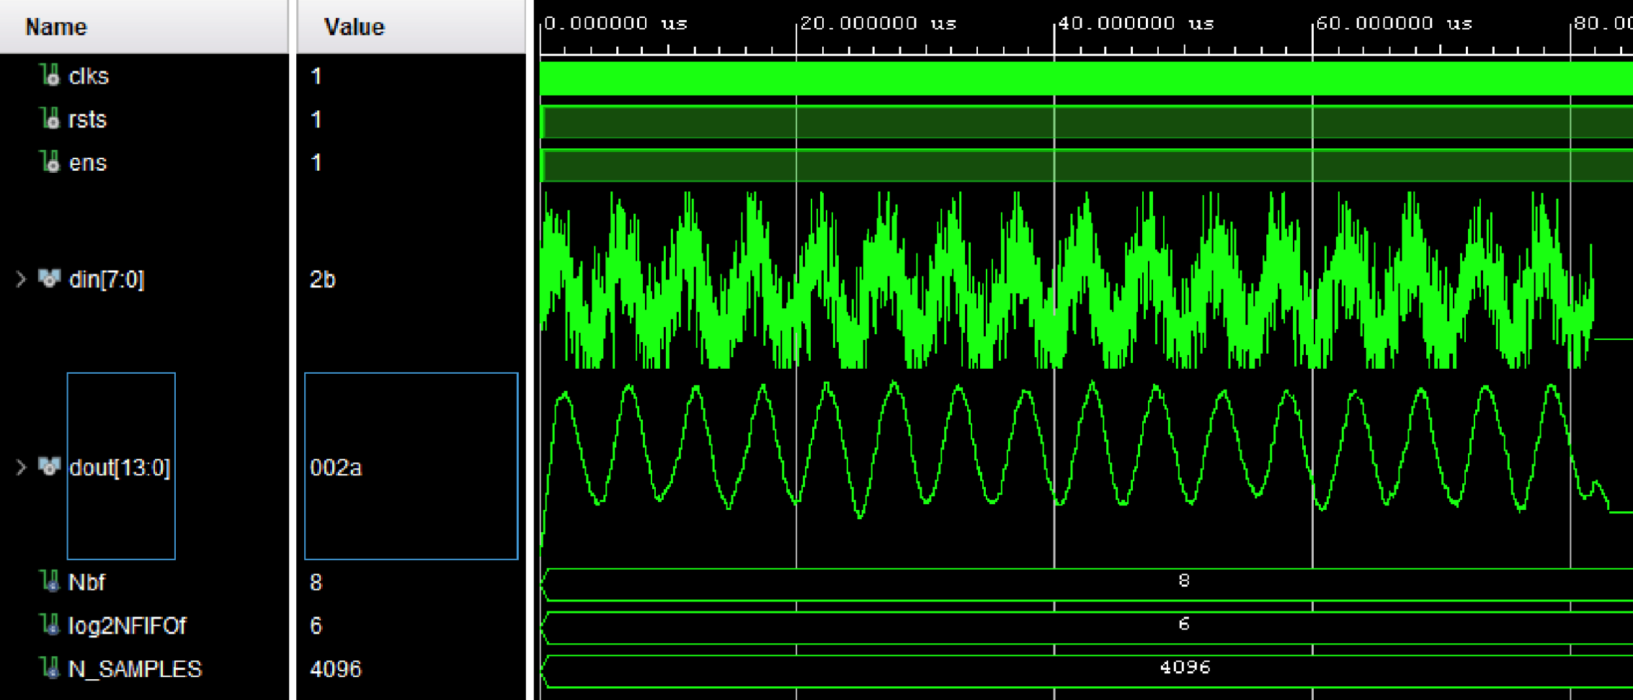
Simulation result – NFIFO = 64 (log2NFIFO = 6)
With NFIFO = 64 the resulting sinusoid shows an improvement

Slide 13
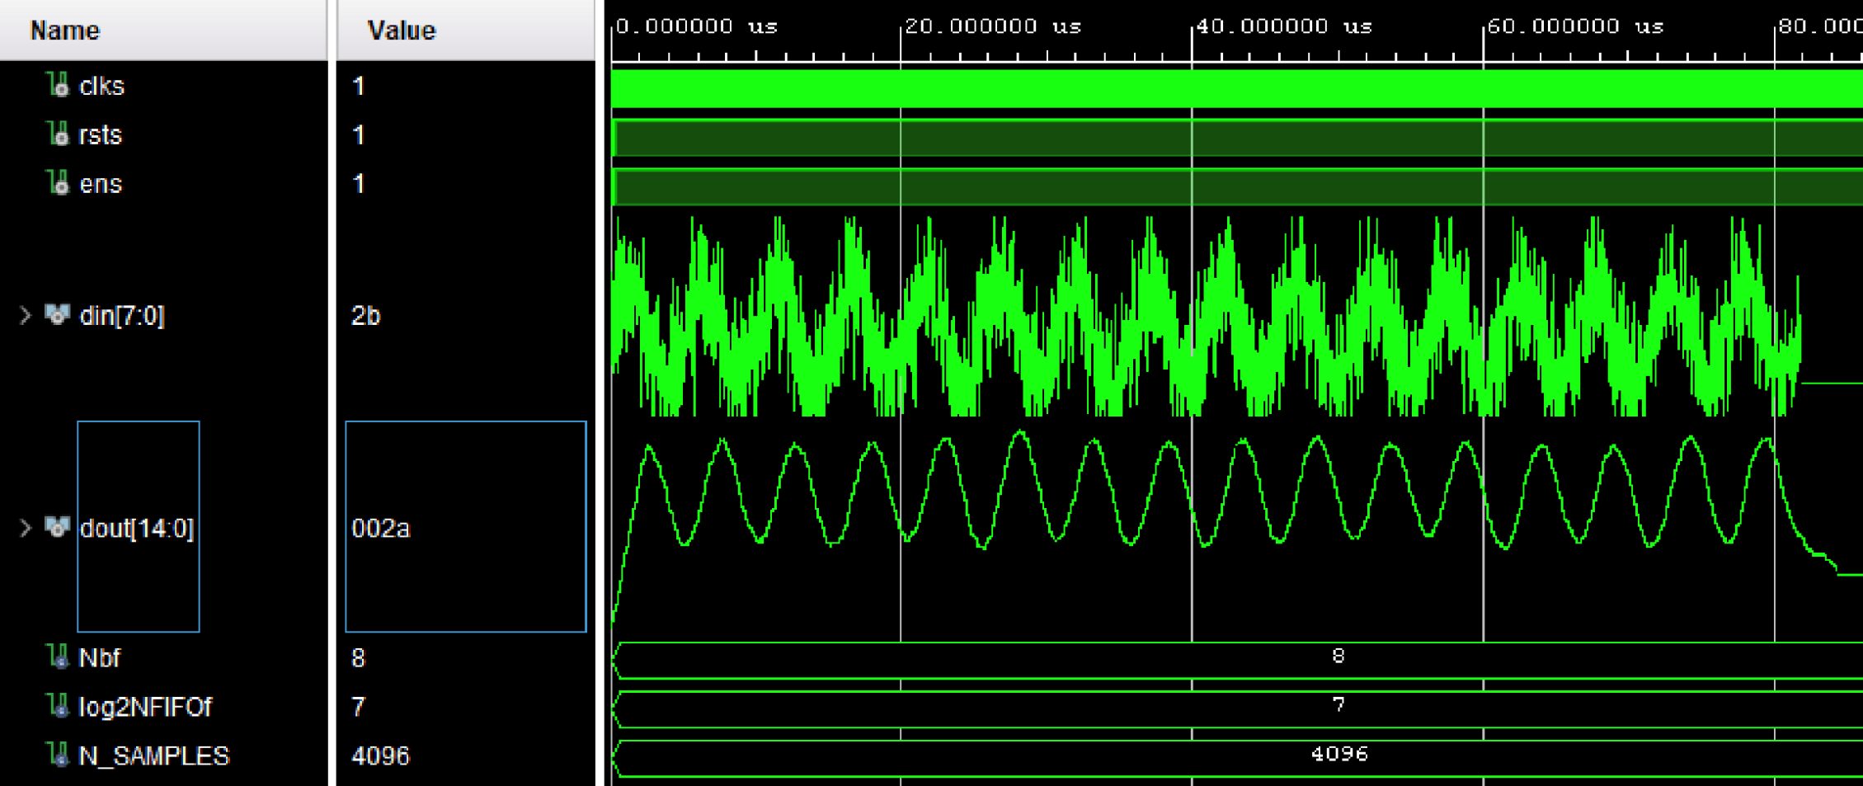
Simulation result – NFIFO = 128 (log2NFIFO = 7)
With NFIFO = 128 the sinusoid is smoother but with more attenuation

Slide 14
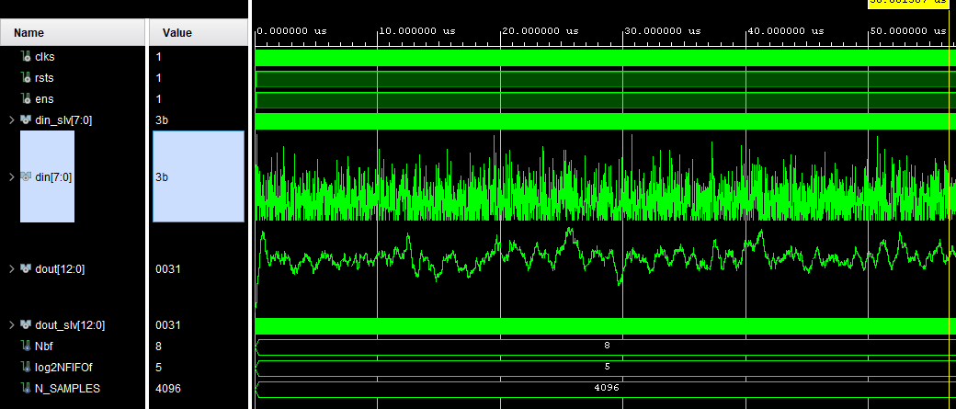
Simulation result of noise - NFIFO = 32 (log2NFIFO = 5)
The filter tries to clean the noise signal but the result is not promising

Slide 15
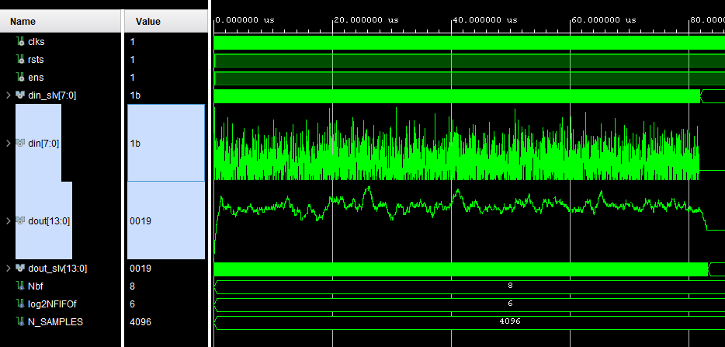
Simulation result of noise - NFIFO = 64 (log2NFIFO = 6)
With NFIFO = 64 we see a noticeable improvement in the resulting signal

Slide 16
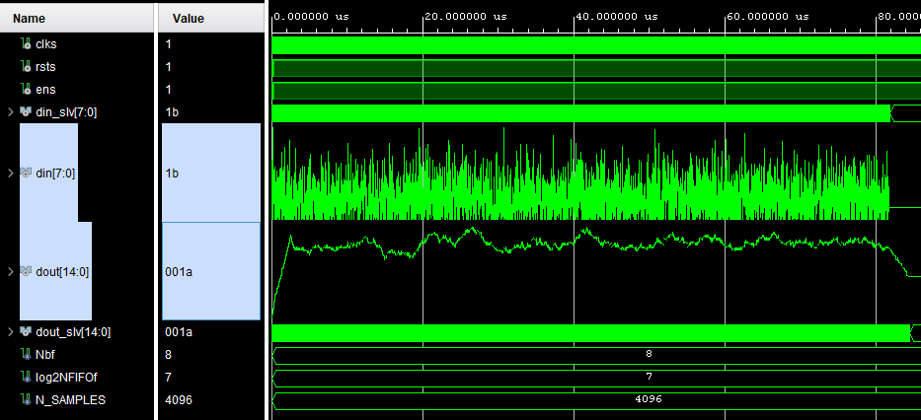
Simulation result of noise - NFIFO = 128 (log2NFIFO = 7)
With NFIFO = 128 noise is more attenuated but the starting delay is worse

Slide 17
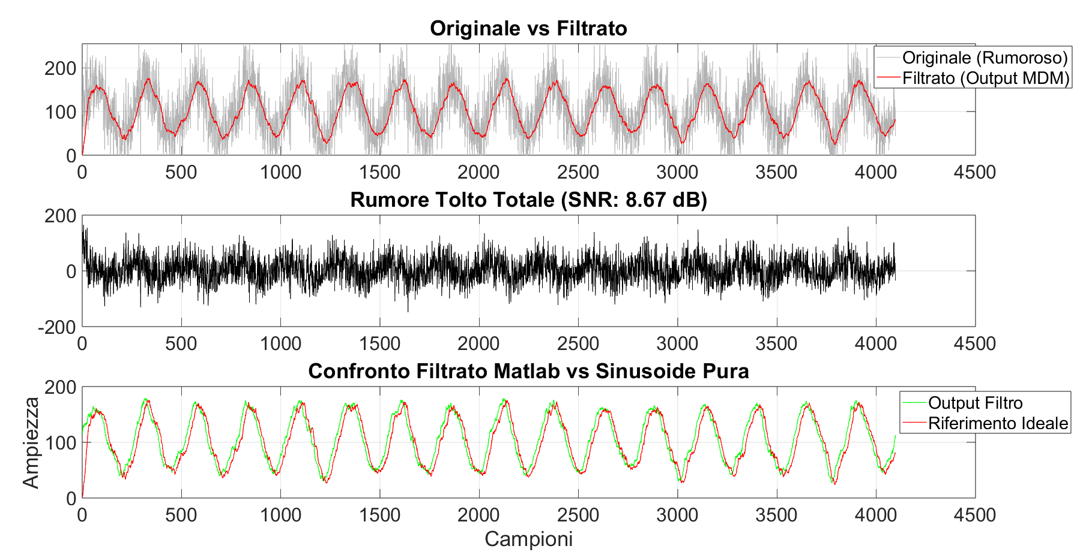
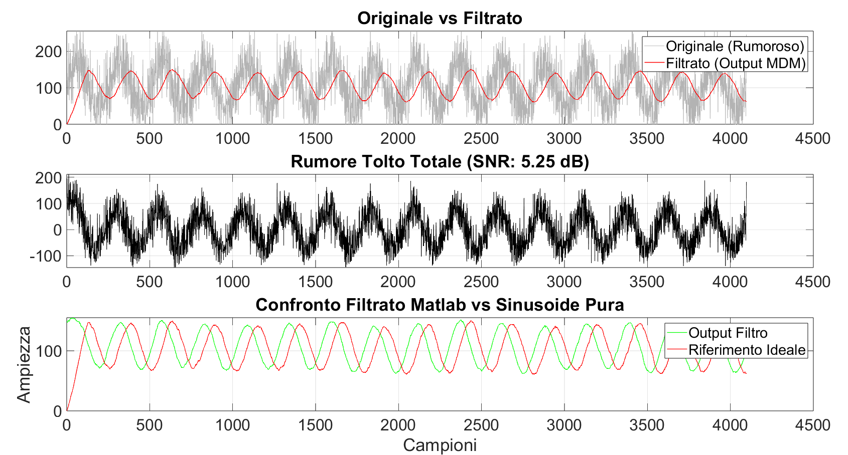
Signal to noise ratio
NFIFO = 32
NFIFO = 128
With NFIFO = 32 we notice more noise, less delay and more amplitude
With NFIFO = 128 the noise is reduced with a penalization of more delay and less amplitude

Slide 18
Final Table Resume and Comments
NFIFO | SNR | Delay (clock cycles) | Amplitude
32 | 8,63 | 34 | 110
64 | 7,30 | 66 | 100
128 | 5,25 | 130 | 80
With the variation of NFIFO we get an improvement in SNR, but there are also unwanted regressions in the amplitude and delay
All the tests were done with the Matlab variable SNRdb = 0

Slide 19
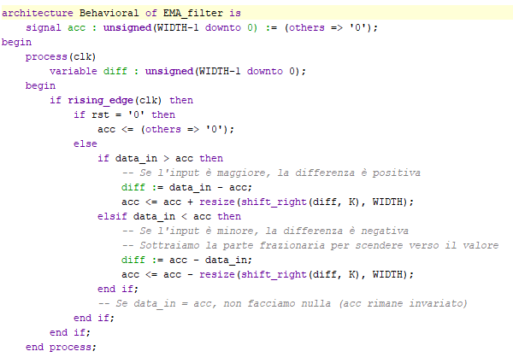
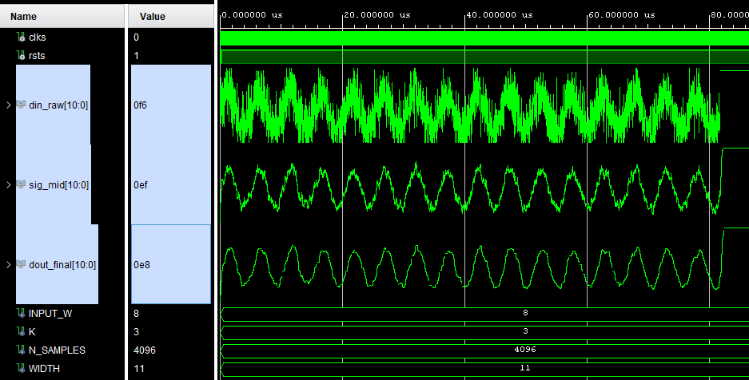
Conclusions
We concluded that having a filter that cleans more noise can also attenuate the original signal, so it’s not always better
We tried implementing an EMA (Exponential Moving Average) filter to reduce the delay

