Slide 1


Implementation of an engine for context analysis of LLM prompts
THIS PROJECT AIMS TO ANALYZE THE GIVEN MESSAGE FOR ALTERNATIVE AND AUGMENTATIVE COMMUNICATION AND EXTRACT INFORMATION ABOUT CONTEXT
a project designed by the polytechnic of Milan in support of the AMBRA PROJECT

Slide 2
what is the context ?
"Context is a frame that surrounds the event and provides resources for its appropriate interpretation."
Alessandro Duranti and Charles Goodwid

Slide 3
how to recognize the context ?
Identify Keywords
Analyze Sentence Structure
Analyze the correlation between the words
Consider the Speaker and Audience
Use Background Knowledge
Consider the Tone and Style

Slide 4

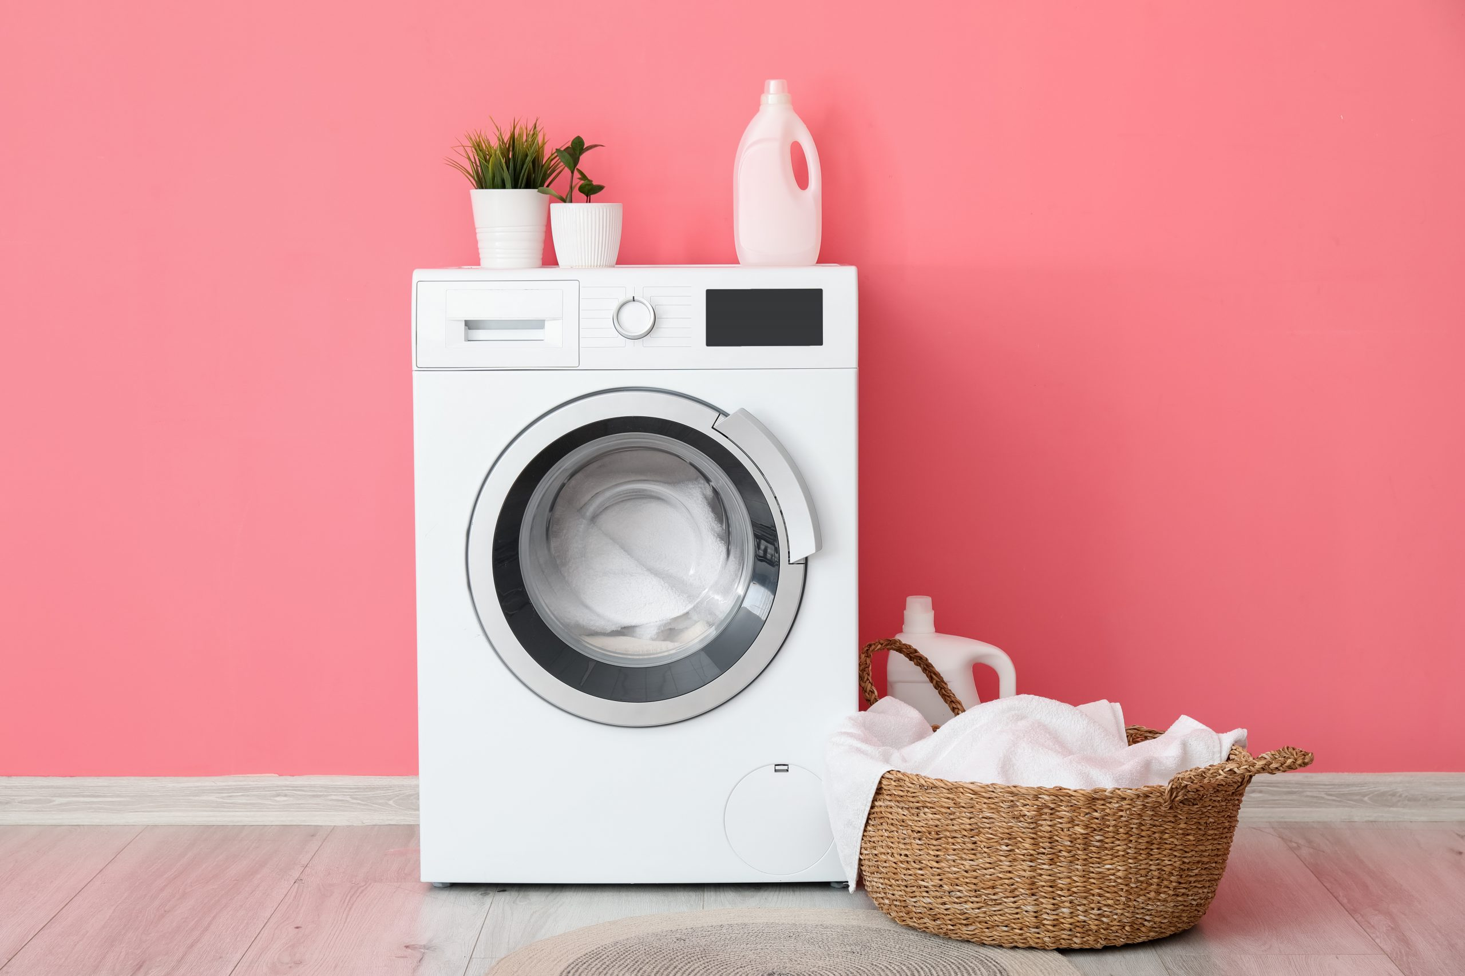
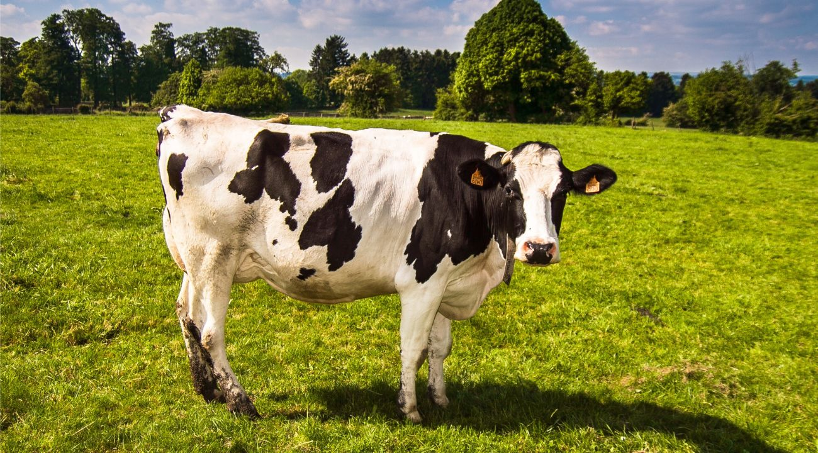
UNAMBIGUOUS WORDS
Mucca
(cow)
Lavatrice
(washing machine)
Sedia
(Chair)

Slide 5




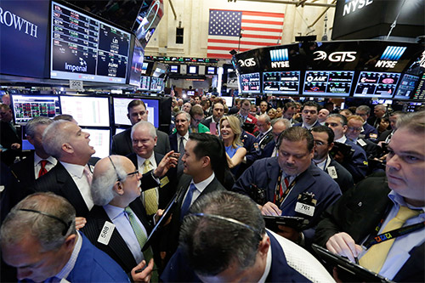

AMBIGUOUS WORDS
Legge?
(law or read)
Pesca?
(peach or fishing)
Borsa?
(stock exchange or bag)

Slide 6
no longer ambiguous in the lemma
legge
legge
Legge:
female noun
Leggere:
transitive verb

Slide 7
still ambiguous in the lemma
pesca
pesca
Pesca:
female noun
Pesca:
female noun

Slide 8
semantic field
We need to analyze the correlation between words to understand the semantic field of a specific word
Una crostata alla pesca
(a peach cobbler)
Una canna da pesca
(a fishing rod)
Semantic field:
-food
-fruit
Semantic field:
-sport

Slide 9

automation
We need to find ways to automate context analysis, even in the most difficult cases.
spaCy is a free open-source library for Natural Language Processing in Python.
It features NER, POS tagging, dependency parsing, word vectors and more.
Has a very active community and offers some already trained models for the
Italian language as well.
The medium model weights only 40 MB.
GLiNER is a zero-shot Named Entity Recognition (NER) model capable of identifying any entity type inserted in a list of labels.

Slide 10
steps for context analysis
With the pre-trained model for the italian language we can start analyze a sentence:
firstly to use the spacy library to separate the sentence into tokens (words) and retrieve the lemma of each word
The second step is to use part of speech (pos) and dependency (dep) to understand the role of the word in the phrase and the correlation with the other words to create a correlated context between words. For more info about pos and dep look here: https://universaldependencies.org/u/pos/ , https://universaldependencies.org/u/dep/
The third step is to use the GLiNER library to understand the semantic field of the word and to add this information to the token.

Slide 11
"luigi ha vinto una gara di pesca sul lago mangiando una pesca matura"
token | part of speech | dependency | lemma | word correlation | semantic field
luigi | PROPRN | nsubj | Luigi | - | persona
ha | AUX | aux | avere | - | -
vinto | VERB | ROOT | vincere | - | -
una | DET | det | uno | - | -
gara | NOUN | obj | gara | gara <-> pesca | -
di | ADP | case | si | - | -
pesca | NOUN | nmod | pesca | pesca <-> lago | sport
sul | ADP | case | su il | - | -
lago | NOUN | nmod | lago | - | luogo
mangiando | VERB | advcl | mangiare | - | -
una | DET | det | uno | - | -
pesca | NOUN | obj | peca | Pesca <-> matura | frutto
matura | ADJ | amod | maturo | - | -

Slide 12
shall we stop here ?
The tokenization, the POS, DEP and lemma analysis are very accurate and precise and this allows us to understand the context of unambiguous words in general or in their lemma .
The word correlation analysis works only with long sentences where the links are clear.
The semantic field analysis from Gliener works well only on simple phrases and if we insert too many labels in his list his performance drops.
so for now we have not yet been able to get a scalable and flexible system that can recognize contexts even in the most difficult cases
A solution is to train our own specific NER model to disambiguate the most difficult words!!!

Slide 13
create a custom NER model
SpaCy lets us to create our custom model for our specific cases!
I created different NER models using CPUs or GPUs, with training datasets of different sizes and for different words.
For example a model trained with CPU on 30 phrases per context will be named " CPU 30 "

Slide 14
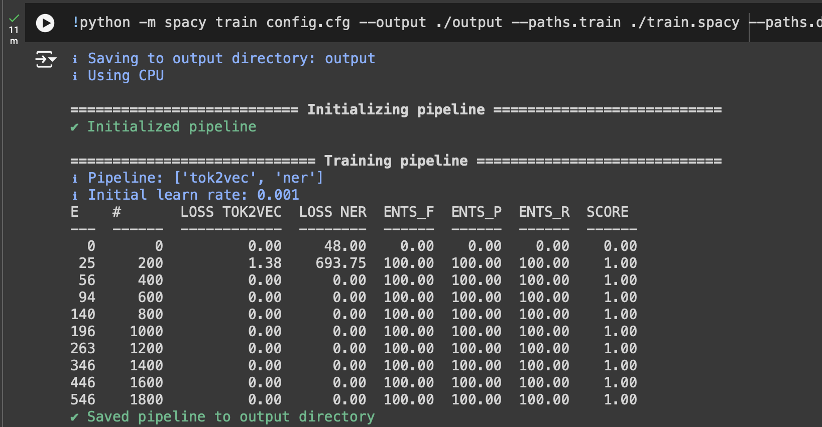
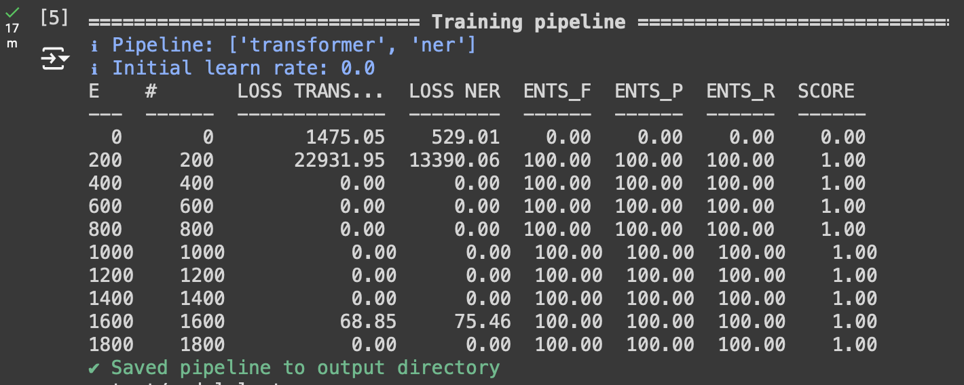
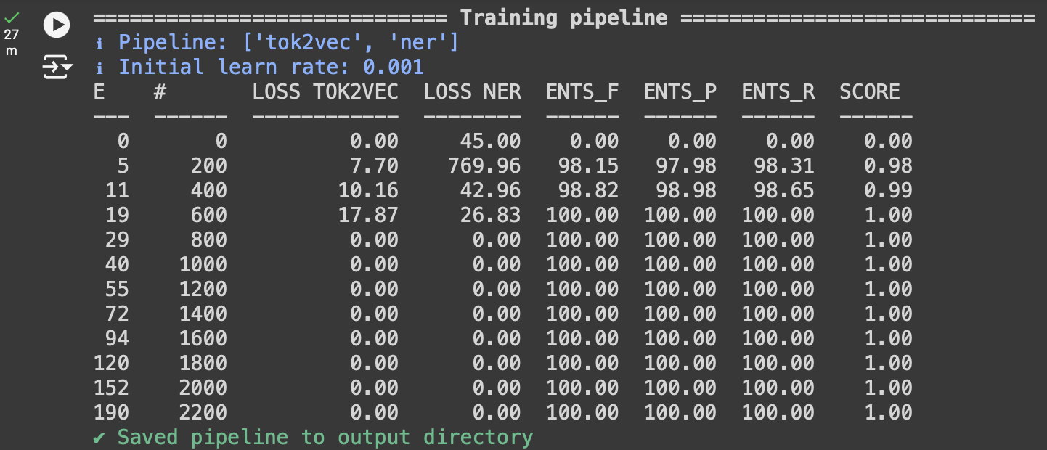
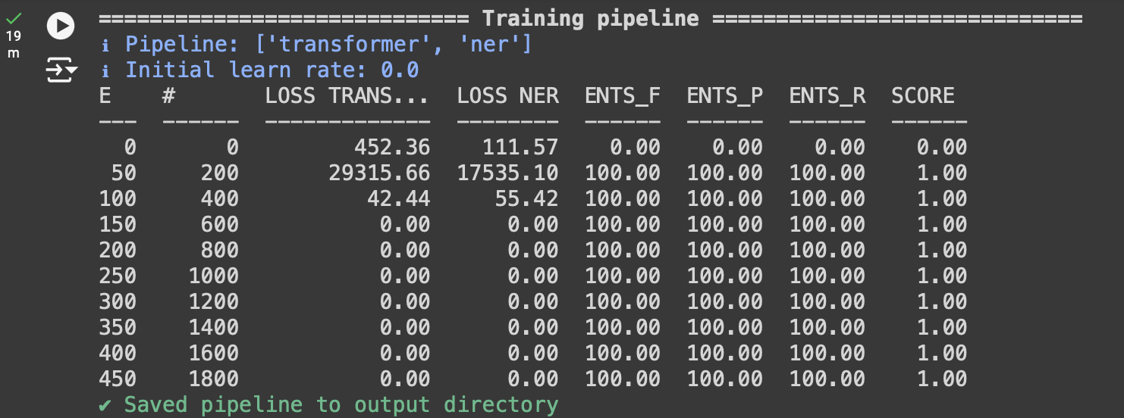
Training CPU vs gpu - time
CPU 30
GPU 30
CPU 30: 11 minutes
GPU 30: 17 minutes
CPU 150: 27 minutes
GPU 150: 19 minutes
CPU 150
GPU 150

Slide 15
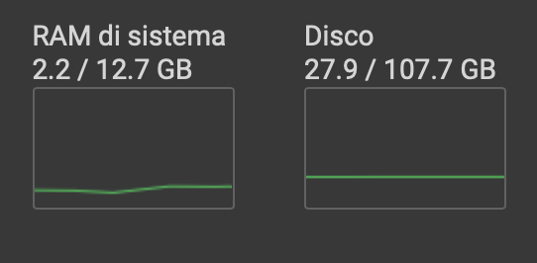
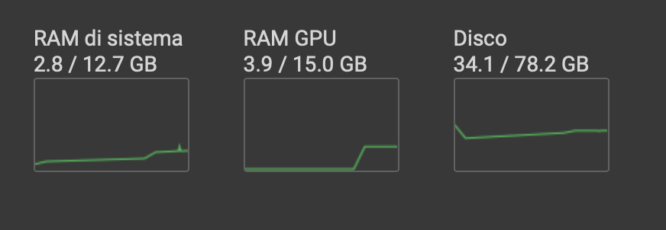
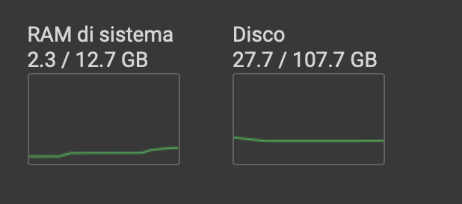
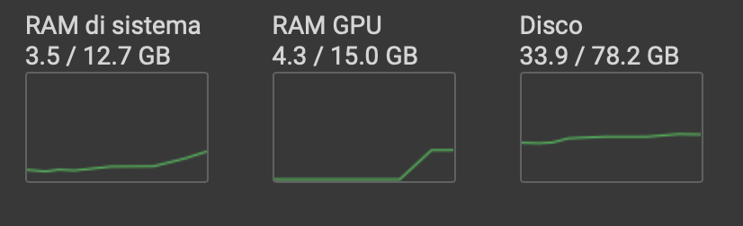
Training CPU vs gpu – resources
CPU 30
GPU 30
CPUs consume fewer resources and are more stable with respect to changes in dataset size
GPUs consume more resources and are less stable on changes in dataset size
CPU 150
GPU 150

Slide 16



Model Cpu vs GPU - weight
GPU on weight is nearly 10x the wheight of CPU
The wieght of a model is indepentent of the size of the training dataset

Slide 17
Model cpu vs gpu - test
To evaluate the performance of the models i created a set of 30 sentences in which the word to be analyzed
appears 2 times with both meanings, these are the accuracies:
CPU 30: 80%
GPU 30: 55%
GPU models fail to recognize the exact context under strong ambiguity, using a larger dataset for training does not significantly improve performance

Slide 18
Model CPU - accuracies
To evaluate the performance of the models i created a set of 30 sentences in which the word to be analyzed appears 2 times with both meanings, these are the accuracies:
For the word "pesca" :
CPU 30: 80%
CPU 50: 76%
CPU 80: 89%
CPU 150: 91%
For the word "borsa" :
CPU 80: 97%
in sentences in which the word appears with only one meaning, models trained from 80 sentences and up recognize the correct context virtually every time

Slide 19
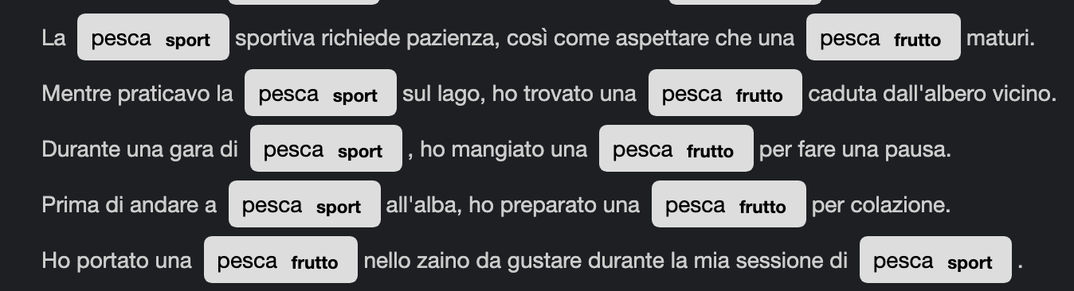
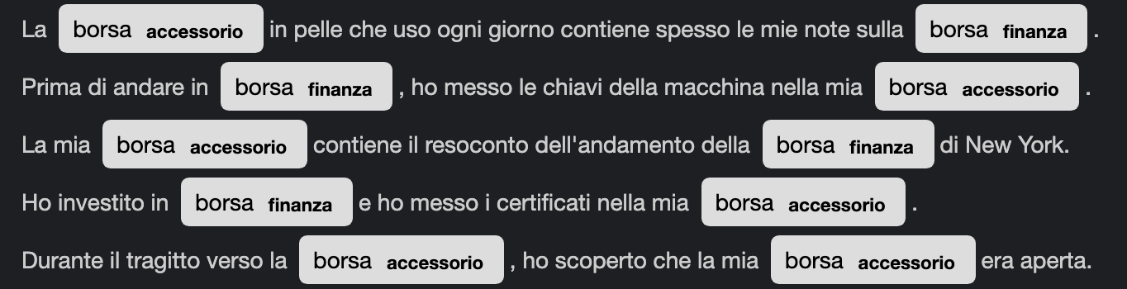
Examples
CPU 150:
CPU 80:

Slide 20
what's next?
The work done so far is certainly not an end point but I hope it is a starting point for even larger and more complex projects. Building on this project, here are some aspects that could be worked on:
We can try to make the model more efficient by removing articles, conjunctions, and prepositions from the sentences in the training dataset and from the sentences to be analyzed in order to focus only on words
To make the system more flexible you can combine several specialized models each on one word or try to train one large model on all ambiguous words
considering the use of this system in the AMBRA project, a system could be created in which users who find an error in the analysis of the model can report it so that the model can be improved in corner cases where it is weak

Slide 21
QUESTIONS ?

Slide 22
THANK YOU FOR YOUR ATTENTION
Author: Reitani Lorenzo
Under the supervision of: Professor Pilato Christian

