Slide 1


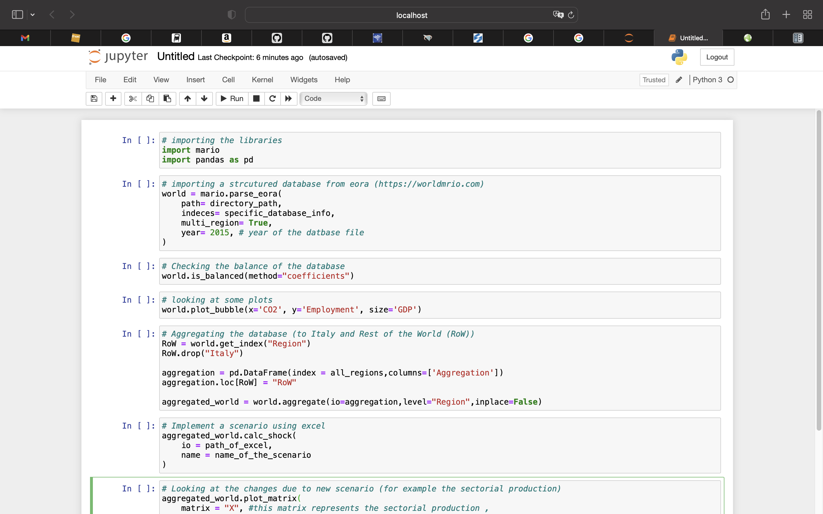
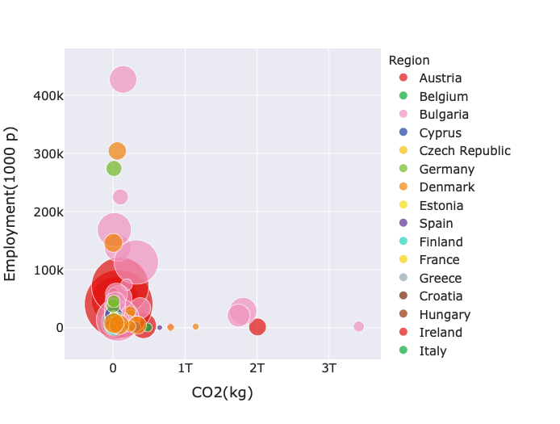
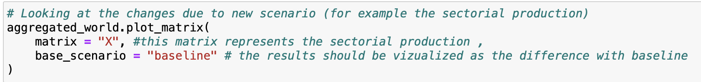
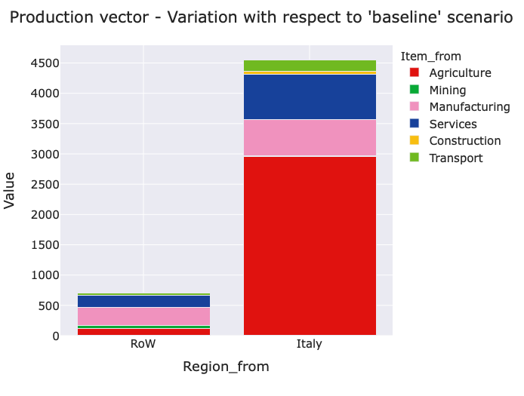
MARIO – Multi-functional Analysis of Regions through Input-Output
Mohammad Amin Tahavori*^{,a}, Nicolo Golinucci ª, L.orenzo Rinaldi ª , Matteo Vincenzo Rocco ª ,Emanuela Colombo ª
ª Politecnico di Milano, Department of Energy, Via Lambruschini, 4, 20156 Milano, Italy
Tel.: +39 02-2399-3861; fax: +39 02-2399-3913
E-mail: mohammadamin.tahavori@mail.polimi.it
Abstract
The global environmental conditions have been dramatically changing during the last decades due to intensive human activities for meeting its energy, goods and services demand leading to deforestation, greenhouse gas emissions by burning fossil fuels, and chemical pollution of air and oceans. Fast economic development and population growth in the developing world may worsen the current situation. The complex nature of the global supply chains makes detailed economic and environmental analysis a difficult task. In the shadow of the Input-Output economic modelling framework, proposed by Wassily Leontief, the tracing of embodied environmental impacts of the economy supply chain alongside with the impact of possible future scenarios has been facilitated. Input-Output framework relies on highly detailed tables of the input and outputs flows of different economic activities from the producer agents to final consumers with environmentally extended information for tracking the environmental footprints. While the framework makes the abovementioned analysis possible, the databases are usually difficult to be handled due to the huge amount of data they collect. Moreover, the structure of databases may differ from model to model and from source to source.
The MARIO package aims at providing simple and intuitive API for handling different types of databases and through an automatically generated excel interface, simulates the specific energy, economic, and environmental scenarios and see their impact.
Keywords: life-cycle assessment, input-output analysis, environmental footprint, impact analysis
Example MARIO application
Input-Output Tables
The structure of an economy can be represented in terms of sales and purchases transactions among different sectors as producers and consumers. These data are usually collected in form of Input-Output tables (IOTs) by national statistics offices. Beside the detailed inter-sectorial information, IOTs depict the cost structure, environmental performance, final use of products, and trades in an economy. While IOTs are built based on national accounts, they can be extended to multi-regional databases, to cover inter-sectorial trades within a sets of regions. Some tables, called Supply and Use tables (SUTs), can explicitly account for products and processes, making the model more suitable for engineering studies.
A series of environmental and economic impact assessment analysis could be performed based on IOTs. A change in economic structure, the final use of products or environmental performance can be represented by a change in one of the matrices in IOTs (shock analysis) and by using the Leontief Model an economic model in the field of input-output analysis which allows for evaluating the socio-economic and environmental impacts of given scenarios perturbating the economic system represented in the IOT.
Objectives
Labour and Emission Consumption of differnet sectors followd by their total production (size of the bubble)
While IOTs and SUTs allows for performing the above-mentioned complex analyses, their systematic use is hindered by their different formats and structures from source to source. Moreover, the huge amount of data collected in IOTs and SUTs, makes those analysis a difficult task. The main objective behind the development of MARIO was to provide a uniform MARIO database object regardless of the structure of the original database, where they can be treated in the same way for a series of standardized mathematical and statistical analysis.
MARIO Structure
When a database is parsed, all the IO matrices will be stored as pandas DataFrame (https://pandas.pydata.org) in a nested python dictionary where all the matrices are stored for every specific scenario under analysis. MARIO consists of three main objects:
CoreModel class working as the highest-level object for handling the matrices and basic IO mathematical calculations.
Database class which contains methods and properties for shock analysis and modification of the database.
marioMetaData class which tracks all the modifications on the database and generates metadata reports in different formats such as json or txt files.
Functionalities
Database Parsing: MARIO can parse a series of different open-source structured database such as EXIOBASE, EORA, and pyrmio library database (https://github.com/konstantinstadler/pymrio). When a database is not structured, pandas DataFrames, excel files or text files could be used to create a MARIO Database.
Database Aggregation: IOTs and SUTs are mostly published with highly disaggregated data. MARIO could aggregate the data by passing an excel file or pandas DataFrame which defines the aggregation.
Mathematical Calculations: MARIO calculates all the matrices and their dependencies automatically when they are requested to avoid overusing the memory.
Database Modification: a MARIO database could be modified by adding new environmental data or economic data through excel files or pandas DataFrame.
Database Balance Check: a monetary IOT or SUT should respect an economic balance which can be checked by MARIO and imbalanced sectors could be identified.
Shock Implementation: MARIO provides methods to implement a change in the database to assess the impact of a specific scenario and analyze the results.
Exporting Database: the modified database as well as the implemented scenarios can be saved in different formats such as excel or csv files along with the metadata.
Visualization: MARIO relies on plotly library (https://plotly.com) for its visualization routines. The outcome of scenarios could be compared for different parameters such as impacts embodied in international trades, environmental footprints of different sectors, production and consumption of different economic agents and more.
Changes in sectorial productions (in terms of monetary output) due to a specific policy in Italy
Resources
MARIO github: https://github.com/SESAM-Polimi/MARIO
Miller, Ronald E., and Peter D. Blair. Input-output analysis: foundations and extensions. Cambridge university press, 2009.
Mohammad Amin Tahavori, Lorenzo Rinaldi, & Nicolò Golinucci. (2022). SESAM-Polimi/MARIO: MARIO v0.1.0 (v0.1.0). Zenodo. https://doi.org/10.5281/zenodo.5879383

