Slide 1

Diabetes Prediction
A complete machine learning pipeline for predicting diabetes diagnosis probability from patient health indicators — covering exploratory analysis, preprocessing, model training, and evaluation.
KAGGLE COMPETITION · PLAYGROUND SERIES S5E12
SANSONE LORENZO · UNIVERSITY OF BOLOGNA · 2025/2026

Slide 2

OVERVIEW
Objective & Dataset
Goal
Predict the probability of diagnosed_diabetes for each patient. Primary metric: ROC-AUC (Area Under the ROC Curve).
Data Source
Synthetically generated from the Diabetes Health Indicators Dataset — realistic distributions, privacy-preserving.
Files
train.csv — 700,000 rows, 26 columns

Slide 3
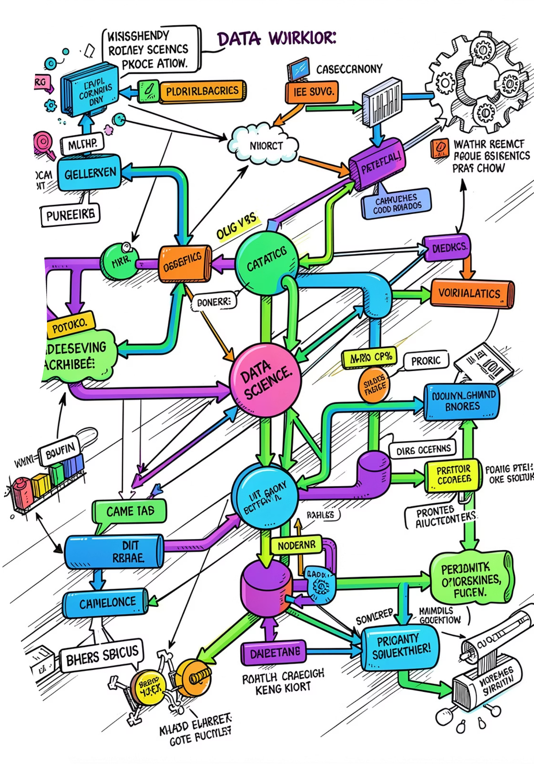
PIPELINE
Full ML Workflow
01
Exploratory Analysis & Cleaning
Understand distributions, detect outliers, check class balance, correlations
02
Preprocessing
Encode categoricals, scale continuous features
03
Model Training
GridSearchCV with 5-fold StratifiedKFold across 8 classifiers
04
Evaluation & Comparison
ROC-AUC on isolated hold-out test set

Slide 4
DATA EXPLORATION
Dataset at a Glance
700K
24
Rows
Features
Synthetic patient profiles
4 domains
0
62%
Missing Values
Positive Class
Clean dataset
Mildly imbalanced
Features span clinical measurements (BMI, blood pressure, cholesterol, …), lifestyle habits (diet, activity, sleep, …), demographics (age, ethnicity, income, …) and medical history (family diabetes, hypertension, cardiovascular, …).

Slide 5
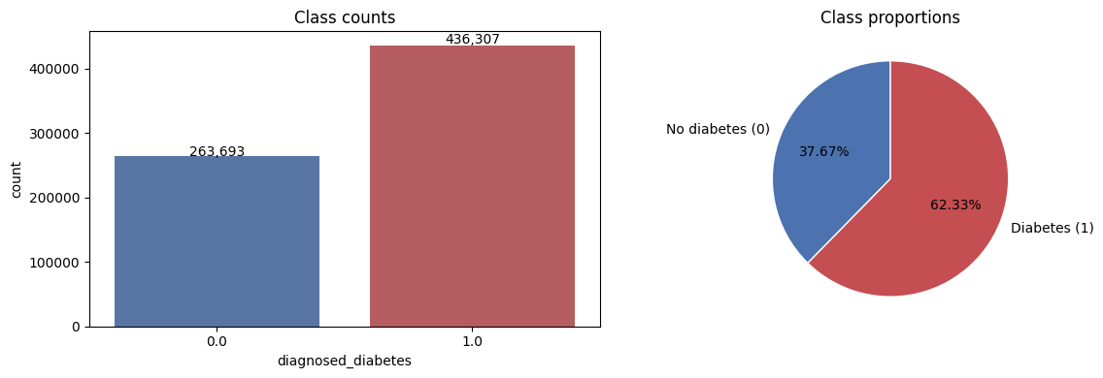

DATA EXPLORATION
Target Distribution & Class Balance
Class Proportions
62.33% diagnosed with diabetes (positive class) vs 37.67% without. Positive/negative ratio: 1.65.
The target is mildly imbalanced — stratified splits and class-weighting were considered, but stratification alone proved sufficient.
No duplicate rows detected. Zero NaN values across all 26 columns.

Slide 6
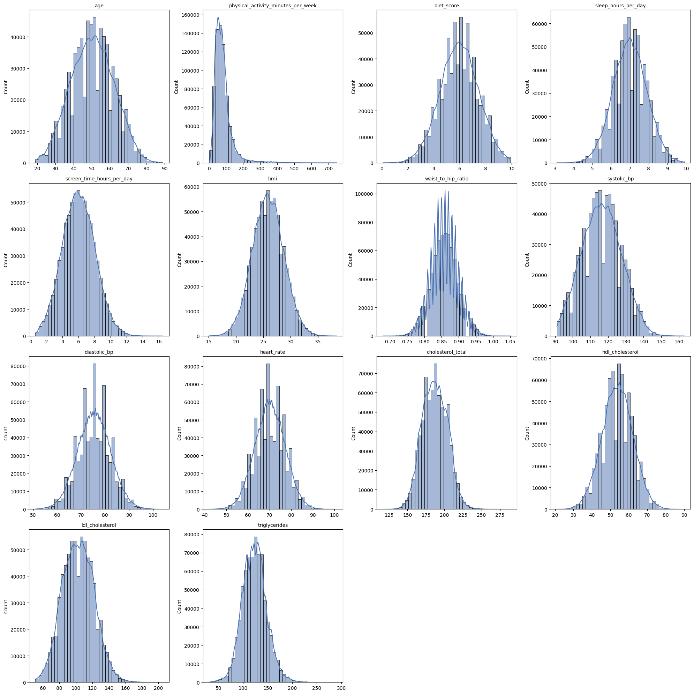
DATA EXPLORATION
Numerical Features Distributions
To understand the intrinsic shape, symmetry, and potential anomalies of our continuous features, a histogram with a Kernel Density Estimate (KDE) was plotted for each of the 14 numerical variables, using 40 bins.
Key Observations
Most clinical features (bmi, systolic_bp, heart_rate, cholesterol metrics) exhibit a roughly bell-shaped, near-Gaussian distribution.
physical_activity_minutes_per_week is distinctly right-skewed with a prominent long tail, indicating a few patients with exceptionally high activity levels.
diet_score, sleep_hours_per_day, and screen_time_hours_per_day generally appear symmetric.
age spans a wide range from 19 to 89 years, with a relatively uniform distribution across adult age groups.
Takeaway: The majority of features are mostly well-behaved and near-Gaussian, which supports the effectiveness of StandardScaler for preprocessing. physical_activity_minutes_per_week remains the main exception, echoing its significance in outlier analysis.

Slide 7
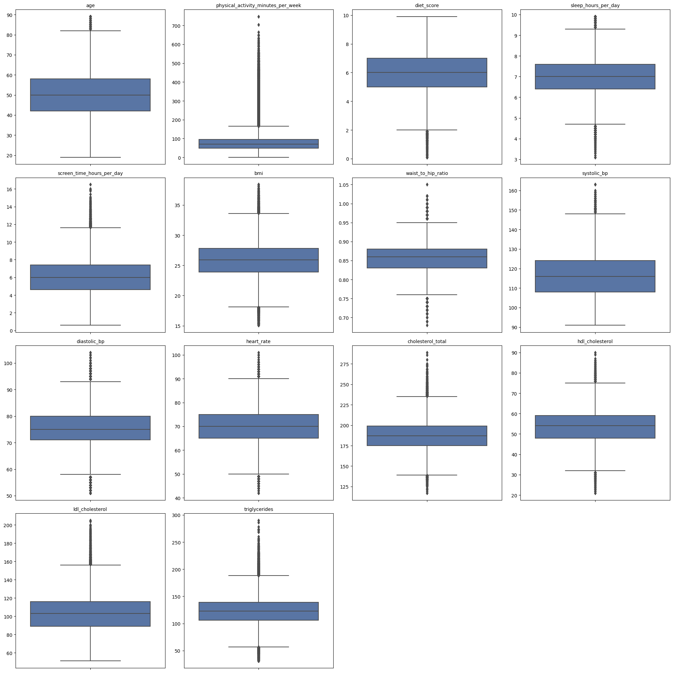
DATA EXPLORATION
Outlier Detection (IQR Rule)
Outliers are flagged using the IQR rule: points falling outside [Q1 - 1.5 * IQR, Q3 + 1.5 * IQR].
Key Observations
Heavy upper tails: Pronounced in physical_activity_minutes_per_week (max value 747, far exceeding IQR upper bound), triglycerides, cholesterol_total, ldl_cholesterol, systolic_bp, and bmi.
Two-sided tails: Features like hdl_cholesterol, waist_to_hip_ratio, and heart_rate exhibit significant outliers on both the lower and upper bounds.
Takeaway: This highlights the necessity of feature scaling for linear models (SVM, KNN), which are highly sensitive to extreme values. Tree-based models (Random Forest, XGBoost, CatBoost) are inherently more robust to outliers.

Slide 8
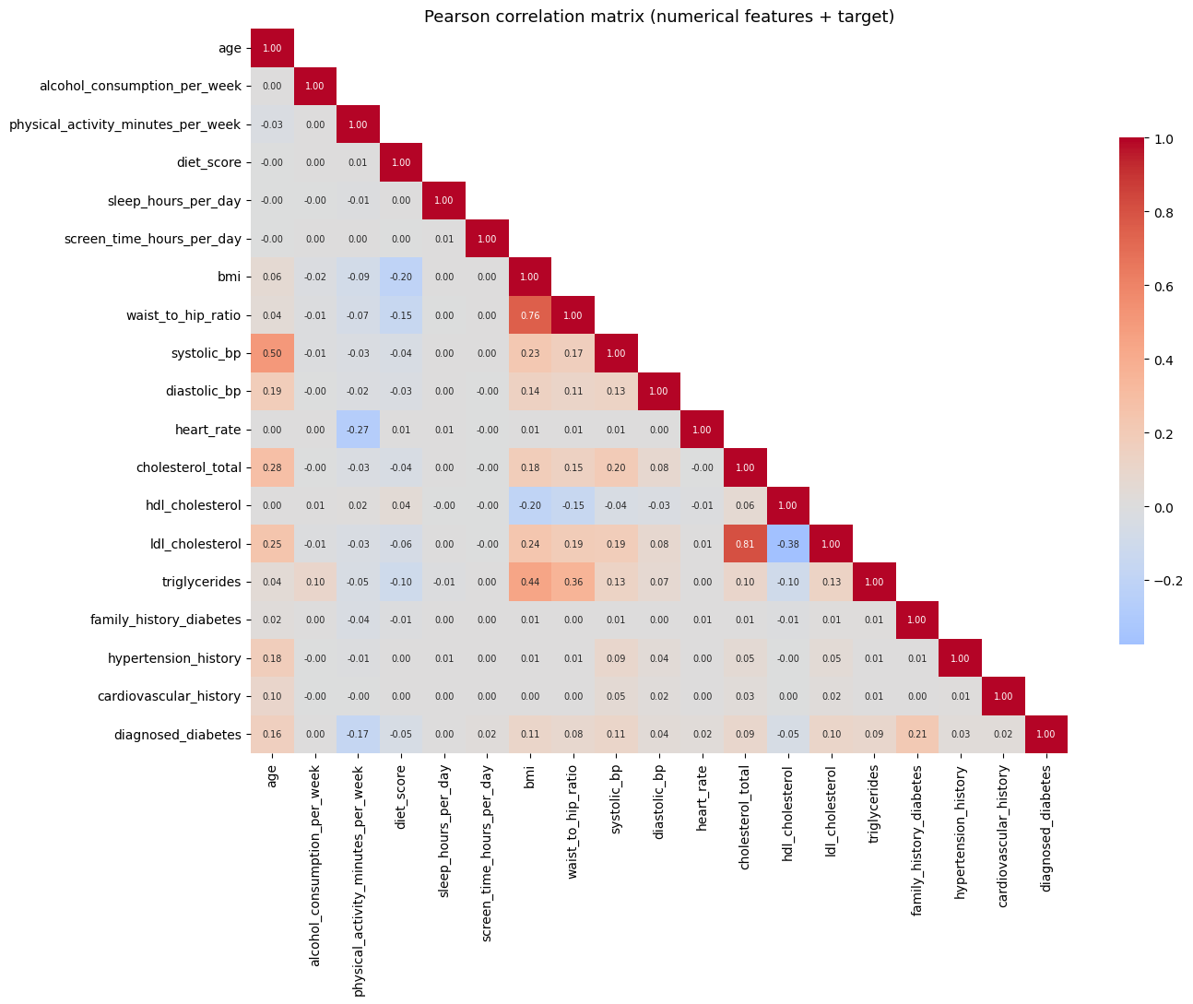
DATA EXPLORATION
Correlation with Target
Key Insights
All per-feature correlations are weak — no single feature is a strong standalone predictor.
Top positive: family_history_diabetes (r=0.21), age (r=0.16), systolic_bp, BMI, LDL
Top negative: physical_activity_minutes_per_week (r=−0.17), HDL, diet_score
Near-zero: sleep_hours_per_day, alcohol_consumption_per_week
This explains the modest final ROC-AUC — the signal is distributed across many weak features.

Slide 9




PREPROCESSING
From Raw Data to Model-Ready Matrix
Drop ID + Target
Remove non-predictive row identifier
Encode Categoricals
Ordinal for education & income; one-hot for gender, ethnicity, smoking, employment
Split Data
67% train / 33% test, stratified
Scale Features
StandardScaler on continuous features (mean=0, std=1)
Feature matrix expanded from 24 → 35 columns after one-hot encoding. StandardScaler outperformed RobustScaler and no-scaling in validation tests.

Slide 10

PREPROCESSING
Encoding of Categorical Features
To prepare categorical features for machine learning models, three distinct encoding strategies were applied based on the variable's nature.
Ordinal Encoding
One-Hot Encoding
No Encoding Needed
For variables with an inherent, meaningful order, ordinal encoding was used to preserve their ranking information.
Purely nominal variables, where no natural order exists, were converted into binary (0/1) columns.
Binary flags, already represented as 0s and 1s, required no further transformation.
education_level: No formal < Highschool < Graduate < Postgraduate
income_level: Low < Lower-Middle < Middle < Upper-Middle < High
gender
ethnicity
smoking_status
employment_status
family_history_diabetes
hypertension_history
cardiovascular_history
The one-hot encoding process expanded the feature matrix from 24 raw features to 35 columns.

Slide 11

PREPROCESSING
Feature Scaling — StandardScaler
StandardScaler standardizes each continuous feature to mean 0 and standard deviation 1 (z = (x − μ) / σ), mapping it onto the standard normal distribution.
Why use it?
Scope of application
Features with different ranges and units can bias scale-sensitive algorithms (KNN, SVM, Logistic Regression, Neural Networks). Scaling ensures all features contribute equally by putting them on a comparable scale.
Applied exclusively to continuous numerical features. Binary flags and one-hot encoded columns are intentionally left unchanged, preserving their intrinsic categorical meaning.
Critical Rule: Prevent Data Leakage
Note on Tree-Based Models
The scaler must be fit only on the training set. This fitted scaler is then used to transform both the training and test data, preventing information from the test set from influencing the training process.
Tree-based models (Random Forest, XGBoost, CatBoost) are scale-invariant and can perform well on unscaled data. For this project, they were evaluated using both scaled and unscaled features for completeness.

Slide 12
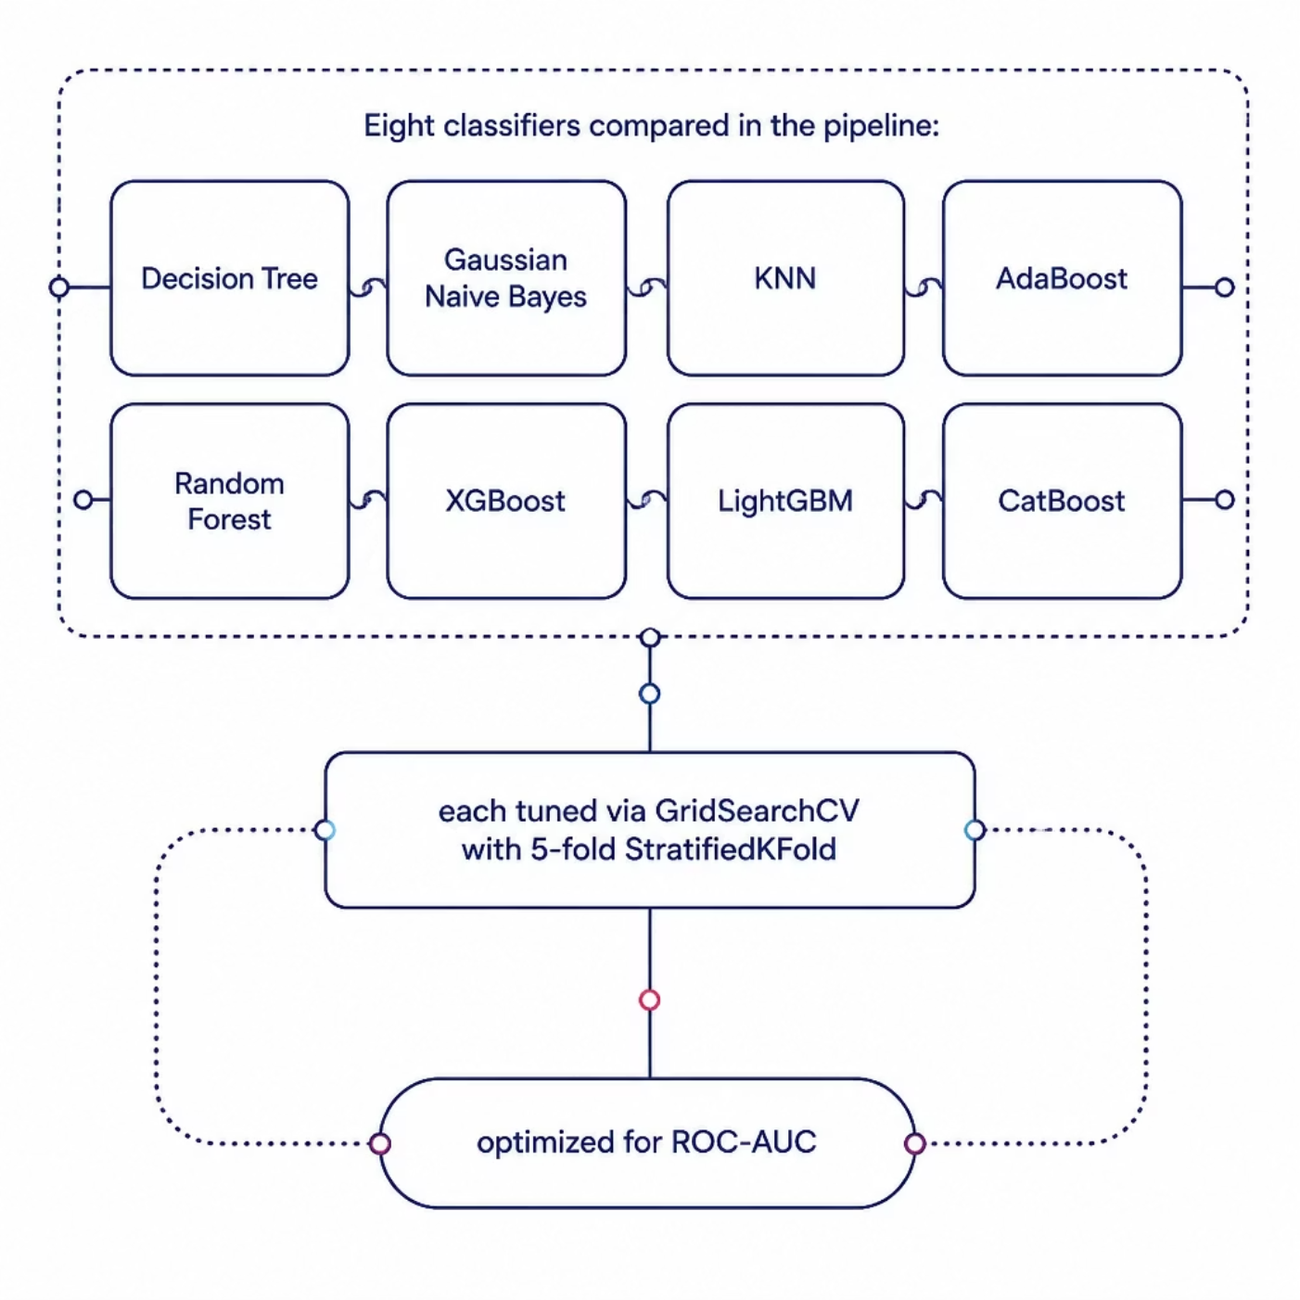
MODEL TRAINING
8 Classifiers, GridSearchCV & ROC-AUC
Training Setup
Scoring: ROC-AUC (robust to class imbalance)
CV: 5-fold StratifiedKFold (preserves class ratio)
Hold-out: Test set (~231K rows) touched once at the end
Parameter Grids
Ranging from 10 combinations (Naive Bayes) to 54 (XGBoost, LightGBM). All models tuned with identical CV strategy for fair comparison.

Slide 13
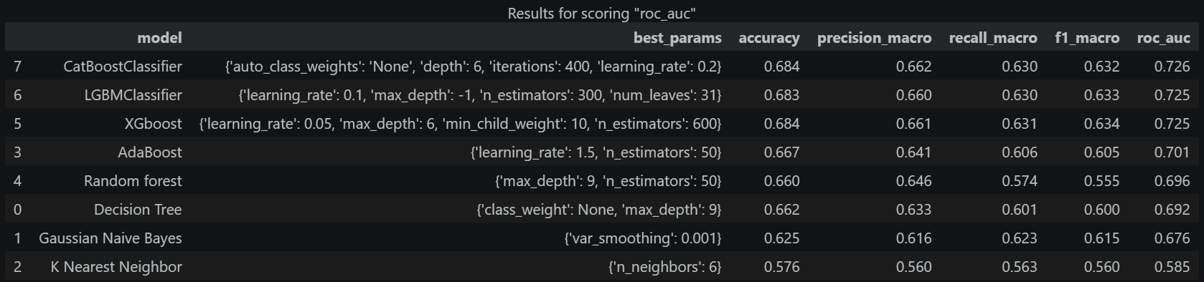
RESULTS
Evaluation: Boosting Models Dominate
ROC-AUC Rankings (Test Set)
Best CatBoost params: {depth: 6, iterations: 400, lr: 0.2}.

Slide 14
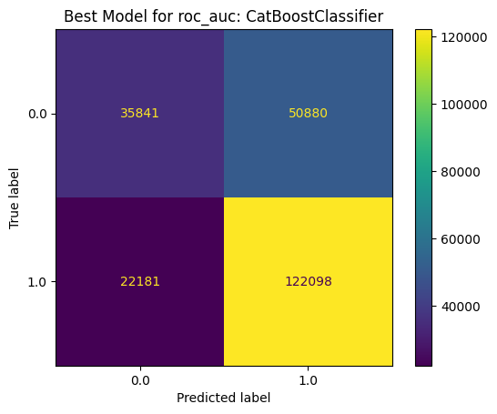
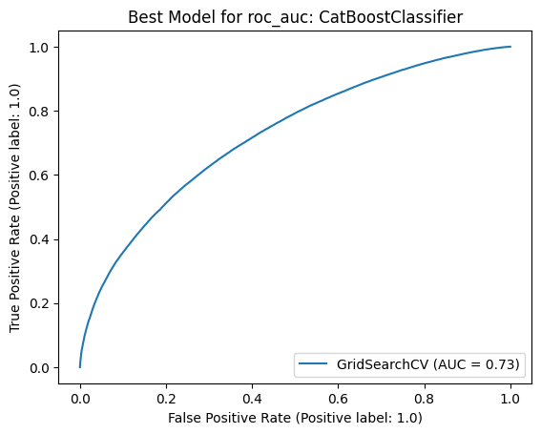
EVALUATION
Final Model — Evaluation on the Test Set
The best model, CatBoost, is evaluated once on the isolated hold-out test set (~231K rows).
0.73
0.68
0.63
ROC-AUC
Accuracy
Recall
Takeaway: Performance is modest but clearly above random (AUC 0.50); the minority "no diabetes" class is the harder one to capture

Slide 15


CONCLUSIONS
Key Takeaways
Best Model
Boosting Wins
CatBoostClassifier achieved ROC-AUC = 0.726 — modest but well above random (0.50), consistent with weak per-feature correlations found in EDA.
CatBoost, LightGBM, and XGBoost clustered tightly at 0.725–0.726, clearly outperforming all other approaches.
No Class Weighting Needed
Scaling Matters
Top models used auto_class_weights: None — stratification alone handled the mild imbalance.
StandardScaler consistently outperformed RobustScaler and no-scaling, though differences were small for tree-based models.

