Slide 1
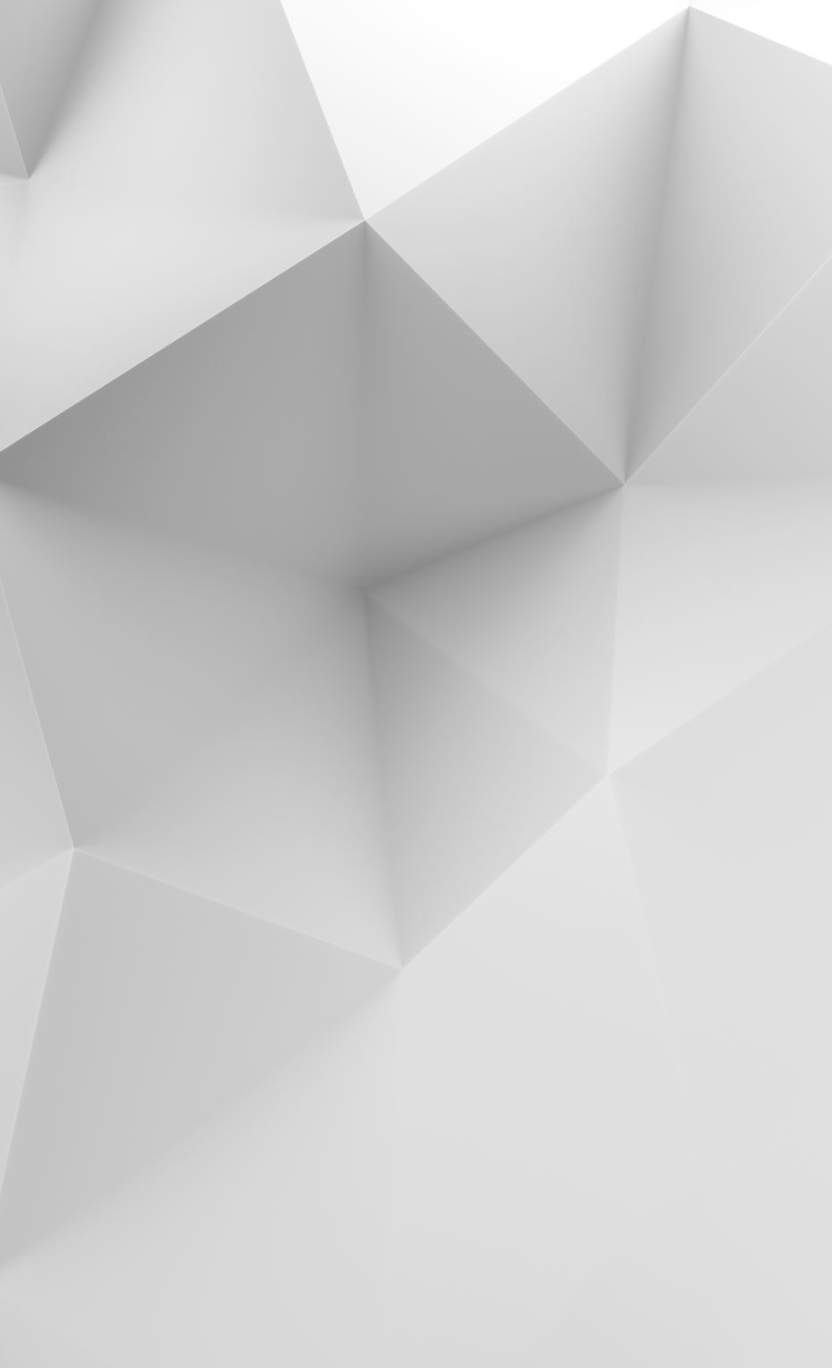
MULTY-PLATFORM SCREEN GRABBER
Lorenzo Sciara, Luca Rota, Francesco Grande

Slide 2
Why ICED?
Pros:
- Cross-platform
- Self thread management
- Event capturing
- Userfriendly UI
Cons:
- Very steep learning curve
- Little documentation
- Limited customization

Slide 3
Screenshot Thread
Since Iced doesn't allow interaction with the entire operating system, it was necessary to use multiple threads to make screen capture possible, excluding the Iced window. The screen grabbed is sent to iced channel.

Slide 4
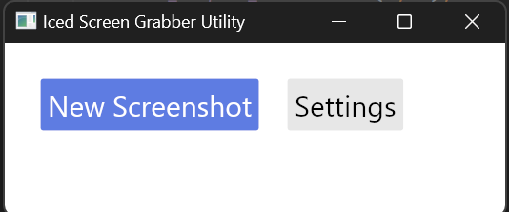
Home
This is the home screen page of the tool, representing the initial state of the application

Slide 5
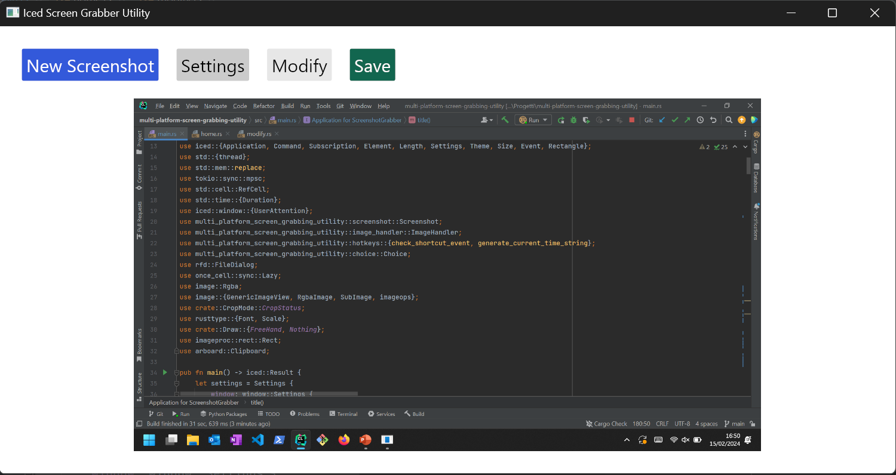
Home
This is the application's home page after capturing the entire system screen

Slide 6
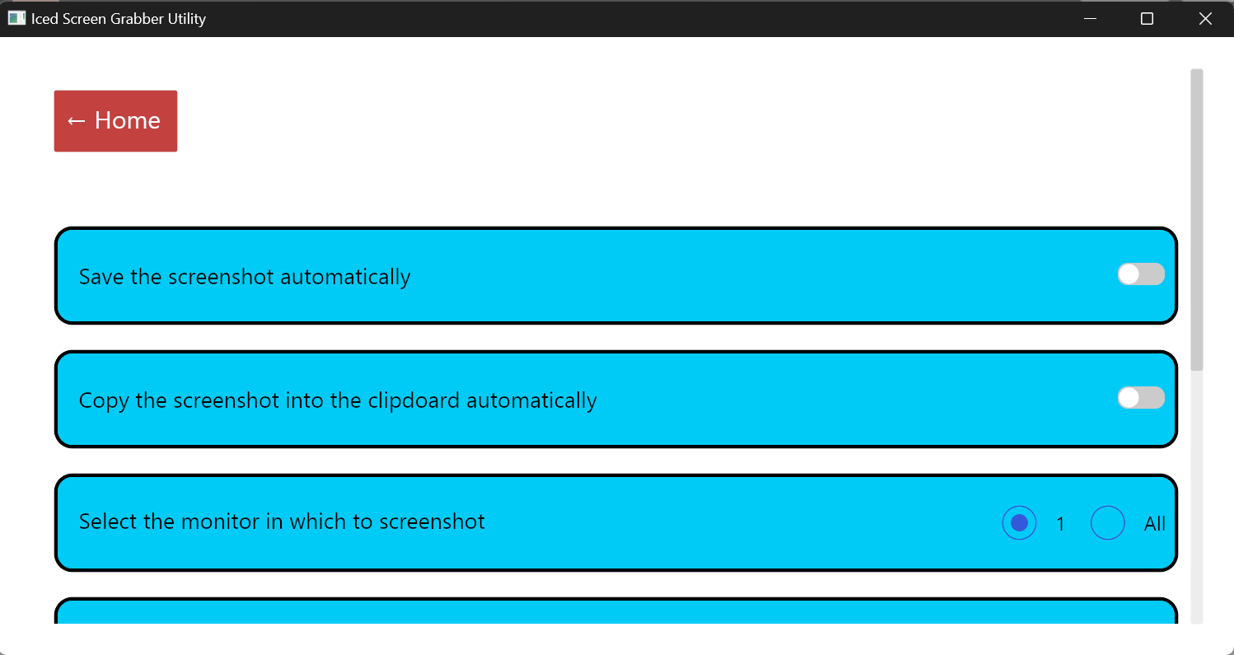
Settings
This is the settings page where you can select the necessary configuration features

Slide 7
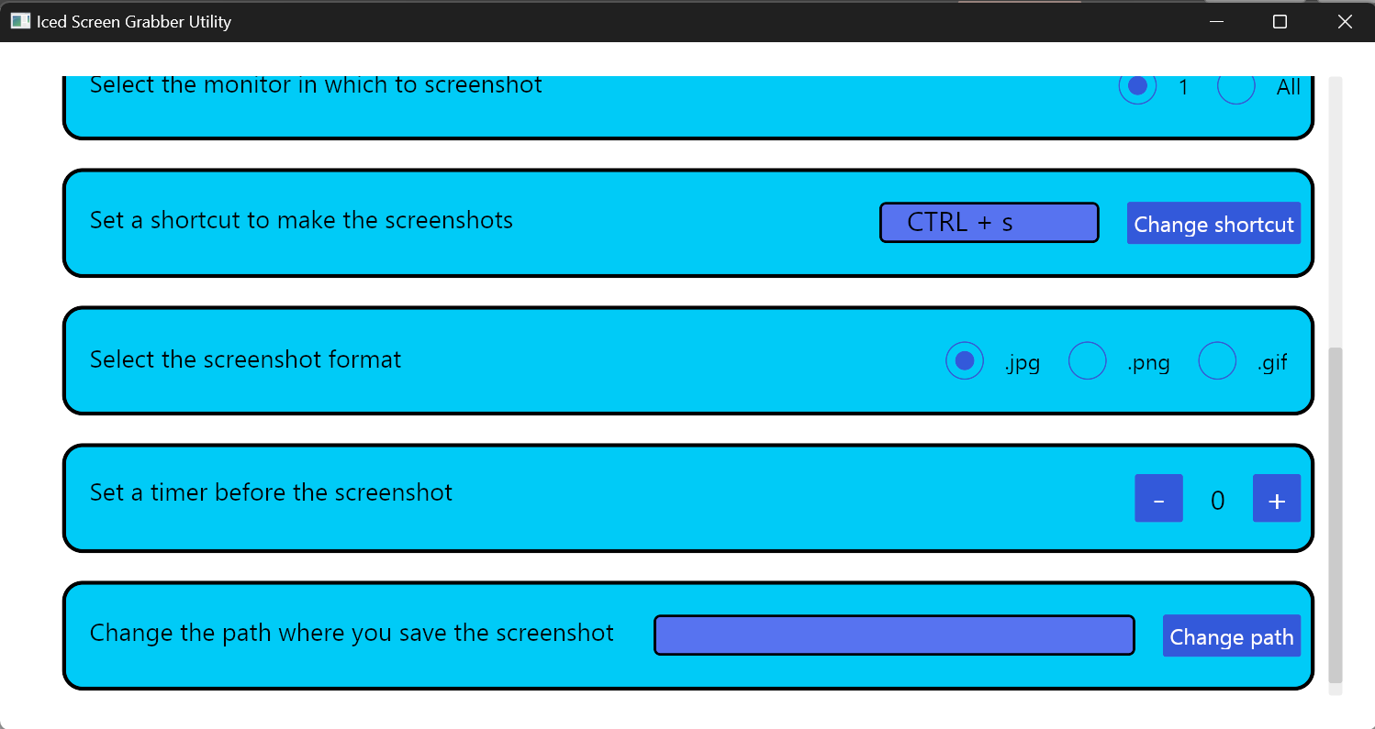
Settings
This is the settings page, which includes some additional features

Slide 8
Home
This is the application's home page after capturing the entire system screen

Slide 9
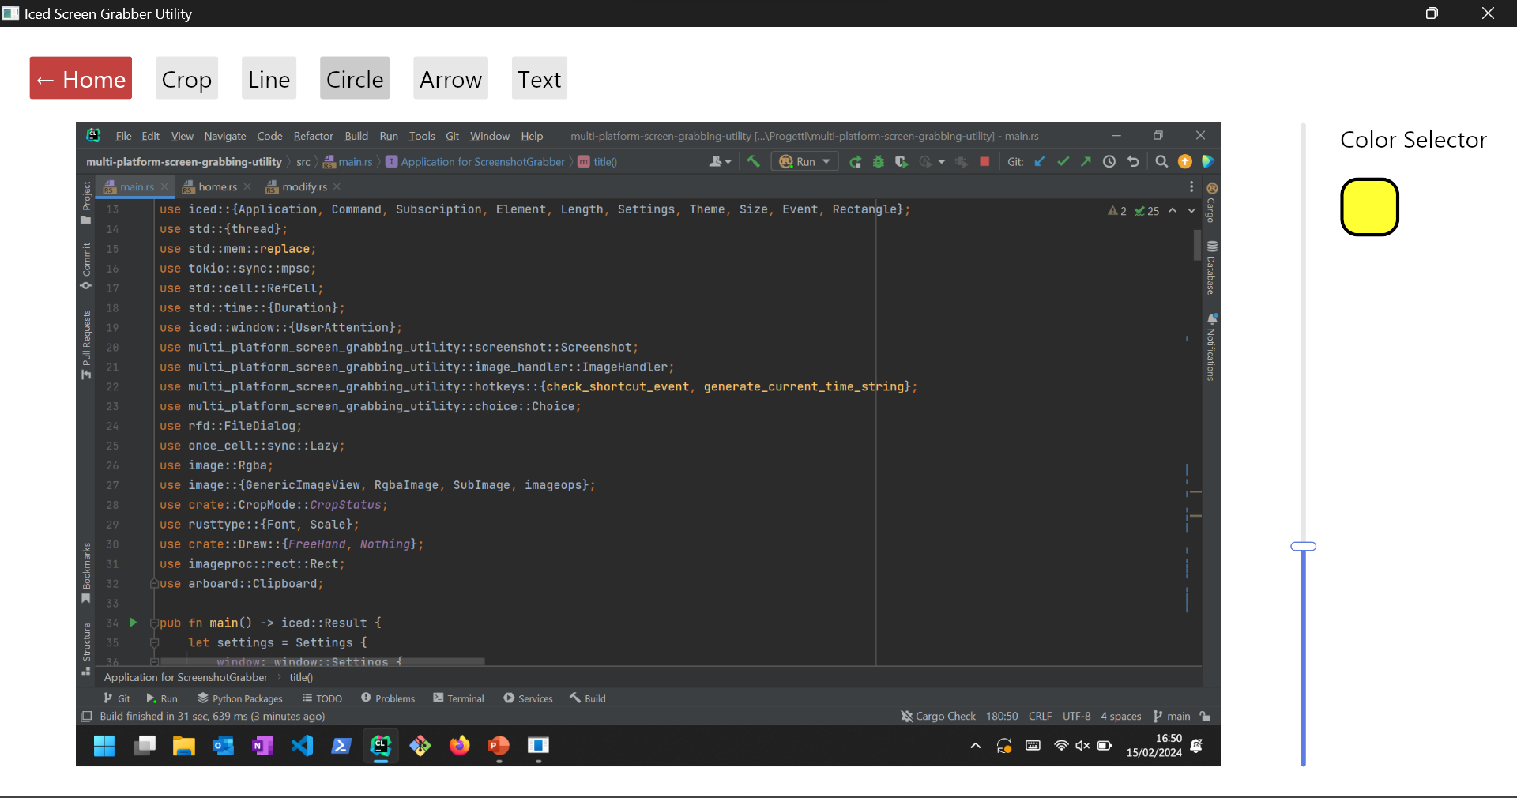
Modify
This is the modification page where you can edit the system image by cropping it and adding shapes

Slide 10
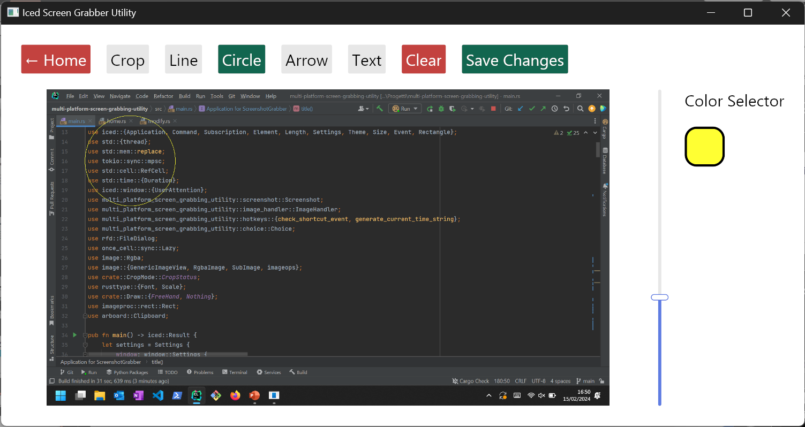
Modify
This is the modified page after the addition of a circular shape

Slide 11
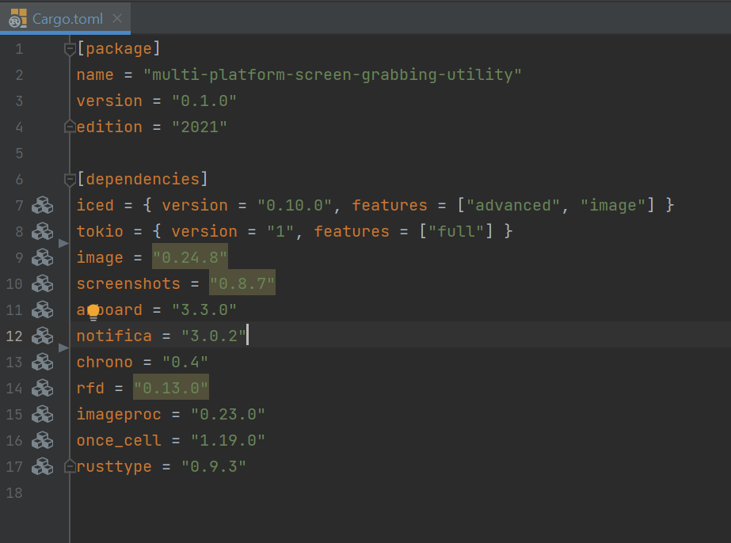
Crates
These are the dependencies of the project for frontend and backend

