Slide 1

ASSIGNEMENT 2: needfinding
Marra Benito (s295220)
Grande Francesco (s296962)
Rota Luca (s303941)
Sciara Lorenzo (s303462)

Slide 2
DOMAIN OF INTEREST
We chose the preparation of medical pre-trainings, because we thought it could improve the daily activities that a medicine student does.
Based on the additional interviews, we focused our attention on post-graduate surgery pre-trainings.

Slide 3
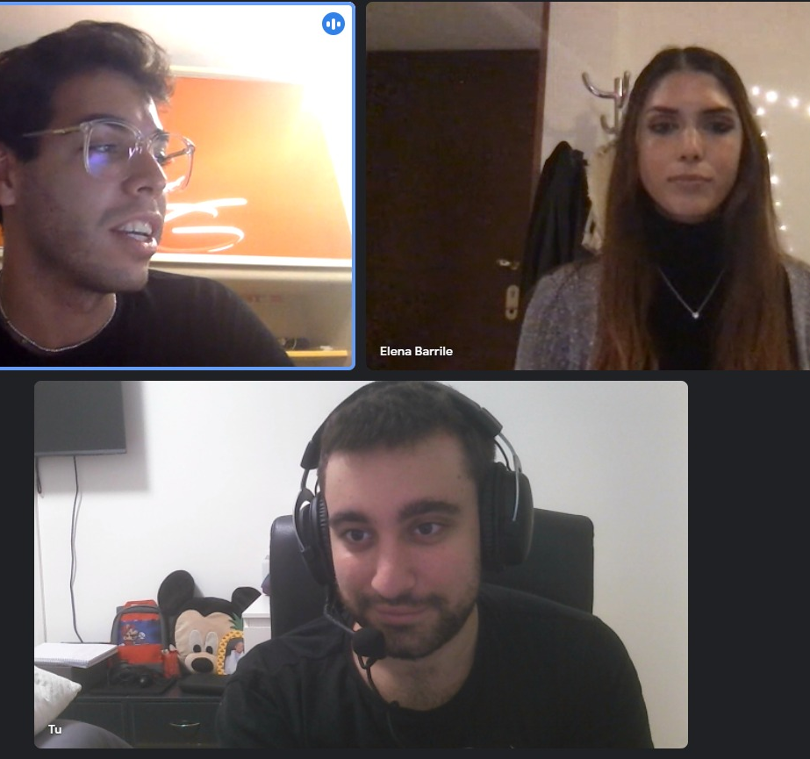
ElELENA BARRILE
Interviewed by Lorenzo and with Benito taking notes, she is a 26 years old at her last year of medicine studies, who has had several training experiences also in the field of surgery. During Covid period she could not do any training because of the emergency.

Slide 4
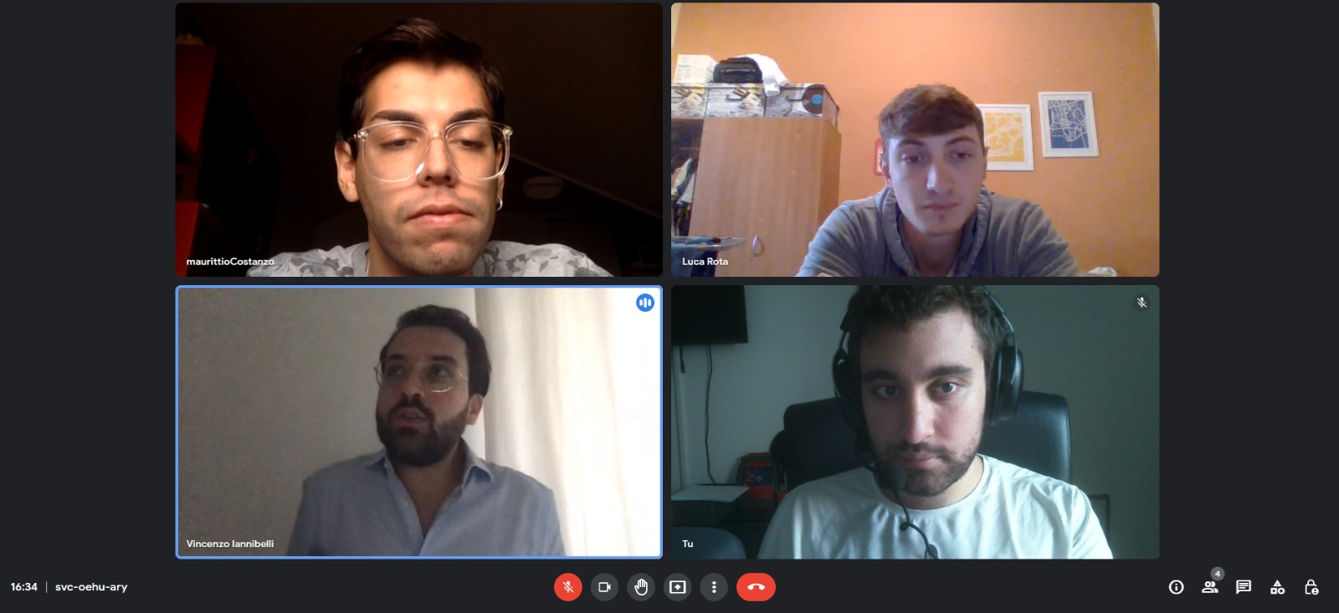
VINCENZO IANNIBELLI
Interviewed by Lorenzo and with Luca taking notes, He is a 29 year old at the specialization in radiodiagnostics. He has many years of experience in both theoretical and practical fields

Slide 5
ADDITTIONAL LEARNING AND RESULTS
Both new respondents had a lot of experience in the medical field and were able to experience different types of training; since they studied in two distant parts of Italy, it emerged from the interviews that the approach to training was also different.
Both think that the theoretical part of their studies is greater than the practical part, with different points of view: Elena believes that it would be useful to have more hours of internship (as also emerged from previous interviews), while Vincenzo thinks that theoretical studies are very important also about the preparation for the training.

Slide 6
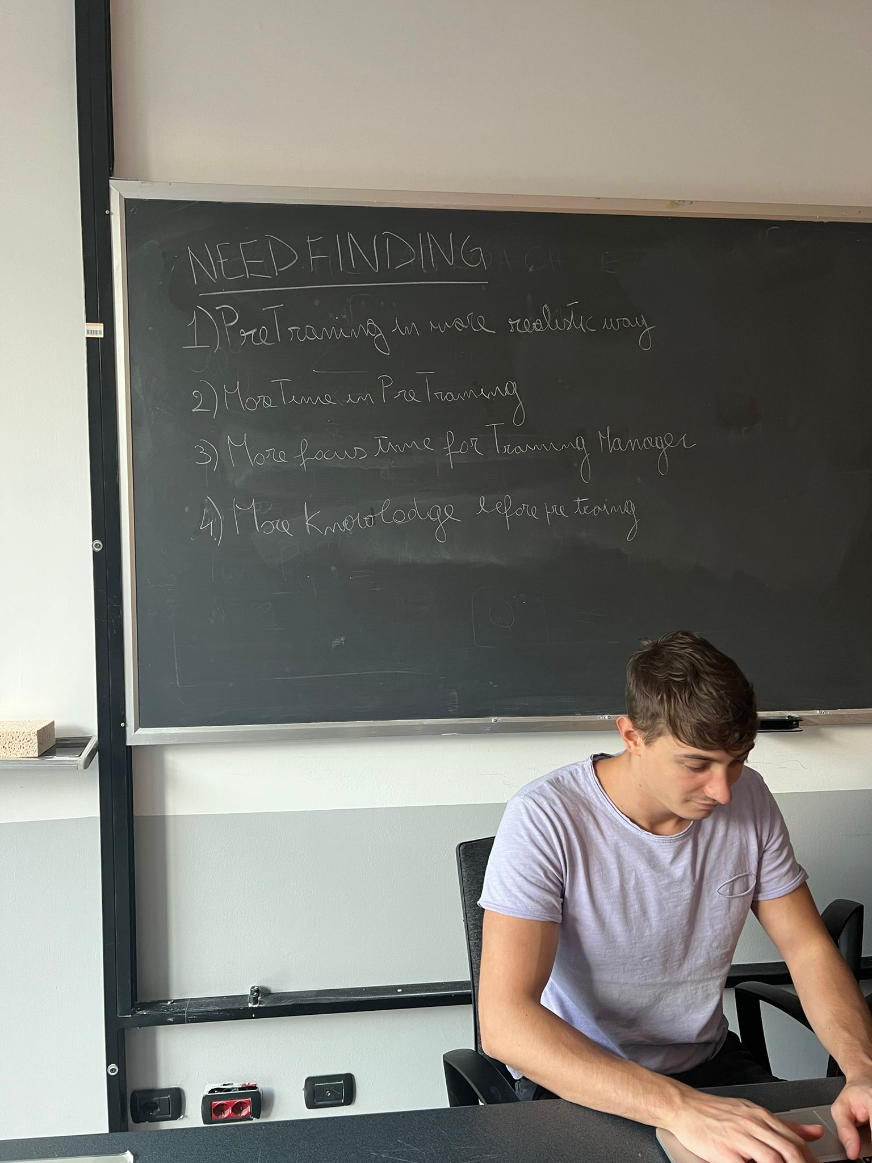
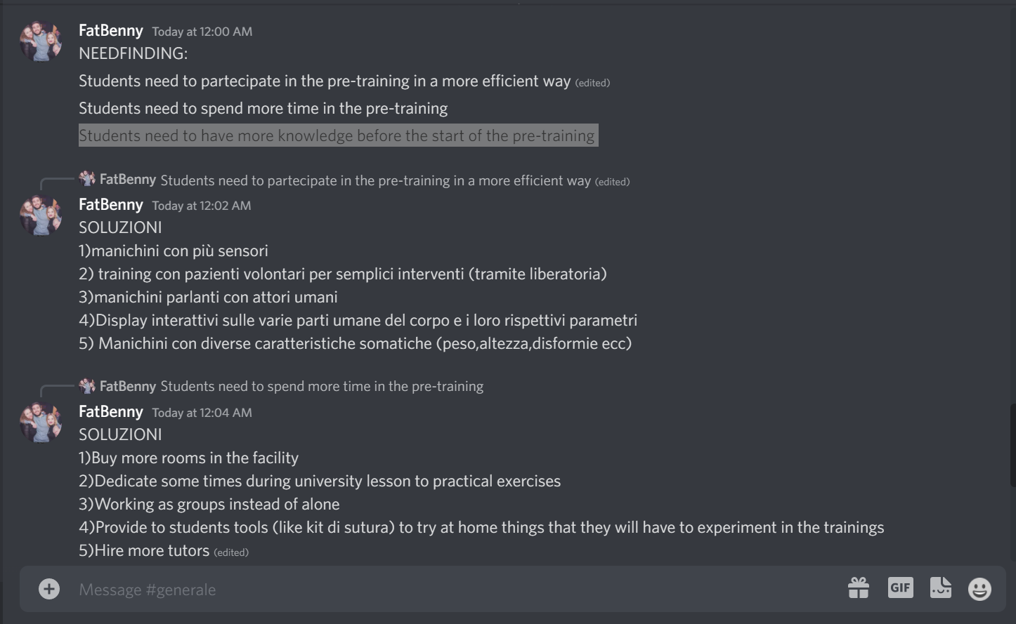
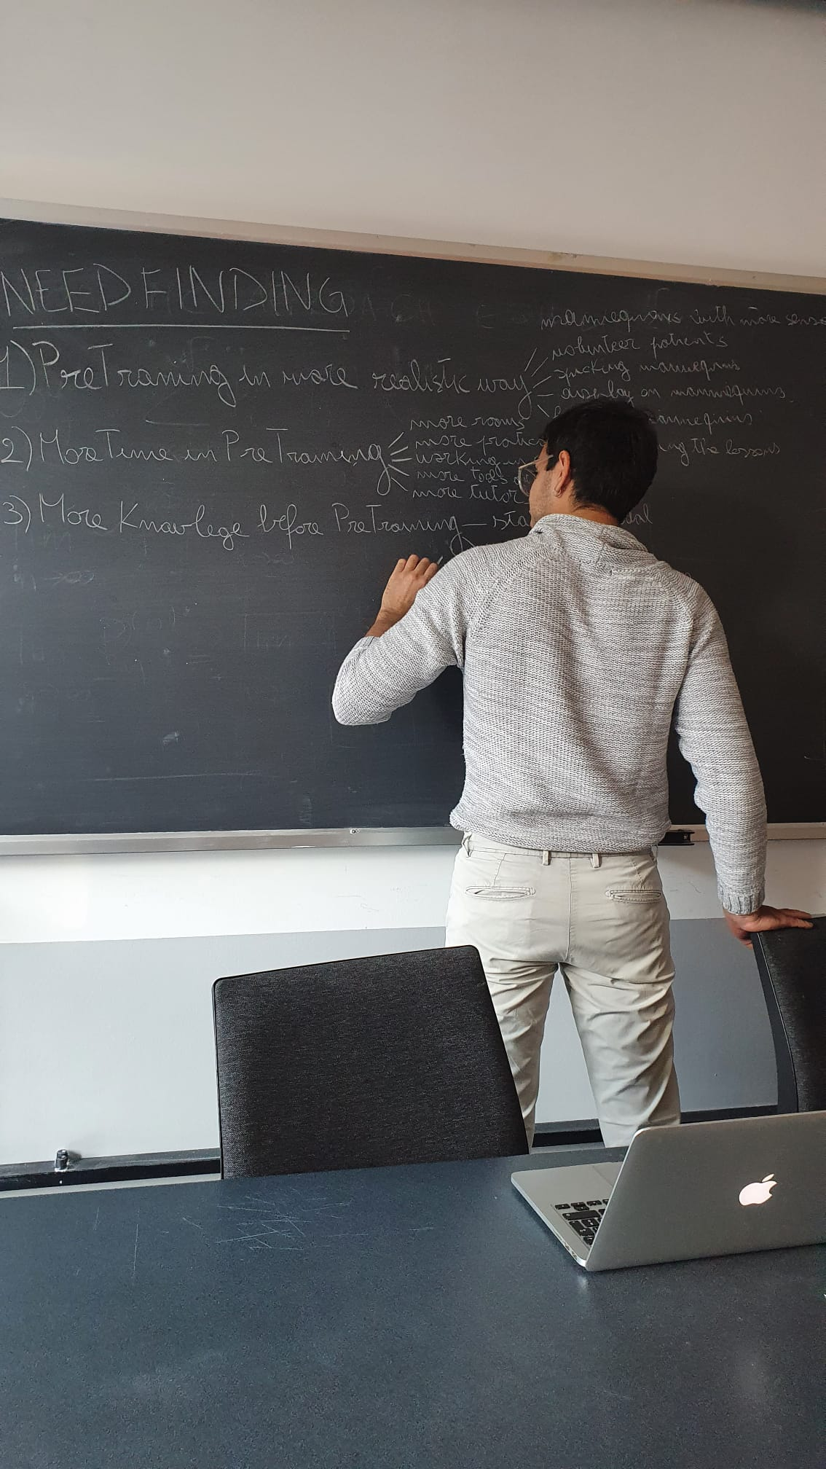
BRAINSTORMING

Slide 7
DEEP USER NEED
Students need to partecipate in the pre-training in a more efficient way (edited)
Mannequins with more sensors
Training with volunteer patients for simple interventions
Talking mannequins with human actors
Interactive displays on the various body parts and the human parameters
Mannequins with different somatic characteristics

Slide 8
DEEP USER NEED
2. Students need to spend more time in the pre-training
Buy more rooms in the facility
Dedicate sometimes during university lesson to practical exercises
Working as groups instead of alone
Provide students tools to try at home things that they will have to experiment in the trainings
Hire more tutors

Slide 9
DEEP USER NEED
Students need to have more knowledge before the start of the pre-training
Have a chance to see in the clinic the basics of medicine
Provide interactive materials to learn-alone e.g. like book-games
Give students videos where they can see the same operation they are going to perform in the pre-training
Fake operations in classroom lessons where the doctor tries to replicate the thing on dead animals
Making groups where the student who already learnt the basic can explain to newbie

Slide 10
SOLUTIONS
AIM NEED: Students need to have more knowledge before the start of the pre-training.
SOLUTION: Provide interactive materials to learn-alone.
SOLUTION DESCRIPTION: The student can be part of an immersive experience: with the use a graphical interface, he can participate in a training simulation; in addition, he could interact with the surrounding environment, make choices and receive feedback, in order to increasing realism.
WHY WE SELECT IT: Most of the students interviewed expressed their feeling of inexperience at the beginning of the internship; moreover, the interview with the extreme user showed that the individual preparation for the pre thyroid greatly increases the learning during the internship.

Slide 11
Project name and value proposition
PROJECT NAME: Medical Reality
HOW THE TEAM LAND ON THE NAME: The name of the project is the fusion of the two basic concepts of the project itself: the study in the medical field and virtual reality.
VALUE PROPOSITION: Train on Bytes before training on real bodies.

