Slide 1

ASSIGNEMENT 3: STORYBOARD AND LOW-Fi PROTOTypes
Marra Benito (s295220)
Grande Francesco (s296962)
Rota Luca (s303941)
Sciara Lorenzo (s303462)

Slide 2
Project name and value proposition
PROJECT NAME: Medical Reality
VALUE PROPOSITION: Train on Bytes before training on real bodies.
PROBLEM: Students need to have more knowledge before the start of the pre-training.
SOLUTION: Provide interactive materials to learn-alone.

Slide 3
TASks
SIMPLE TASK: Begin a new preparatory lesson to the pre-training
MODERATE TASK: Share train result to the professor
COMPLEX TASK: Receive tips on future medical pre-training lessons based on demonstrated skills

Slide 4
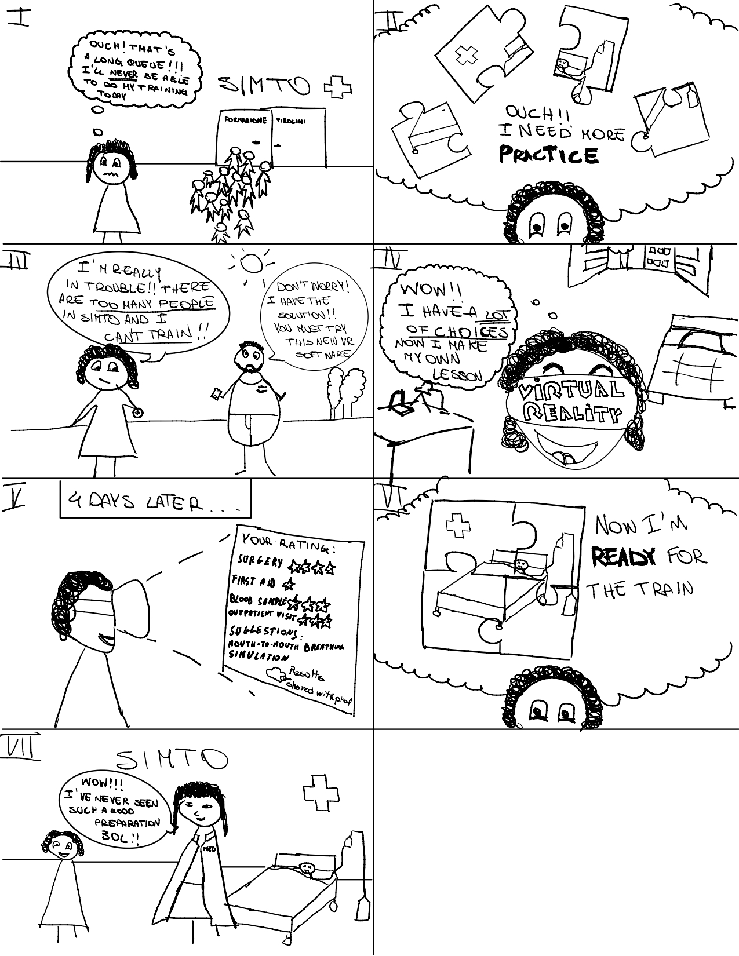
storyboard
WHY: These figures best express our idea
STRENGHTHS: It represents all chosen tasks
WEANESSES: Our drawing may not be totally clear
HOW WELL GOAL ARE ACHIEVED: The goals have been partially represented because to show them at best we would need to represent also the graphical interface

Slide 5
Modalities exploration
OVERVIEW: We focused on portable and immersive devices that can meet our tasks
ALTERNATIVES:
Tablet / VR: Has an affordable cost and has a very large screen that increases the immersivity of the experience
Visor / VR: Maximizes the immersivity of the experience and allows you to interact with the environment

Slide 6
Prototype #1
CONNECTION WITH STORYBOARD: The prototype is connected with the storyboard but the device used for this prototype is not the same of the storyboard one.
CONNECTION WITH TASKS: The prototype is perfectly connected with the tasks. More in deep the simple task is represented by figure 5, the moderate task is represented by figure 8 and the complex task is represented by figure 4

Slide 7
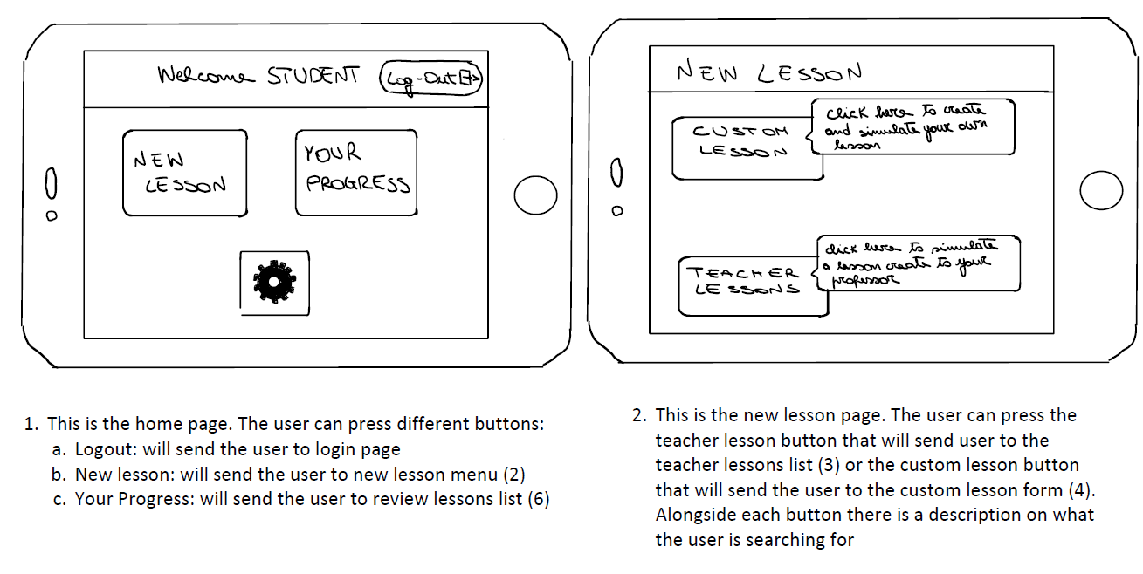
PROTOTYPE #1

Slide 8
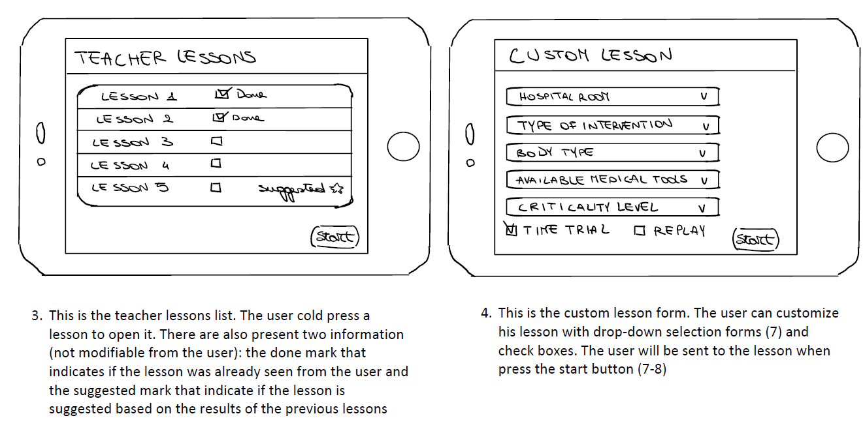
Prototype #1

Slide 9
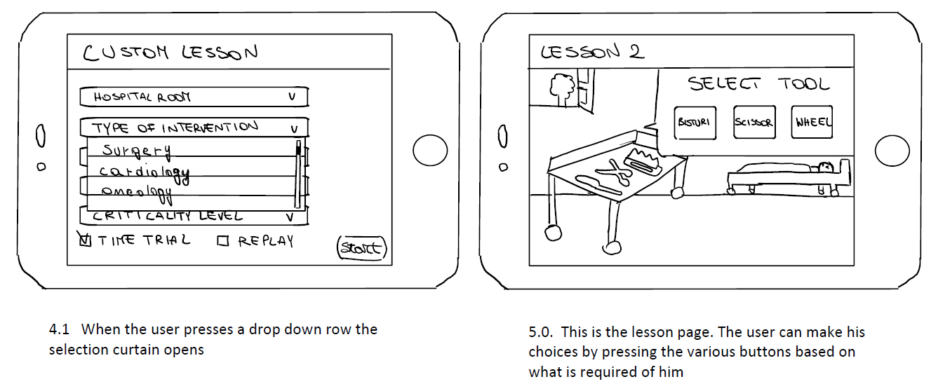
Prototype #1

Slide 10
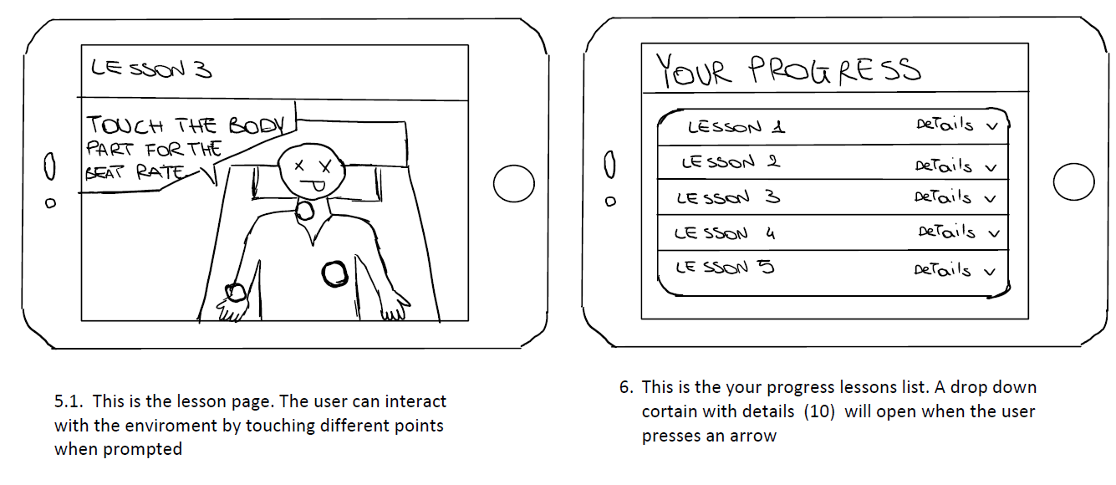
Prototype #1

Slide 11
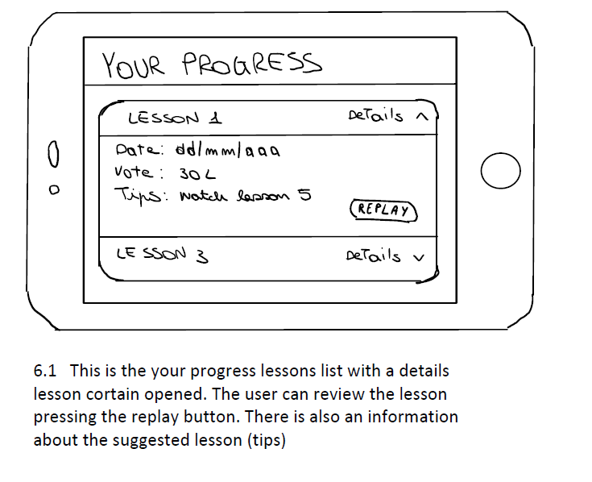
Prototype #1

Slide 12
PROS&CONS PROTOTYPE #1
PROS:
The device is portable and with moderate price;
Different options are clearly distinguishable and easly selectable with the touchscreen;
Pages are clearly distinguished so that the user can always know where it is;
User can do a login;
CONS:
The interface is not totally immersive;
User can only interact with touch screen;

Slide 13
Prototype #2
CONNECTION WITH STORYBOARD: The prototype is connected with the storyboard because it represents the graphical interface that was not present in the storyboard
CONNECTION WITH TASKS: The prototype is perfectly connected with the tasks. More in deep the simple task is represented by figure 5, the moderate task is represented by figure 8 and the complex task is represented by figure 4

Slide 14
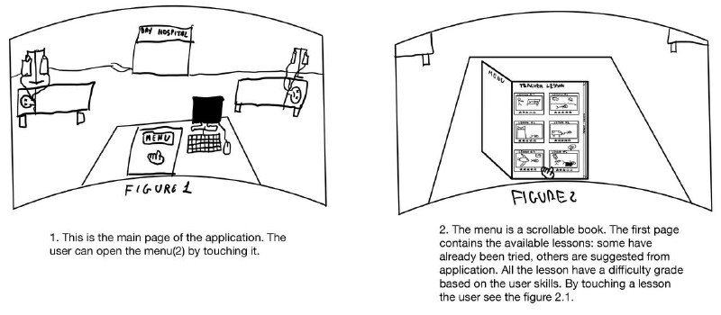
Prototype #2

Slide 15
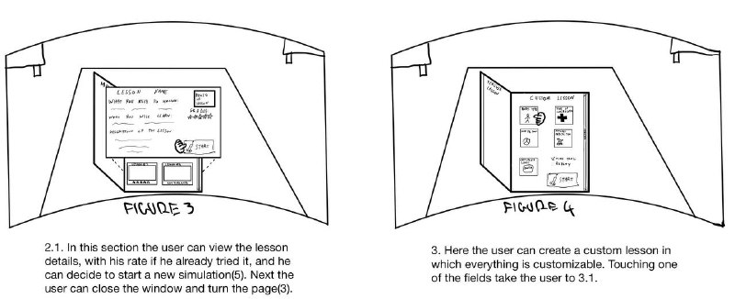
Prototype #2

Slide 16
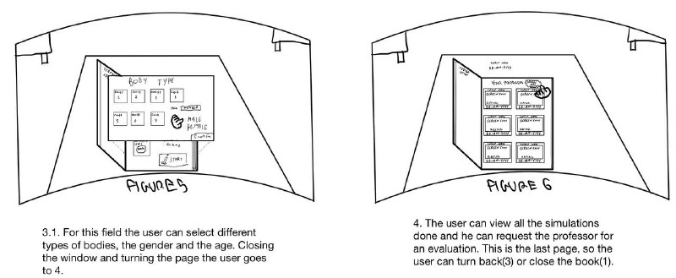
Prototype #2

Slide 17
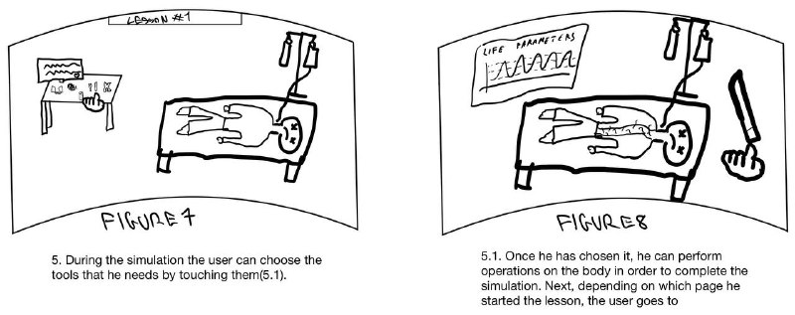
Prototype #2

Slide 18
PROS&CONS PROTOTYPE #2
PROS:
More immersive since people can interact with the experience using their hands directly;
Video recordings of the simulation can help to analyze the students mistake in a very efficient way;
It provides a more detailed view during the simulation;
CONS:
Tiring to the eyes (virtual reality can't be used for long time);
Create a custom lesson requires more time since you have to scroll the book pages;
It may be portable but it’s not optimal to use everywhere;

Slide 19
CHOICE OF PROTOTYPE
We chose prototype #2 because, although prototype #1 apparently has more pros than cons, since the main objective of the project is to provide the most interactive and immersive lessons possible, the prototype #2 responds better to this need.
Furthermore, the menu presented by a scrollable book, in the prototype #2, is more user friendly as it seems like a study book for the med students.

