Slide 1
Output File
Output of scattered far and near fields
Choice among 18 coordinates couples
Choice among 10 field components couples
Output on multiple planes for field representation on a volume
Multiple sources contribution

Slide 2
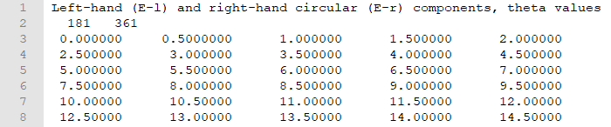
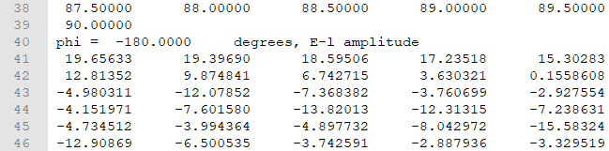
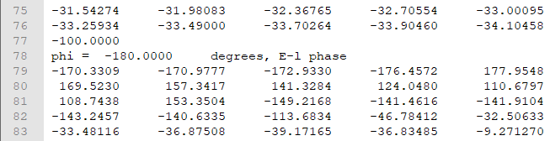
General output file format for field description (near or far field)
Title, summary of the data types (components and coordiantes)
N of values of the first and second coordinates
List of the 1st coordinate
…
2nd coordinate value, type of component
…
List of the component (amplitude in dB) at constant 2nd coordinates for variable 1st coordinates
List of the component (phase in deg) at constant 2nd coordinates for variable 1st coordinates

Slide 3
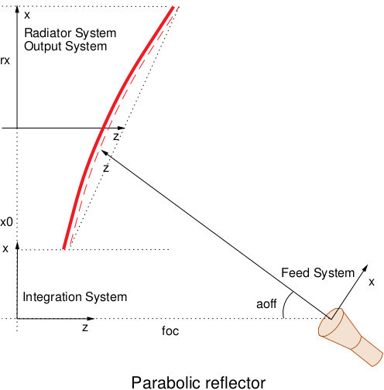
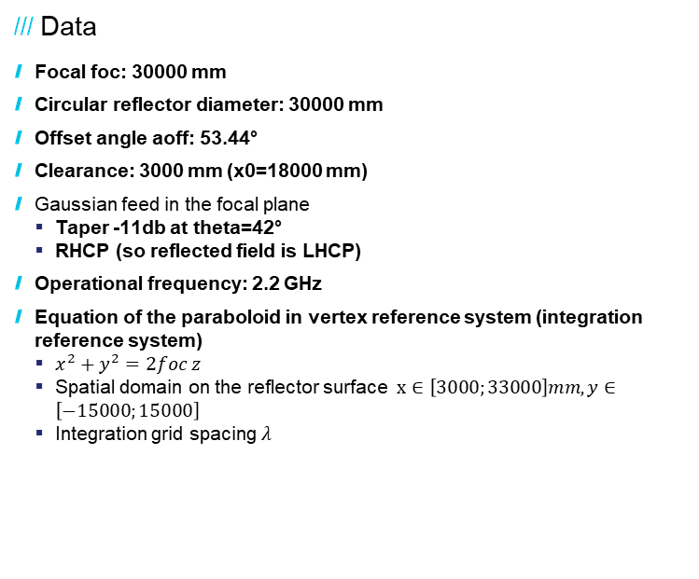
Sband reflector
Data
  Focal foc: 30000 mm
  Circular reflector diameter: 30000 mm
  Offset angle aoff: 53.44°
  Clearance: 3000 mm (x0=18000 mm)
  Gaussian feed in the focal plane
    Taper -11db at theta=42°
    RHCP (so reflected field is LHCP)
  Operational frequency: 2.2 GHz
  Equation of the paraboloid in vertex reference system (integration reference system)
    $x^{2}+y^{2}=2foc z$
    Spatial domain on the reflector surface $x∈\left[3000;33000\right]mm, y∈\left[−15000;15000\right]$
    Integration grid spacing $λ$

Slide 4

Sband reflector
Data
  Focal foc: 10000 mm
  Circular reflector diameter: 10000 mm
  Offset angle aoff: 34.18°
  Clearance: 1500 mm (x0=6500 mm)
  Gaussian feed in the focal plane
    Taper -11db at theta=25.60°
    RHCP (so reflected field is LHCP)
  Operational frequency: 30 GHz
  Equation of the paraboloid in vertex reference system (integration reference system)
    $x^{2}+y^{2}=2foc z$
    Spatial domain on the reflector surface $x∈\left[1500;11500\right]mm, y∈\left[−5000;5000\right]$
    Integration grid spacing $λ$

