Slide 1
Introduction to inverse problems and Markov chain Monte Carlo methods
School of Mathematics, University of Edinburgh
Lorenzo Gabriel Stigliano
24th April 2021

Slide 2
Outline of todays presentation
What are inverse problems?
Optimization Approach
Bayesian Inference Approach
Markov chain Monte Carlo Methods (MCMC)
Markov chain theory
Motivation to use MCMC methods
Reversible Samplers
Nonreversible Samplers
Takeaways

Slide 3

1. What are inverse problems?
Concerned with determining casual factors from observed data.
Mathematically: determine function inputs based on function outputs.
$$y=G\left(u\right)+η$$
These problems appear in, for example:
Computational imaging
Why are these problems hard to solve?
We do not know the value of $η$.
We cannot simply invert $G$.

Slide 4

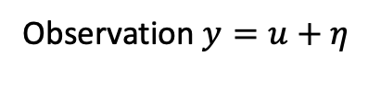
1. Example - Image De-noising
Observation$y=u+η$
Original image $u$
Each pixel $u_{n,m}$ has some additive noise from some $N\left(0, σ^{2}I\right).$

Slide 5

1.1 Optimization Approach
Minimize an objective function.
$$u^{∗}=arg\min_{u^{∗}∈U} ||y−G(u)||_{2}^{2}$$
Leads to:
Ill-posed problem:
there could not be a unique solution $u^{∗}$
$u^{∗}$does not depend continuously on $y$
Ill-conditioned problem: small changes in $y$ can lead to large changes in $u^{∗}$
We can introduce a regularization term.
$u^{∗}=arg\min_{u^{∗}∈U} ||y−G(u)||_{2}^{2}$ + $αR(u)$
We produce a point estimate.

Slide 6

1.2 Bayesian inference approach
Probabilistic approach.
Solution: Probability density function $p(u|y)$.
This allows for:
uncertainty quantification.
incorporation of prior knowledge.
The inverse problem is well-posed:
A unique posterior distribution.
The posterior distribution depends continuously on $y$.

Slide 7
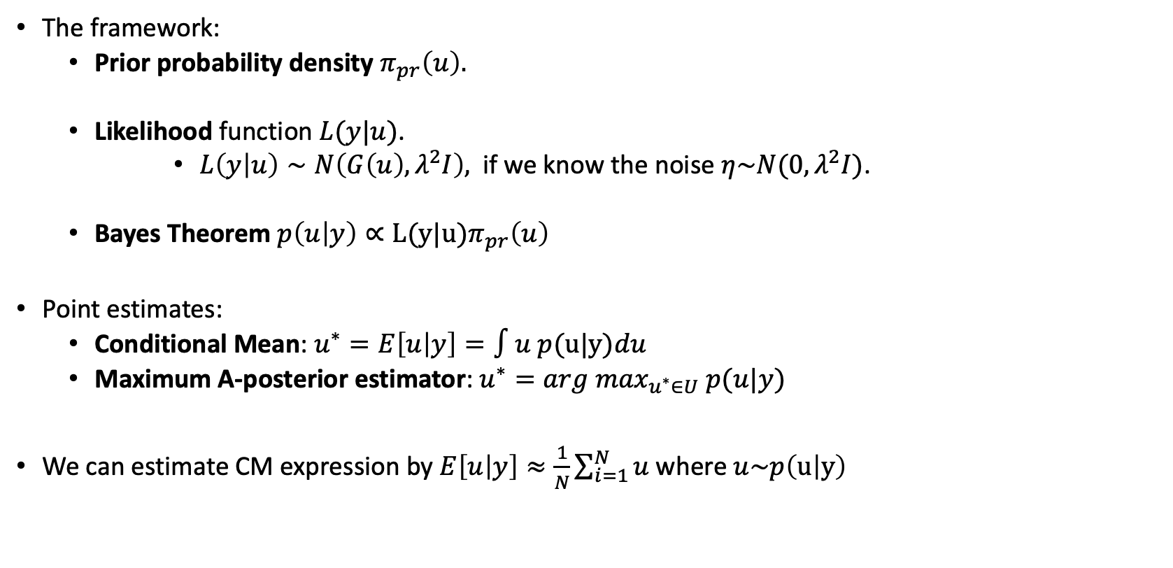
1.2 Bayesian inference approach
The framework:
Prior probability density $π_{pr}\left(u\right).$
Likelihood function$L(y|u)$.
$L\left(y | u\right)∼N\left(G\left(u\right),λ^{2}I\right),$ if we know the noise $η\sim N(0,λ^{2}I)$.
Bayes Theorem $p\left(u | y\right)∝L(y|u)π_{pr}\left(u\right)$
Point estimates:
Conditional Mean: $u^{∗}=E\left[u | y\right]=∫u p(u|y)du$
Maximum A-posterior estimator:$u^{∗}=arg\max_{u^{∗}∈U} p(u|y)$
We can estimate CM expression by $E\left[u | y\right]≈\frac{1}{N}\sum_{i=1}^{N}{u}$ where $u\sim p\left(u | y\right)$

Slide 8
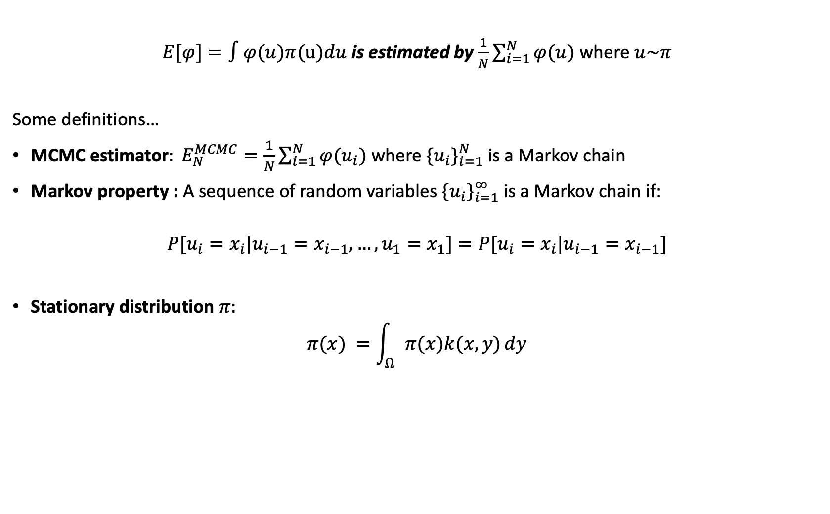
2. Markov chain Monte Carlo Methods (MCMC)
$E[φ]=∫φ(u)π(u)du$ is estimated by $\frac{1}{N}\sum_{i=1}^{N}{φ(u)}$ where $u\sim π$
Some definitions…
MCMC estimator$: E_{N}^{MCMC}=\frac{1}{N}\sum_{i=1}^{N}{φ(u_{i})}$where $\{u_{i}\}_{i=1}^{N}$is a Markov chain
Markov property : A sequence of random variables $\{u_{i}\}_{i=1}^{∞}$is a Markov chain if:
$$P[u_{i}=x_{i}|u_{i−1}=x_{i−1},…,u_{1}=x_{1}]=P[u_{i}=x_{i}|u_{i−1}=x_{i−1}]$$
Stationary distribution $π:$
$$π(x) =\int_{Ω}{π(x)k(x,y)}dy$$

Slide 9

2.1. Why use MCMC Methods
We do not need to know the explicit form of the target distribution.
Linking back… $p\left(u | y\right)∝L(y|u)π_{pr}\left(u\right)$.
From Markov chain theory:
Stationary distribution: we can create a chain $\{u_{i}\}_{i=1}^{∞}$ such that $u_{i}∼π$as $i→∞$
The Ergodic average $\frac{1}{N}\sum_{i=1}^{N}{φ\left(u_{i}\right)→E[φ]}$ as N $→∞$
Central limit theorem:
The estimator $\frac{1}{N}\sum_{i=1}^{N}{φ\left(u_{i}\right)}$ $→$ $N(E[φ], \frac{σ^{2}}{N})$
The asymptotic variance: $σ^{2}$= $Var[φ(u_{1})] + 2\sum_{i=1}^{∞}{Cov[φ(u_{1}),φ(u_{i})]}$

Slide 10

2.3. Implementing MCMC – Reversible Samplers
Reversible chain: $π(y)k(y,x) =π(x)k(x,y),∀x,y∈Ω$
Metropolis Hastings Algorithm:
Choose $u_{0}$with $π(u_{0})>0$
At state $u_{i}$, sample a proposal $u′$ from density $q\left(u^{′} | u_{i}\right)$
Accept sample $u′$ with probability:
$$α(u^{′}|u_{i})=min\left(1, \frac{π(u^{′})q(u_{i}|u′)}{π(u_{i}) q\left(u^{′} | u_{i}\right)}\right)$$
We accept a proposal sample $u^{′},$when $\frac{π(u^{′})}{π(u_{i})}$ and $\frac{q(u_{i}|u′)}{q(u′|u_{i})}$ are large.
We need to properly tune the parameters in $q\left(u^{′} | u_{i}\right)$
Loop

Slide 11

2.4. Example – Reversible Sampler
Target distribution: $π=N(10,2)$
Algorithm: Metropolis Hastings algorithm with a random walk proposal density.
Random walk proposal: $q\left(u^{′} | u_{i}\right)∼ N(u_{i},β^{2}I)$ ; $u^{′}=u_{i}+βε where ε∼N(0,I).$
We are interested at the rate at which the autocorrelation function decays.
Autocorrelation function : $δ\left(τ\right)=\frac{cov\left(u_{i},{ u}_{i+τ}\right)}{cov\left(u_{1},u_{1}\right)}$

Slide 12

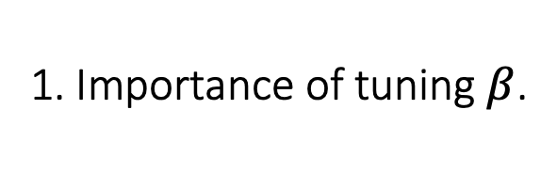
1. Importance of tuning $β$.
Chains ran for 4000 iterations using small and large $β.$
Top figure:
$$β=20.$$
Bottom figure:
$$β=0.3.$$
$α(u^{′}|u_{i})=min\left(1, \frac{π(u′)q(u_{i}|u′)}{π(u_{i})q({u′|u}_{i})}\right)$

Slide 13


2. How to tune $β$.
Tuning $β$ with such that average acceptance probability $≈0.234$.
This is rule of thumb is for random walk proposals.

Slide 14

2. How to tune $β$.
Top graph :
Autocorrelation function against lag.
Bottom graph:
Estimated target distribution.
4000 iterations, $β= 3.2$.

Slide 15
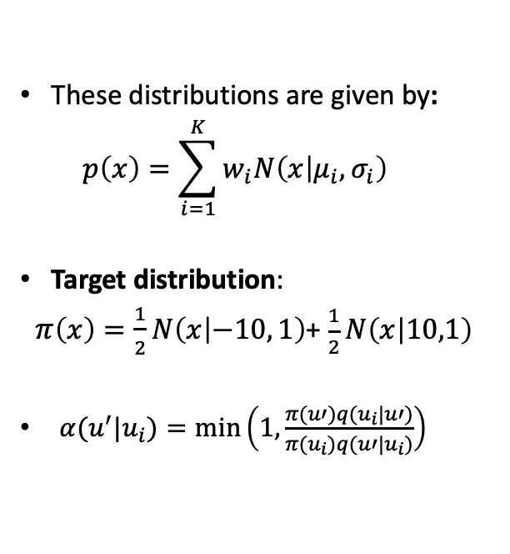
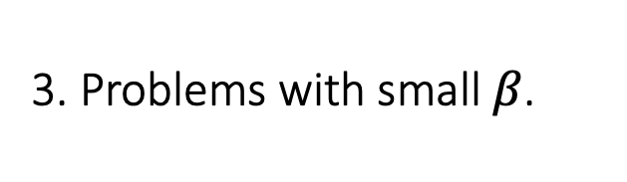
3. Problems with small $β$.
These distributions are given by:
$$p\left(x\right)=\sum_{i=1}^{K}{w_{i}N\left(x | μ_{i}, σ_{i}\right) }$$
Target distribution:
$π\left(x\right)=\frac{1}{2}N\left(x | −10, 1\right)$+ $\frac{1}{2}N\left(x | 10,1\right)$
$α(u^{′}|u_{i})=min\left(1, \frac{π(u′)q(u_{i}|u′)}{π(u_{i})q({u′|u}_{i})}\right)$

Slide 16
2.5. Challenges - Reversible Samplers
How do we determine that we have reached our desired stationary distribution?
The samples are usually correlated.
Which proposal density do we choose?

Slide 17
2.6. Non-Reversible Samplers
Non-reversible samplers create non-reversible chains.
They are useful since they have the same properties as reversible chains:
Stationary distribution
The Ergodic average
Advantages over reversible samplers:
Faster convergence to equilibrium.
Reduction of asymptotic variance.

Slide 18


2.7. Implementing MCMC – I-Jump Sampler
The I-Jump sampler is a nonreversible sampler.
Like the MH algorithm but with two key differences.
Use of two one-sided proposal densities.
$f\left(u^{′} | u_{i}\right)$ : ${ u}^{′ }=u_{i}+ξ$
$g\left(u^{′} | u_{i}\right)$ : $u^{′}=u_{i}−ξ$
$ξ\sim Γ(a,b)$.
Introduction of an indicator variable $z$.
I-Jump Sampler:
Choose $u_{0}$with $π(u_{0})>0$
Randomly pick $z∈\{−1,1\}$
If $z > 0$:
At state $u_{i}$, sample $u′$ from $f\left(u^{′} | u_{i}\right)$
$α(u^{′}|u_{i})=min\left(1, \frac{π\left(u′\right)g(u_{i}|u′)}{π\left(u_{i}\right)f(u′|u_{i})}\right)$
else:
At state $u_{i}$, sample $u′$ from $g\left(u^{′} | u_{i}\right)$
$α(u^{′}|u_{i})=min\left(1, \frac{π\left(u′\right)f(u_{i}|u′)}{π(u_{i})g({u′|u}_{i})}\right)$
Accept sample $u′$ with probability $α\left(u^{′} | u_{i}\right)$
if we reject : $−z$
Loop

Slide 19

1. Comparing against MH algorithm.
Target distribution: $π=N\left(10,2\right)$
Autocorrelation function against lag.
MH algorithm the same one we tuned before.
Here $a= 1$, $b=0.4.$

Slide 20
3. What we can takeaway from this presentation
Inverse problems are hard to solve.
Why we would like to use Bayesian inference approach.
The need and advantages of using of MCMC methods.
The importance of appropriately tuning MCMC parameters.
The benefits of using nonreversible samplers over reversible samplers.

Slide 21
Thank you for listening. Any questions?

