Slide 1

ISEQL-Glucose Analyzer
Lorenzo Tucceri Cimini
n.294425

Slide 2
Introduction
• Objective: Improve diabetes management.
• Analysis Period: February 13, 2024 - May 12, 2024.
• Tools:
Python , Flask, ISEQL and Laravel
• Types of events analysed
Glicemyc Intervalies
• Overcome: Identifying patterns to improve diabetes monitoring and management

Slide 3
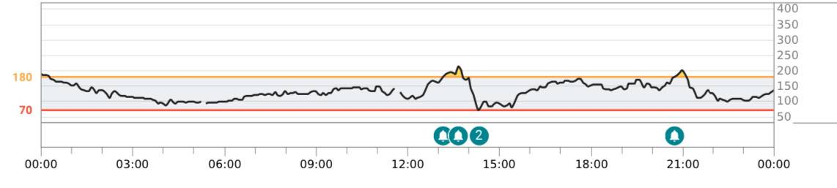
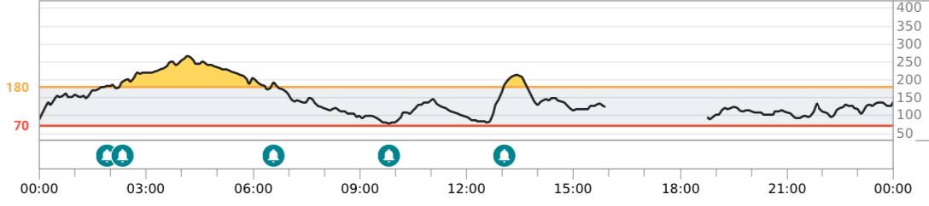

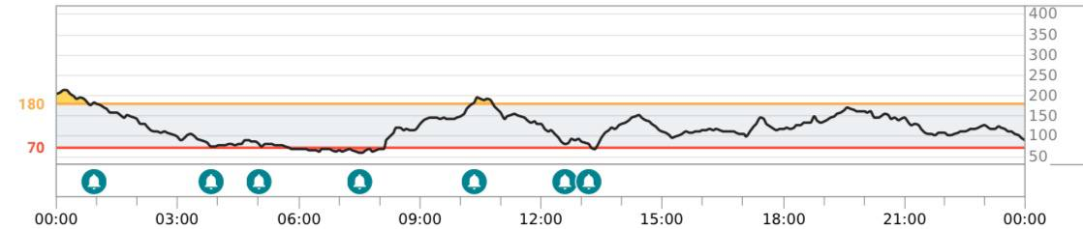
State of art
• Dexcome G7:
• DiaHealth:
• Feedforward Neural Networks (FNNs) :

Slide 4
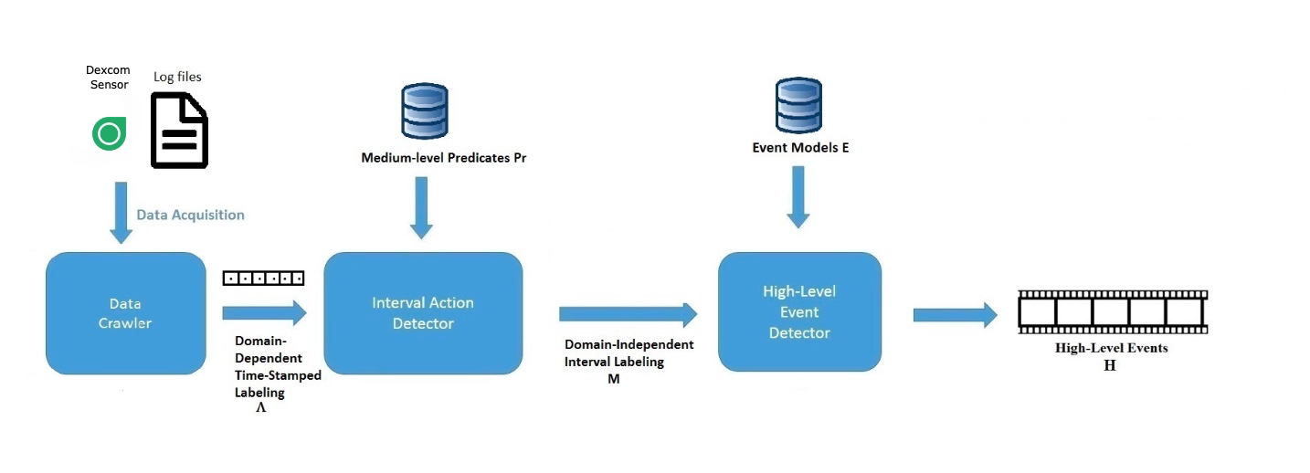
Overview and Formalization
Three levels:
Data Crawler
Interval Action Detector
High-Level Event Detector
Advantages of the system:
Generalizable and flexible
Improve the glycemic analysis
Introduces new high-level events

Slide 5
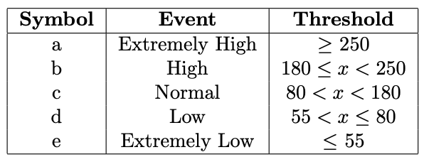
Data Crawler
Associate events with glucose levels based on specific thresholds
Each event is labelled

Slide 6
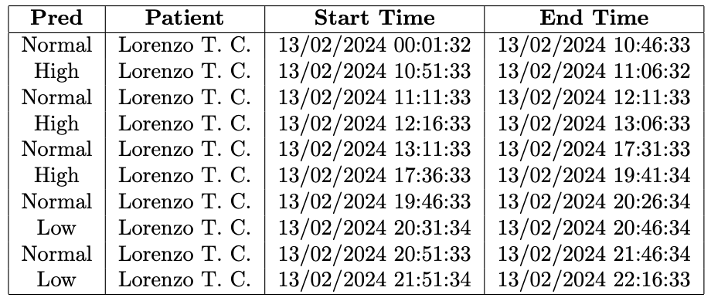
Interval Action Detector
Organize data into time intervals
Use algorithm to select the maximum subset of non-overlapping intervals.
Analyse the duration of events

Slide 7
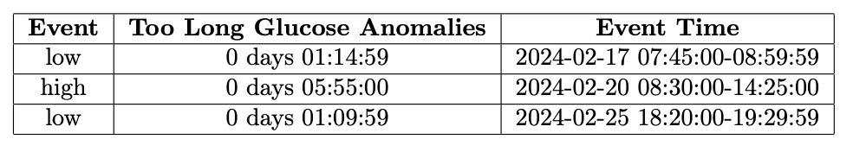
High-Level Event Detector
The analysis includes two levels:
Simple High-Level Event
Aggregated high-Level Event

Slide 8
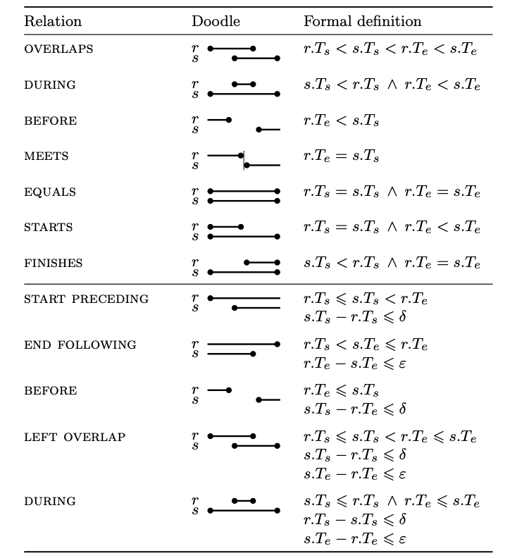
ISEQL
Advanced Monitoring
Decision support
Efficiency in Time Analysis

Slide 9
Modelling High-Level Event with ISEQL
Simple High-Level Event
Time Swing
Too Long Glucose Anomalies
Aggregated High-Level Event
Too Frequent Glucose Anomalies
Too Frequent Time Swings
Time Swing With Too Long Glucose Anomalies

Slide 10
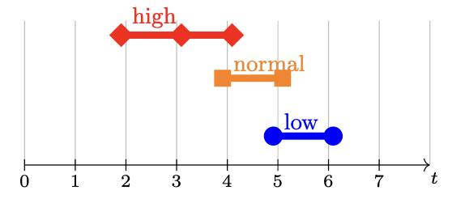
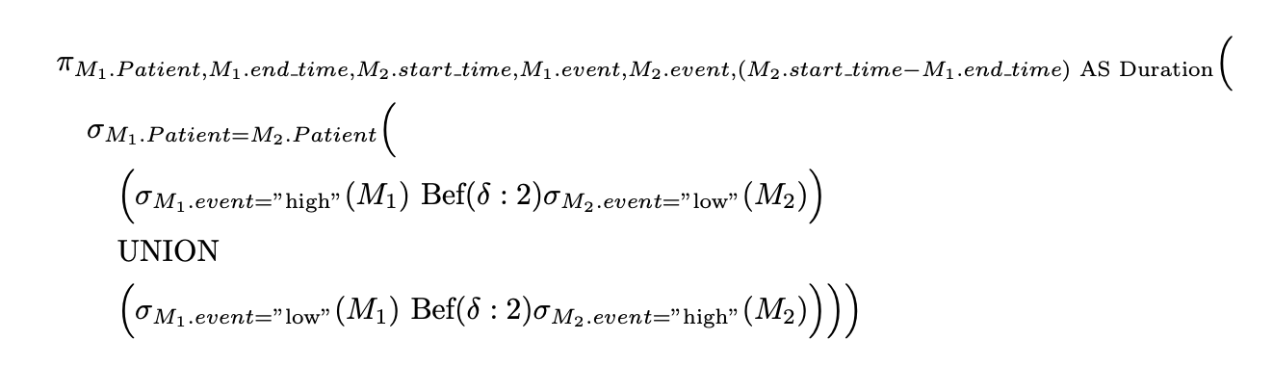
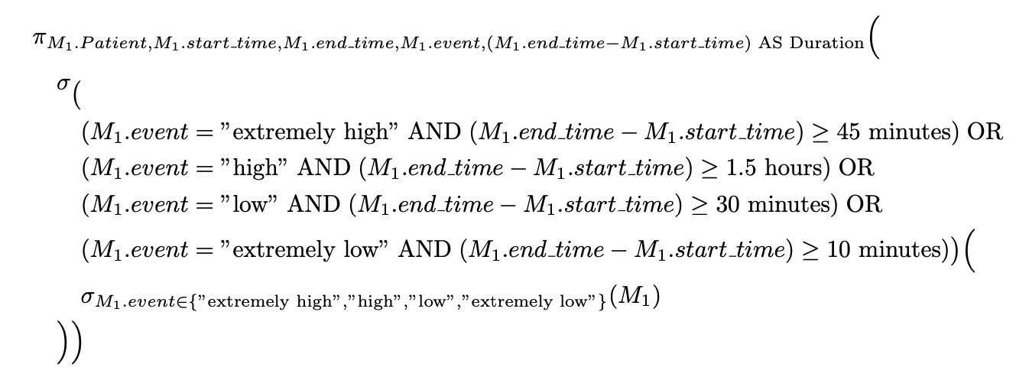
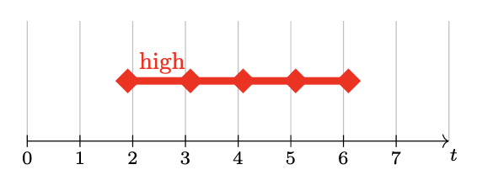
Simple High-Level Event
Time Swing
Too Long Glucose Anomalies

Slide 11
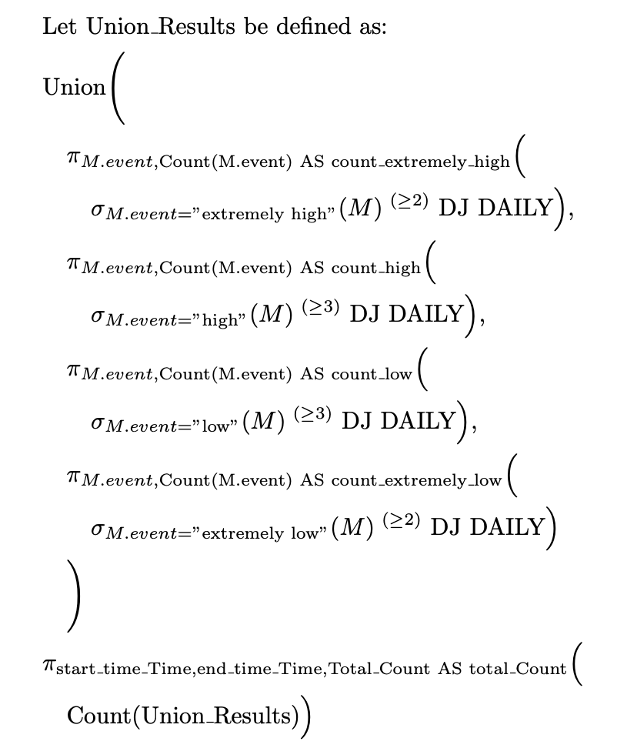
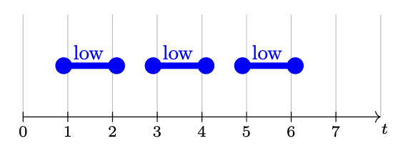
Aggregation High-Level Event
Too Frequent Glucose Anomalies

Slide 12
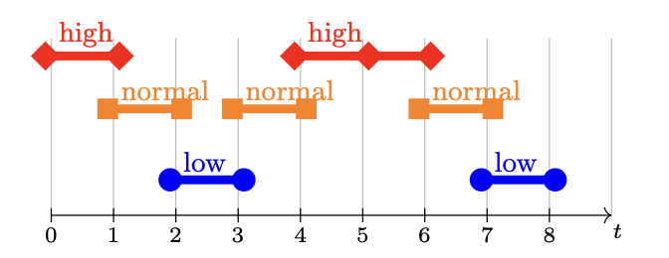
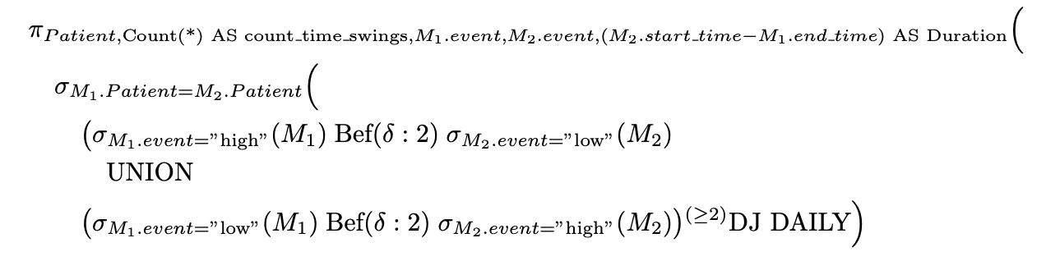
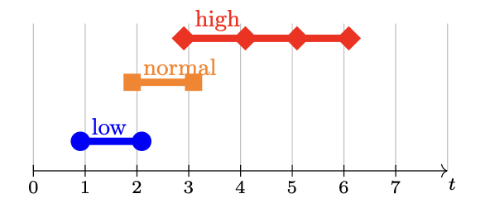
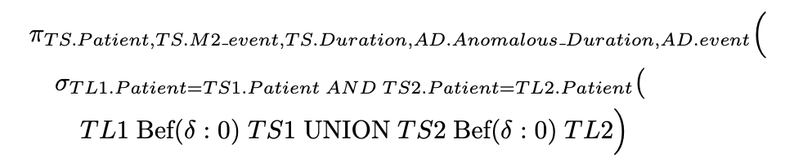
Aggregation High-Level Event 2
Too Frequent Time Swings
Time Swing With Too Long Glucose Anomalies

Slide 13



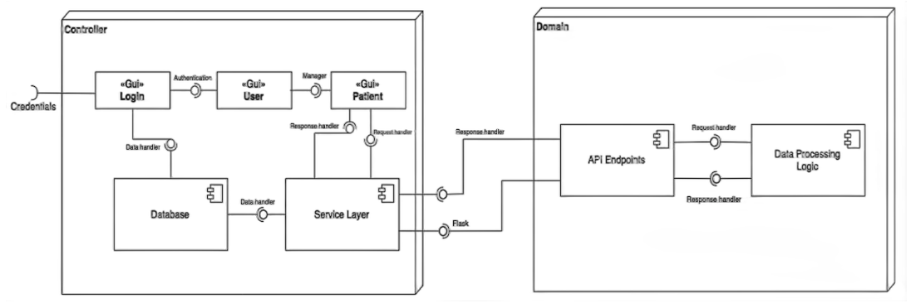
System Architecture
Efficency and scalability
Intregretion of Flask, MySql and Laravel
System Adaptability and Flexibility

Slide 14
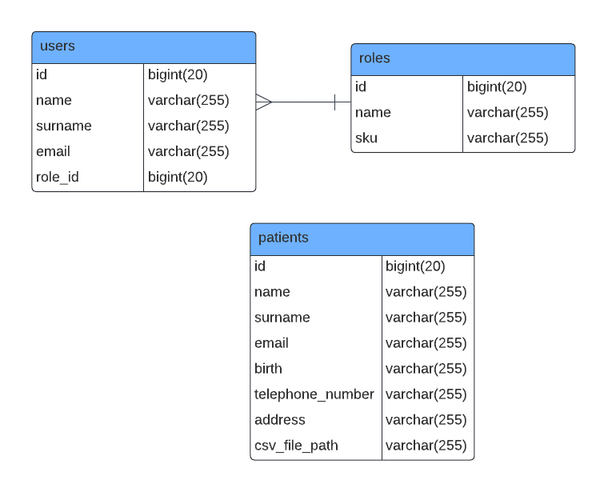
UML Diagrams: ER Diagram
Entity:
users
roles
patients
Relationships:
one-to-many relationship between roles and users

Slide 15
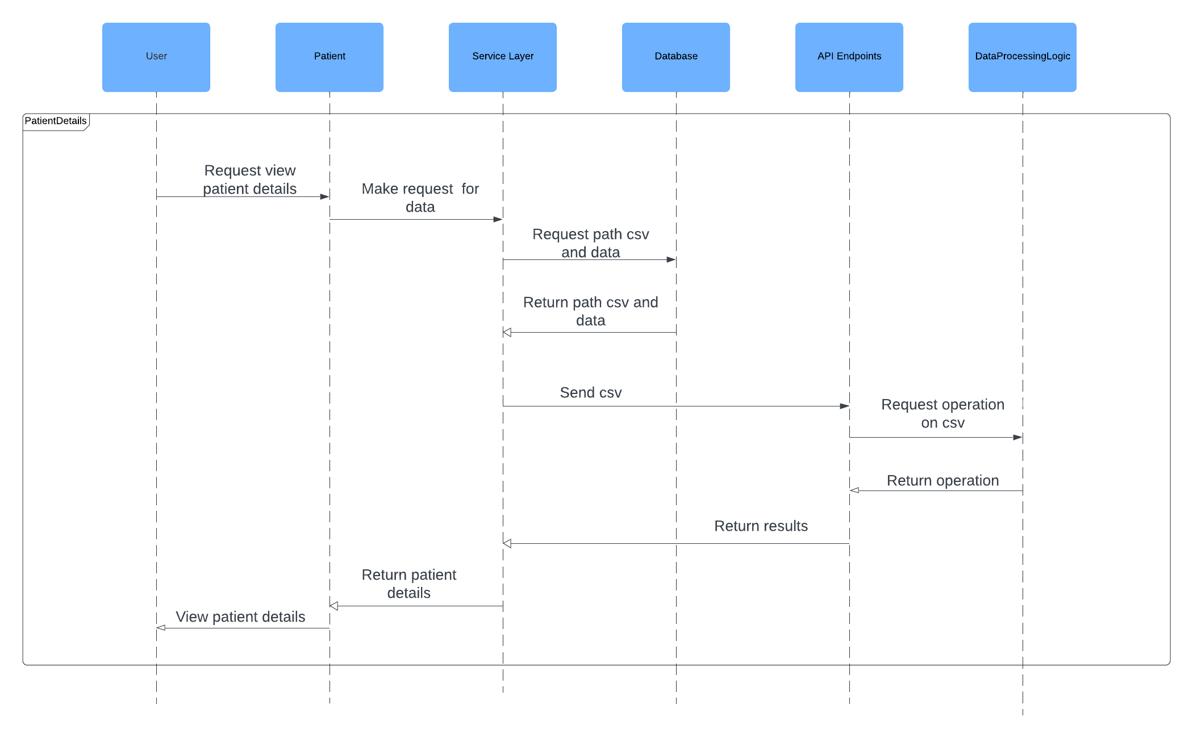
UML Diagrams: Sequence Diagram
User Request
Forward to Service Layer
Data Retrieval
CSV File Transfer:
Data Processing Processing Results
Data Compilation
Display to User

Slide 16
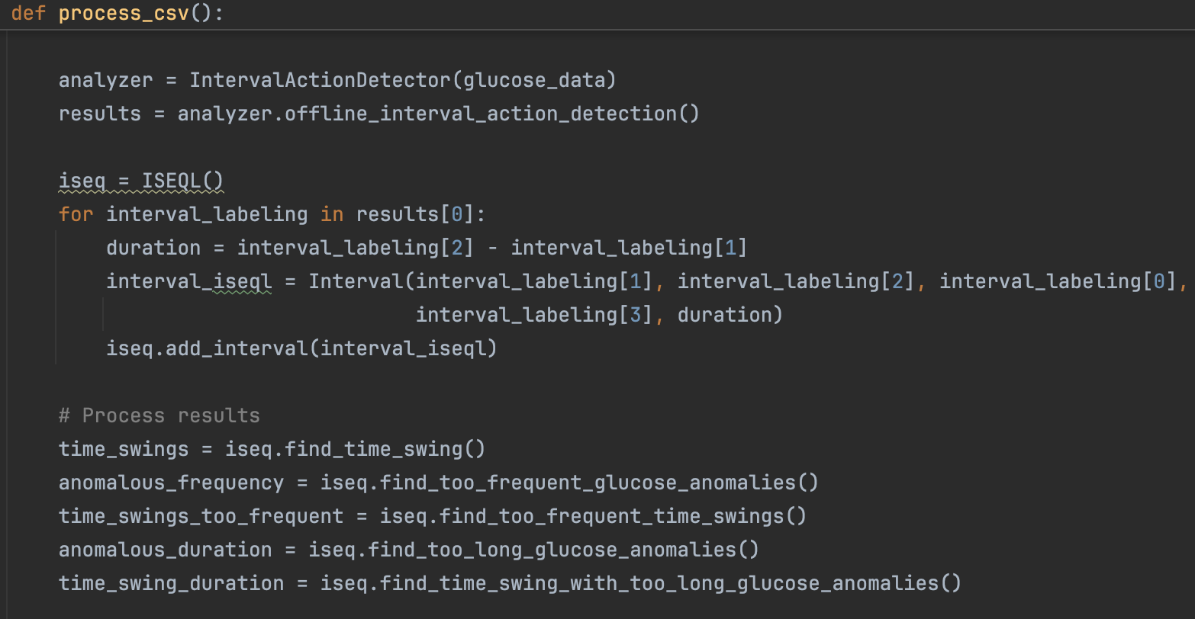
Implementation: Python
Interval_action_detector.py
interval.py
iseql.py
Data_processing_logic.py
analysis.py

Slide 17
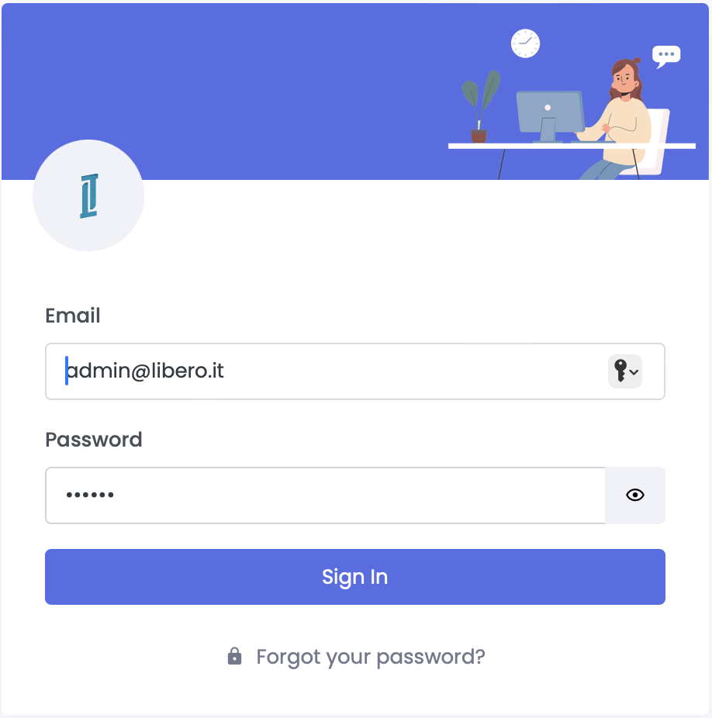
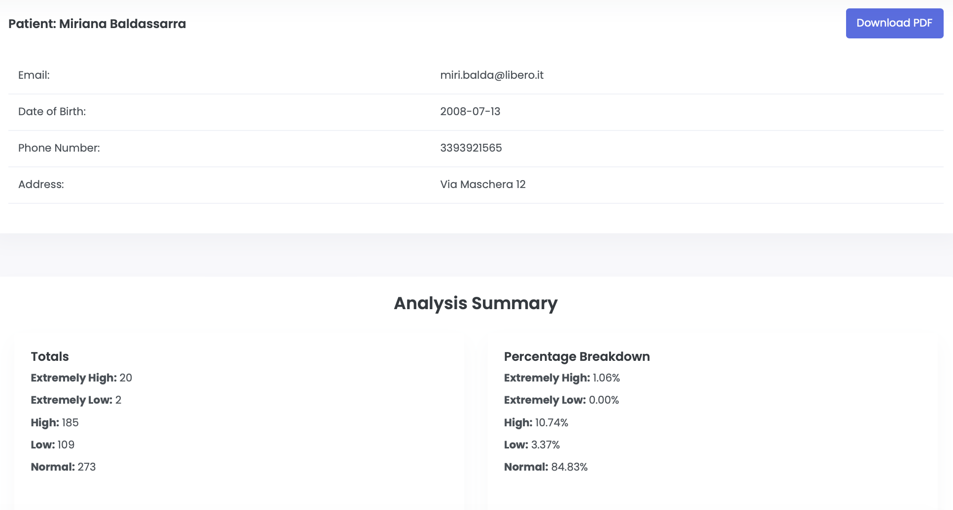
Implementation: Laravel
Login
Dashboard
User profile
User management
Patient management

Slide 18
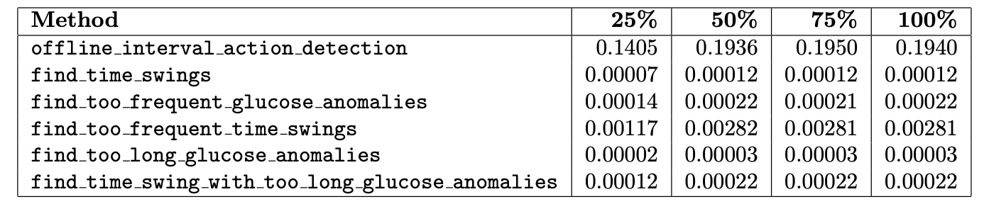
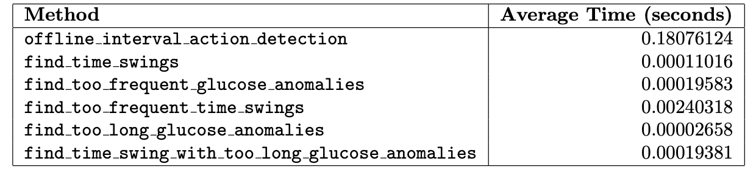
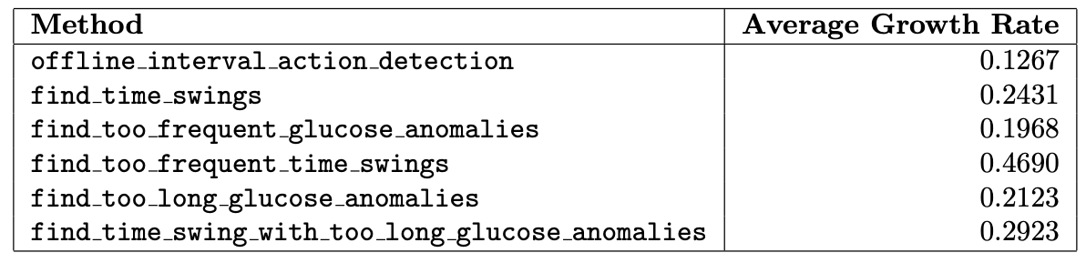
Result and Anlysis
Total Count : EHG 20, HG 185, NG 273, LG 109, ELG 2
Total Duration: EHG 08h 20min, HG 84h 30min, NG 667h 44min, LG 26h 33min, ELG 0min
Time Swing: 39 times
Too Frequent Glucose Anomalies: February 23, 2024, 3 HG, 13 LG, 0 EHG, and 1 ELG, totaling 17.
Too Frequent Time Swings: 17.95% of the total Time Swing
Too Long Glucose Anomalies: EHG 1.06%, HG 10.74%, 3.37%, ELG 0.00%
Time Swings With Too Long Glucose Anomalies: 28.21% of the total Time Swing

Slide 19
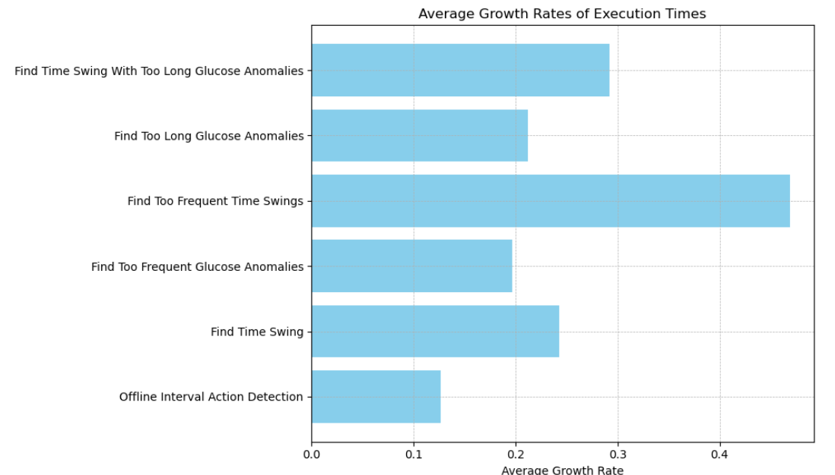
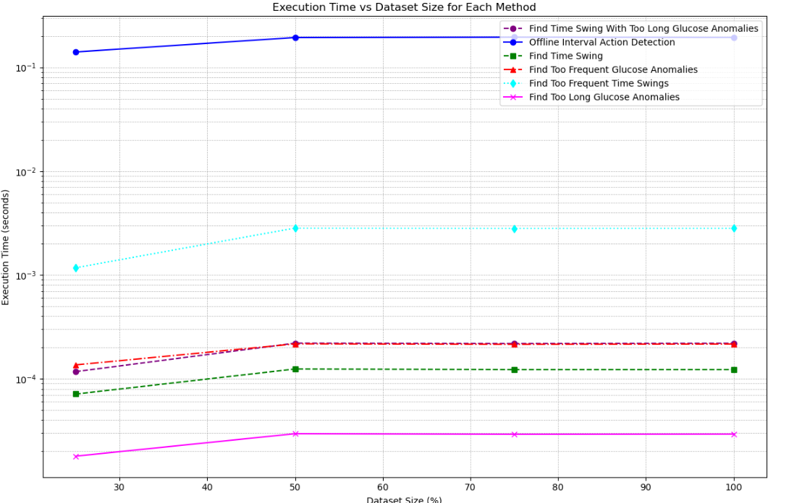
Result and Anlysis 2

Slide 20
Conclusion
Glucose Data Analysis:
Identified glucose level changes, significant anomalies, and Time Swings.
Critical for improving diabetes management and personalized treatment.
Future Work:
Enhance high-level event analysis.
Address current limitations (single CSV, lack of graphs).
Develop a mobile version.
Mobile Version Benefits:
reater accessibility, real-time monitoring, and improved user interface.
Overall Goal:
Improve the website’s utility in diabetes care.

Slide 21
Thanks for your attention
Lorenzo Tucceri Cimini
n.294425

