Slide 1
AGENT LOOP WORKSHOP • 90 MINUTES
TODAY'S LOOP
Trace, evaluate,
and improve an AI agent
1
Run
2
Observe
3
Curate
Follow one PatchPilot repair from its first checks to a tested improvement—and decide where a person still needs to review.
4
Evaluate
5
Improve
6
Decide
FOLLOW ALONG
ASK QUESTIONS
NO PYTHON REQUIRED
Notes:
PURPOSE — Open with the full Agent Loop and the 90-minute promise.
SAY — “Today we’ll follow one coding-agent repair from its first checks, through testing, to an improved version. Then we’ll decide where the agent can act and where a person still needs to review.”
SAY — “This is guided and follow-along. No Python knowledge is required. The code is there for technical questions, not as a coding exercise.”
TRANSITION — “First, a quick introduction. Then we’ll start with the bug.”

Slide 2

MEET YOUR FACILITATOR
Lorenzo Balderrama
DEVELOPER RELATIONS
@ Weights & Biases
I’ll guide one shared path through the notebook and Weave, with room for business and technical questions.
LET'S CONNECT
X
@TheCodingSoup · x.com/TheCodingSoup
in
Lorenzo Porras · linkedin.com/in/lorenzo-porras
</>
LorenzoWandB · github.com/LorenzoWandB
ASK ME ANYTHING
“
The example is a coding agent, but the method applies to any AI workflow.
GITHUB.COM/LORENZOWANDB • QUESTIONS ARE WELCOME THROUGHOUT
02
Notes:
PURPOSE — Introduce the facilitator without delaying the business story.
SAY — “I’m Lorenzo. I work with teams building and evaluating AI applications at Weights & Biases. Today I’ll connect the business requirement to evidence we can inspect.”
SAY — “Please bring business and technical questions. This is follow-along: I’ll move between the slides, notebook, and Weave. You can click with me or stay with the shared screen.”
DO — Point to the GitHub and LinkedIn links. Invite questions throughout.
TRANSITION — “Let’s start with the bug we need PatchPilot to repair.”

Slide 3
THE PROBLEM
We found a bug in BeeVerse’s support system
THE BUG
WHY IT MATTERS
Checks ticket numbers,
not who owns them.
01
Pollen’s ticket could be closed by mistake
02
The original checks could still pass
A Honeycomb request can include Pollen’s ticket.
03
The team could approve an unsafe repair
OUR GOAL — Prove the repair keeps customers separate, then decide when a person should review.
BUG → TRACE → TEST THE REPAIR → COMPARE RESULTS → DECIDE
03
Notes:
PURPOSE — State the bug, its business effect, and the goal before introducing the tools.
SAY — “We found a bug in BeeVerse’s bulk-close workflow. It accepts the ticket numbers in a request, but it never confirms that each ticket belongs to the customer making the request.”
SAY — “That means a Honeycomb request could close Pollen’s ticket by mistake. The original checks can still pass, so the team could approve a repair that is not safe.”
SAY — “Our goal is to prove that PatchPilot’s repair keeps customers separate. We will inspect one run, turn the risk into repeatable tests, compare two versions, and decide when a person should review.”
TRANSITION — “Let’s look at the exact Honeycomb request that exposes the bug.”

Slide 4
THE USE CASE
Honeycomb asks for help. Pollen’s ticket is at risk.
BeeVerse runs the support-ticket system used by both companies. Before a seasonal sale, Honeycomb asks to close two tickets—but one belongs to Pollen.
BEEVERSE
HONEYCOMB BOOKS
POLLEN OUTFITTERS
Runs the shared ticket system
Asks to close HB-101 and PO-209
Owns PO-209
Closing both would let one customer’s request change another customer’s data.
!
OUR JOB Use evidence to decide whether PatchPilot’s repair prevents that mistake.
PATCHPILOT IS THE CODING AGENT REPAIRING BEEVERSE’S SOFTWARE
04
Notes:
PURPOSE — Introduce the problem as a simple customer story.
SAY — “BeeVerse runs support-ticket software for other companies. Two of those companies are Honeycomb Books and Pollen Outfitters.”
SAY — “Before a seasonal sale, Honeycomb asks BeeVerse to close two tickets: HB-101 and PO-209. The catch is that PO-209 belongs to Pollen. If the software closes both tickets just because their numbers were supplied, Honeycomb’s request changes another customer’s data.”
SAY — “PatchPilot is the coding agent repairing that software. Our job today is to inspect its repair, test it, improve it, and decide when a person should review its work.”
ASK — “If three checks passed, would that be enough for you to trust the repair?”
TRANSITION — “Let’s look at exactly what PatchPilot did.”

Slide 5
WHAT PATCHPILOT DOES
RUN
OBSERVE
CURATE
EVALUATE
IMPROVE
DECIDE
PatchPilot prepares a software repair
1
2
3
4
5
ISSUE
→
INSPECT
→
PATCH
→
CHECK
→
REVIEW
BeeVerse reports a problem closing tickets
Read the report and inspect the software
Propose a one-file repair
Run three checks
Send the repair for human review
Versions 1 and 2 are prepared. The LLM judge is the only live model call in this workshop.
AI AGENT — SOFTWARE THAT USES A MODEL, INSTRUCTIONS, AND TOOLS TO COMPLETE A TASK
05
Notes:
PURPOSE — Define the AI agent and distinguish the prepared application versions from the live judge.
SAY — “An AI agent is an application that can use a model, instructions, and tools to complete a task. A production coding agent could choose tools, inspect files, propose edits, and run tests.”
SAY — “PatchPilot Version 1 and Version 2 are prepared examples today. The live AI in this guided workshop is the LLM judge, called through W&B Serverless Inference.”
SAY — “We fixed the application layer so we can clearly see what tracing and evaluation add.”
TRANSITION — “This workflow fits a broader industry pattern: the AI Loop.”
[Sources]
- https://docs.wandb.ai/weave/concepts/what-is-weave
[/Sources]

Slide 6
FRAMEWORK • COREWEAVE AI LOOP
RUN
OBSERVE
CURATE
EVALUATE
IMPROVE
DECIDE
Run → Observe → Curate → Evaluate → Improve → repeat
RUN
→
OBSERVE
→
CURATE
→
EVALUATE
→
IMPROVE
→
REPEAT
PatchPilot V1
Inspect trace + add annotation
Build four test cases
Score all four cases
PatchPilot V2
Compare, decide, repeat
REPEAT
We will use this loop to turn one software repair into evidence for a decision.
OFFICIAL COREWEAVE AI LOOP • CONTEXT FOR TODAY'S WORKSHOP
06
Notes:
PURPOSE — Place the existing workshop inside CoreWeave's official AI Loop without changing the workshop stages.
SAY — “CoreWeave describes the production lifecycle as Run, Observe, Curate, Evaluate, Improve, and repeat. Our workshop maps directly onto that loop.”
MAP — “Run is prepared PatchPilot V1. Observe is the trace and annotation. Curate is the four-case dataset. Evaluate is the scorer set and evaluation runs. Improve is PatchPilot V2. Then we compare and decide before repeating.”
TRANSITION — “Weave is the evidence layer connecting those stages.”
[Sources]
- https://coreweave.com/blog/the-ai-loop-launch-day-is-day-one
[/Sources]

Slide 7
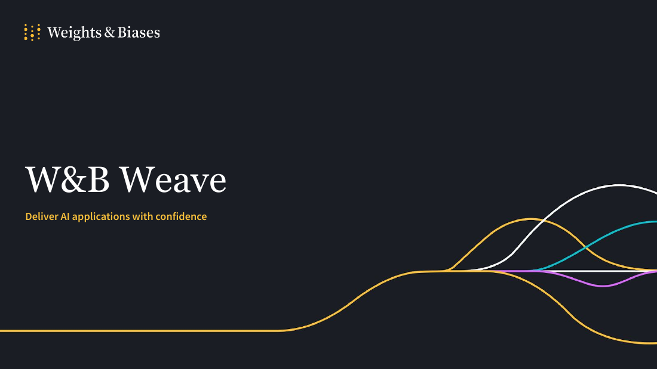
HOW WEAVE TURNS THE RUN INTO EVIDENCE
RUN
OBSERVE
CURATE
EVALUATE
IMPROVE
DECIDE
Weave records each run and helps us test changes
THE CHAIN WE WILL BUILD
PATCHPILOT
↓ @weave.op records each step
CALLS + TRACE
↓ A dataset supplies repeatable cases
EVALUATION RUNS
↓ Compare Version 1 and Version 2
WHAT IS WEIGHTS & BIASES?
W&B is CoreWeave’s platform for building and improving AI applications. Weave records the work, test cases, and evaluation results.
The LLM judge is the only live model call in this workshop.
WEAVE RECORDS RUNS • VERSIONS DATASETS • RUNS EVALUATIONS • COMPARES RESULTS
07
Notes:
PURPOSE — Define Weave before showing the live UI and make Serverless Inference's role precise.
SAY — “W&B Weave is an observability and evaluation platform for AI applications. The @weave.op decorator records versioned operations as Calls. Those Calls form traces. We version datasets, run scorers, create evaluation runs, and compare versions.”
SAY — “W&B Serverless Inference enters this picture only through the live LLM-judge scorer.”
TRANSITION — “Let’s start with the smallest useful unit of evidence: one recorded run.”
[Sources]
- https://docs.wandb.ai/weave/concepts/what-is-weave
- Supplied reference: Weave Presentation.pdf
[/Sources]

Slide 8
THE SHARED VOCABULARY
The terms we’ll use today
W&B WEAVE Records AI application runs and helps teams test and compare them.
TRACE
CALL
ANNOTATION
What happened during one complete run.
One recorded step inside that run. @weave.op marks the function to record.
Human feedback saved with a recorded step.
DATASET
SCORER
EVALUATION
A saved set of cases we can test again.
One repeatable way to grade a result.
The test setup: dataset, scorers, and settings.
EVALUATION RUN
LLM JUDGE
RUBRIC
One time that test setup is run against a version.
A model that grades evidence using written rules.
The written rules given to the judge.
WE WILL REINTRODUCE EACH TERM WHEN WE USE IT
08
Notes:
PURPOSE — Give the room a short plain-language reference before the first Weave stop.
SAY — “You do not need to memorize this slide. Trace means one complete run. A Call is one recorded step. A dataset is the cases we save. A scorer grades a result. An evaluation is the saved test setup, and an evaluation run is one use of that setup.”
SAY — “The LLM judge is one scorer. It reads the evidence and applies the rubric, which is simply the written rules.”
TRANSITION — “I’ll define each term again when we use it. We start with one run: the trace.”

Slide 9
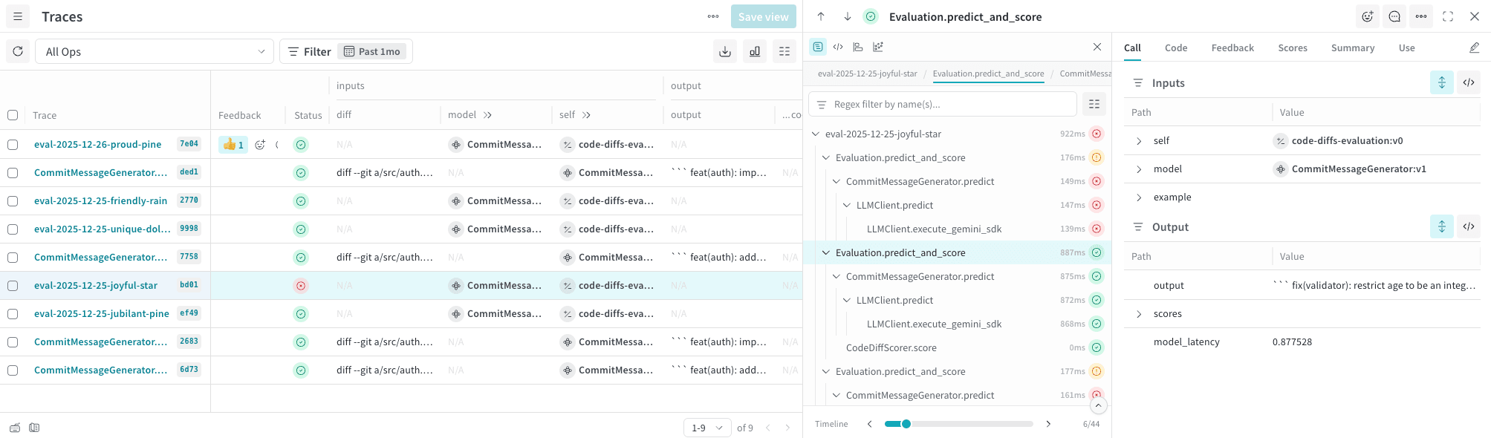
CHAPTER 1 • TRACE
RUN
OBSERVE
CURATE
EVALUATE
IMPROVE
DECIDE
A trace shows one run—and every recorded step
OP
CALL
TRACE
INPUTS + OUTPUTS
FEEDBACK
A function Weave tracks and versions
One time that function runs
The full record of one run and its Calls
What went in and what came back
Human notes and other feedback saved with a Call
ANNOTATION — STRUCTURED HUMAN FEEDBACK ATTACHED TO A CALL
09
Notes:
PURPOSE — Define Op, Call, Trace, inputs, outputs, and feedback using official Weave terminology.
SAY — “An Op is a versioned function tracked by Weave. A Call is one recorded execution of that Op. A trace is the end-to-end record of one application run and the Calls inside it.”
SAY — “The trace also preserves inputs, outputs, timing, errors, and feedback. An annotation is structured human feedback attached to a Call.”
DO — Move to the notebook and show @weave.op briefly. Explain that it records the function; it does not change the business logic.
TRANSITION — “Now let’s read Version 1 before we judge it.”
[Sources]
- https://docs.wandb.ai/weave/guides/tracking/trace-tree
- https://docs.wandb.ai/weave/guides/tracking/feedback
[/Sources]

Slide 10
THE V1 TRACE
RUN
OBSERVE
CURATE
EVALUATE
IMPROVE
DECIDE
The first checks passed—but they missed the real risk
Honeycomb asks to close HB-101 + PO-209
REQUEST
3
Looks up tickets by number only
VERSION 1
GREEN CHECKS
One expected behavior passes
CHECK 1
1
Two more passes—same missing customer check
CHECKS 2 + 3
CUSTOMER CHECK MISSING
Honeycomb can change Pollen’s ticket
RISK
WEAVE STOP 1 → OPEN THE TRACE → FIND THE TICKET LOOKUP → ADD YOUR ANNOTATION
10
Notes:
PURPOSE — Prepare the room for Weave stop 1 and the annotation.
DO — In the notebook, run PatchPilot Version 1 and open its Weave trace. Find the request, child Calls, ticket lookup, and three recorded checks.
SAY — “The first checks passed. The trace also shows the missing check: Version 1 looks up tickets by number but never checks which customer owns them.”
PARTICIPANTS — Add the Customer isolation annotation to the root Call.
ASK — “What can this trace tell us, and what still needs to be tested across more cases?”
TRANSITION — “The trace gave us a specific risk. Now we turn it into a case we can run again.”
[Sources]
- https://docs.wandb.ai/weave/guides/tracking/trace-tree
- https://docs.wandb.ai/weave/guides/tracking/feedback
[/Sources]

Slide 11
CHAPTER 2 • DATASET
RUN
OBSERVE
CURATE
EVALUATE
IMPROVE
DECIDE
Turn the trace finding into a case we can test again
WHAT THE TRACE SHOWED
TEST CASE
The request
The request
→
The Version 1 result
What should happen
What went wrong
Where the case came from
Came from a real incident
Saved version
DATASET — CASES WE SAVE SO WE CAN TEST THEM AGAIN
11
Notes:
PURPOSE — Show how an observed trace risk becomes a versioned evaluation case.
SAY — “A dataset is a versioned collection of test examples. A useful row separates the request from the expected behavior, then records source and risk metadata.”
SAY — “Historical cases preserve real operating context. Synthetic cases deliberately probe rare but costly boundaries before a customer incident.”
TRANSITION — “Our dataset has four rows so one fix cannot hide a regression elsewhere.”
[Sources]
- https://docs.wandb.ai/weave/guides/core-types/datasets
[/Sources]

Slide 12
THE FOUR-CASE DATASET
RUN
OBSERVE
CURATE
EVALUATE
IMPROVE
DECIDE
Four cases cover normal work and likely failures
1
2
3
4
NORMAL
MIXED CUSTOMER
RETRY
INCOMPLETE EVIDENCE
From history • close only Honeycomb’s requested tickets
Designed test • Honeycomb must not change Pollen’s ticket
Designed test • repeat without doing the work twice
Based on past cases • send to a person when proof is missing
EACH CASE request + expected result + source + risk
5
WEAVE STOP 2 → PUBLISH THE FOUR CASES → OPEN THE DATASET IN WEAVE
12
Notes:
PURPOSE — Explain the four cases before publishing them to Weave.
SAY — “Normal checks the ordinary workflow. Mixed customer probes the isolation boundary. Retry checks duplicate effects. Missing evidence tests whether uncertainty still routes to a person.”
DO — In the notebook, choose the source strategy and mixed-customer shape, then publish the four-row dataset. In Weave, show request, expected_behavior, source_type, risk, and the versioned dataset reference.
ASK — “Who should contribute cases in your organization besides engineering?”
TRANSITION — “We have cases. Now we need focused questions for every output.”
[Sources]
- https://docs.wandb.ai/weave/guides/core-types/datasets
[/Sources]

Slide 13
CHAPTER 3 • SCORERS
RUN
OBSERVE
CURATE
EVALUATE
IMPROVE
DECIDE
Each scorer asks one question
FOUR QUESTIONS
ONE SCORECARD FOR EACH CASE
REQUIRED CHECKS • EXACT
CUSTOMER ISOLATION • EXACT
Did the expected checks pass?
Did Honeycomb change Pollen’s data?
RETRY • EXACT
LLM JUDGE • LIVE MODEL
Did a retry do the work twice?
Did the evidence meet the written rules?
RUNS THROUGH W&B SERVERLESS INFERENCE
SCORER — A REPEATABLE WAY TO GRADE ONE RESULT
13
Notes:
PURPOSE — Introduce all four scorers and state exactly where AI is used.
SAY — “A scorer is logic that examines an output and returns metrics. We have three deterministic Python scorers: visible checks, customer isolation, and retry safety. We also have one class-based scorer that calls a live LLM judge.”
SAY — “The prepared PatchPilot outputs are fixed. The live judge is the model-powered, potentially variable part of this guided workflow.”
TRANSITION — “Exact rules and model judgment are complementary; they answer different questions.”
[Sources]
- https://docs.wandb.ai/weave/guides/evaluation/scorers
[/Sources]

Slide 14
TWO KINDS OF SCORING
RUN
OBSERVE
CURATE
EVALUATE
IMPROVE
DECIDE
Rules check facts. The LLM judge explains judgment calls.
1 · EXACT RULES
2 · LLM JUDGE
DIRECT CHECK
WRITTEN RULES + EVIDENCE
Same evidence → same answer
Verdict + explanation
Good for facts and safety rules
Useful when context matters
Pass / review / block
May vary
Use when the requirement can be checked directly
Live model call—inspect its reasons in Weave
Human review remains separate from both
LLM JUDGE — A MODEL THAT GRADES EVIDENCE USING WRITTEN RULES
14
Notes:
PURPOSE — Separate exact scorers, the LLM judge, and human review.
SAY — “An exact scorer applies a direct rule. Give it the same evidence and it gives the same answer. That is useful for facts and safety requirements.”
SAY — “The LLM judge reads the same evidence, applies written rules, and explains its verdict. It is useful when context matters, and its answer may vary.”
SAY — “Human review is separate. Neither kind of scorer decides on its own whether the agent can act.”
TRANSITION — “To compare the two PatchPilot versions fairly, we keep the test setup the same.”
[Sources]
- https://docs.wandb.ai/weave/guides/evaluation/scorers
[/Sources]

Slide 15
CHAPTER 3 • EVALUATION
RUN
OBSERVE
CURATE
EVALUATE
IMPROVE
DECIDE
For a fair comparison, keep the test the same
SAME TEST
ONLY CHANGE
4
cases
PATCHPILOT VERSION
V1 → V2
4
scorers
now checks ticket owner
1
rubric + judge model
Evaluation = saved test setup • Evaluation run = one use of that setup on one version
SAME CASES + SCORERS + RULES + JUDGE MODEL • CHANGE ONLY PATCHPILOT
15
Notes:
PURPOSE — Define evaluation and evaluation run, then keep the comparison fair.
SAY — “An evaluation is the saved test setup: the dataset, scorers, and configuration. An evaluation run is one time we use that setup against an application version.”
SAY — “We keep the four cases, four scorers, rubric, judge model, and review rules the same. The only thing we change is PatchPilot Version 1 versus Version 2.”
DO — In the notebook, show the selected scorers, rubric, weave.Scorer, and weave.Evaluation code. Keep the frozen-comparison control selected.
TRANSITION — “First we run Version 1 and make it our baseline.”
[Sources]
- https://docs.wandb.ai/weave/guides/core-types/evaluations
- https://docs.wandb.ai/weave/guides/evaluation/scorers
[/Sources]

Slide 16
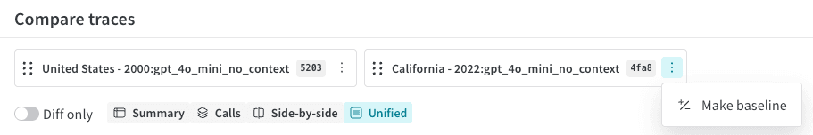
WEAVE STOP 3 • VERSION 1
RUN
OBSERVE
CURATE
EVALUATE
IMPROVE
DECIDE
Version 1 is our starting point
PASS
BLOCK
REVIEW
NORMAL
RETRY
MIXED CUSTOMER
MISSING EVIDENCE
Expected behavior holds
Pollen’s ticket changed
Not enough evidence
IN WEAVE
Open the Version 1 results, inspect the wrong-customer case, and choose Make baseline.
BASELINE — THE RUN WE WILL COMPARE VERSION 2 AGAINST
16
Notes:
PURPOSE — Create and inspect the Version 1 baseline run.
DO — Run the Version 1 evaluation. In Weave, open the mixed-customer row and follow dataset input → V1 output → deterministic scorer Call → LLM-judge Call → criterion reasons. Set V1 as Baseline.
SAY — “Normal and retry pass. Mixed customer blocks because Pollen Outfitters changed in a Honeycomb request. Missing evidence stays in review.”
SAY — “Baseline means reference run for comparison—not a production recommendation.”
QUESTION WINDOW — “If you disagree, is the problem the application output, evidence, Python scorer, rubric, or judge interpretation?”
TRANSITION — “We found a specific failure. Now we can make a specific change.”
[Sources]
- https://docs.wandb.ai/weave/guides/core-types/evaluations
- https://docs.wandb.ai/weave/guides/tools/comparison
[/Sources]

Slide 17
CHAPTER 4 • IMPROVE
RUN
OBSERVE
CURATE
EVALUATE
IMPROVE
DECIDE
Version 2 checks who owns each ticket
PATCHPILOT V1
PATCHPILOT V2
SELECT
CHECK TICKET OWNER
SELECT
tickets by number
ticket number + owner
One change: close only tickets owned by the customer who made the request.
SAME PATCHPILOT WORKFLOW • TWO PREPARED VERSIONS
17
Notes:
PURPOSE — Make the one intended application change visually obvious.
SAY — “These are two development versions of the same PatchPilot application. Version 1 selects ticket IDs. Version 2 adds the requesting-customer constraint.”
DO — In the notebook, show the prepared diff and the application properties stored on weave.Model. Clarify that the separate foundation model openai/gpt-oss-20b is used by the judge.”
SAY — “We changed the application—not the evaluation setup—to address the trace finding.”
ASK — “In your system, what might change here: prompt, retrieval, model, tool, skill, code, or policy?”
TRANSITION — “Whatever changes, run the same evaluation again.”

Slide 18
CHAPTER 4 • VERSION 2
RUN
OBSERVE
CURATE
EVALUATE
IMPROVE
DECIDE
Test Version 2 with the same cases and scorers
SAME TEST
ONLY CHANGE
NEW EVIDENCE
PATCHPILOT
VERSION
Weave records new runs and scores, so the change can be inspected.
Dataset + scorers
+
=
Rubric + judge model
V1 → V2
now checks owner
Exact scorers should repeat. The live judge may vary—read its reasons.
RUN VERSION 2 • KEEP THE TEST THE SAME
18
Notes:
PURPOSE — Run Version 2 while reinforcing what stays fixed.
DO — Click Run the Version 2 evaluation with the same setup.
SAY WHILE IT RUNS — “The dataset fingerprint, three Python scorers, judge rubric, judge model, and policy remain fixed. This creates new application and scorer Calls.”
SAY — “The deterministic results should repeat. The LLM judge is live, so its wording or verdict may vary and should be inspected.”
TRANSITION — “Now the comparison can tell us whether the change fixed the intended risk without introducing a regression.”
[Sources]
- https://docs.wandb.ai/weave/guides/core-types/evaluations
[/Sources]

Slide 19
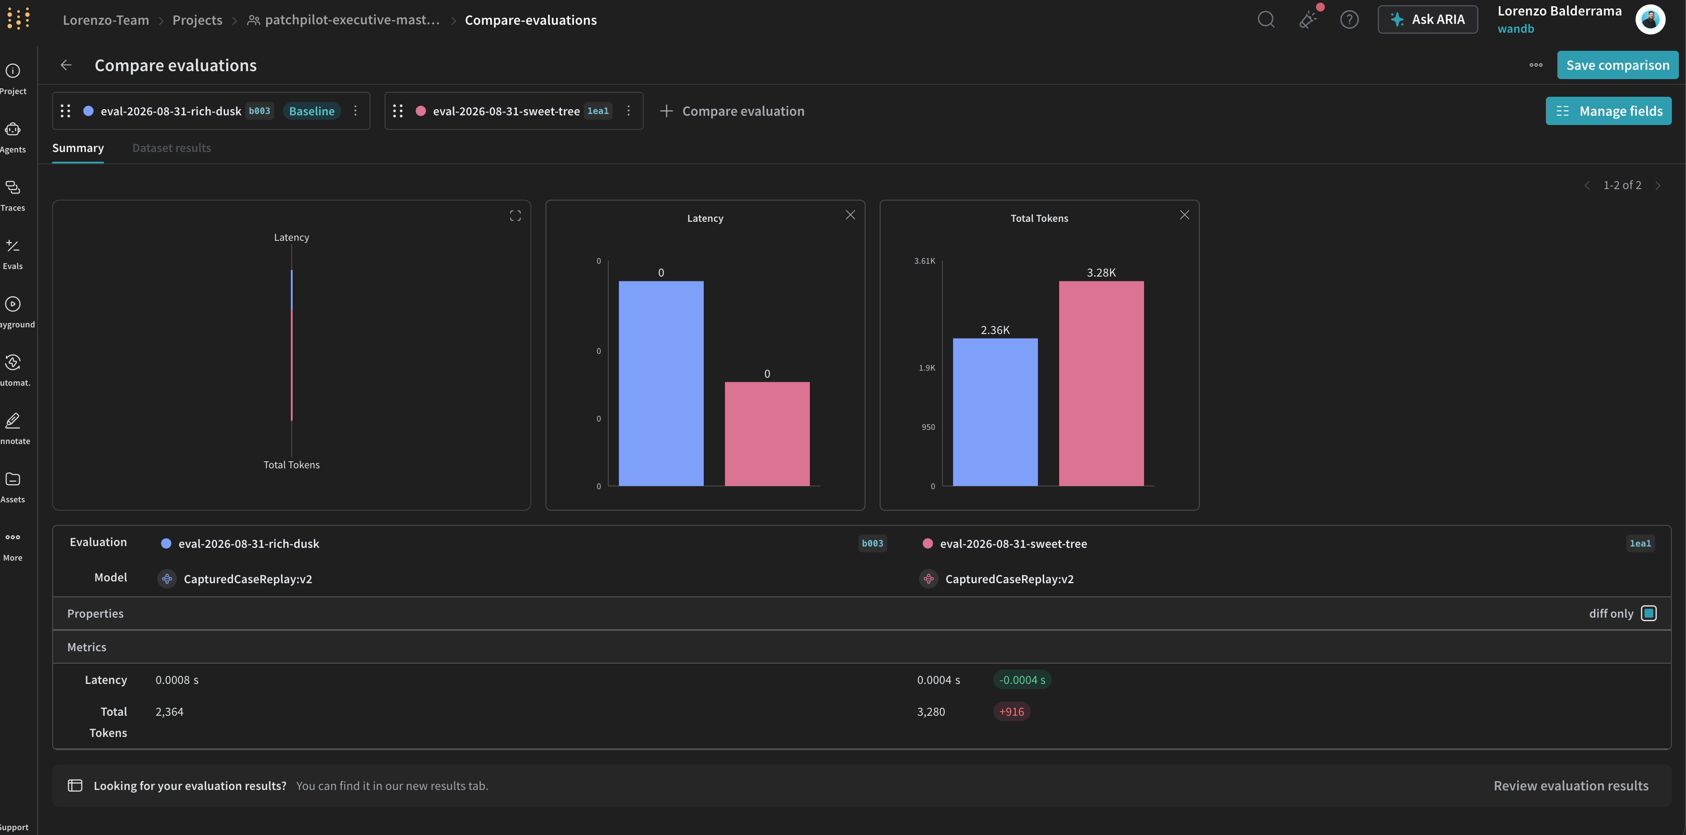
WEAVE STOP 4 • COMPARE
RUN
OBSERVE
CURATE
EVALUATE
IMPROVE
DECIDE
Compare each case—not just the average
✓
NORMAL
V1 PASS → V2 PASS
↑
MIXED CUSTOMER
V1 BLOCK → V2 PASS
✓
RETRY
V1 PASS → V2 PASS
—
MISSING EVIDENCE
V1 REVIEW → V2 REVIEW
Workshop-owned screenshot • the live Weave comparison view
READ IT LIKE THIS
AI
LLM JUDGE
Judge answer may vary—read the reason
The mixed-customer case moved from block to pass—and the other cases did not get worse.
V1 IS THE BASELINE • V2 IS THE NEW VERSION • READ EACH CASE, NOT ONLY THE AVERAGE
19
Notes:
PURPOSE — Compare case-level evidence and the live Weave view.
DO — Open the comparison with V1 as Baseline and V2 as candidate. Show application properties, fixed evaluation properties, the mixed-customer case, normal and retry, missing evidence, and the traced judge Call.
SAY — “The intended case moved from block to pass. The normal and retry cases stayed safe. Missing evidence still requires a person.”
SAY — “We do not hardcode a guaranteed judge verdict. If the model differs, inspect the evidence and reasons.”
TRANSITION — “This is enough evidence to make a narrower operating policy.”
[Sources]
- https://docs.wandb.ai/weave/guides/tools/comparison
- Workshop-owned screenshot: PatchPilot Weave comparison view
[/Sources]

Slide 20
CHAPTER 5 • HUMAN IN THE LOOP
RUN
OBSERVE
CURATE
EVALUATE
IMPROVE
DECIDE
Decide when the agent acts—and when a person steps in
AUTOMATIC
REVIEW
BLOCK
CLEAR CASE
UNCERTAIN
UNSAFE
enough evidence
missing evidence
another customer’s data at risk
PROCEED
PERSON APPROVES
STOP
Automatic when the case is clear • Human review when evidence is missing • Block when a safety rule fails
HUMAN IN THE LOOP — A RULE FOR WHEN A PERSON MUST REVIEW BEFORE ACTION
20
Notes:
PURPOSE — Turn the evidence into a practical human-review rule.
SAY — “The point is not to put a person in front of every action. Clear cases with enough evidence may proceed automatically. Missing evidence goes to a person. A failed safety rule blocks the action.”
DO — In the notebook, save the final decision, confidence, approved scope, and reviewer. Open the saved review Call and, if time permits, return to the original annotated trace.
SUGGESTED INTERPRETATION — “Version 2 may proceed for well-understood, single-customer cases. Missing evidence still requires human review.”
TRANSITION — “Let’s close by returning to the full loop.”
[Sources]
- https://docs.wandb.ai/weave/guides/tracking/feedback
[/Sources]

Slide 21

CLOSE • THE AGENT LOOP
RUN
OBSERVE
CURATE
EVALUATE
IMPROVE
DECIDE
Use the Agent Loop to turn a change into a decision
WHAT TO TAKE HOME
See
What happened in one run
TRACE
Test
The same cases every time
EVALUATE
Decide
Whether the change actually helped
Fully Connected 2026 • Built for AI
COMPARE
Moscone South, San Francisco • September 29–October 1
FULLY CONNECTED 2026 • COREWEAVE.COM/FULLY-CONNECTED-2026
21
Notes:
PURPOSE — Close with a reusable mental model and the official Fully Connected invitation.
SAY — “A trace shows what happened in one run. A dataset saves the cases we care about. Scorers turn expectations into measurements. Evaluation runs show whether a change helped. People decide where the agent can act.”
CLOSE — “That is the Agent Loop: observe the work, test the risks, compare the change, and use the evidence to decide.”
PLUG — “If you want to keep exploring how teams build and operate AI in production, Fully Connected 2026 is September 29 through October 1 at Moscone South in San Francisco.”
MASTERCLASS — Replace this slide with the standardized MasterClass closer when it arrives, or place that slide immediately after this one.
[Sources]
- https://www.coreweave.com/fully-connected-2026
[/Sources]

