Slide 1
K-Indistinguishable Data Access for Encrypted Key-Value Stores
Design of a privacy-preserving key-value storage system that can resist access pattern attacks with minimal storage and bandwidth overhead

Slide 2
Problem Statement

Slide 3
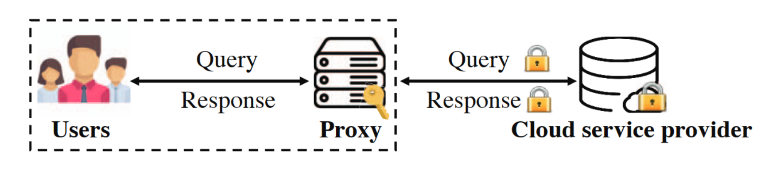
System structure and threat model
Users access the data in the store through the proxy. The proxy resides in the same internal network as the users.
The proxy encrypts key-value pairs using a pseudo-random function and a symmetric encryption algorithm (with a secret key, that can not be compromised). Protection against length-leakage is provided by a padding of all the values to a same size.
The CSP provides data storage and query services.
Adversaries can see the queries, but not understand them. They can not modify the queries or inject new queries.

Slide 4
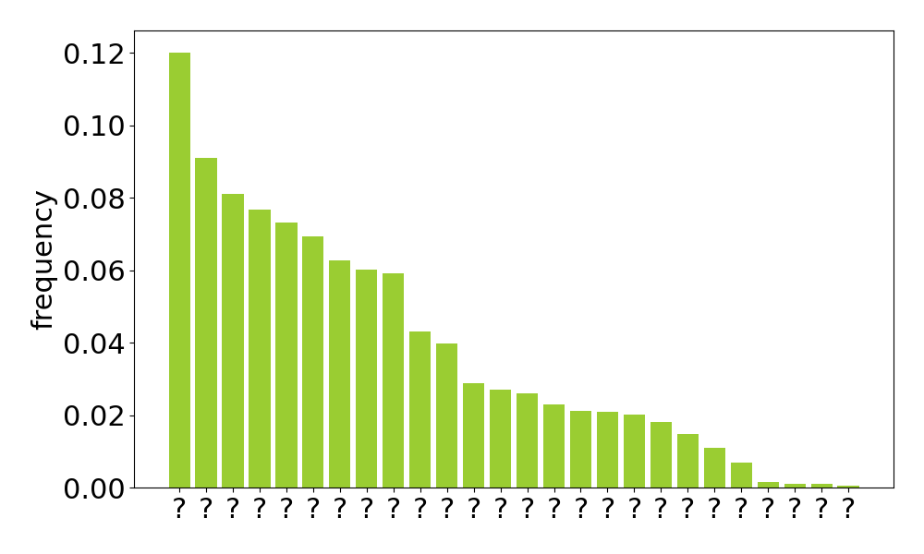
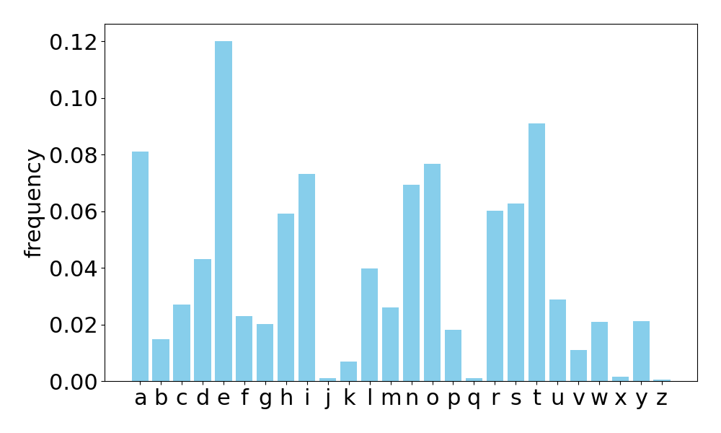
Access pattern attacks: frequency analysis
Passive persistent adversaries can launch access pattern attacks, such as frequency analysis.
Adversaries can see access patterns, without understanding the content of the queries.
Adversaries have prior knowledge about the structure of the data stored.

Slide 5
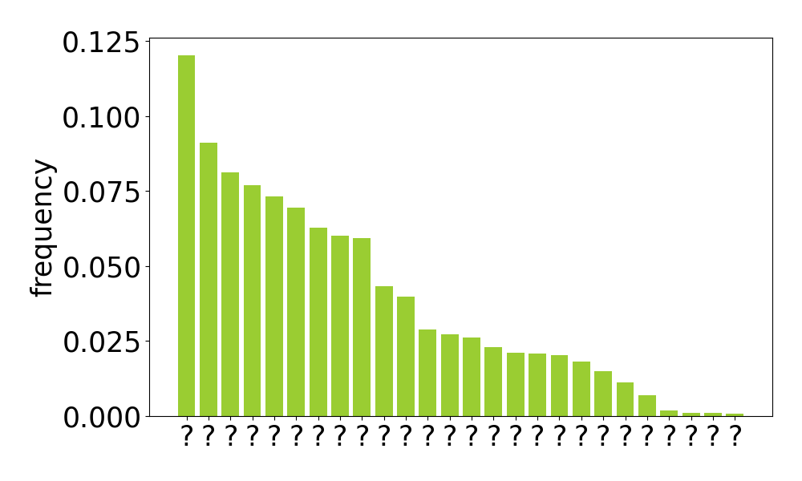

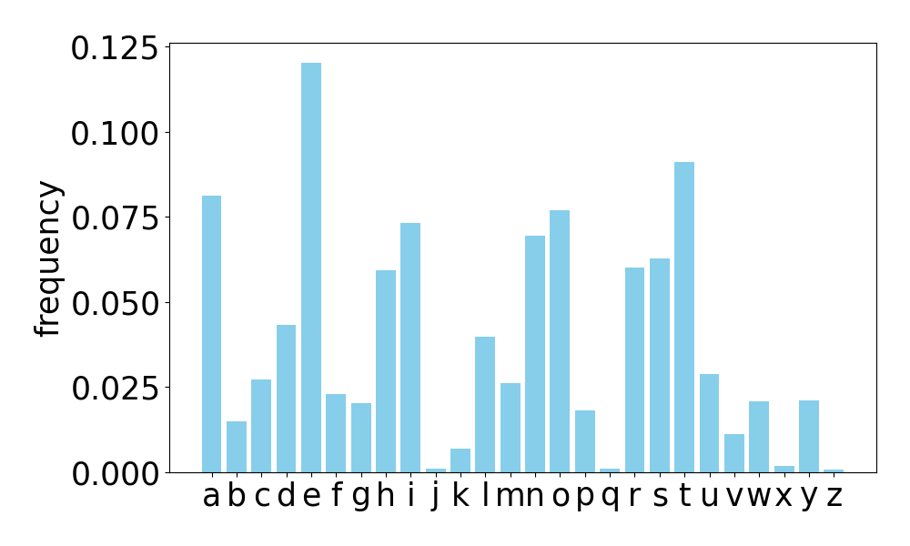
Access pattern attacks: frequency analysis
The key identities are discovered

Slide 6
Prior solutions: ORAM and pathORAM
ORAM: Oblivious Random Access machine.
Given an element location/index on the database and an operation to perform on it, decide a subset of the remote storage that certainly (or at least with high probability) contains the desired element.
Download all the subset.
Decrypt locally the subset downloaded.
Find the desired element and perform the desired operation on it.
Shuffle the position of some or all the database elements in the subset.
Re-encrypt the subset with a randomized scheme, using the same symmetric key.
Re-upload the freshly re-encrypted data.
PathORAM
Same concept of ORAM, but developed in a smarter way.
The database is stored in a binary tree structure. Its map is stored locally.
The subset that is downloaded in this case is a branch of the tree.

Slide 7
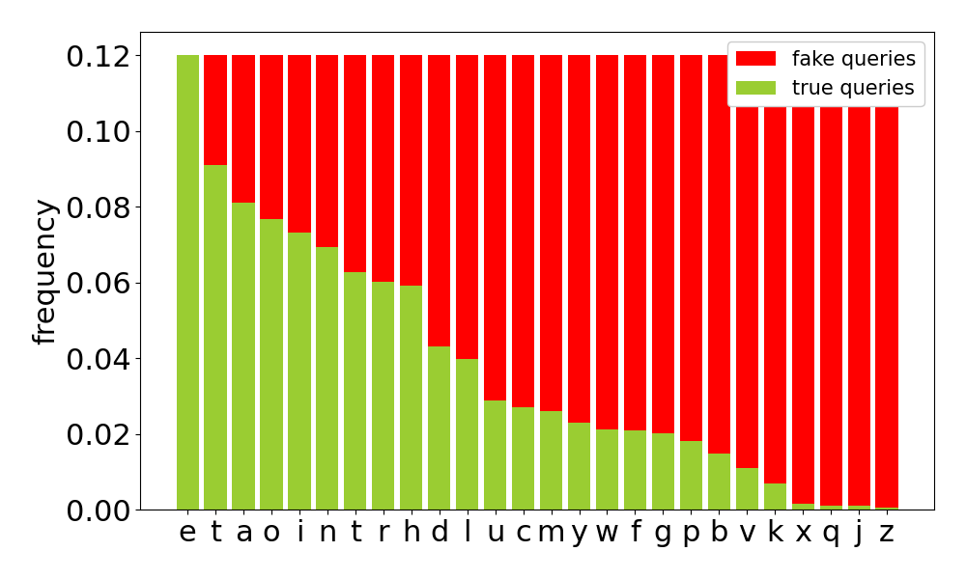
Prior solutions: PANCAKE
Frequency smoothing by adding fake queries: no pattern can be extracted from the access frequencies.

Slide 8
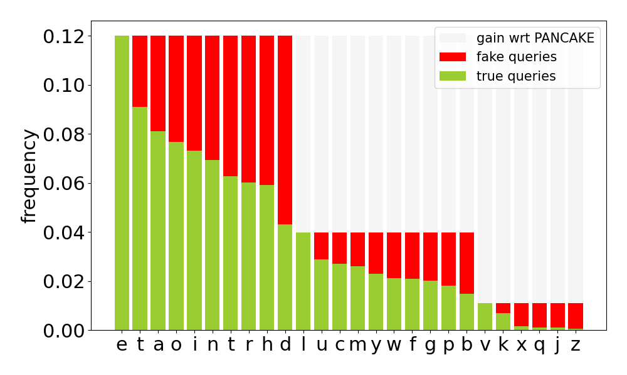
New solution: idea
The frequency smoothing is applied by intervals, depending on the frequency of subsets of keys.

Slide 9
Design Implementation

Slide 10
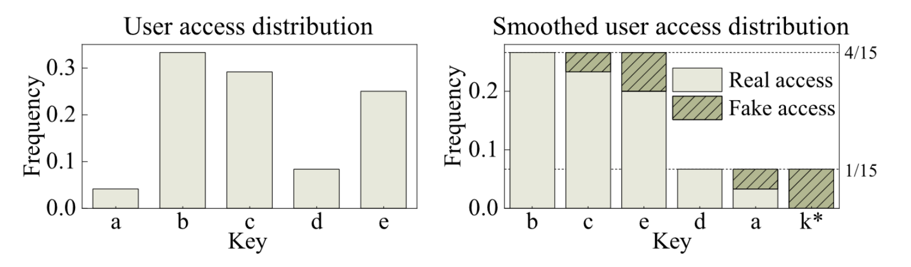
K-indistinguishable Frequency Smoothing
Smooth the keys access frequencies into levels of K entries each.
The selection of the best K is critical to the system: trade-off between the bandwidth overhead and system security level.

Slide 11
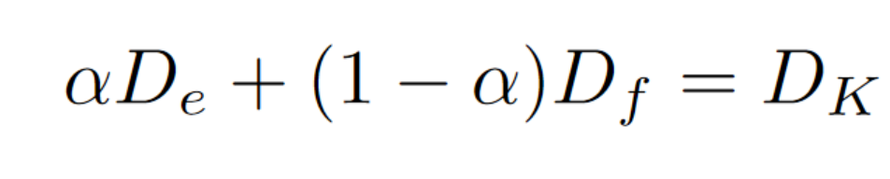
System initialization
The plaintext key-value store with is transformed into an encrypted key-value store and then uploaded to the CSP.
The proxy estimates the entries access frequencies. Then sets different frequency levels for the key-value store and assigns each entry into one of the levels based on its access frequency.
Dummy key-value pairs are added to the last level.

Slide 12
Query execution
The proxy receives user queries and maintains a query queue, before routing them to the CSP.
For each request in the query, the proxy repeatedly flips a α-biased coin until it returns head, only then it routes the query to the CSP. For every tail a fake query is generated.
Problems arise if the stream of requests is not continuous: the last query is always real. There the necessity of a batch of fake queries at the end.
Write operations are problematic: the mechanism of fake queries can’t work. ORAM is used.

Slide 13
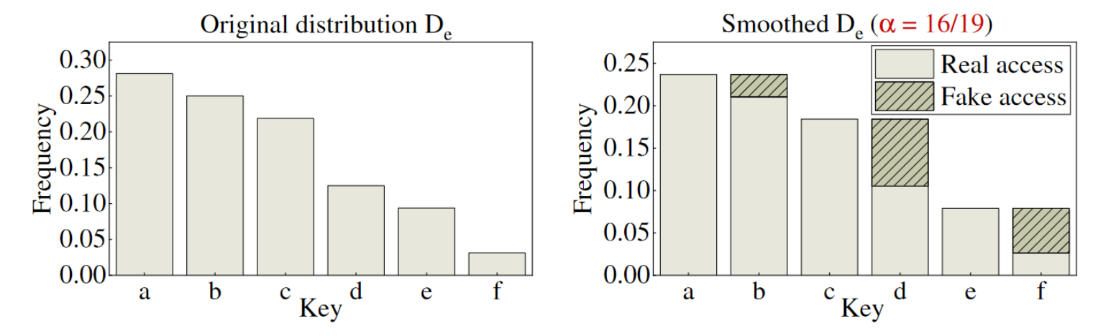
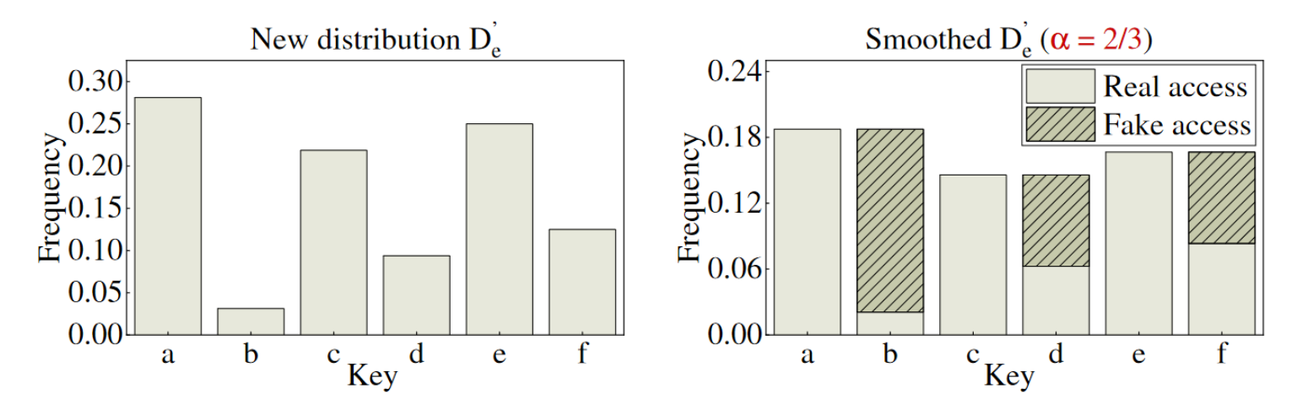
Dynamic Frequency Smoothing

Slide 14
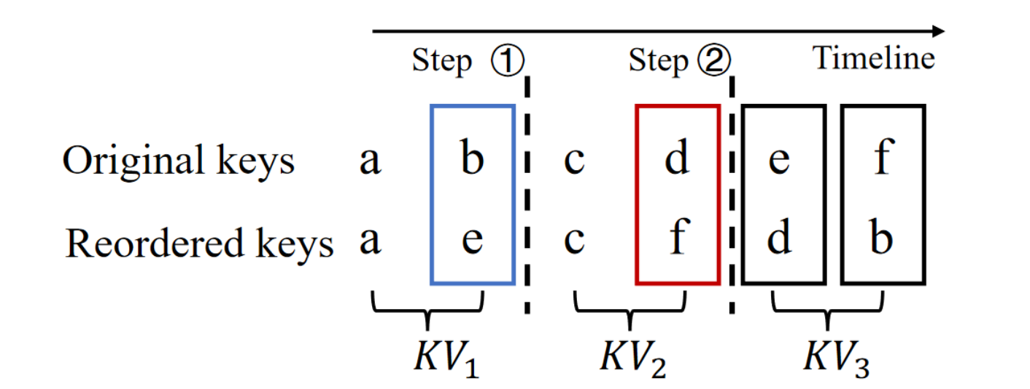
Key swapping mechanism
Due to the changes in the real queries frequency, the number of fake queries can increase dramatically.
Downloading the whole database and repeating the initialization costs too much bandwidth and interrupts the service. An online adjustment method is needed.
The main idea of key swapping is to reorder keys by access frequency and swap the keys whose access frequencies have a large difference from the rest of the keys in their respective groups (following the same logic used in the initialization). When one key leaves a group, there will be another key joining.
The pairs of keys to be swapped are found with an iterative algorithm, comparing the access frequencies between the different keys.
A threshold for swap operations is necessary, otherwise the swap operations will occur too frequently causing an increase in the overhead.

Slide 15
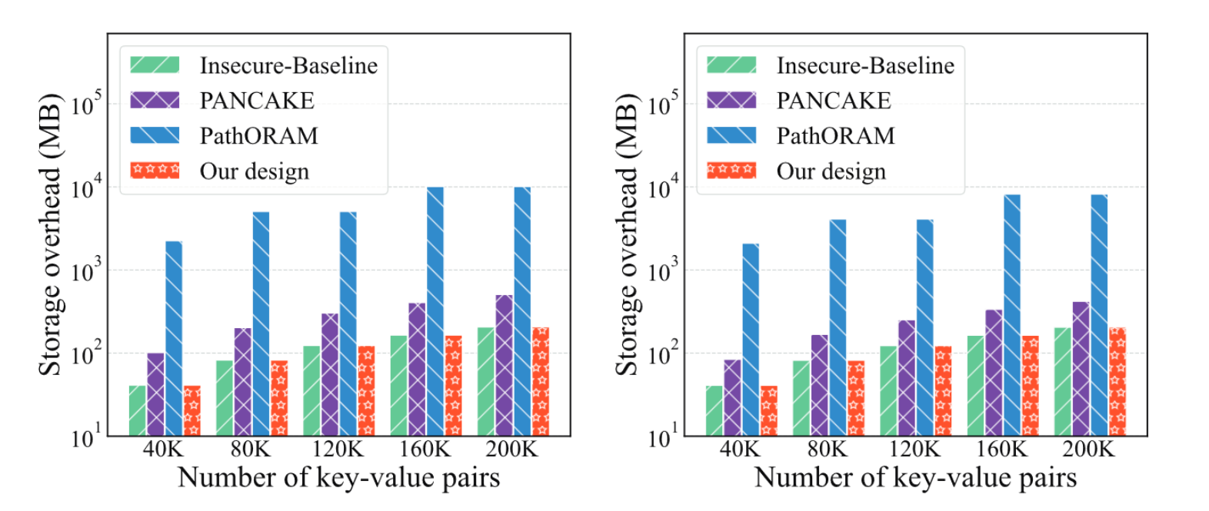
Storage overhead evaluation

Slide 16
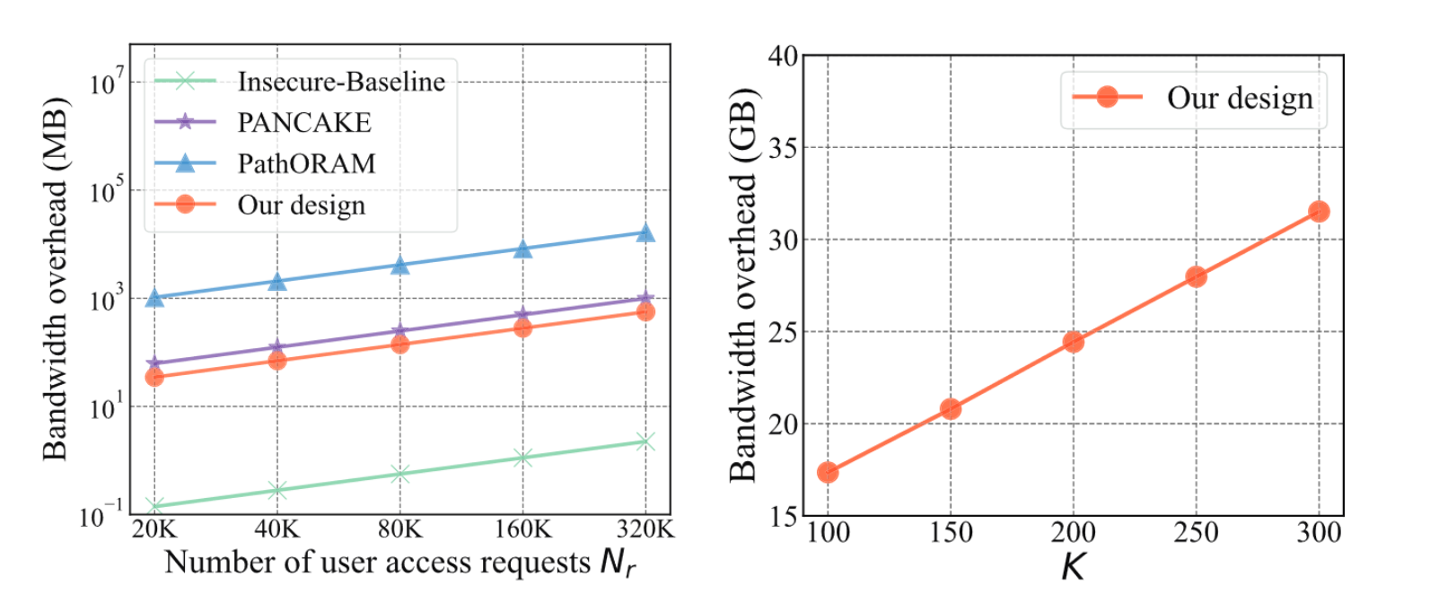
Bandwidth overhead evaluation

Slide 17
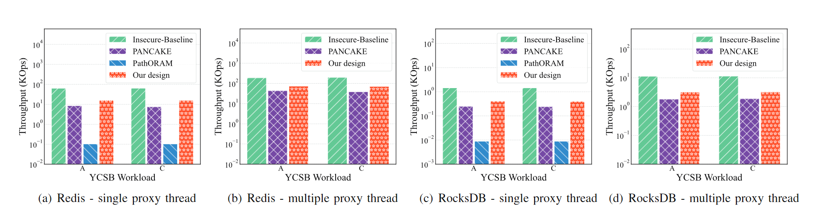
Throughput evaluation

Slide 18
Paper evaluation
Originality: 2/5
Technical meaning: 5/5
Presentation: 5/5
Focus: 4/5
Overall: 4/5

