Slide 1
Exam Preparation Assignment
Lorenzo Valeriani

Slide 2
Description of the environment UC
UC: Credit Card (CC) Transaction for a Bank
Every CC transaction requires:
Checking CC validity
Checking POS validity
Checking money amount validity
Checking if the transaction is suspect
Performing possible second identification steps
Issuing OK or abort at the end of the transaction
Storing all the information about the transaction

Slide 3
Sizing
The system supports an average of 2000 TPS, with an upper bound on the peak of 4 times the average (so up to 8000 TPS)
The Developement environment has half the size of the full Production environment
The Testing environment has the same size of the Developement environment
The Pre-Production environment is the exact replica of the Production environment

Slide 4
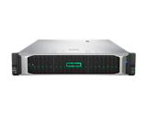
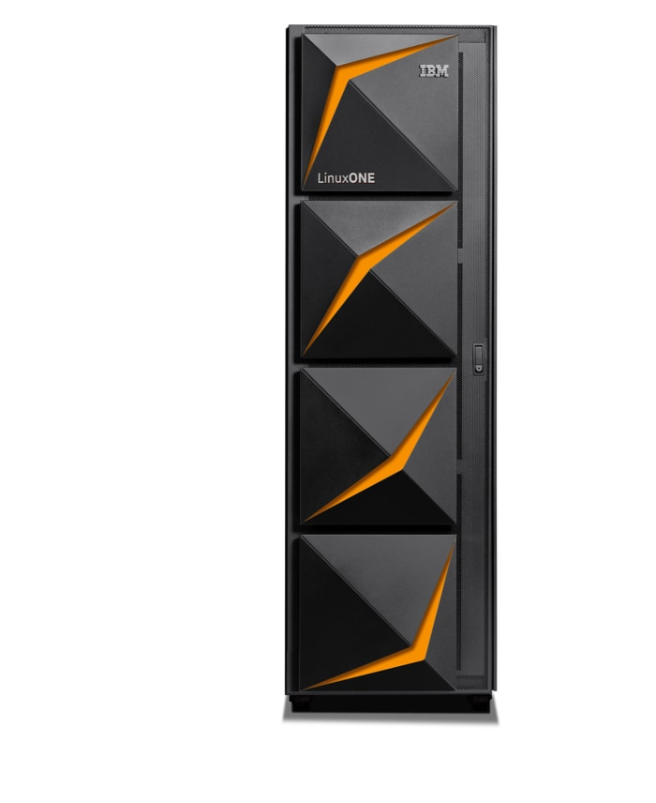
Technical Architectures for the two cases
Case 1: Rack HPE w Xeon Gold 6230 20C 2.10GHz (2 Chips, 40 Cores)
Site 1:
Prod: 12 Servers, 480 Cores
PreProd: 12 Servers, 480 Cores
Dev: 6 Servers, 240 Cores
Site 2:
Test: 6 Servers, 240 Cores
DR: 24 Servers, 960 Cores
60 Servers 2400 Cores total
Case 2: IBM LinuxONE Server
Site 1:
Prod: 40 Cores
Dev: 20 Cores
Spare: 40 CBU
Site 2:
PreProd: 40 Cores
Test: 20 Cores
Spare: 40 CBU
2 Servers 120 IFL 80 CBU

Slide 5
TCO Comparison on 5 years
These schemas show 33% savings over 5 years when using IBM LinuxONE, despite its TCA is 382% higher and the TCO of the first year is almost the same

Slide 6
X86 TCO Assumptions
Hardware
  Rack server w Xeon Gold 6230 20C 2.10GHz (2 Chips, 40 Cores)
  Acquisition cost: 8000€ including 3 years support
  Support for following years is 20% of purchase price
Network
  7000€ per server -30% discount
  Maintenance is 10% of purchase price from year 2
People
  One FTE covers 30 servers
  Average yearly fully loaded costs = 100000€
Space
  Fully loaded cost of space per square meter = 3068€
Electricity
  Cost per KWh = 0,12€
Software
  OS: subscription 2000€/year per socket, with a 20% discount
  VM: license 5000€ - 20% discount. Maintenance is 20% of purchase price from year 2
  Application Server: license 47,82€/PVU -75% discount (70 PVU per core). Maintenance 20% of purchase price from year 2
  DB: subscription 8500€/year per server
  Data Replication Tools: subscription 3000€/year per core pair with a 75% discount
  Monitoring Tools: license 5.000€/server -40% discount. Maintenance 20% of purchase price from year 2
  Security Tools: license 5.000€/server -40% discount. Maintenance 20% of purchase price from year 2

Slide 7
LinuxONE TCO Assumptions
Hardware
  LinuxONE servers configured as the example
  Acquisition cost: 3.500.000€ - 30% discount, including 3 years support
  Support for following years is 10% of purchase price
Network
  14000€ per LinuxONE server -30% discount
  Maintenance is 10% of purchase price from year 2
People
  One FTE covers 10 servers
  Average yearly fully loaded costs = 100000€
Space
  Fully loaded cost of space per square meter = 3304€
Electricity
  Cost per KWh = 0,12€
Software
  OS: subscription 6000€/year per core, with a 20% discount
  VM: Included in HW
  Application Server: license 47,82€/PVU - 50% discount (120 PVU per core). Maintenance 20% of purchase price from year 2
  DB: subscription 8500€/year per server
  Data Replication Tools: subscription 3000€/year per core with a 50% discount
  Monitoring Tools: license 5.000€/server -40% discount. Maintenance 20% of purchase price from year 2
  Security Tools: license 5.000€/server -40% discount. Maintenance 20% of purchase price from year 2

Slide 8
Considerations on some NFRs:
NFR-1: A sizing that takes the average TPS into account would require a deeper study. Even using statistical multiplexing, in occurrence of the maximum peak, a part of the users would be cut off. Furthermore, NFR-6 clearly states that a test phase must be carried out at the value of TPS peaks so these must be fully supported
NFR-2: High Availability on x86 is achieved by oversizing environments. In this case, the price increases by over 1 million for each server added. 10 servers are required to handle 8000 TPS . Two servers have been added for HA reasons. The probability of server failures increases as the number of servers increases
NFR-4: The Developement team must have an environment that is half of the full Production environment, so HA servers are counted

Slide 9
TCO Comparison on incremental TPS: considerations
This data is calculated considering only 1 max server fault
The above chart shows how x86 TCO diverges quickly, while Linux ONE TCO stays almost constant for a relatively small amount of TPS. The lower TCA of x86 platforms may lead to inaccurate thinking. Changing some parameters like the price of electricty or space does not matter much. This is beacuse most of the cost of x86 systems comes from software and DR. On LinuxONE the cost is heavily determined by hardware and software, but LinuxONE has a smaller amount of cores so the price of software is way lower than x86 systems. This particular scenario is also making use of a convenient Database. The savings favor x86 only for a small amount of TPS, thus it may be suitable for small companies, not large enterprises. Also, if a small business wants to grow, it might consider going straight for a better system instead of scaling in the future.

