Slide 1

Ansible Ants Quintet solution
Group 1:
Loreta Bolsevica
Liene Malkalne
Dace Dresmane
Antra Bagone
Anda Paegle Kadike

Slide 2
Plan
1. Create new project, share to GitHub, each member checkout their branch.
2. Together write the vagrantfile and develop the structure for Ansible and divide tasks:
-Antra -> install
-Liene and Dace -> create user
-Loreta and Anda -> app setup
3. Meet up to put everything together and run, look for errors, adjust and update
4. Choose Java project
5. Create presentation

Slide 3
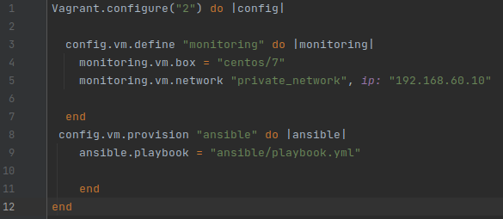
Vagrantfile

Slide 4
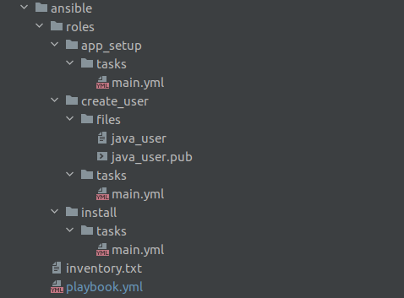
Ansible playbook structure

Slide 5
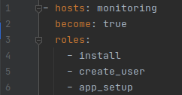

playbook.yml
inventory.txt

Slide 6
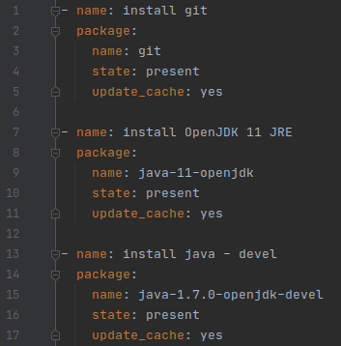
Role: install

Slide 7
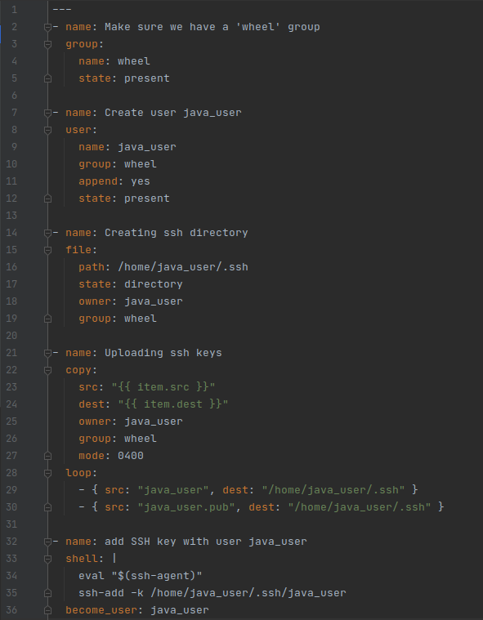
Role: create_user

Slide 8
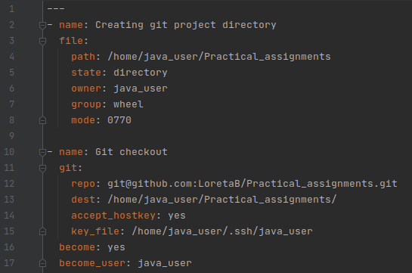
Role: app_setup (Git)

Slide 9
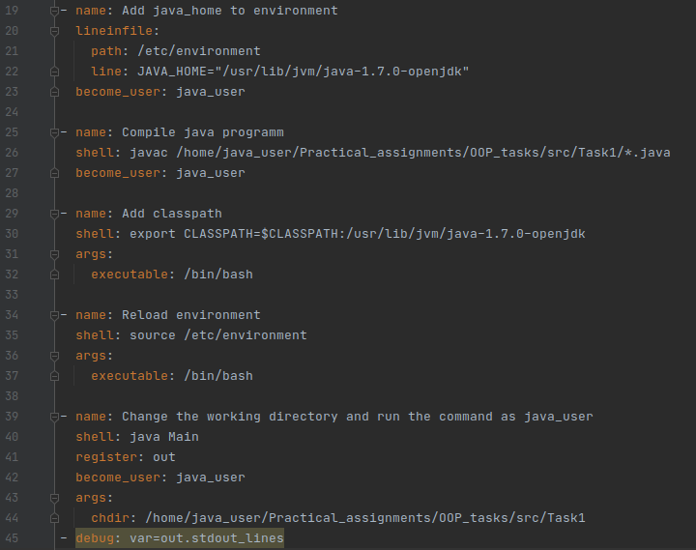
Role: app_setup (Java)

Slide 10
References
Ant’s clipart https://st.depositphotos.com/1967477/2305/v/380/depositphotos_23054666-stock-illustration-cute-ant-cartoon-waving.jpg

