Slide 1
FIFA 2021
Case study – Unit 2 Ironhack

Slide 2
OUR DATA
FIFA 2021 players database
Huge matrix → 17125 rows x 107 columns
Columns like: ‘Profile Photo, Club Logo, Flag Photo; with no valuable information
SO? → create a useful and an affordable database focused on the objective

Slide 3
OBJECTIVE AND DATABASE
Predicting the Overall Rating of a player based on the transfer value and the player skills to see which would be the best replacement.
Transfer value = Coeficient of Position * Market value *
Coeficient of Position:
Striker/Forward = 1
Midfielders = 0.75
Backers and Goalkeepers = 0.5

Slide 4
OBJECTIVE AND DATABASE
→Selection of the variables that help our goal and cleaning data
Player skills = PAC, SHO, PAS, DRI, DEF, PHY
Best Position
Wage
Value
Contract → we work only with active players i.e. contract finished in 2021 or later
Nationality
Age

Slide 5
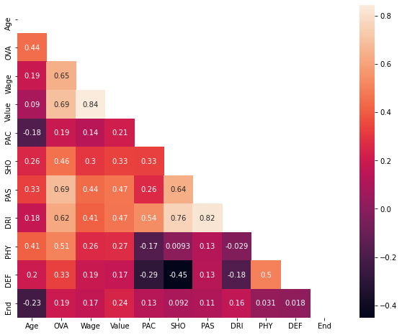
EXPLORATORY DATA ANALYSIS
Checking correlations and multicollinearity:
Remarkable correlations between OVA and PAS, DRI, SHO, Value and Wage. May be not all are necessary

Slide 6
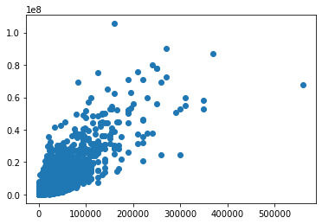
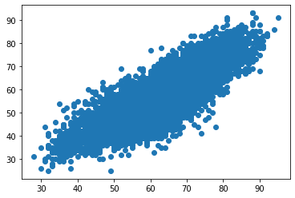
EXPLORATORY DATA ANALYSIS
Checking correlations and multicollinearity:
Highest correlations:
Wage and Value
DRI and PAS
→ might be measuring the same
→ one of the could be dropped
Value
Wage
PAS
DRI

Slide 7
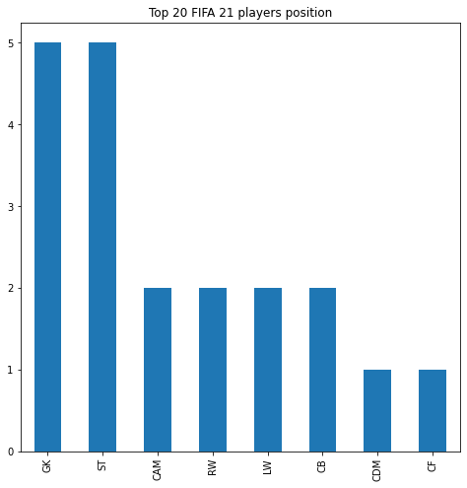
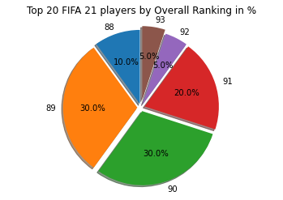
EXPLORATORY DATA ANALYSIS
Plotting:
30% of the top 20 FIFA players have 89 or 90 OVA value
CB and ST, highest played positions among the 20 top FIFA players

Slide 8
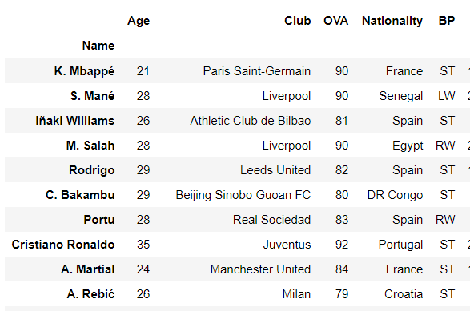
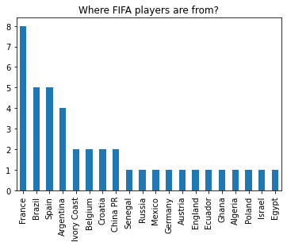
EXPLORATORY DATA ANALYSIS
Plotting…
France, Brazil, Spain and Argentina are the highest “strikers producers”
TOP 10 Striker/Forward players:

Slide 9
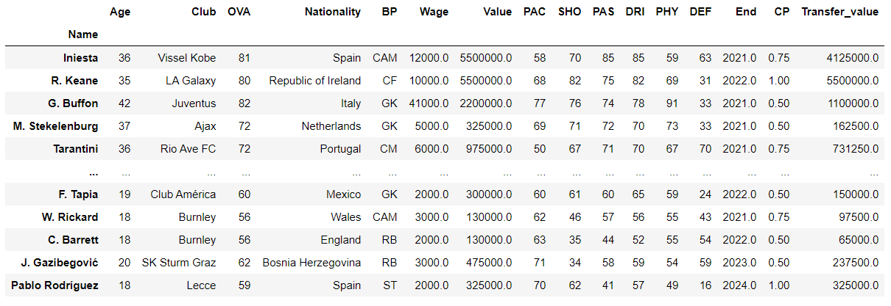
EXPLORATORY DATA ANALYSIS
*Computing the transfer value:
Relate the Coeficient of Position (CP) to each player Best Position
Multiply the CP times the market value

Slide 10
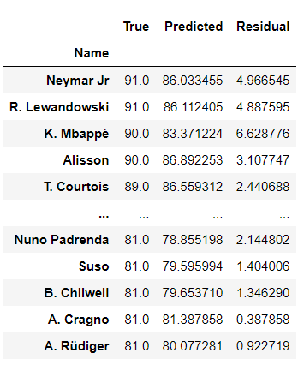
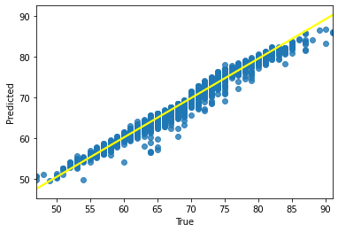
LINEAR REGRESSION MODEL
Variables:
PAC
DRI
PHY
DEF
CP
Age
Best Position (BP)
Wage
Transfer Value
Predicting the OVA value:
BoxCox transformation (without)
Encoding and fitting
Predictions
R2→ 0.970941 (0.824913)

Slide 11

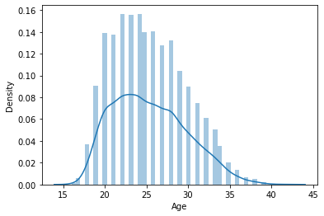
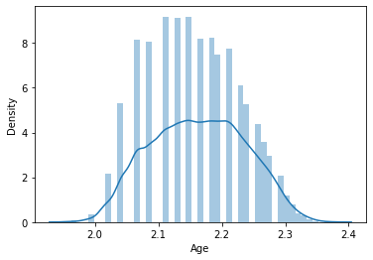
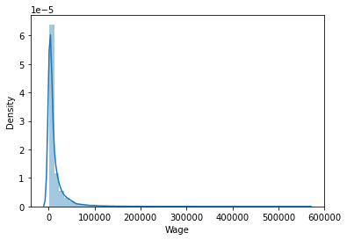
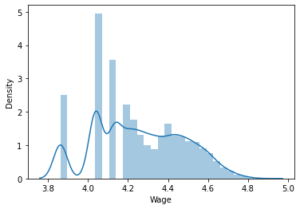
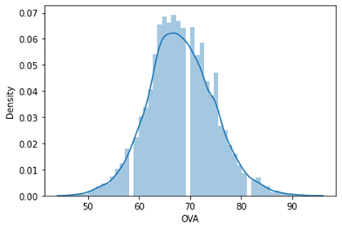
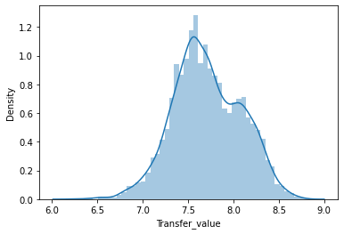
DISTRIBUIONS BEFORE AND AFTER
Checking the distribution of our data:
Close to normal distributions
Form skewed distributions to ‘more normal’ ones

