Slide 1
Team project Mag6Plus Earthquakes 1900 - 2014
Course: Data Visualization with Tableau
Dr. George Jen
Project Team Leader, Loretta Gray
Team Members - Joyce Cheng, Dr. Jhansi Narisetti,PharmD., Mehreen Zakria

Slide 2
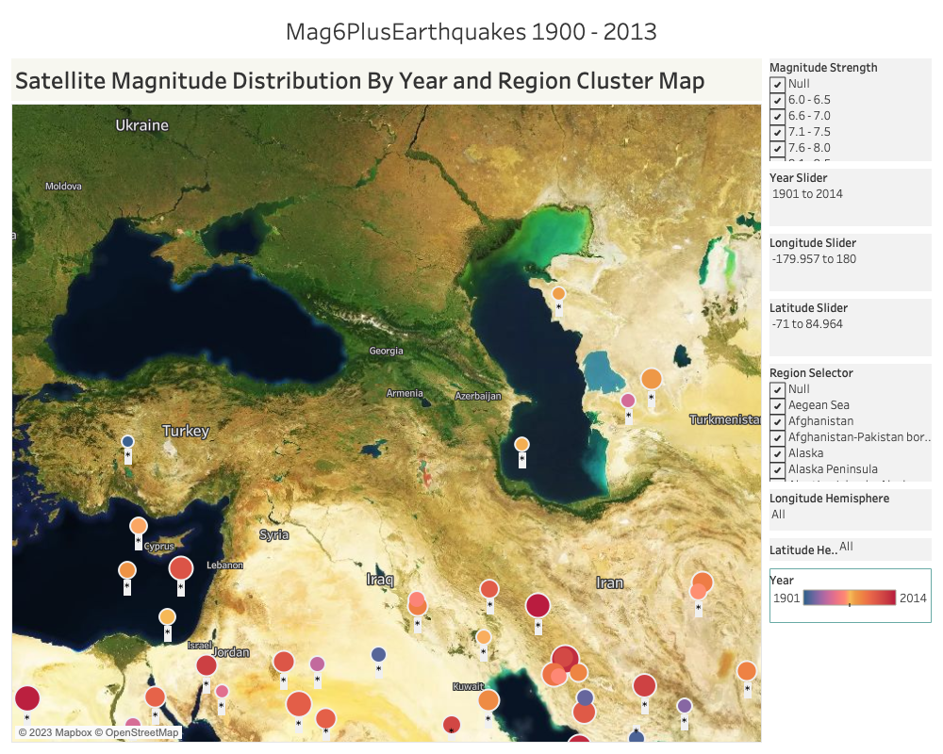
Team project Mag6Plus Earthquakes 1900 - 2013
The Project Description
The "Mag6Plus Earthquake Analysis" project provides a comprehensive exploration of significant earthquakes measuring magnitude 6.0 and above. Leveraging advanced data visualization tools in Tableau, this project aims to uncover patterns, trends, and insights within seismic activity across regions and years.

Slide 3
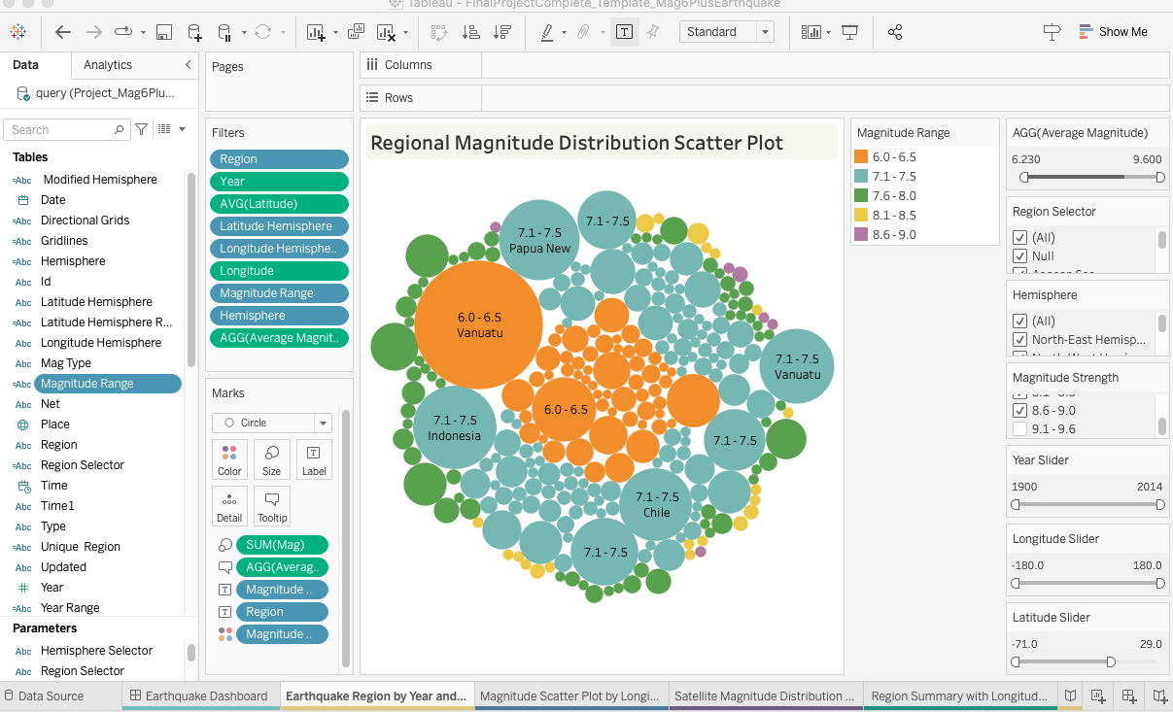
Team project Mag6Plus Earthquakes 1900 - 2014
The Tableau Worksheet
The "Mag6Plus Earthquake Analysis" project embodies the power of data visualization to unlock insights from complex datasets. Whether for scientific research, disaster preparedness, or educational purposes, the “Mag6Plus Earthquake Analysis” project offers a visually engaging platform to explore and comprehend earthquake occurrences and their implications. Through interactive tools we uncovered the fascinating world of seismic events.

Slide 4
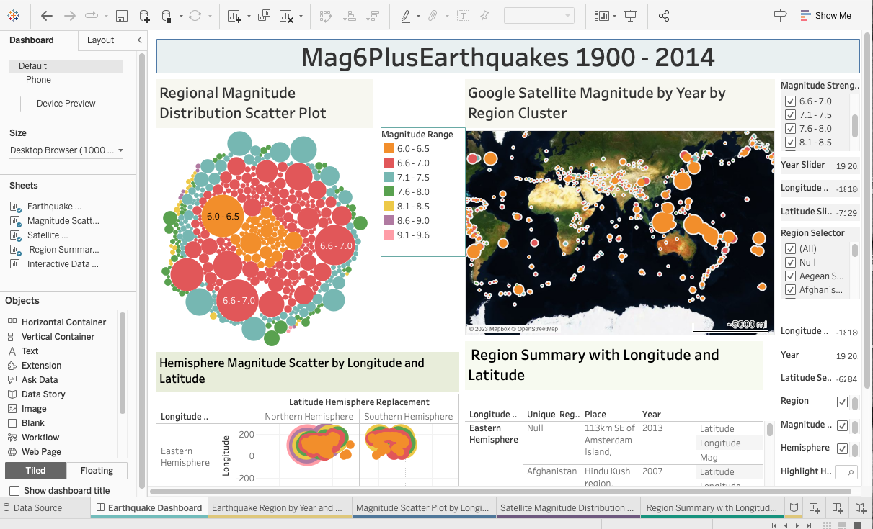
Team project Mag6Plus Earthquakes 1900 - 2014
The Tableau Dashboard
The "Mag6Plus Earthquake Dashboard” serves as a dynamic gateway to explore visualize seismic events of magnitude 6.0 and above across the glob.
As you navigate through this dashboard, you'll embark on a journey to discover the patterns and distribution of significant earthquakes. The interactive map provides a visual representation of earthquake locations, allowing you to zoom in on regions of interest. Hover over data points to access detailed information.

Slide 5
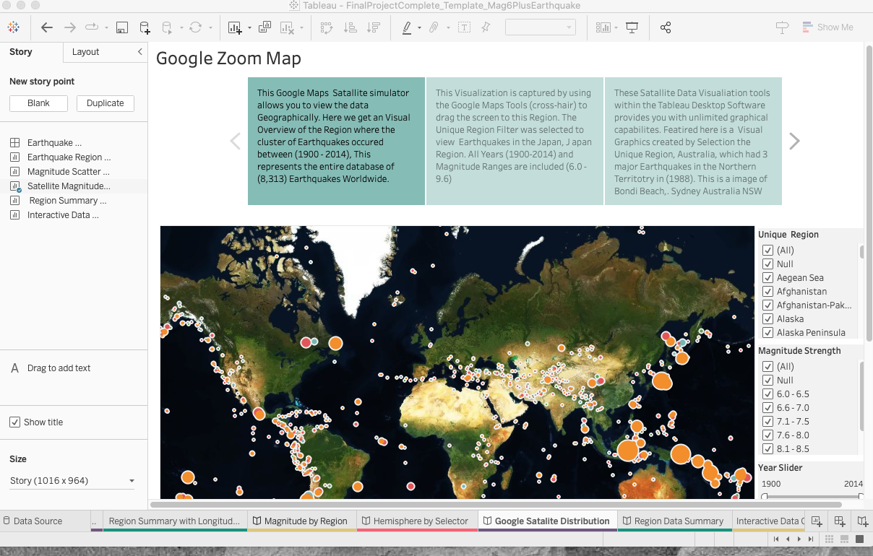
Team project Mag6Plus Earthquakes 1900 - 2014
The Tableau Story Board
Storyboards – Insightful Narratives: To facilitate a coherent narrative storyboards have been created for each worksheet. These storyboards guide users through a sequence of visualizations and annotations that highlight trends and discoveries. Starting with an overview and gradually delving into finer details, the storyboards enrich the viewers understanding of the seismic data.

Slide 6
Team project Mag6Plus Earthquakes 1900 - 2014
Project Interactive Presentation
Team Members: Joyce Cheng, Dr. Jhansi Narisetti ,PharmD.

Slide 7
Team project Mag6Plus Earthquakes 1900 - 2014
THANK YOU

