Slide 1
V G G
Visual Geometry Group
Proposed by:
K. Simonyan and A. Zisserman from Oxford University
Published Paper: Very Deep Convolutional Networks for Large-Scale Image Recogniti
Presented by: Loretta Gray

Slide 2
VGG ARCHITECTURE
What Is VGG16?
VGG16 refers to the VGG model, also called VGGNet.
It is a convolution neural network (CNN) model supporting 16 layers.

Slide 3
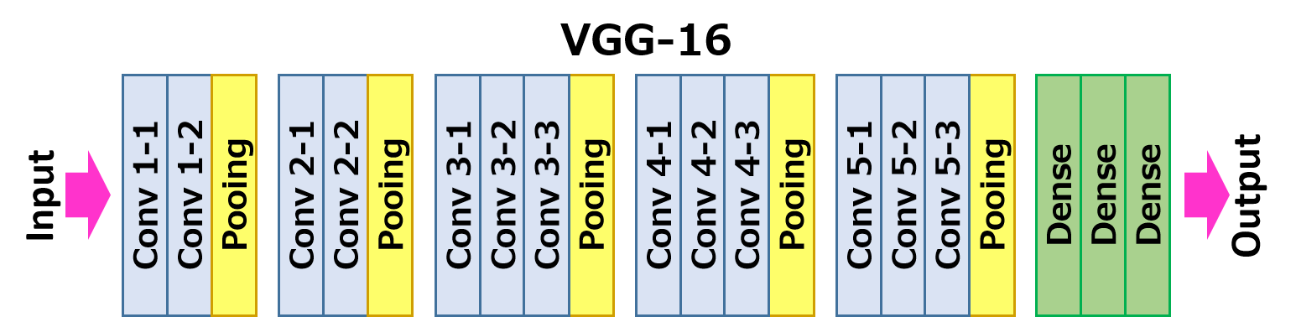
Architecture
Convolution + ReLU
Max Pooling
Fully Connected + ReLU
Softmax
Filters and size of features map
Process: finds patterns, simplifies, guess, probabilities

Slide 4
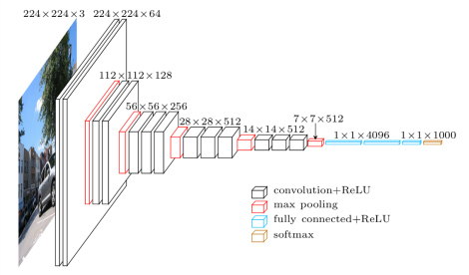
This image shows the VGG16 architecture with its multiple convolutional layers, max-pooling layers, and fully connected layers.
The image also includes the number of filters in each layer and the size of the feature maps.
Architecture
Breakdown smaller pixels
Filter keeps important features

Slide 5
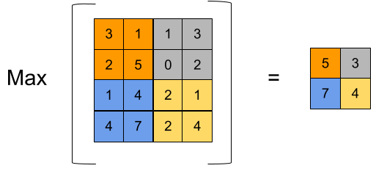
Pooling
Pixels, bright & dark spots
Groups into smaller picture
Reduce overfit

Slide 6
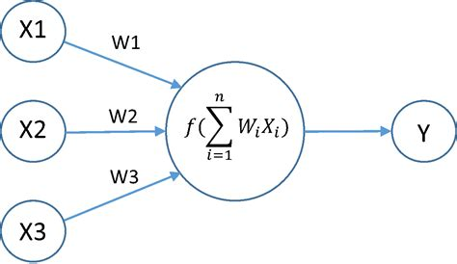
Activation Function
Switch in computer decides important parts
Colors & Shapes
Scores image parts
Understand pictures

Slide 7
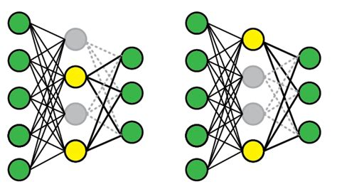
Dropout Function
Prevents overthinking
Random turn off unimportant
parts of picture
Focus for better decision

Slide 8
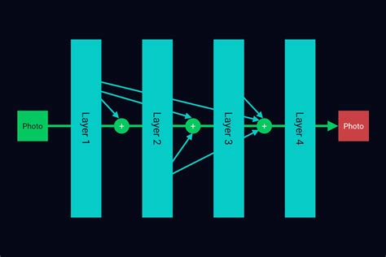
Pre-Trained Model
Computers have learned information about picture
Trained on 1,000+ pictures
More Accurate understanding of pictures

Slide 9
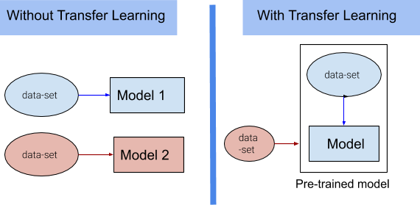
Transfer Learning
Learns to understand something new
Transfers learned knowledge
Applies knowledge for more efficiency

Slide 10
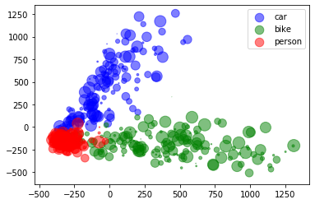
Image Classification
Takes guess
Matches shapes, colors of objects
Labels and categorizes
Sorts and identifies real life objects

Slide 11
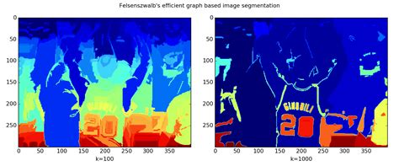
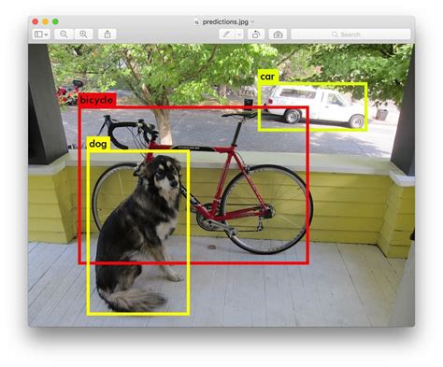
Object Detection
Finds picture, draws box
Tries to match colors and shapes
Boxes each thing in picture
Can count objects, to help robots navigate

Slide 12
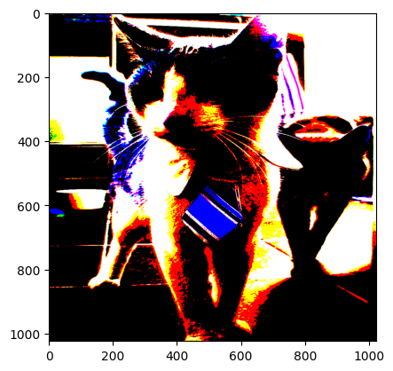
Image Segmentation
Segments based on what computer sees
Looks at colors and shapes then puts together
Shows where one object begins and ends
Removes background for better understanding of picture
End Presentation

Slide 13
THANK YOU

