Slide 1

VECTOR FIT GOLF
1610 99th Ave. NE
Blaine, MN 55449
www.vectorfitgolf.com
612-998-8335
RUNNING THE FORESIGHT GC QUAD LAUNCH MONITOR AND SIMULATOR SOFTWARE TO MEASURE THE MAJOR PARTS OF YOUR GOLF SWING TO ANSWER THE QUESTIONS OF WHAT HAPPENED AFTER EACH GOLF SWING INSTEAD OF GUESSING. LET'S SEE WHAT IS MEASURED.
Click to turn pages

Slide 2

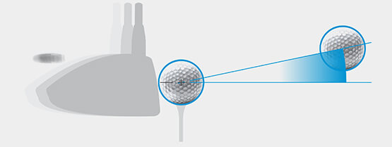
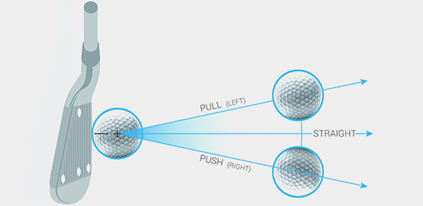
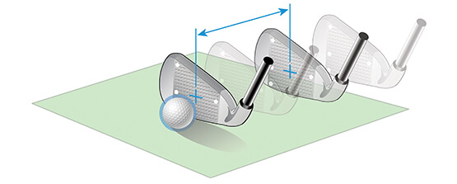
Ball Speed
The measurement of the golf ball’s velocity just after impact. Ball speed is the main component in generating distance.
Launch Angle
The initial vertical angle of ascent relative to the ground plane measured in degrees. The launch angle, combined with ball spin and speed, will determine the ball’s carry and total distance.
Azimuth
The initial horizontal angle relative to the target line. The azimuth, combined with side spin, will determine the final ball position range relative to the target line.
Club Speed
The velocity at which the head travels, measured just prior to ball contact.

Slide 3

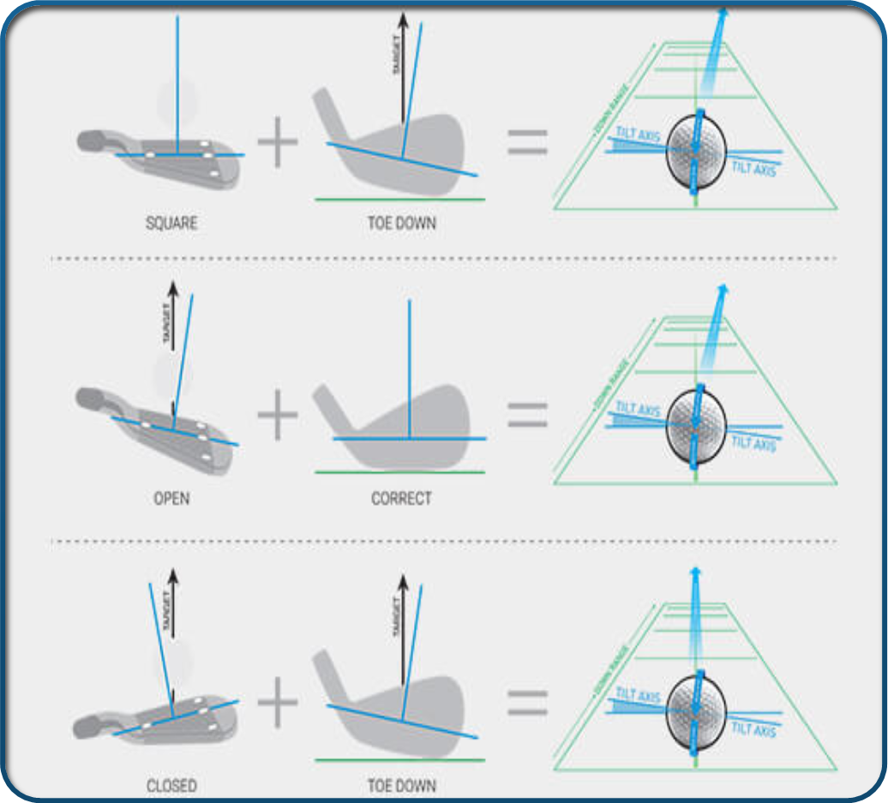
Spin-Tilt Axis
One of the most important pieces of data measured by our launch monitors is the spin-tilt axis. The spin-tilt axis is the axis that the golf ball rotates around to create shot curvature and lift.
Club Data

Slide 4
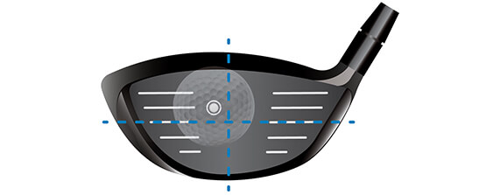
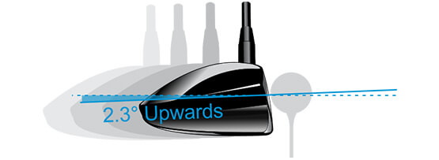
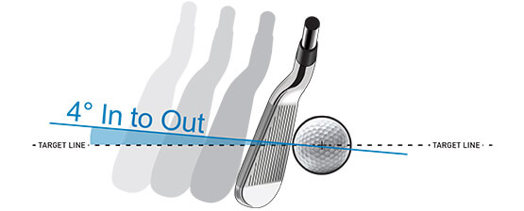
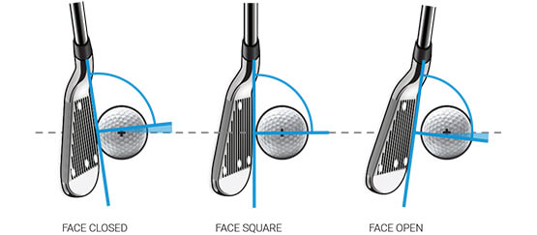
Impact Point
The measurement of the contact point of the golf ball on the club face relative to face center.
Angle of Attack
The descending or ascending path of the club head, measured in degrees.
Club Path
The swing path measured in a horizontal plane relative to the target line. This data point will tell you if the club was moving from inside-out, outside-in, or perfectly down the line.
Delivered Face Angle
The dynamic measurement of the club head’s face plane position square to the target line.

Slide 5
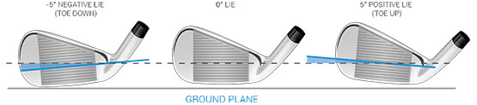
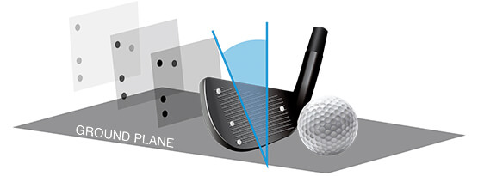
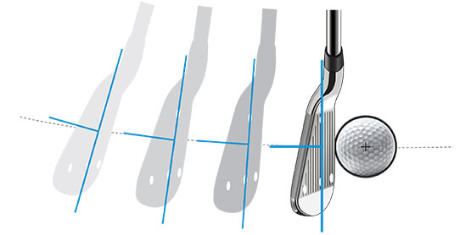
Delivered Lie Angle
The lie of the club is the way the club compares to the ground through the hitting area. This is a dynamic measurement, and it is relative to the ground plane. A negative number means the club is “toe down” at impact, while a positive number means the club is “toe up.”
Impact Loft
The dynamic measurement in degrees of the club head’s face plane position vertically relative to the ground plane.
Closure Rate
The rotation of the club head heel to toe measured about the shaft in degrees per second or rpm.

Slide 6
VECTOR FIT GOLF
1610 99th Ave. NE
Blaine, MN 55449
www.vectorfitgolf.com
612-998-8335

