Slide 1


Management Committee KPI Meeting
Oct 31st, 2022

Slide 2

Sales.
30% growth vs. last year
Checking the attractivity of our products and our Marketing & Sales teams’ performances

Slide 3

Profit .
Identifying the most/least profitable categories/regions
Margin : 10 % next year

Slide 4
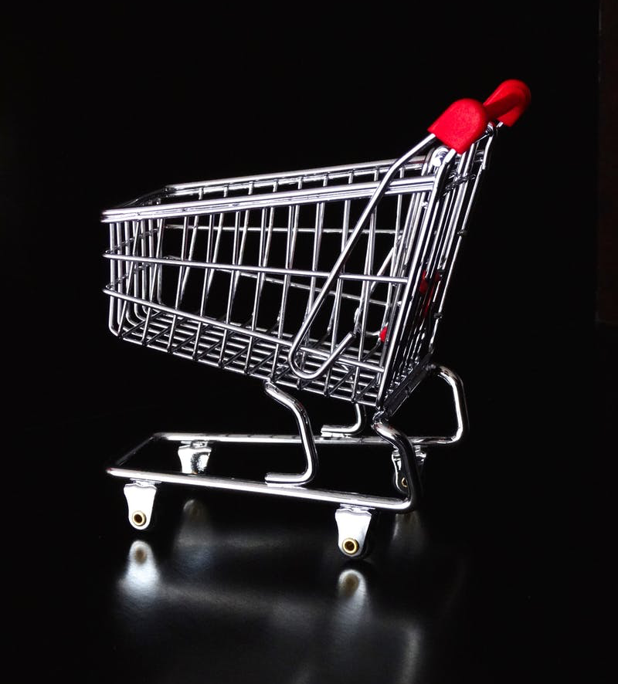
Average basket
Understanding how to improve our sales
Improve average basket volume
Improve average basket value

Slide 5

New clients.
Get 100 new clients next year
Improve loyalty (>= 2 orders a year)
Reduce churn rate: 3%
Ensuring that we recruit enough new clients

Slide 6
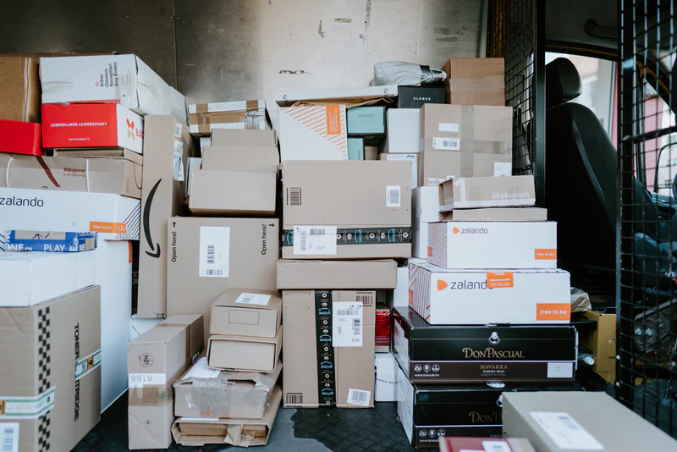
Return rate.
Checking clients’ satisfaction with their order
Reduce return rate below 20 % next year

Slide 7
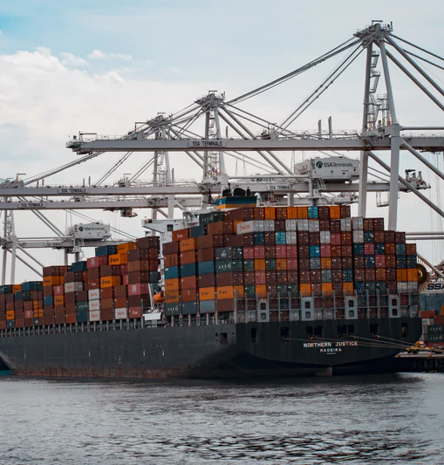
Shipping efficiency
Tracking our Logistics team and our shipping partners’ efficiency
Same day delivery : 0 day
First class delivery : 2 days
Second class delivery : 3 days
Standard class delivery : 5 days

