Slide 1
Air b and see: into the Future
Brianna McKelvey, Lori Harris, Rachel Powell

Slide 2
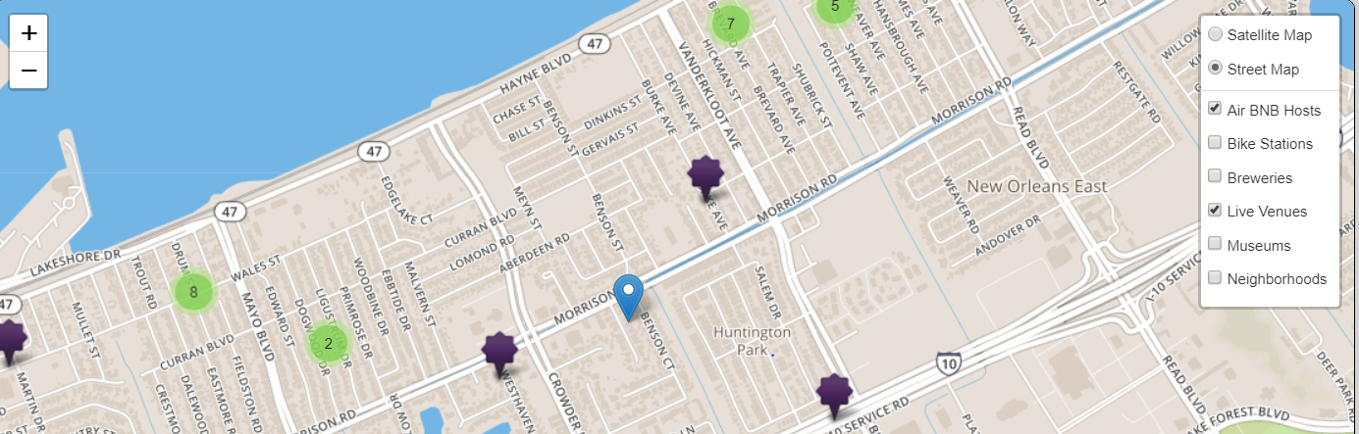
Recap
Traveling to New Orleans
Goal: choose an Airbnb close to the breweries, live venues, museums, etc. that YOU care about; filter by accommodations criteria
Notes:
Blue icon is a super hot concert venue where you’re going to see your FAVORITE artist. Now you can see which listings are walking distance so you don’t have to wait around for and pay for an Uber back to your Airbnb after the concert. Even better, imagine if you knew you were getting an awesome deal. Wouldn’t you feel great?!

Slide 3


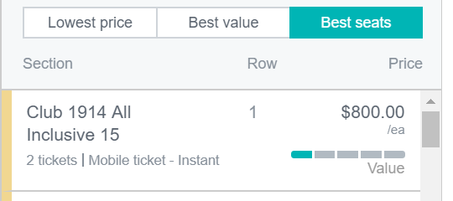
Visualizing Value
Notes:
When we left off a few weeks/months ago, we had come up with grand ideas we would have tackled if we had had more time….seemed like a natural place to pick up for project 3

Slide 4
Goals
Analyze pricing fluctuations and influences
Elucidate correlations between Airbnb “features”
Utilize VADER sentiment analysis to Airbnb reviews
Predict pricing based upon each Airbnb’s unique features using machine learning modeling
Rate Airbnb options by relative value

Slide 5
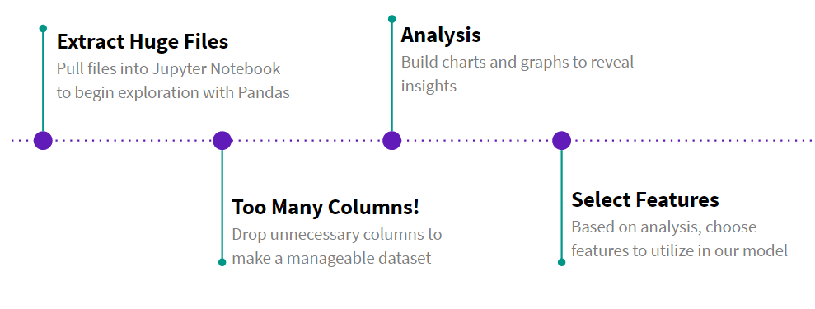
Cleaning Data
Two sets of Airbnb data:
276,455 rows by 6 columns
6,632 rows by 106 columns

Slide 6
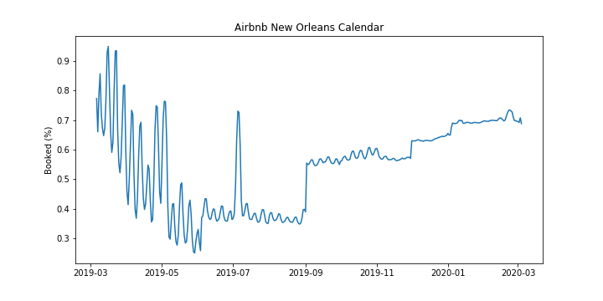
Pricing Variation

Slide 7
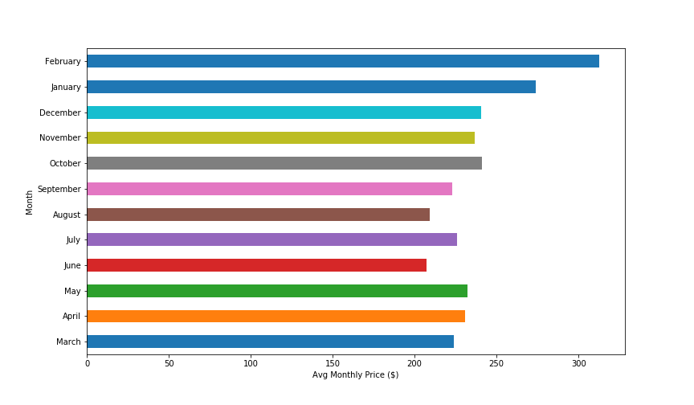
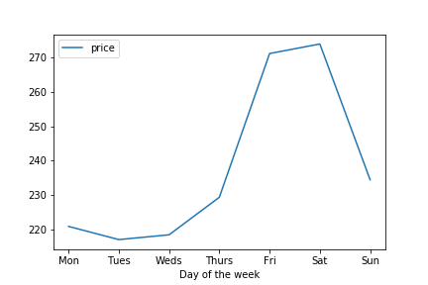
Pricing Variation

Slide 8
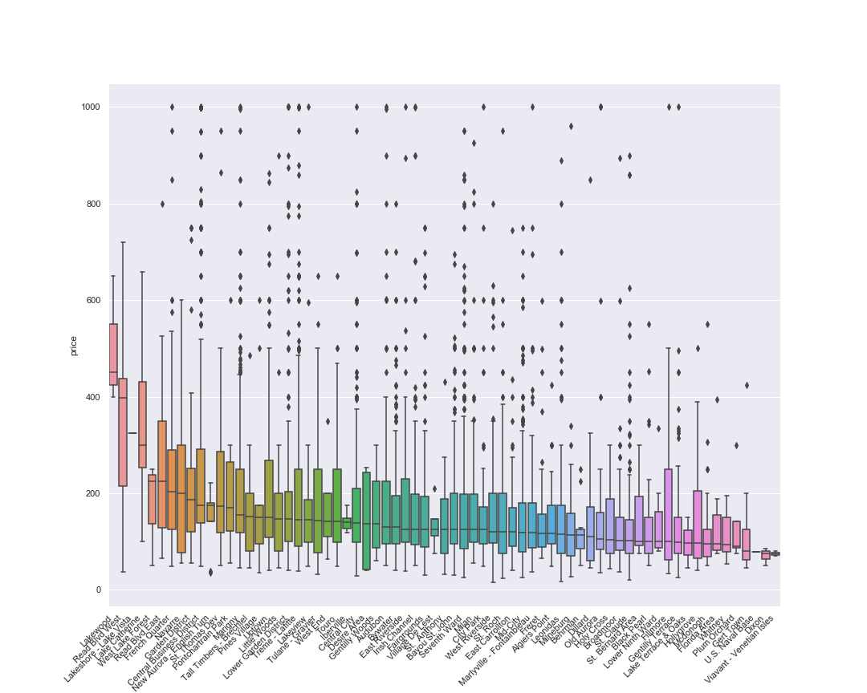

Slide 9
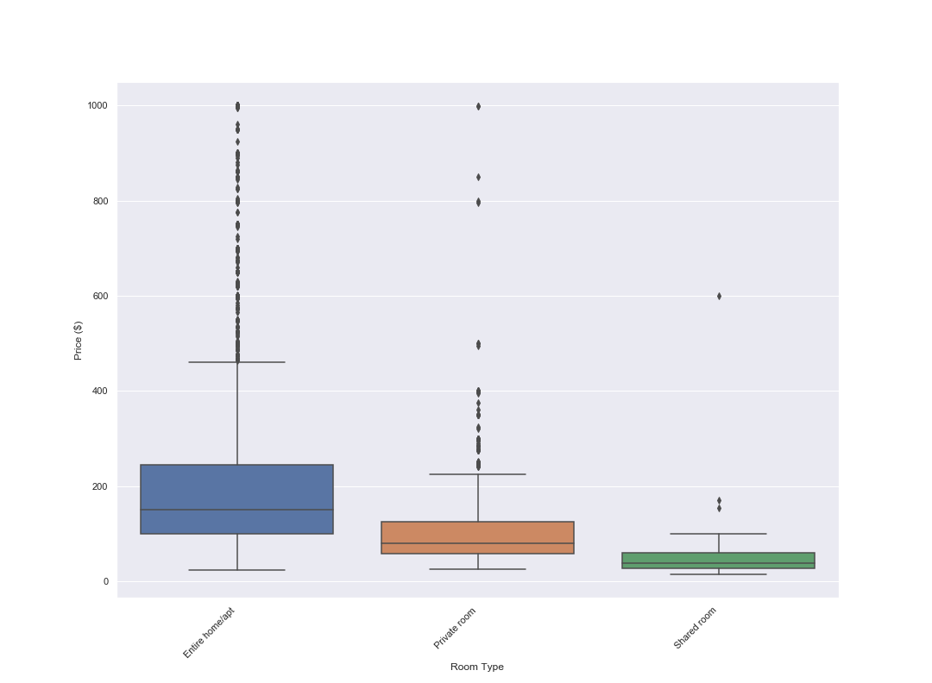
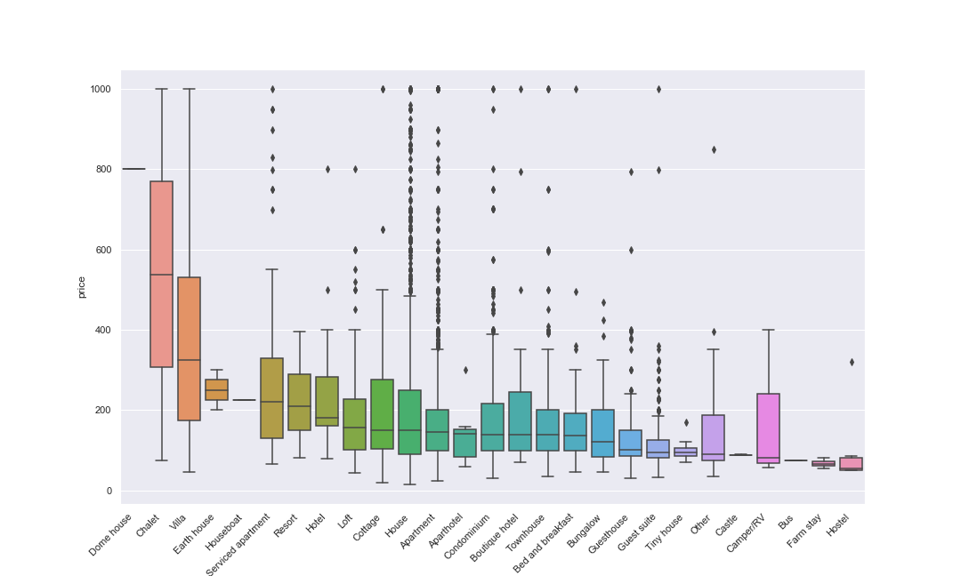
Room Type
Property Type

Slide 10
VADER Sentiment
Positives: made for social media, no training
Key points for analysis:
Punctuation: Awesome!!!!!
Capitalization: Food was GREAT
Degree modifiers: Marginally good; extremely awesome
Conjunctions: Food was great, but service was terrible
Preceding Tri-gram/Negation: Food here isn’t really all that great
Emojis, slang, acronyms
Returns a score from -1 to +1

Slide 11
VADER Sentiment
test_sentence_1 = 'The room was beautiful. It was not awful at all. I really loved it.’
0.8903
test_sentence_2 = 'I detest this room. It was the most terrible. I will never stay here again.’
-0.5256
test_sentence_1 = 'The room was the most absolutely beautiful. I really loved it. I have never loved any room more’
0.937
test_sentence_2 = ‘ I HATED this room. The room was terrible! I will NEVER stay here again.’
-0.8528
Caveat: more exclamation points made it a positive score??
Notes:
Bias towards the positive? Exclamation points skew positive so saying “I hated this room!!!!!!!!!!!!!!!!!” will yield a positive result

Slide 12
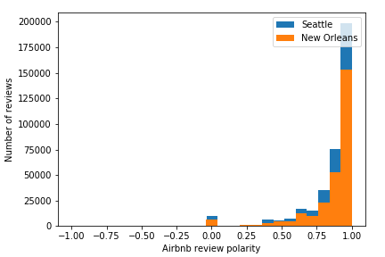

Slide 13
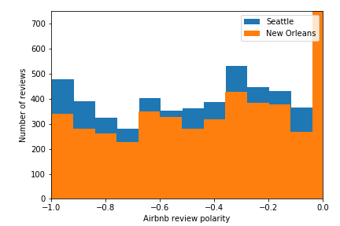

Slide 14
Making a model

Slide 15
Purpose
Predict Pricing
Based on user input
Give user a result
Result will indicate if listing is a good deal

Slide 16
Process
Use Machine Learing
Analysis
Pre-processing
Model testing
Implementing

Slide 17
Choosing Features
Distance to Bourbon St!
Plot correlation of price
Geopy Python Library
Calculates distances from a point
Can be iterated through DF

Slide 18
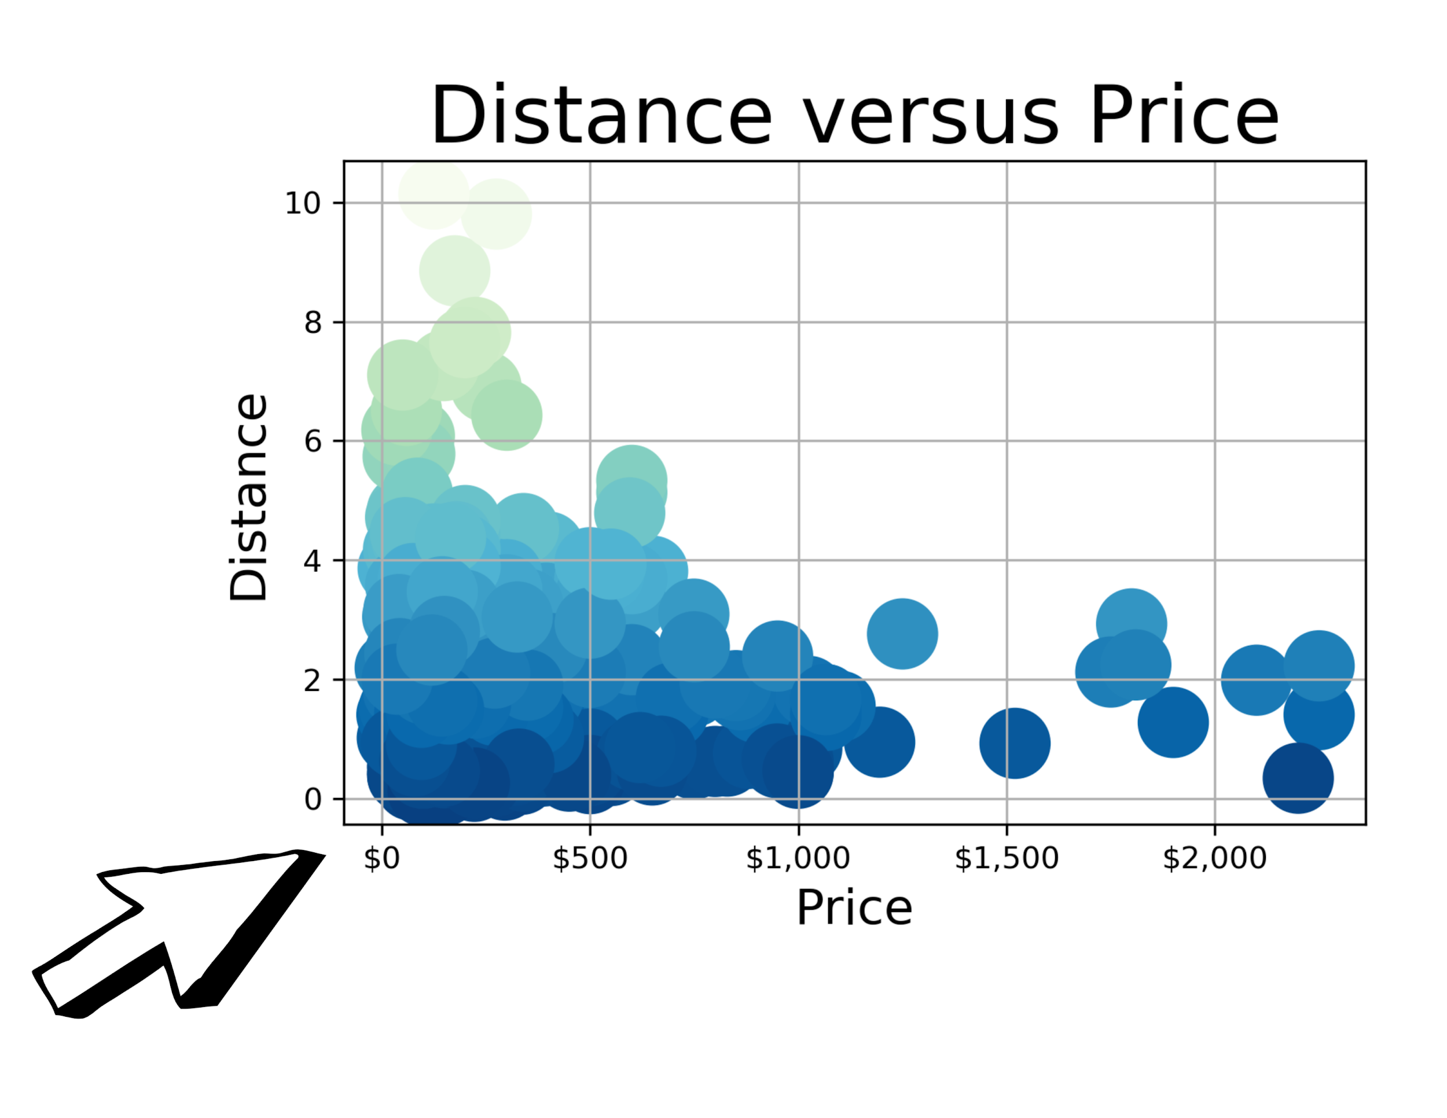
Surprising Results
No Correlation!!
Darker colors distance to Bourbon St
The most expensive rentals were furthest
The cheapest were closest
More availability
Supply could be driving pricing

Slide 19
Choosing Features
Team Analysis Reveals:
Vader sentiment polarity scores
Less obvious features held weight –
Number of listings per host
Cleaning fee
Obvious features held weight, but not as much as anticipated:
Number of bedrooms
Square Footage

Slide 20
Final Selection
Cleaning fee
Distance
Listing count of host
No. People accommodated
Number of bookings
Bathroom count
Bed count
Bedrooms count
Etc.

Slide 21
Pre-process the data
Binning Price
Requires at least 2 of each item. So binned pricing to create categories with multiples
Encode all data
One hot encoding
NaN were problematic
Fill all Nan with mean of the entire column
Split data
Train, test, split function

Slide 22
Running the models

Slide 23
Models Used
Sklearn Library:
Nearest Neighbors
Random Forest
Gaussian
Decision Tree
SVC
Keras & Tensorflow:
Dense Neural Network

Slide 24
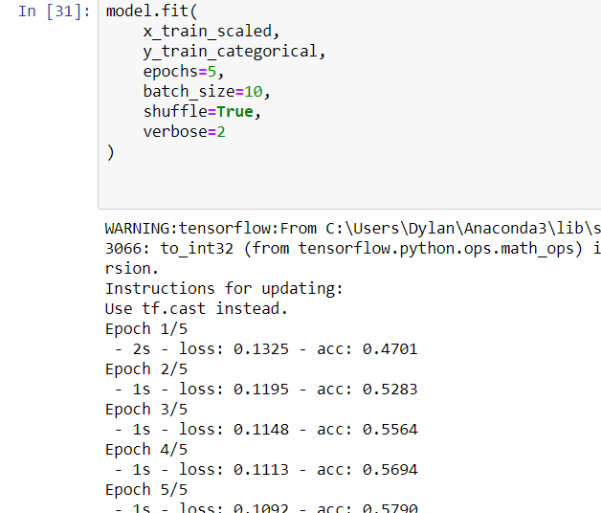
Neural Network Frustration
The more epochs on trained data the more acccurate
Ran enough training to get up to 90% accruacy
Accuracy was never carried over to test data
Why?
Massive Overfitting of Data

Slide 25
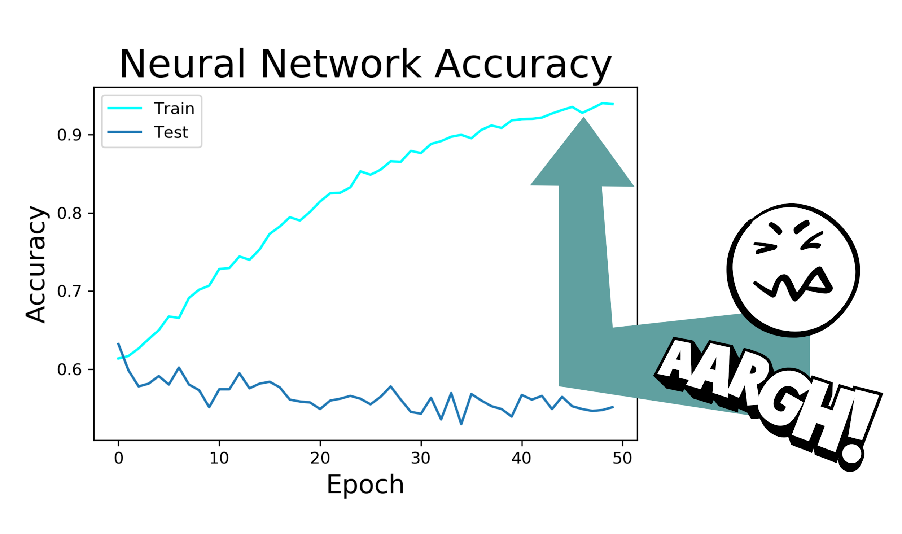

Slide 26
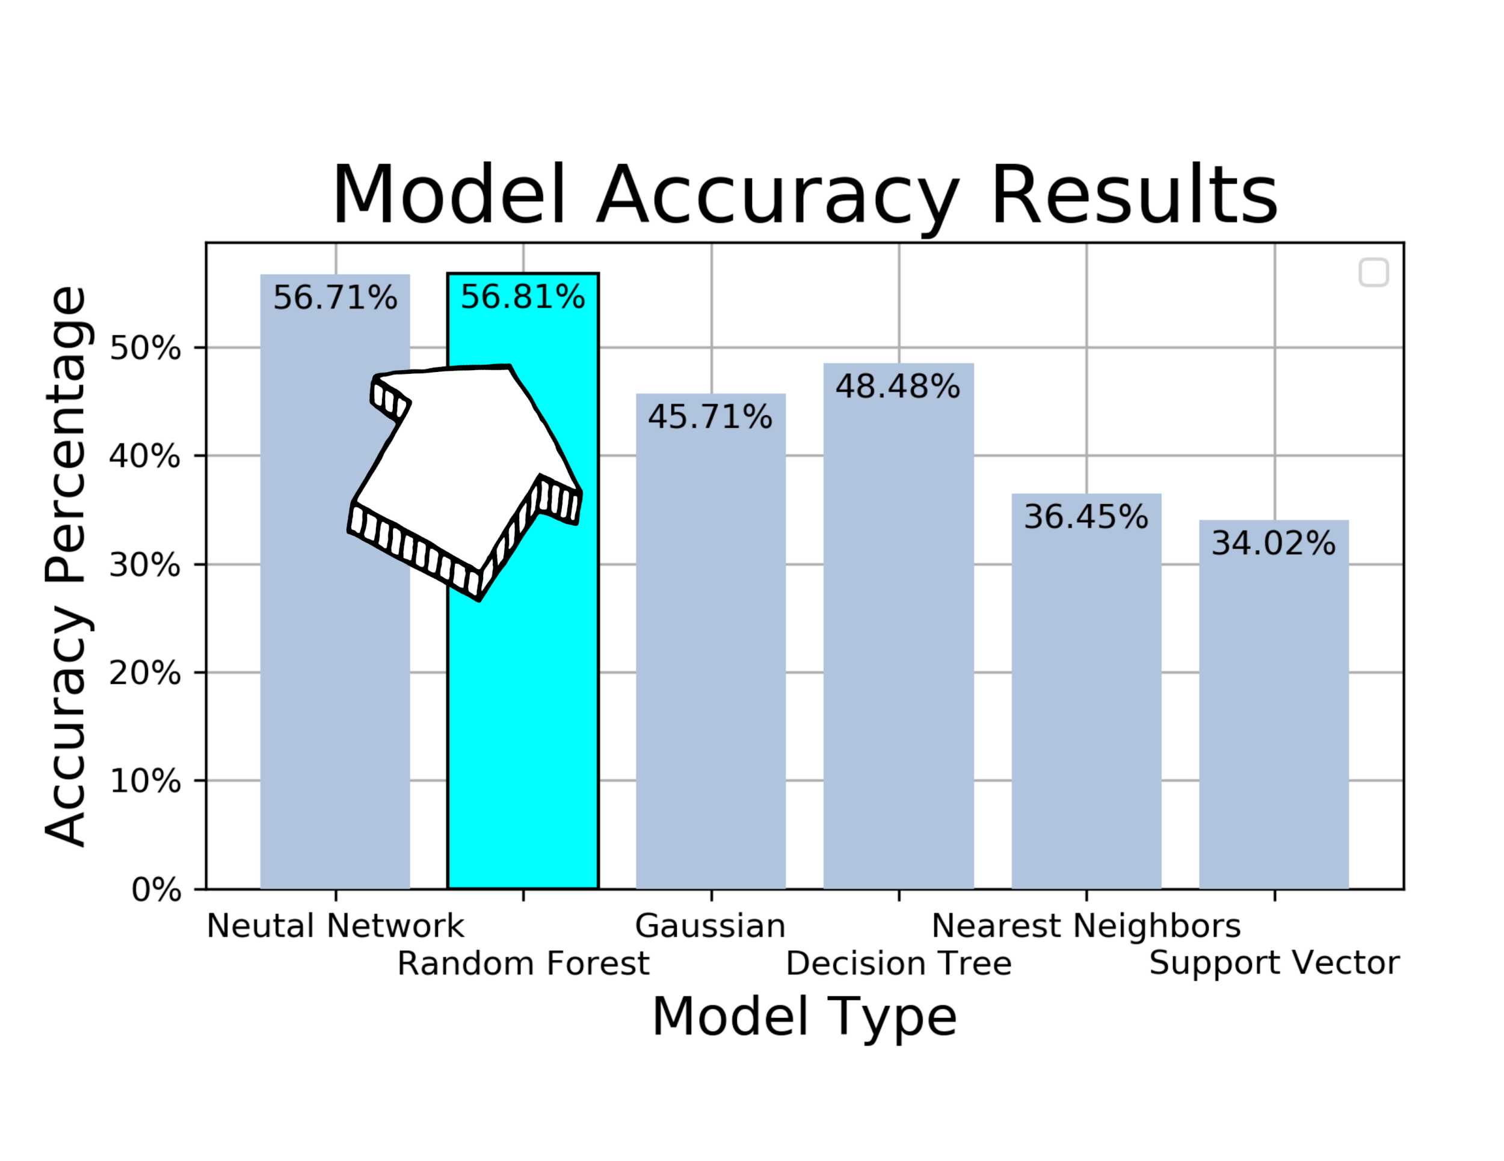
Close Finish!
Neural Network and Random Forest - close
Random Forest wins
The others were much less accurate
Neural Network

Slide 27
Check Out the forest

Slide 28
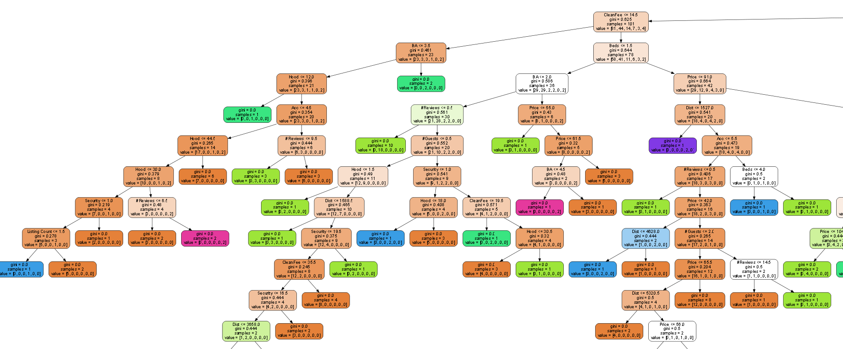
Many Huge Decision Trees

Slide 29
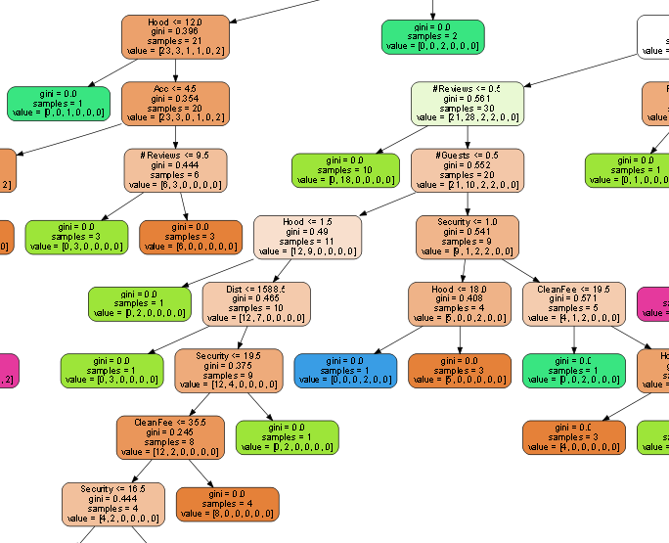
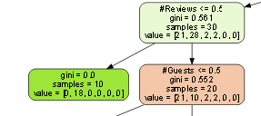
Zooming In:

Slide 30
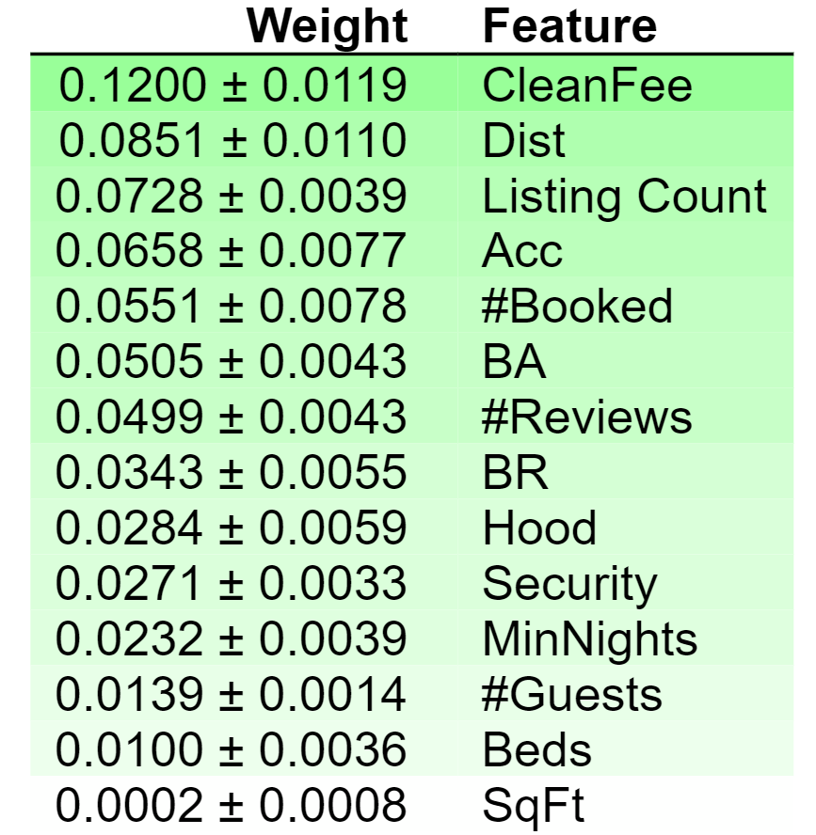
Interesting Weights!
Clean fee was most important indicator
Number of listings by host was #3
Number of times booked in one month #5
Distance was second, despite my earlier analysis

Slide 31
Implementation
Incorporate ML in our Airbnb web app
Pushed new dataset to our Mongo DB
Altered app.py with new route to search a listing on selection
Utilized JS library - SweetAlerts

Slide 32
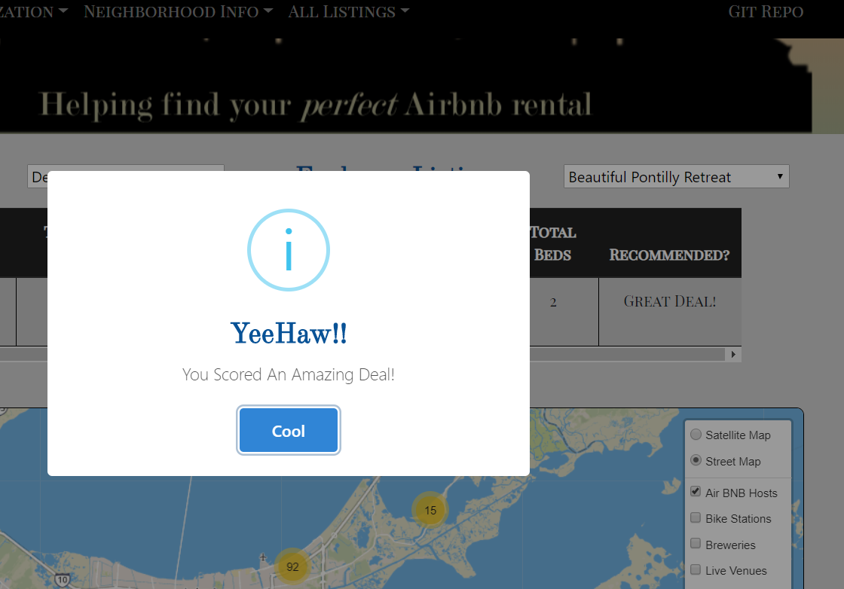
Great Deal!
Based on user input,
Model predicts pricing of listing
If actual price is less than prediction then:
You found a great deal!

Slide 33
Future plans:
Continue to improve the platform
Want to incorporate more detail
More specific recommendation
Especially want to work on site design

Slide 34
Supplemental Slides

Slide 35
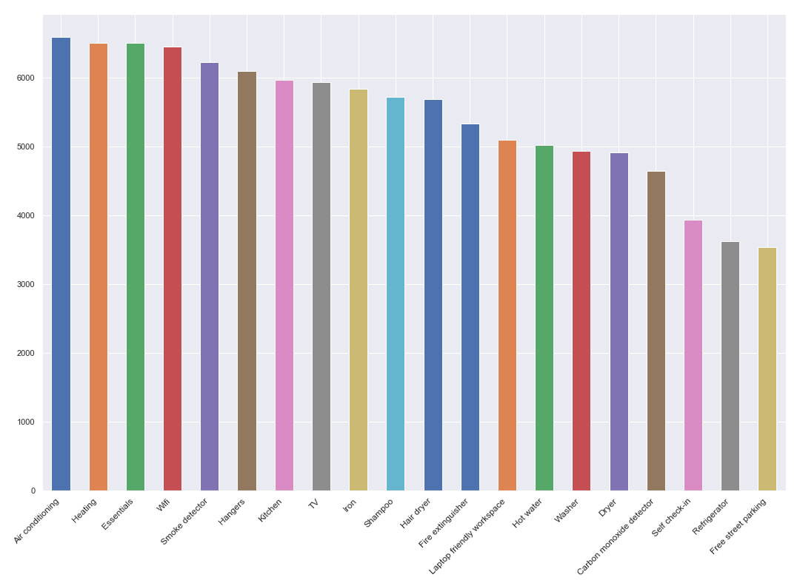
Top Amenities

