Slide 1
ETHEREAL CRYPTO
ADVENTURES IN MACHINE LEARNING,
DASHBOARDING & DAY TRADING
XRP
BITCOIN
ETC
BY: LORI HARRIS

Slide 2
TABLE OF CONTENTS
01
04
About the Project
Machine Learning &
Analysis
02
05
Choosing a Crypto
Visualization Dashboard
03
06
Major Requirements
Final Thoughts
Overview of project scope
How we chose our model and a closer look at our charts.
How we decided on ETC
Local deployment of live feed charts using Panel, HVPlot and Streamz
Project requirements and their implementations
How we did, and what we’d like to work on

Slide 3
PROJECT OVERVIEW
ETHEREAL CRYPTO
Make a small initial investment/purchase of Ethereum Classic crypto currency.
Use machine learning algorithms to predict when to buy/sell.
Complete the project with a servable dashboard to showcase the success (or failure!) of the predictions made.

Slide 4
WHY CHOOSE ETHEREUM CLASSIC?
AFFORDABLE
ACCESSIBLE
RELIABLE - ISH?
With an initial investment reserve of $50, only certain crypto currencies made sense. Crypto under $4 per coin allowed for maximum purchase.
Originally we chose Stellar Lumen at only $.08 per coin, but access to an exchange (Kraken) took too long, so we chose ETC which is more widely available.
Though work only a small fraction of its original value, ETC is still what Ethereum as we know it today was born from, so of all the ‘cheap’ crypto this one seemed most reliable.

Slide 5
PURCHASING ETHEREUM CLASSIC
Kraken required lots of documentation
to begin trading with USD.
Through research, Robinhood was
discovered.
Robinhood allows near instant deposit
of USD and free trading.

Slide 6
MAJOR REQUIREMENTS
ETL & ANALYSIS
MACHINE LEARNING
VISUALIZATIONS
Using Jupyter Notebook, data imported, cleaned, and loaded for analysis and machine learning.
After playing with several models, the SciKit Learn Gradient Boosting Regressor was chosen.
Interactive visualizations were produced using Streamz, HVPlot, and Panel.

Slide 7
MACHINE LEARNING
FEATURES
FINAL MODEL
MODEL DISPLAYS ON WEBAPP
GRADIENT BOOSTING REGRESSOR
TESTING
JOBLIB
Which features produce best results?
Used all features and had 97% accuracy for predictions.
Using techniques from class, chose the best learning rate and narrowed modes down to 3
Using JOBLIB, the model was exported and then loaded in our deployed app

Slide 8
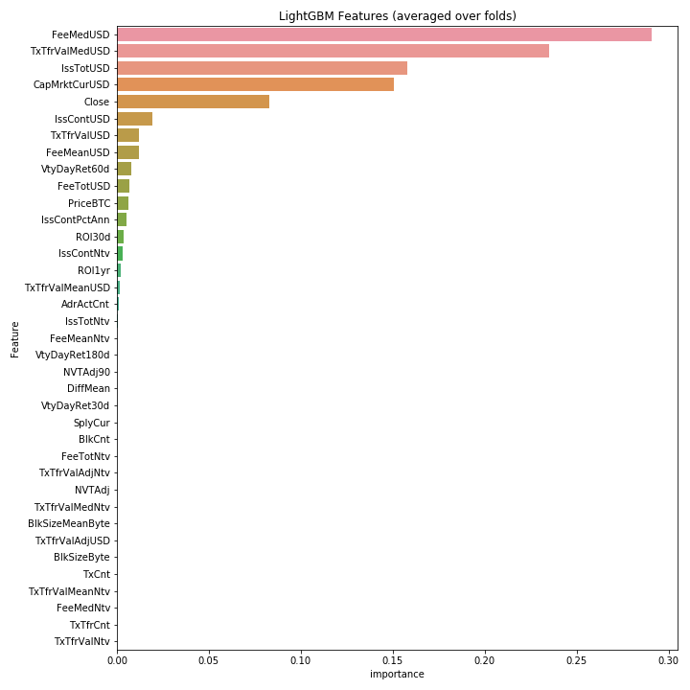
FEATURE IMPORTANCES

Slide 9
FEATURE IMPORTANCES

Slide 10
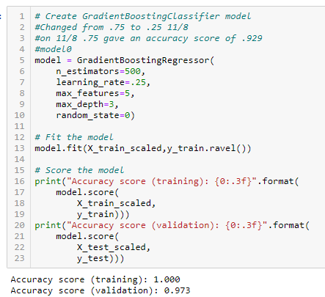
MODEL SUCCESS!

Slide 11
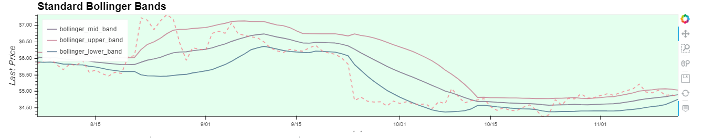
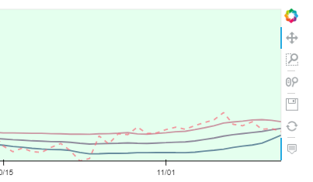
BOLLINGER BAR ANALYSIS
Using these bands, you can see that ETC is approaching a BUY signal!
Unfortunately, I bought during a SELL signal, without realizing it.
This was the only part of the dashboard using static data. All other data was pulled live from Kraken API.

Slide 12
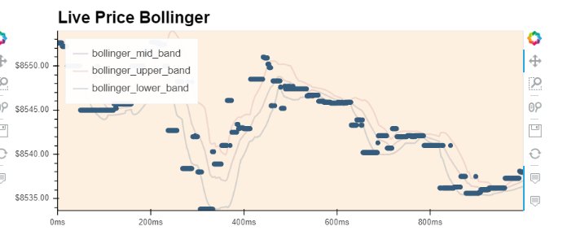
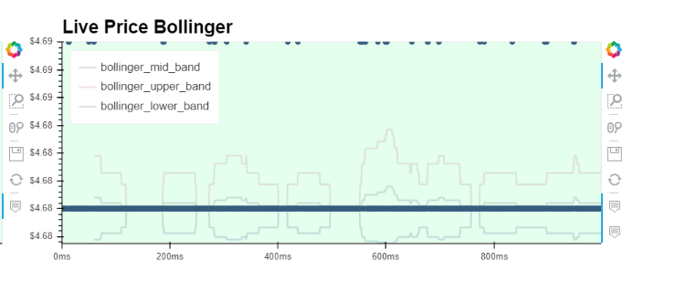
LIVE BOLLINGER BAR ANALYSIS
I saw these in my research incorporated with candlestick charts, and would like to refine these.
Attempting a live price bollinger band series with BTC and ETC. They need finessing to gain usefulness.

Slide 13
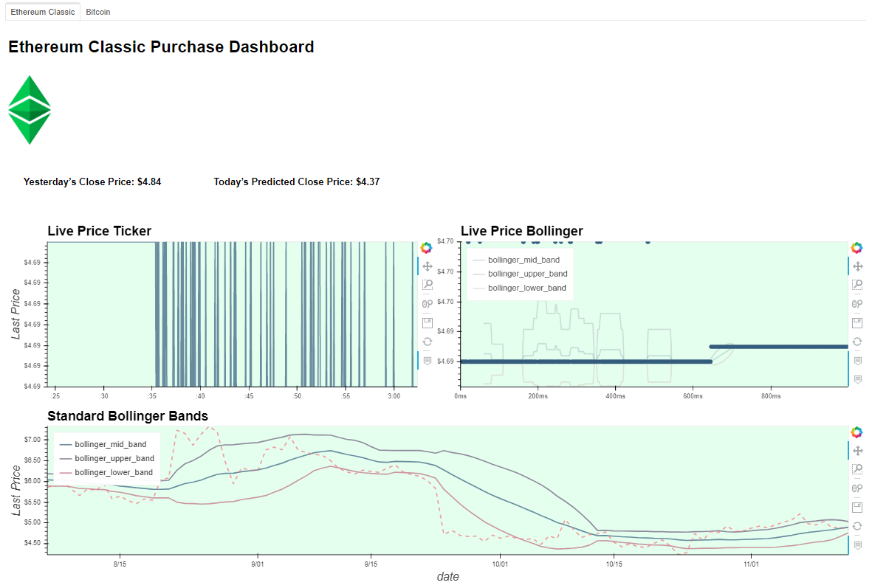
ETC DASHBOARD
LIVE BOLLINGER
MODEL PREDICTION and CLOSE PRICE
LIVE PRICE
TICKER
BOLLINGER BANDS

Slide 14
The price movements were so small, the charts showed little movement, so Bitcoin was brought in for comparison.

Slide 15
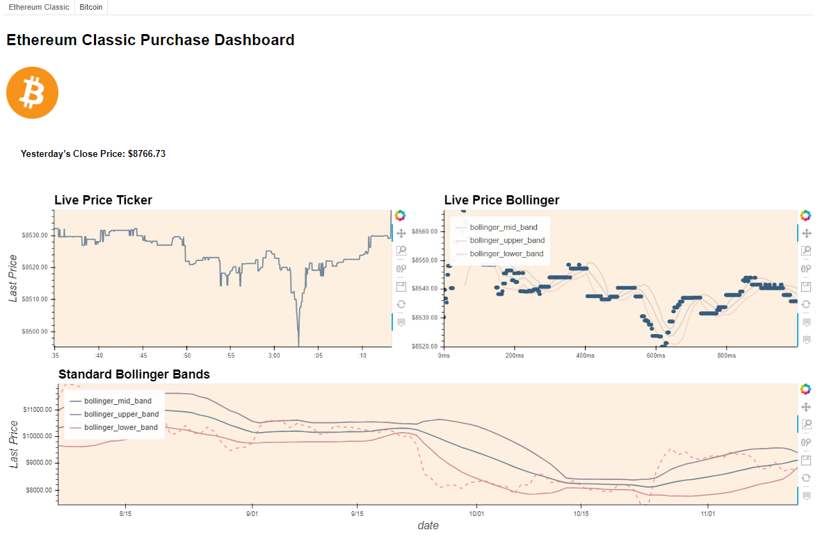
BTC DASHBOARD
LIVE BOLLINGER
PREVIOUS DAY’S CLOSE PRICE
LIVE PRICE
TICKER
BOLLINGER BANDS

Slide 16
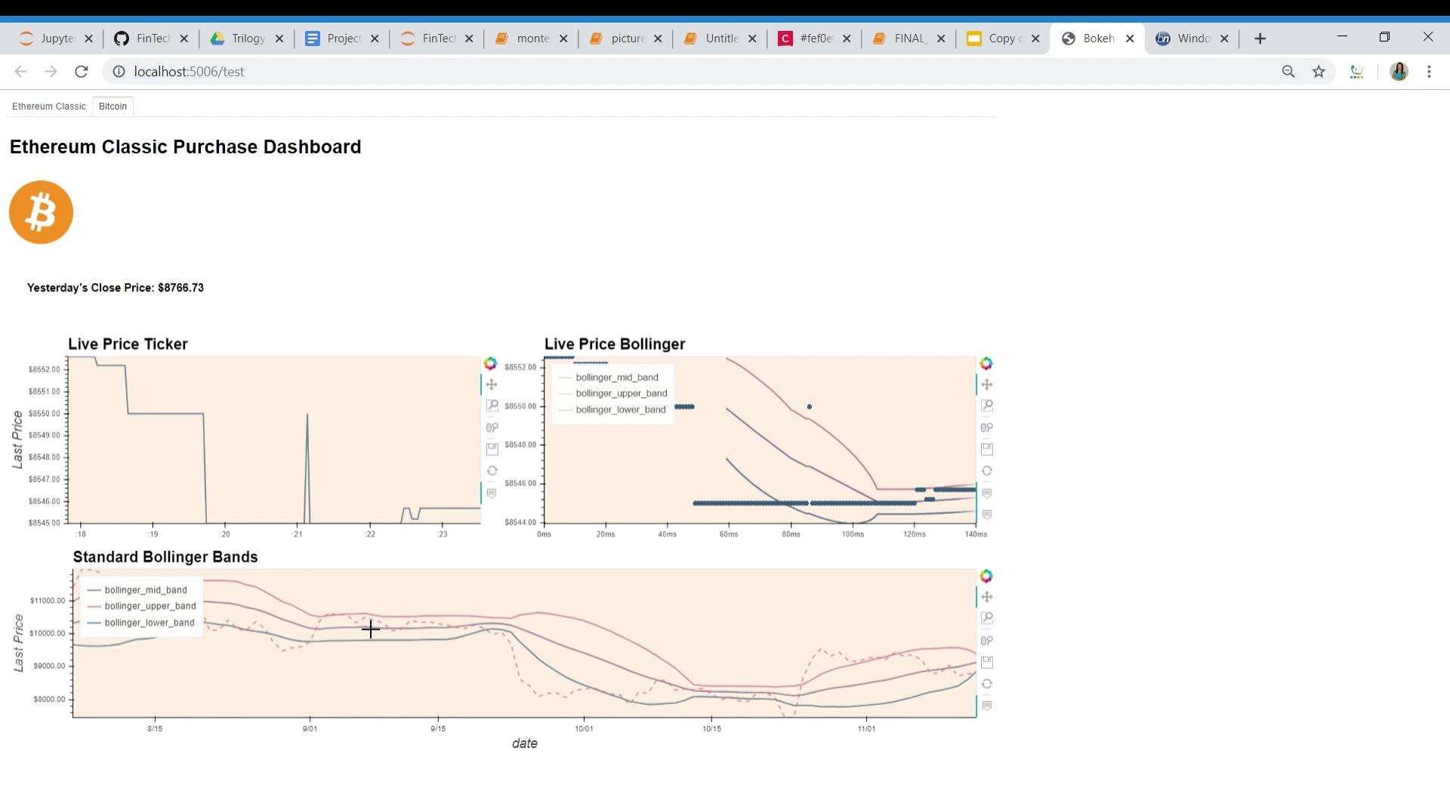
A V
SEE IT IN ACTION!
Insert your multimedia content here

Slide 17
SO - HOW’D WE DO?

Slide 18
FROM “WHOA!” TO “OH NO!”
WHOA!
OH NO!
Need more time to accurately assess results
Model predicted high!
ETC went down to $4.70 from $5.03 after our purchase

Slide 19
What Next?

Slide 20
CURRENT APP
LACKS LIVE DEPLOYMENT
NOT ALL DATA IS DYNAMIC
MODEL NEEDS REFINEMENT

Slide 21
FUTURE APP
FULLY DEPLOYED WEB APP
AUTOMATED MODEL SIGNALS
IMPROVED INTERFACE

Slide 22
WRAPPING UP
TWO:
ONE:
THREE:
What a great project! I can genuinely use these dashboards and models to work a day trading side hustle!
Our model was 97% accurate at predictions during test phase, more time is needed to assess it’s real world abilities.
Boy would I love to own just ONE Bitcoin! Their Bollinger Bars indicate a good time to BUY! Only need about 8 grande!

Slide 23
THANKS!
Does anyone have any questions?

Slide 24
CREDITS
This is where you give credit to the ones who are part of this project.
TEMPLATE by Slidesgo
Static data from Coinmetrics free downloads
Live data from Kraken API
Icons by Flaticon
Infographics by Freepik
Images created by Freepik
Author introduction slide photo created by Freepik
Text & Image slide photo created by Freepik

