Slide 1
Affordability Demographics
What does housing affordability look like for the average home owner?
Educational Attainment
02
03
Education and Income
Does Educational Attainment increase or decrease the affordability?
How do education and income work together to affect affordability?
01
04
Unemployment Rate
Average Mortgage Payer
Does the unemployment rate pay a significant role in affordability?
Pulling it all together – what do the stats of an average mortgage payer look like?

Slide 2
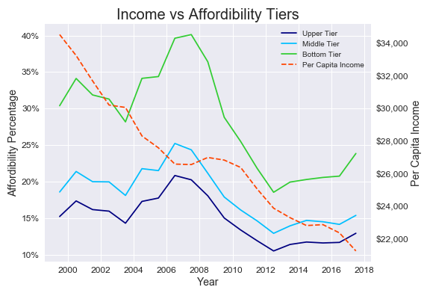
Affordability Demographics
Income
Bottom Tier spends the most
Margins remain constant
Bottom>Middle, Upper = %10, 15%
Middle>Upper=5%
Exception – 2008
Bottom>Middle, Upper =15%, 20%
As income goes down, affordability goes down

Slide 3
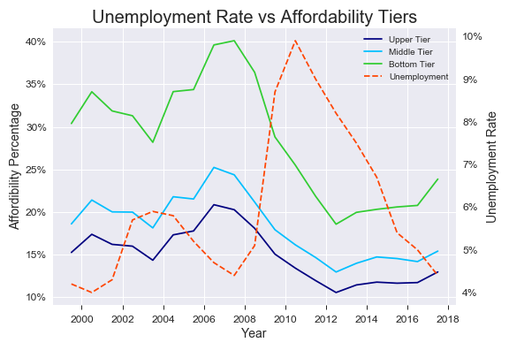
Affordability Demographics
Unemployment
When unemployment increased:
So did Affordability
Possibilities:
Government assistance
Downsizing to save
Economic Contraction

Slide 4
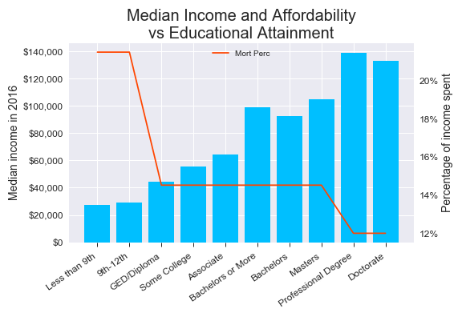
Affordability Demographics
Education
Income increases with higher education
Doctorate only 12%
Less than HS 22%
Big jump with diploma from 22% to 14%
Middle tier, is very middle:
Average income, affordability, education
As income goes down, affordability goes down

Slide 5
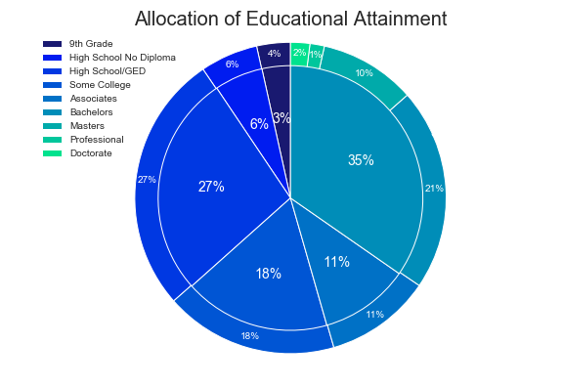
Affordability Demographics
Educational Allotments
Most mortgage payers have finish HS
Most get post-secondary education
More than a third obtain a Bachelor’s degree or Higher

Slide 6
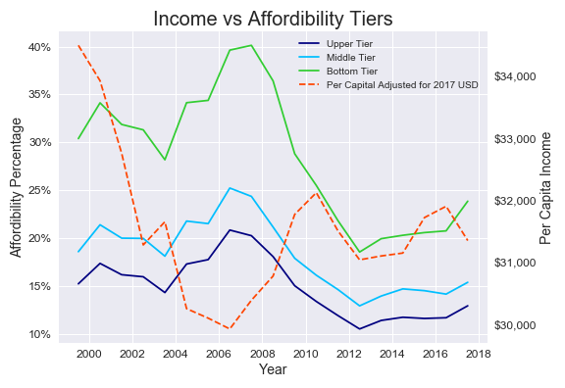

Affordability Demographics
So Who’s Your Average Mortgage Payer in America? (2016)
Employment
Income
Tier
Education
5%
$99,160
Middle
Bachelor’s +

