Slide 1
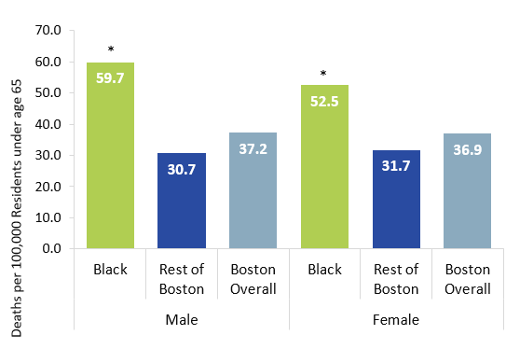
How does cancer affect Black men?
Cancer Premature Mortality†, Black Residents, 2018-2024 Combined
Black men experienced the highest rates of cancer premature mortality-nearly twice the rate of other male residents.
* Statistically significant difference when compared to reference group
† Age-Adjusted Rates per 100,000 Residents under age 65
DATA SOURCE: Boston Resident Deaths, Massachusetts Department of Public Health (2017,2018,2019,2020,2021,2022,2023)

Slide 2
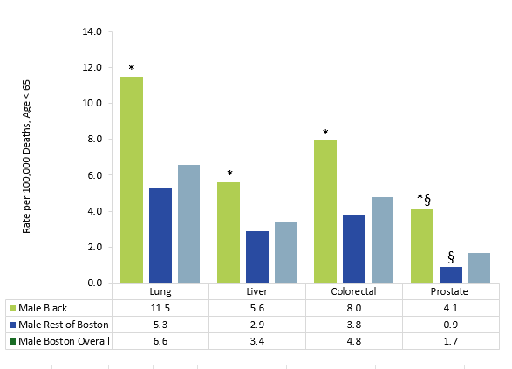
Which cancers drive these inequities?
Premature Cancer Mortality† by Type, Black Male Residents, 2018-2024 Combined
Black men had the highest premature mortality rates of all cancers observed-over twice the rate of premature lung, liver, and colorectal cancer deaths and four times the rate of prostate cancer premature death compared to other male residents.
* Statistically significant difference when compared to reference group
† Age-Adjusted Rates per 100,000 Residents
§ Indicates that rates are based on 20 or fewer cases and should be interpreted with caution
DATA SOURCE: Boston Resident Deaths, Massachusetts Department of Public Health

Slide 3
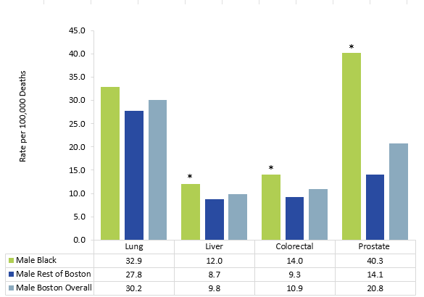
Which cancers drive these inequities?
Cancer Mortality† by Type, Black Male Residents, 2018-2024 Combined
For all age mortality, Black men also had higher rates of liver, colorectal and prostate cancer-with prostate cancer being almost four times the rate of other male residents.
* Statistically significant difference when compared to reference group
† Age-Adjusted Rates per 100,000 Residents
DATA SOURCE: Boston Resident Deaths, Massachusetts Department of Public Health

