Slide 1
Smart Lock Project
Attestation work
Maksim Holikov, Oleksii Klochko, 2018

Slide 2
Agenda
1 Project description
2 Structure of project
3 Problems

Slide 3
About Smart Lock project
Main idea - create system in kernel space for controlling thedoor lock.
Steps to implement project:
Design architecture of project
Design communications between elements of architecture
Realise all elements of architecture by code
Testing
Publish on githab https://github.com/LorinsBeard/KNURE-linux-base-camp-2018

Slide 4
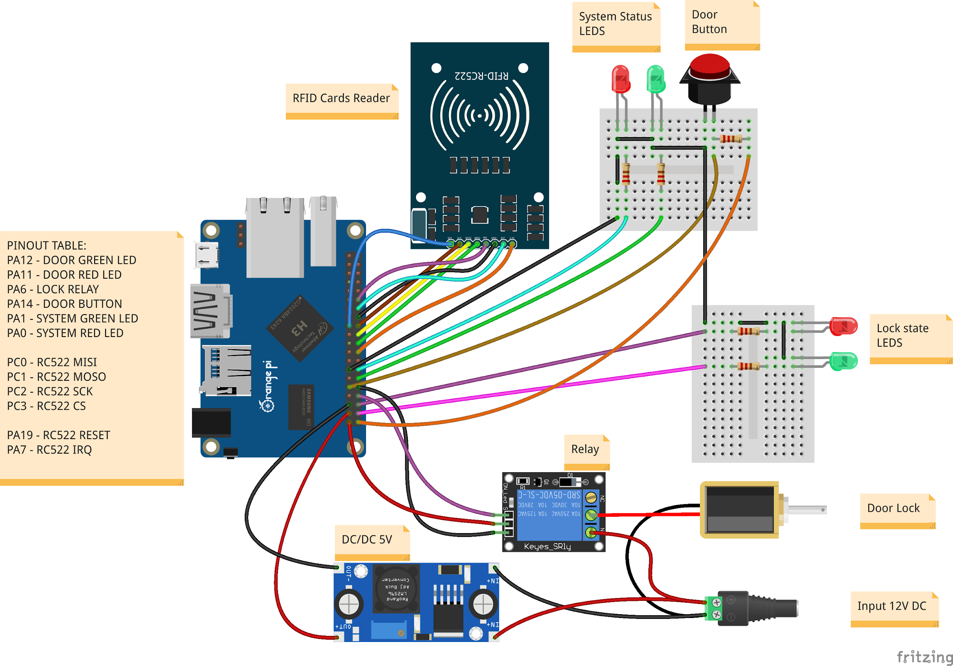
Connection diagram

Slide 5
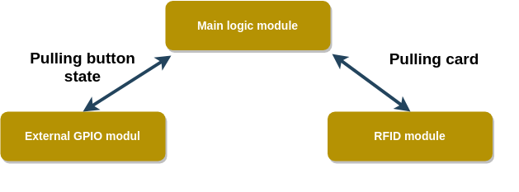
Project`s architecture

Slide 6
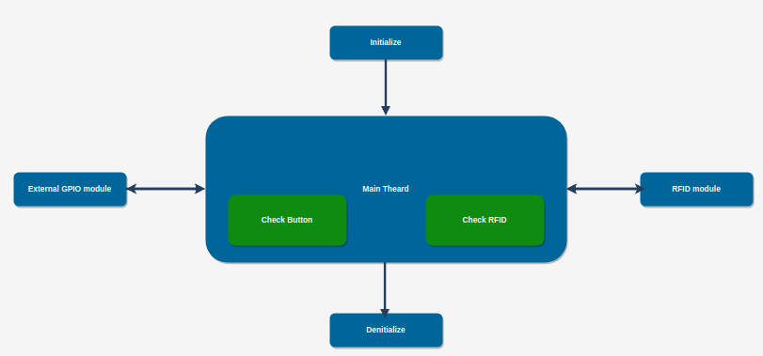
Project`s connections

Slide 7
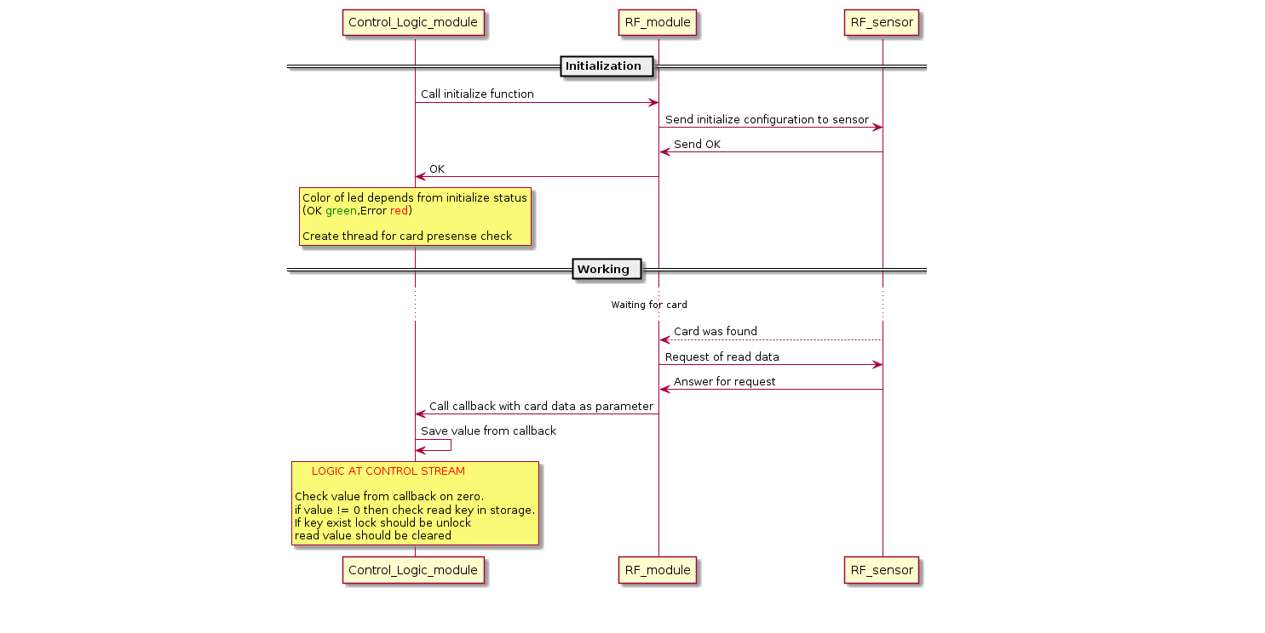
Project`s sequence diagram

Slide 8
Used elements
dts (to configure GPIO)
interrupts (to detect button and RFID change)
timer (to measuring time period before lock)
thread (for waiting event from button or rfid)
sysfs (to debug)
character driver (to detect by main system)
kmalloc (for reserve memory)

Slide 9
Detected problems
Create interrupt handler if irq was initialized at another module
Problem with version of kernel ( “sunxi+” instead of “sunxi”)

Slide 10
Thanks for your attention!

