Slide 1
https://store.google.com/it/?hl=it

Slide 2
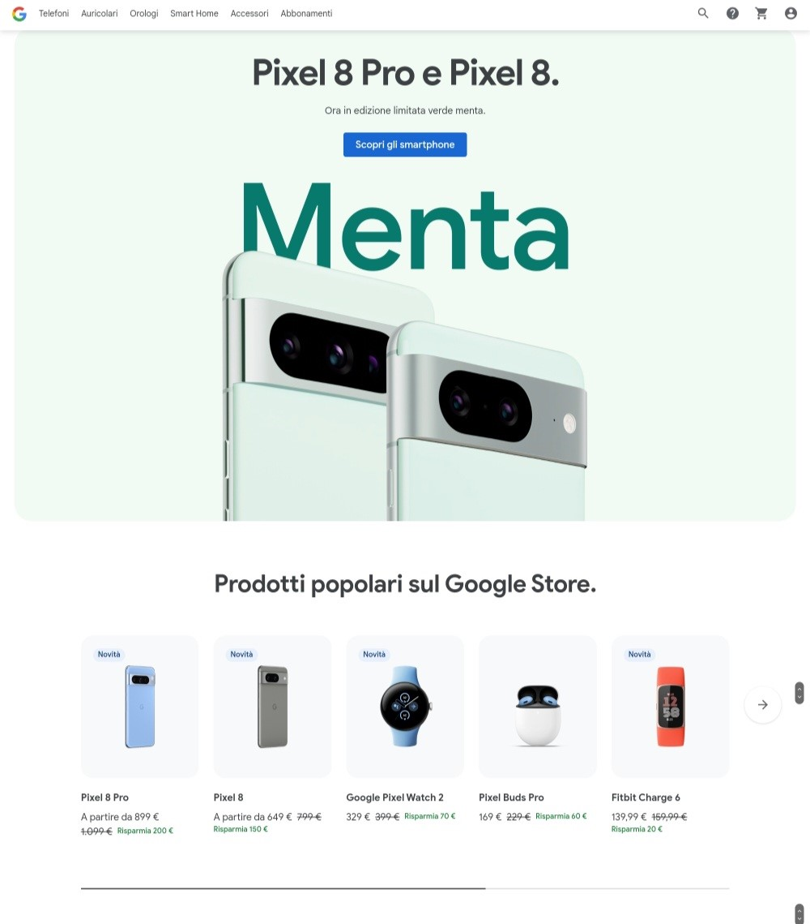

Slide 3
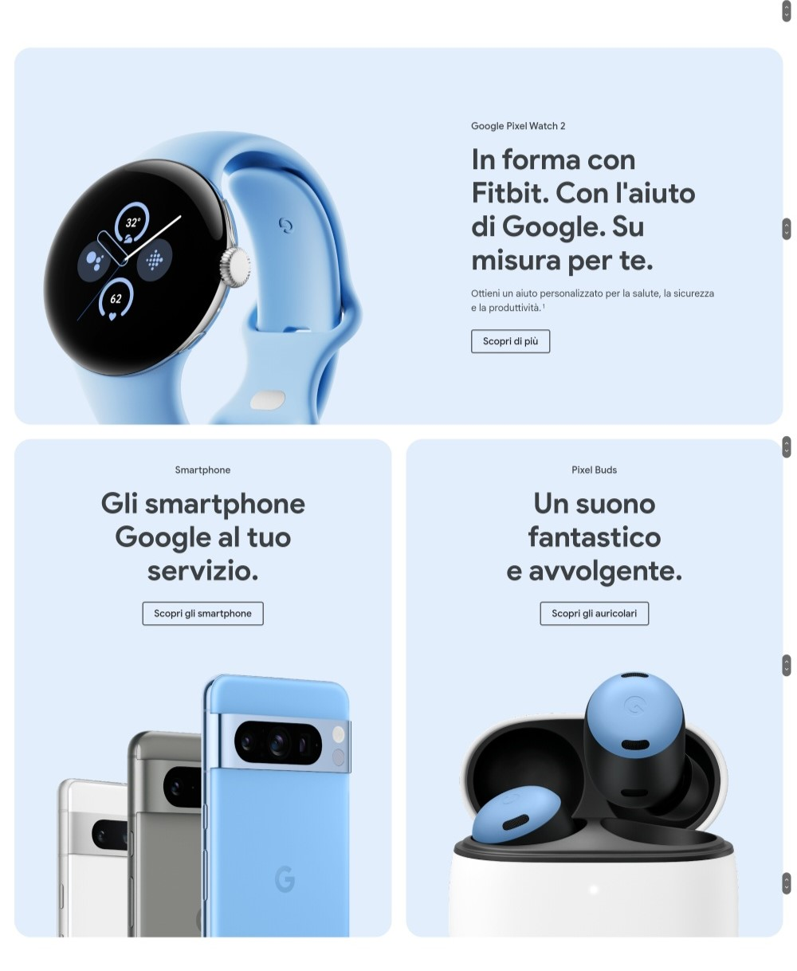

Slide 4
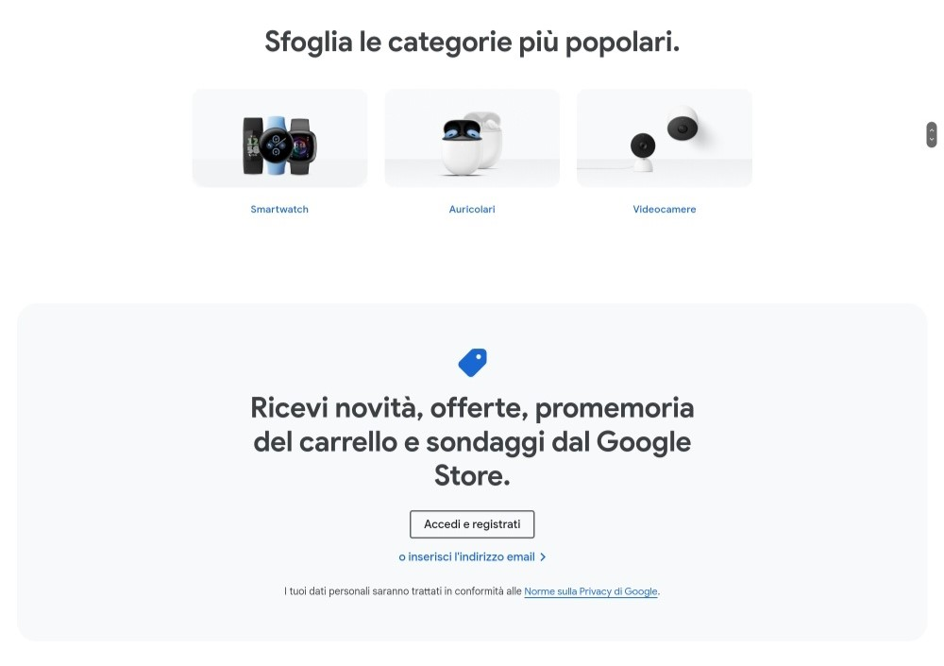

Slide 5
