Slide 1

Computer Vision
Project: Enhanced Deployment of YOLO V8 on Nvidia Jetson Nano through Model Compression Techniques
Harsh Lohriya | AU2140154
Urmil Jagad | AU2140179
Rahul Patel | AU2140205

Slide 2

Introduction
Main Challenges Using State of the Art AI model:
Resource Constrained
Limited Memory, Limited Processing capabilities
Deep Learning Models:
Bigger in Size
Difficult to deploy on Resource Constrained Device
Higher Inference Time, More Energy Consumption.
| 2

Slide 3
Problem Statement
Applying Model Compression techniques on YOLO V8 pretrained model on NVIDIA Jetson Nano.
| 3

Slide 4
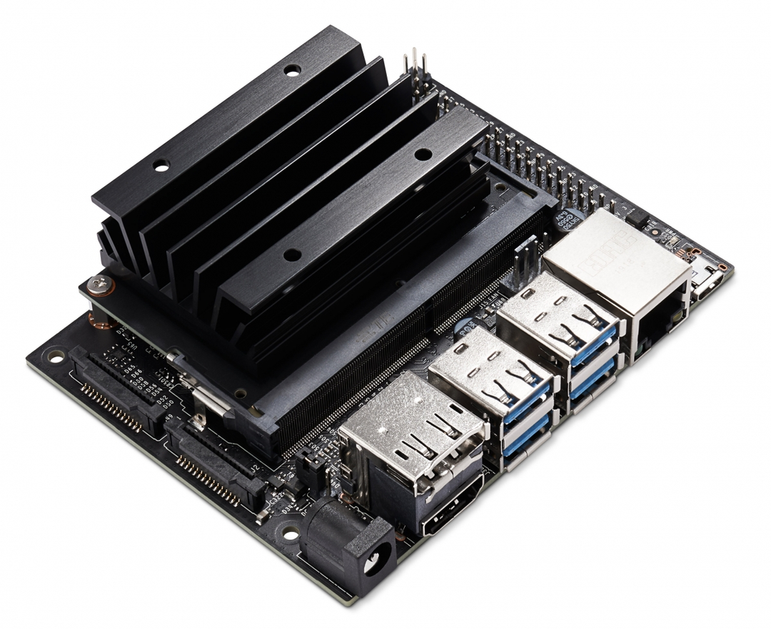
Jetson Nano
NVIDIA Jetson Nano Developer Kit small, powerful computer.
4GB RAM
CUDA Support
TensorRT
Low Power Consumption
Best for AI development on IOT device
NVIDIA Jetson Nano Developer Kit. (n.d.). NVIDIA Developer. https://developer.nvidia.com/embedded/jetson-nano-developer-kit
| 4

Slide 5
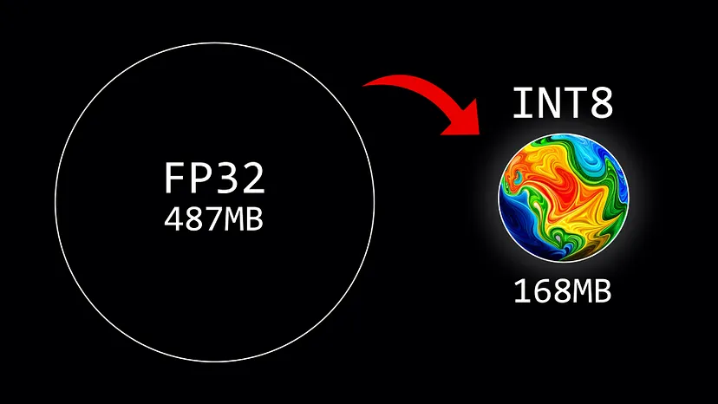
Our Approach
Weight Quantization
Quantization is a technique to reduce the computational and memory costs of running inference by representing the weights with low-precision data types like 16-bit floating point (float16), 8-bit integer (int8) instead of the usual 32-bit floating point (float32).
Labonne, M. (2023, July 9). Introduction to Weight Quantization | towards Data Science. Medium. https://towardsdatascience.com/introduction-to-weight-quantization-2494701b9c0c
| 5

Slide 6
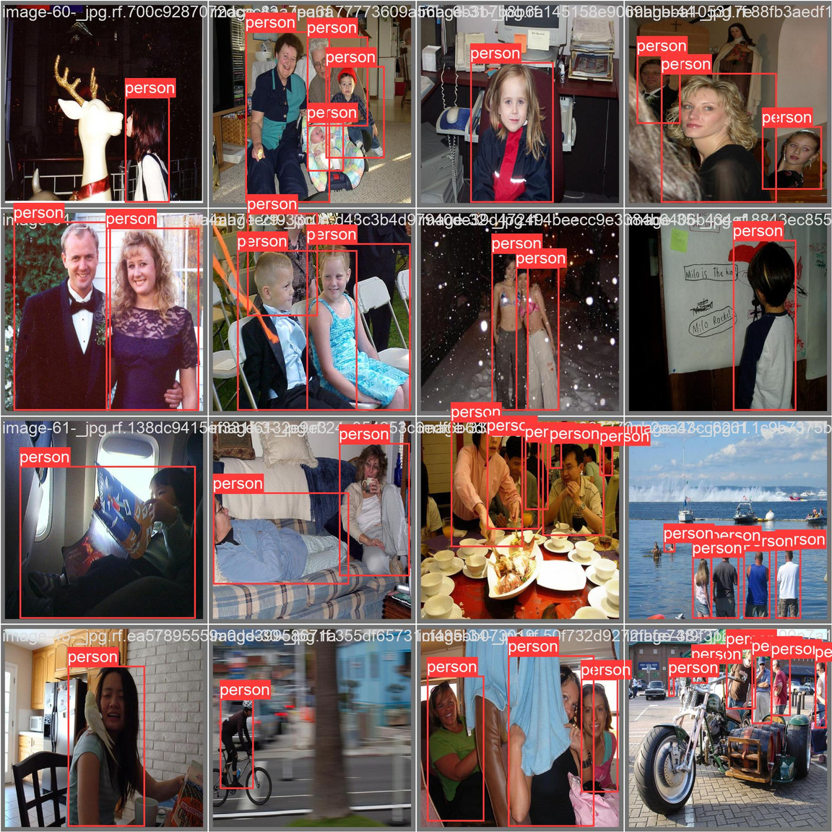
Dataset
https://www.kaggle.com/datasets/karthika95/pedestrian-detection
160 Validation Images with XML Annotation
Conversion of Dataset to yaml format for YOLOv8.
| 6

Slide 7
Methodology
Conversion of Dataset
Validation of both models (.pt format)
Export to onnx format
Validation on onnx format
Quanization of the models (onnx format)
Validation on this quantized models
Enivornment set up on Jetson nano
Validation of all the models on same dataset (Jetson nano)
| 7

Slide 8
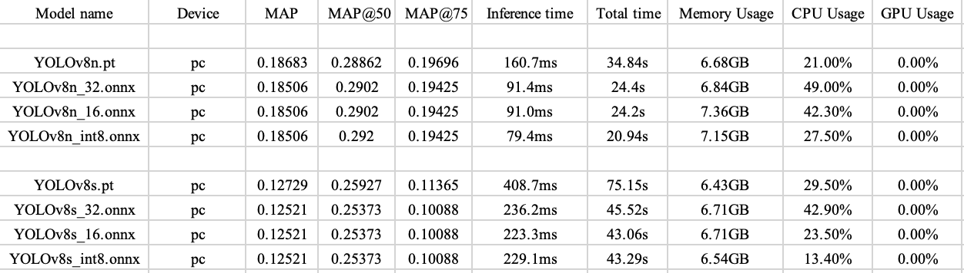
Results(1/2):
I 8

Slide 9
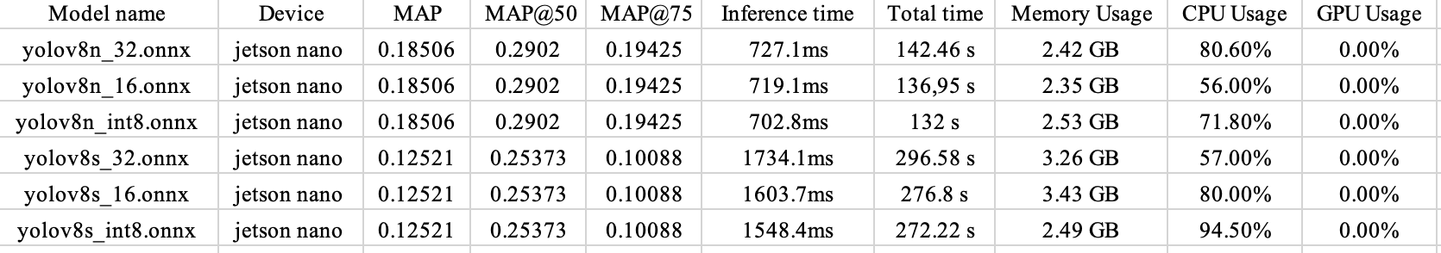
Results(2/2):
I 9

Slide 10
Future Work:
Solve dependencies on the Jetson nano
Utilise the Jetson nano by TensorRT
Use Other Model compression techniques
I 10

Slide 11
References
Lining Hu, & Yongfu Li. (n.d.). Micro-YOLO: Exploring efficient methods to compress CNN based object detection model. Department of Micro-Nano Electronics, https://www.scitepress.org/Papers/2021/102344/102344.pdf.
Ultralytics. (2024b, March 13). Home. Ultralytics YOLOv8 Docs. https://docs.ultralytics.com/
Krishnamoorthi, R. (2018, June 21). Quantizing deep convolutional networks for efficient inference: A whitepaper. arXiv.org. https://arxiv.org/abs/1806.08342
Labonne, M. (2023, July 9). Introduction to Weight Quantization | Towards Data Science. Medium. https://towardsdatascience.com/introduction-to-weight-quantization-2494701b9c0c
NVIDIA Jetson Nano Developer Kit. (n.d.). NVIDIA Developer. https://developer.nvidia.com/embedded/jetson-nano-developer-kit
| 11

Slide 12
Thank You

