Slide 1

Computer Vision
Project: Enhanced Deployment of YOLO V8 on Nvidia Jetson Nano through Model Compression Techniques
Harsh Lohriya | AU2140154
Urmil Jagad | AU2140179
Rahul Patel | AU2140205

Slide 2

Problem Statement
Applying Model Compression techniques on YOLO V8 pretrained model on NVIDIA Jetson Nano.
| 2

Slide 3
Our Approach
Weight Quantization
Quantization from 32-bit floating integers (float32) to 16-bit floating integers (float16) to 8-bit integer (int8).
| 3

Slide 4
Limitation
Low Light Detection
Occlusion
High Intensity of Background
| 4

Slide 5
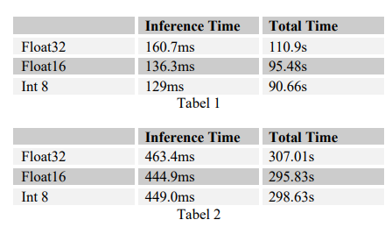
Results:
YOLOv8n
YOLOv8s
I 5

Slide 6
Future Work:
Quantization to int8
Implementation on Jetson nano
Pruning
I 6

Slide 7
References
Lining Hu, & Yongfu Li. (n.d.). Micro-YOLO: Exploring efficient methods to compress CNN based object detection model. Department of Micro-Nano Electronics, https://www.scitepress.org/Papers/2021/102344/102344.pdf.
Ultralytics. (2024b, March 13). Home. Ultralytics YOLOv8 Docs. https://docs.ultralytics.com/
Krishnamoorthi, R. (2018, June 21). Quantizing deep convolutional networks for efficient inference: A whitepaper. arXiv.org. https://arxiv.org/abs/1806.08342
Labonne, M. (2023, July 9). Introduction to Weight Quantization | Towards Data Science. Medium. https://towardsdatascience.com/introduction-to-weight-quantization-2494701b9c0c
| 7

Slide 8
Thank You

